Slide 1
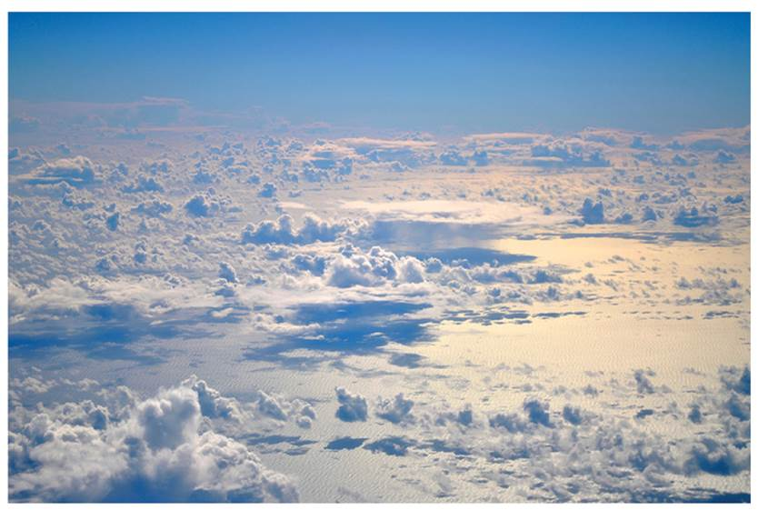
Next
“Next-generation Remote Sensing for VALidation Studies II”
NARVAL-II mission
Felix Ament¹, Susanne Crewell², Stefan Bühler¹, Bernhard Mayer³, Bjorn Stevens⁴, Manfred Wendisch⁵
¹ University of Hamburg, ² University of Cologne, ³ LMU Munich, ⁴ Max-Planck-Institute for Meteorology (MPI-M), ⁵ University of Leipzig

Slide 2
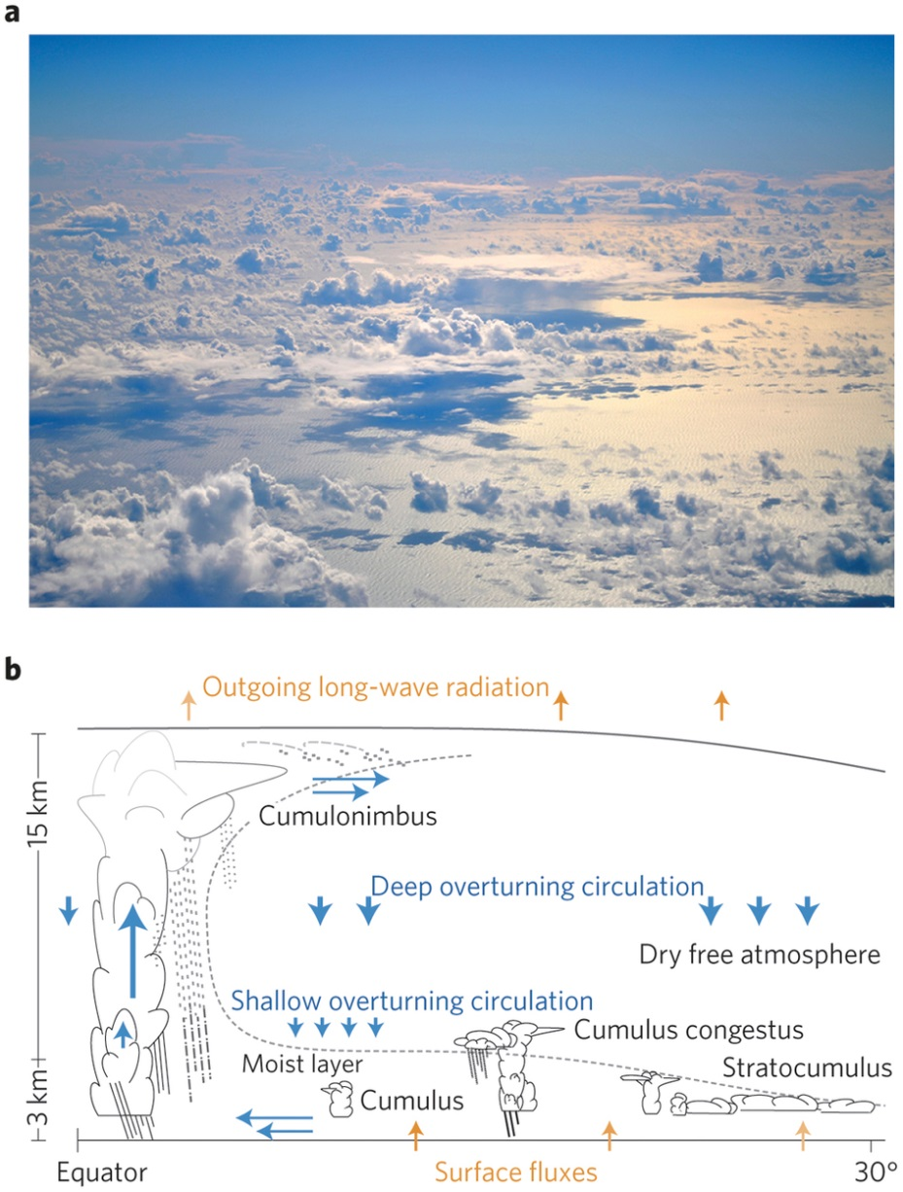
Clouds, Circulation and Climate Sensitivity
Four key questions (Bony et al., 2015)
What role does convection play in cloud feedbacks?
What controls the position, strength and variability of storm tracks?
What controls the position, strength and variability of the tropical rain belt?
What role does convective aggregation play in climate?
(Bony et al., 2015)

Slide 3
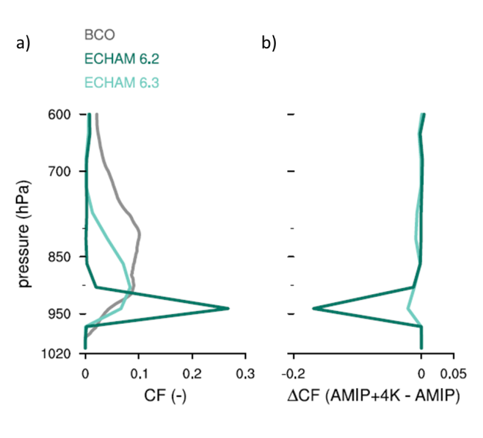
Clouds, Circulation and Climate Sensitivity
Four key questions (Bony et al., 2015)
What role does convection play in cloud feedbacks?
What controls the position, strength and variability of storm tracks?
What controls the position, strength and variability of the tropical rain belt?
What role does convective aggregation play in climate?
(Stevens et al., 2016)
(Bony et al., 2015)

Slide 4
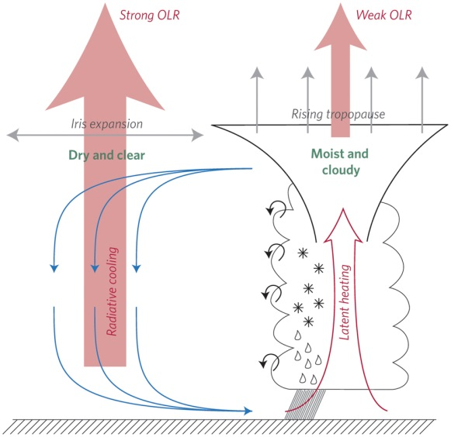
Clouds, Circulation and Climate Sensitivity
Four key questions (Bony et al., 2015)
What role does convection play in cloud feedbacks?
What controls the position, strength and variability of storm tracks?
What controls the position, strength and variability of the tropical rain belt?
What role does convective aggregation play in climate?
(Mauritsen and Stevens, 2015)
(Bony et al., 2015)

Slide 5
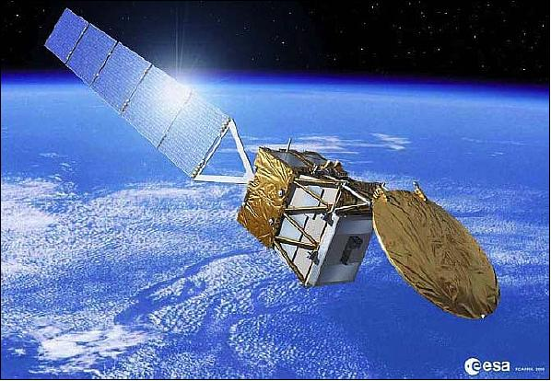
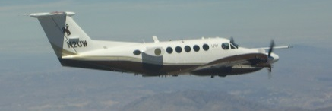
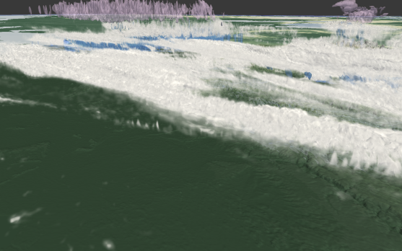
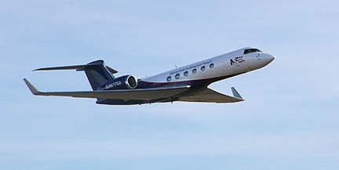
Cloud research tools
Satellite
Airborne remote sensing
High spatial and temporal resolution
(Tobin et al., 2012)
Comprehensive reference
Cloud resolving models
Broadening local perspectives
Super Sites
Targeted observations towards times and regions of interest
(Stevens et al., 2016)
Notes:
welche Einheit hat lambda? D Durchmesser [mm]
N(D) Anzahldichte [m-3 mm-1]
R Regenrate [mm h-1]

Slide 6
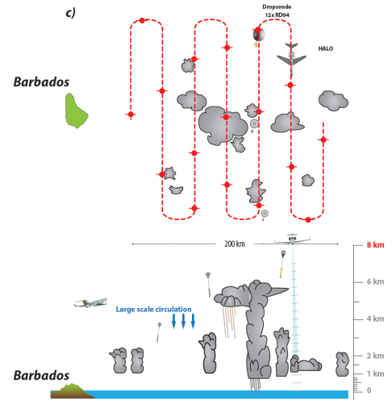
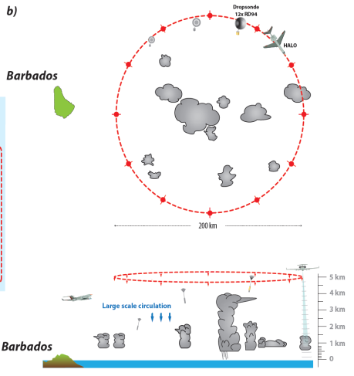
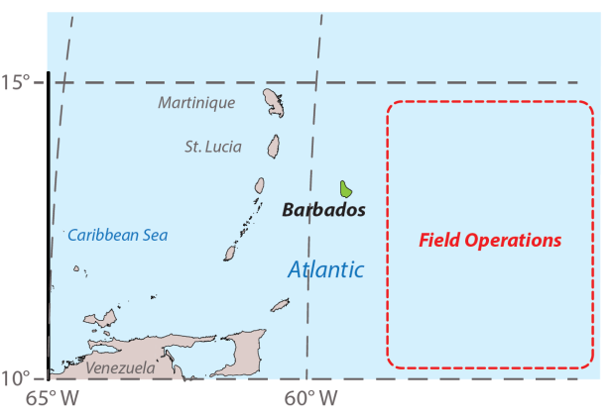
NARVAL-II objectives
Flight pattern
Characterization of cloud macrophysics and microphysics of trade wind convection and its evolution
Characterization of the thermodynamic structure and the dynamics in vicinity of evolving convective systems in the trade wind region
3.5 weeks, 8. - 31. August 2016
9 scientific missions + 2 ferry flights (95 hours)
stationed at Barbados
Notes:
welche Einheit hat lambda? D Durchmesser [mm]
N(D) Anzahldichte [m-3 mm-1]
R Regenrate [mm h-1]

Slide 7
NARVAL-II objectives
Flight pattern
Characterization of cloud macrophysics and microphysics of trade wind convection and its evolution
Characterization of the thermodynamic structure and the dynamics in vicinity of evolving convective systems in the trade wind region
3.5 weeks, 8. - 31. August 2016
9 scientific missions + 2 ferry flights (95 hours)
stationed at Barbados
Notes:
welche Einheit hat lambda? D Durchmesser [mm]
N(D) Anzahldichte [m-3 mm-1]
R Regenrate [mm h-1]

Slide 8
NARVAL-II objectives
Flight pattern
Characterization of cloud macrophysics and microphysics of trade wind convection and its evolution
Characterization of the thermodynamic structure and the dynamics in vicinity of evolving convective systems in the trade wind region
3.5 weeks, 8. - 31. August 2016
9 scientific missions + 2 ferry flights (95 hours)
stationed at Barbados
Notes:
welche Einheit hat lambda? D Durchmesser [mm]
N(D) Anzahldichte [m-3 mm-1]
R Regenrate [mm h-1]

Slide 9
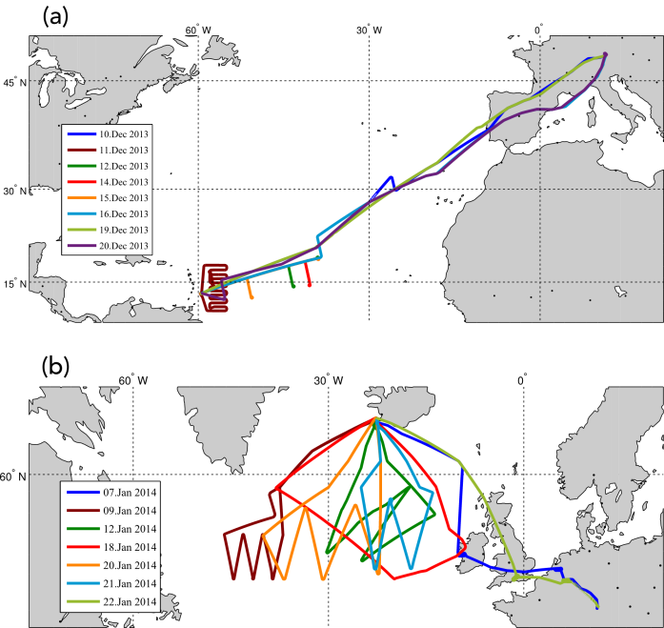
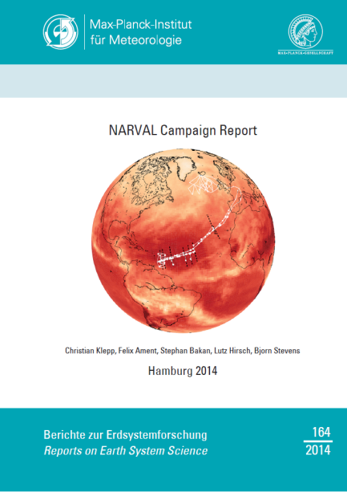
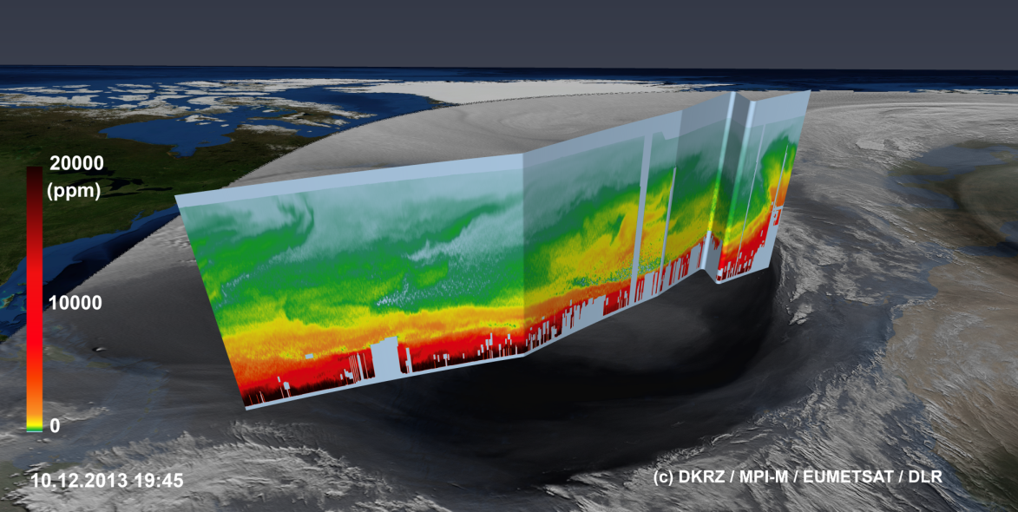
NARVAL-I
South
Dec 2013 & Jan 2014
15 scientific missions (~ 95 hours)
South and North component with focus on trade wind and postfrontal convection, respectively
North
Selected Results (NARVAL-I South)
Intense and frequent precipitation from shallow clouds
Representativeness of Barbados cloud observatory
CloudSat evaluation
Reliable operation of all instruments

Slide 10
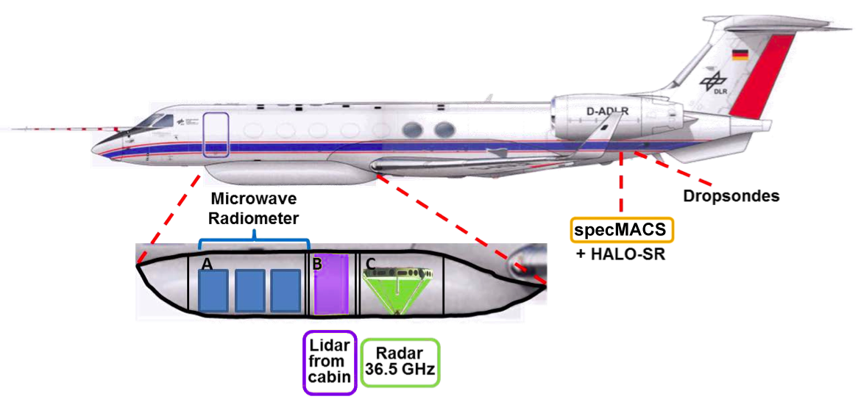
The NARVAL payload
+ SMART
HAMP (HALO Microwave Package) | Cloud Radar + Microwave Radiometer | MPI-M Hamburg, Univ. Hamburg, Univ. Cologne, DLR-IPA
WALES | LIDAR | DLR-IPA
SMART | Solar Irradiances | Univ.Leipzig
specMACS | Solar Imager | LMU Munich
dropsondes | In-situ profiles | DLR-PA
BAHAMAS | In-situ flight data | DLR-FX
Notes:
welche Einheit hat lambda? D Durchmesser [mm]
N(D) Anzahldichte [m-3 mm-1]
R Regenrate [mm h-1]

Slide 11
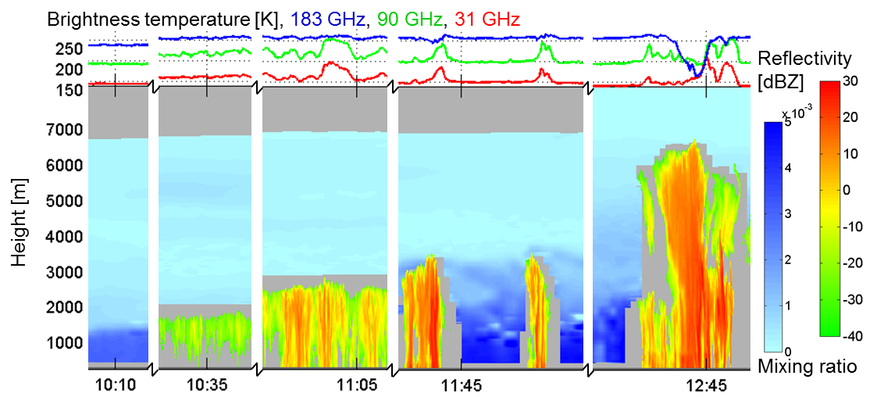
The NARVAL payload
HAMP (HALO Microwave Package) | Cloud Radar + Microwave Radiometer | MPI-M Hamburg, Univ. Hamburg, Univ. Cologne, DLR-IPA
WALES | LIDAR | DLR-IPA
NARVAL-I North example
Notes:
welche Einheit hat lambda? D Durchmesser [mm]
N(D) Anzahldichte [m-3 mm-1]
R Regenrate [mm h-1]

Slide 12
The NARVAL payload
radiance
wavelength [μm]
SMART | Solar Irradiances | Univ.Leipzig
specMACS | Solar Imager | LMU Munich
(top: ACRIDOCON mission; bottom: NARVAL-South)
Notes:
welche Einheit hat lambda? D Durchmesser [mm]
N(D) Anzahldichte [m-3 mm-1]
R Regenrate [mm h-1]

Slide 13
NARVAL-II Consortium
Joint mission by four Universities (50%) and MPI for Meteorology (50%)
DLR provides WALES LIDAR at own costs
NARVAL-II related DFG proposals:
Contribution of clouds to radiative diabatic heating and cooling from synergy of airborne lidar, radar, and imager observations | Zinner, Groß, Mayer | LMU Munich, DLR
Understanding clouds and precipitation at the sub kilometer scale using HAMP | Ament, Crewell, Bühler | Univ. Hamburg, Univ. Cologne
Influence of ice phase on radiative forcing of clouds: Observations and representation in numerical weather prediction models | Wendisch | Univ. Leipzig
Forcing in the long-wave spectrum due to aerosol-cloud interactions: satellite and climate modeling vs. HALO (FLASH) | Quaas | Univ. Leipzig

Slide 14
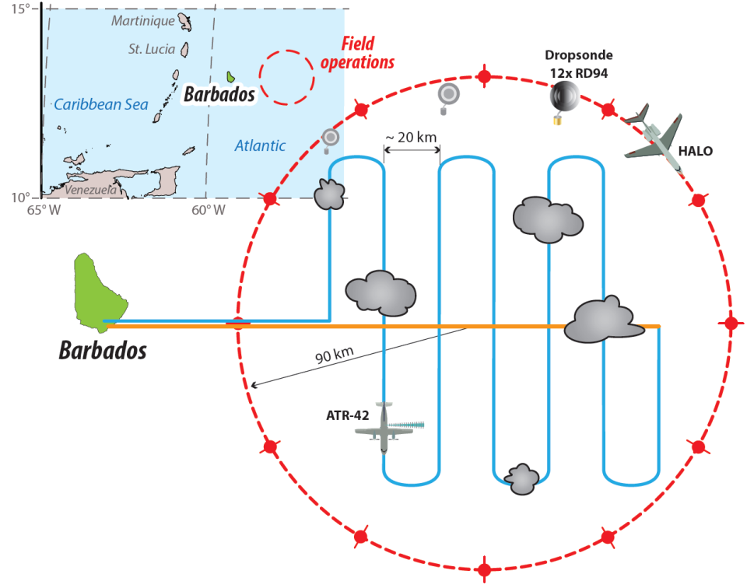
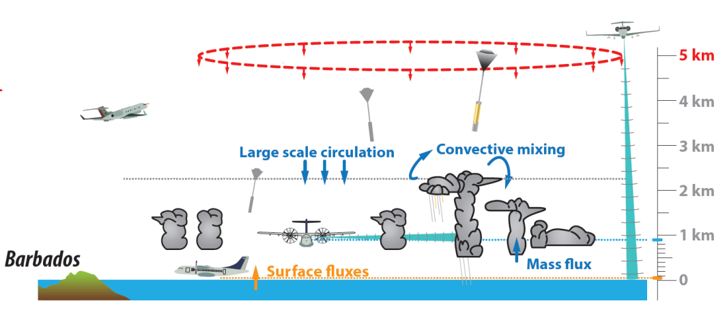
EUREC⁴A
Elucidating the role of Cloud-Circulation Coupling in Climate
German-French field experiment ...
planed for 2019 …
as joint HALO – ATR-42 mission …
to measure directly the relationship between convective mixture and large-scale environmental state.
Notes:
welche Einheit hat lambda? D Durchmesser [mm]
N(D) Anzahldichte [m-3 mm-1]
R Regenrate [mm h-1]

Slide 15
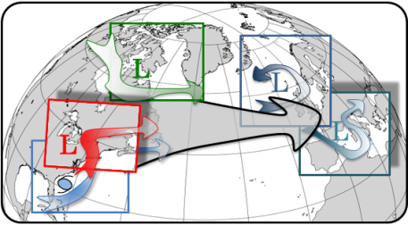
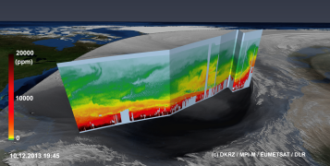
„NARVAL“ evolution I
NARVAL-I
NARVAL-II & NAWDEX
EUREC⁴A
Dec 2013 /
Jan 2014
Aug 2016 / Sep 2016
2019
Answering Science questions
Airborne cloud remote sensing super-site!
Expanding the cloud statistics
Enhanced microphysical observations (ice phase)
Sampling the environment …
... to relate large scale dynamics with cloud evolution.
Work load
Scientific data product generation
Operating the instruments
Notes:
welche Einheit hat lambda? D Durchmesser [mm]
N(D) Anzahldichte [m-3 mm-1]
R Regenrate [mm h-1]

Slide 16
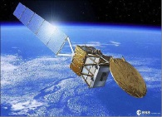
NARVAL-II status today
NARVAL-II mission funding by MPI, DLR and DFG (almost) settled
Evaluations of all NARVAL-II related DFG projects are positive (despite some reductions)
No critical issues while preparing the instruments
What we should achieve today and tomorrow?!
Unify our thinking how to operate HALO during NARVAL-II
Broaden our perspective to link our observations with models, satellite data, ground base remote sensing, …
Keep the NARVAL evolution going by drafting the EUREC⁴A mission
Notes:
welche Einheit hat lambda? D Durchmesser [mm]
N(D) Anzahldichte [m-3 mm-1]
R Regenrate [mm h-1]

