Slide 1
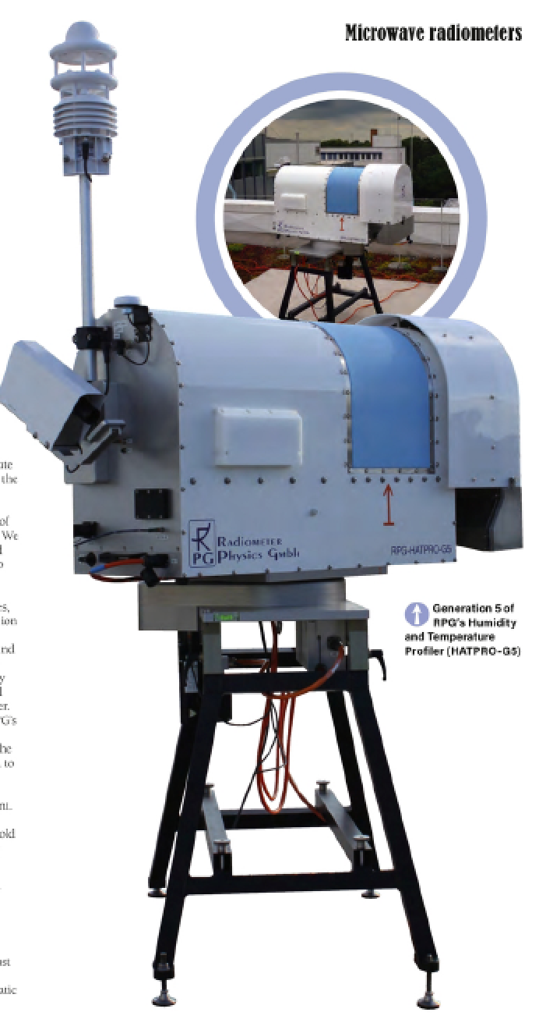
EMS Oral Session,
Sep. 7th 2022
Session UP1.5 - Atmospheric measurements: Instruments, experiments, networks and long-term programs using in-situ and remote sensing techniques
Characterizing the Influence of Obstacles on Scanning Microwave Profilers
Institute for Geophysics and Meteorology, University of Cologne | Tobias Böck, Bernhard Pospichal, Ulrich Löhnert

Slide 2
Instrument: HATPRO MWR
Humidity And Temperature PROfiler from Radiometer Physics GmbH
Measures thermal emissions from the atmos-phere in 14 different frequencies (H₂O-band and O₂-band)
Converts these radiances into Brightness Temperatures TBs [K] (through Planck’s law)
allows investigation of (via inversion):
temperature profiles
rudimentary humidity profiles
integrated water vapor (IWV)
liquid water path (LWP)
commercially available for ~10 years, ready for network applications (in principle)
continuous data in all-sky conditions: resolution of seconds to minutes
2

Slide 3
General Goals
Integration of ground-based thermodynamic profilers into the DWD forecasting system (TDYN-PRO)
EMF III: The potential of ground-based thermodynamic profilers for improving short-term weather forecasts
Q: Are the considered state-of-the-art ground-based profilers accurate and reliable enough for data assimilation?
Also interesting for E-PROFILE (EUMETNET)*, COST action PROBE and ACTRIS
*https://www.eumetnet.eu/activities/observations-programme/current-activities/e-profile/
3

Slide 4
Motivation
External error sources like physical obstacles and radio frequency interference (RFI) can have an impact on observations and the quality of the obtained atmospheric profile
t → important to search for a suitable measurement location with low disturbances
If e.g. trees, towers, masts, walls and mountains are too close to the MWR, they can have significant repercussions in elevation scans which are necessary for deriving accurate T-profiles
→ crucial to pinpoint the exact location of these obstacles and to determine a minimum distance at which they do not interfere with the MWR anymore
4

Slide 5
MW-profiling: How does it work theoretically?
H₂O vapor - band
humidity
(channel 1-7)
O₂ - band
temperature
(channel 8-14)
pressure broadened WV line → total water vapor & weak profile information
WV channels are
optically thin:
MWR can “see” far into the atmosphere
Is more susceptible to external errors like RFI and far away obstacles
Oxygen absorption line
constant mixing ratio with height → TB only a function of T and p → used for temperature profiling
O2-band channels are
optically thick,
especially ch 11-14:
MWR does not penetrate that far into the atmosphere
Measured TBs are Ts nearer to the ground
ch 11-14
cloud contribution
5

Slide 6
Impact of Obstacles on T-profiling
Assumptions for simulation:
Horizontal homogeneity
Obstacle is a solid blackbody
Obstacle fills out the entire beamwidth
No added noise in model or T-profile retrieval
lower
optical thickness τ of atmosphere
90°
30°
5°
higher
6

Slide 7
Sensitivity Study: Simulate Obstacles in Line of Sight
Simulate obstacles by increasing optical thickness to very high values in a non-scattering LBL-RT model
1) simulate obstacle at ambient temperature
2) simulate warmer obstacle (e.g. + 5K)
lower
distance x₂^{30°}
optical thickness τ of atmosphere
distance x₁^{90°}
distance x₁^{30°}
90°
30°
5°
higher
distance x₁^{5°}
distance x₂^{5°}
7

Slide 8
Sensitivity Study: Simulate Obstacles in Line of Sight
Simulate obstacles by increasing optical thickness to very high values in a non-scattering LBL-RT model
1) simulate obstacle at ambient temperature
2) simulate warmer obstacle (e.g. + 5K)
lower
distance x₂^{30°}
optical thickness τ of atmosphere
distance x₁^{90°}
distance x₁^{30°}
90°
30°
5°
higher
distance x₁^{5°}
distance x₂^{5°}
8

Slide 9
Results: Impact on certain channels
9

Slide 10
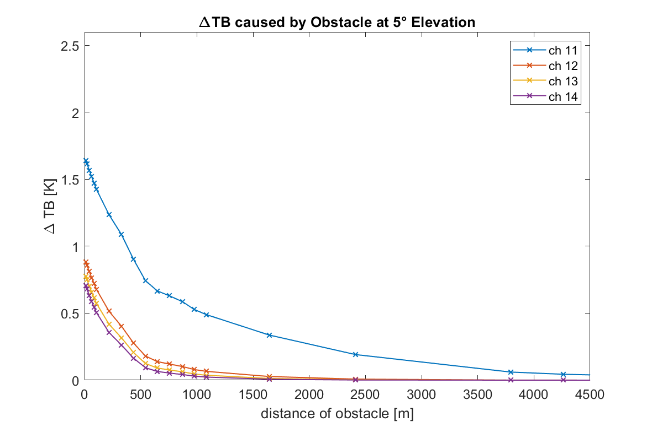
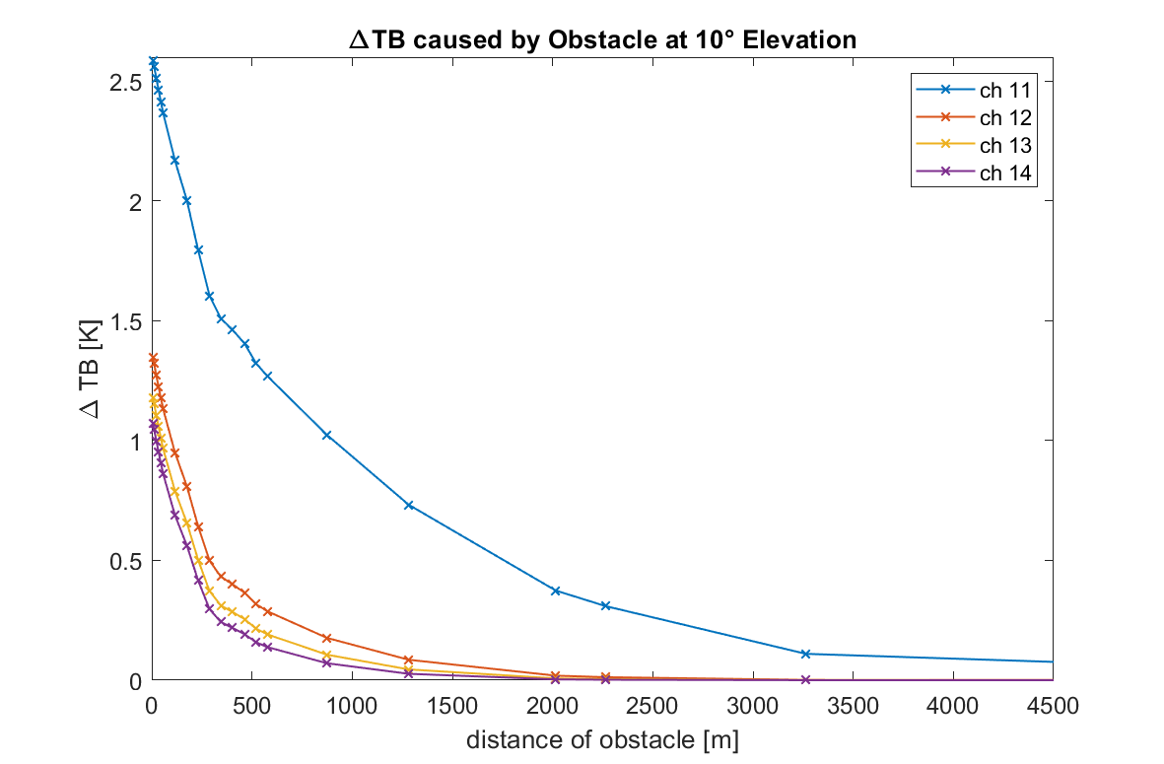
∆TB caused by obstacle in a well mixed ABL
≤0.1K
(accepted
threshold)
Obstacle has ambient temperature
For T-profiles, elevation scans are conducted only with ch 11-14
10

Slide 11
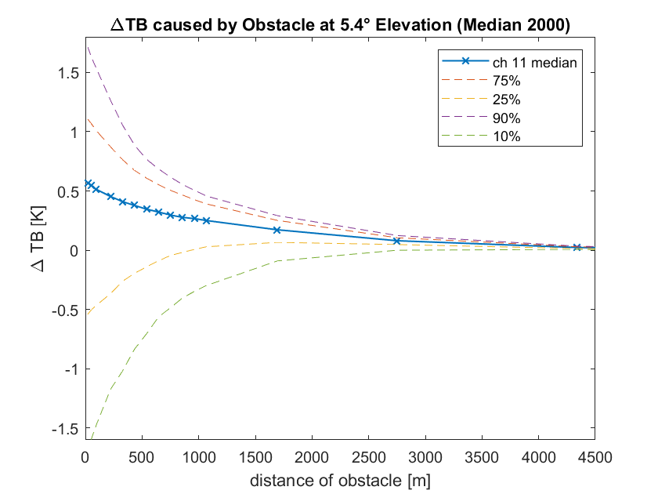
∆TB caused by obstacle (median profile of one year)
Remember: obstacle has same temperature as its surroundings
The 10th and 25th percentile lines show cases with a temperature inversion at ground
The 90th percentile line approximately represents the well mixed ABL case from before
11

Slide 12
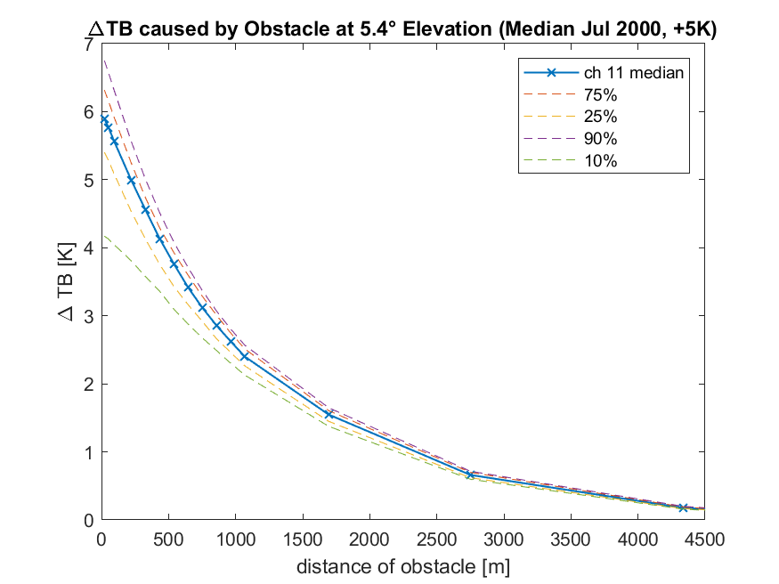
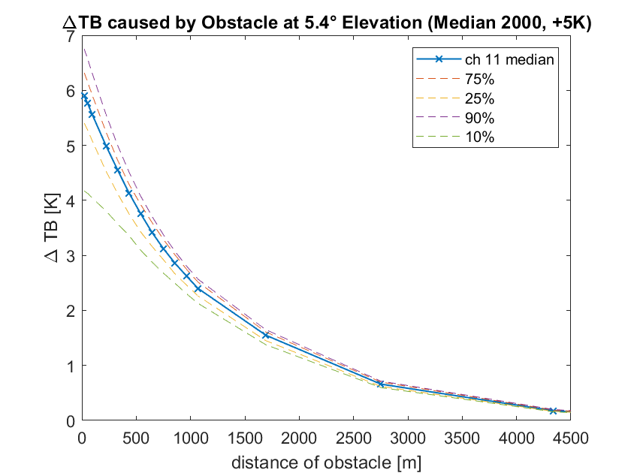
∆TB caused by a warmer obstacle (+5K)
→ Now obstacle is 5K warmer than its surroundings
≤0.1K
12

Slide 13
Results: Impact on retrieved T-profiles
13

Slide 14
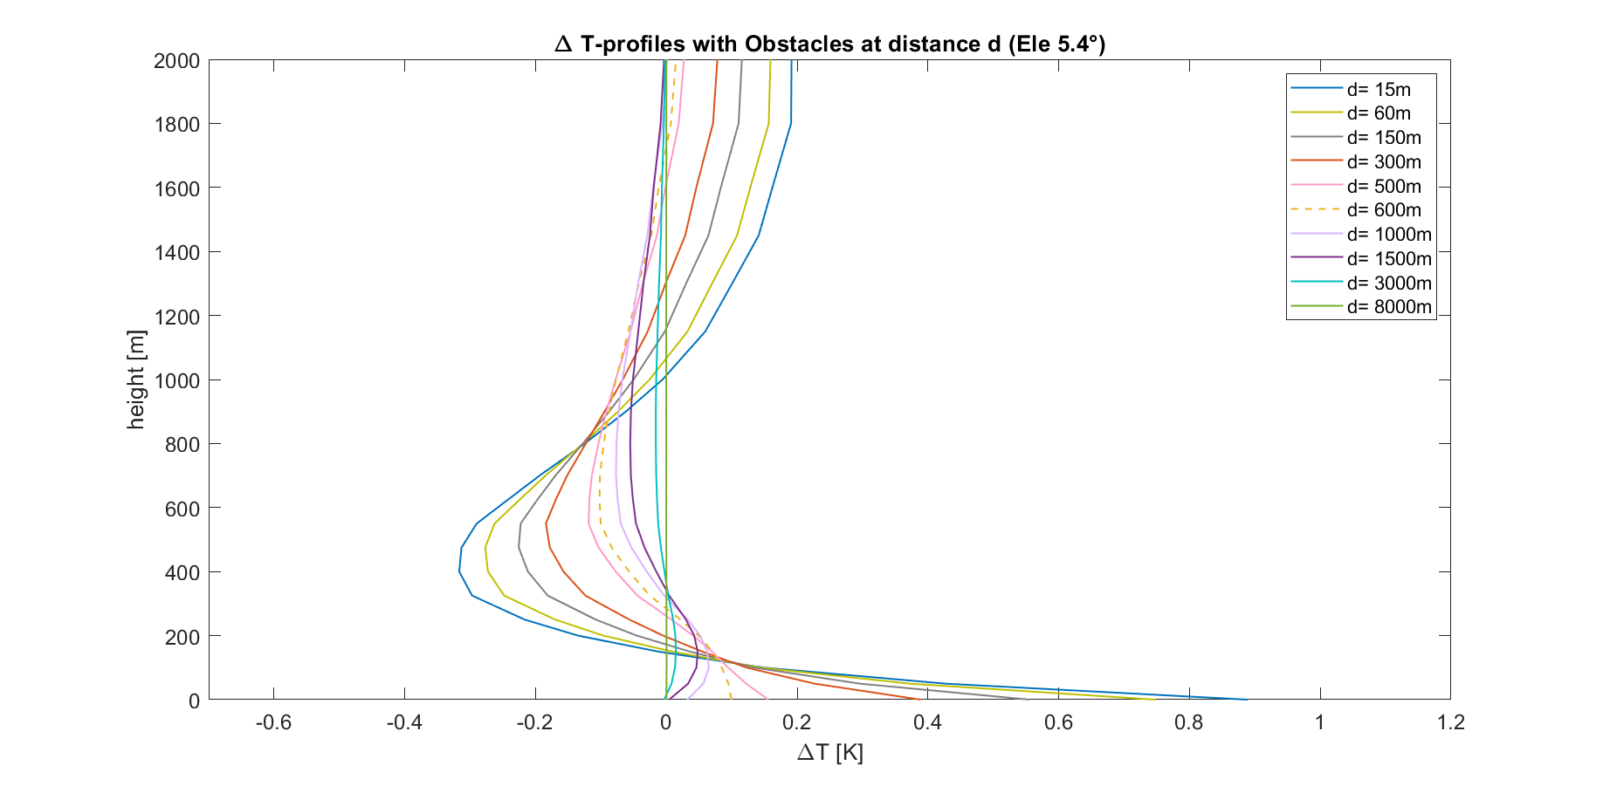
∆T-profiles caused by obstacles in well mixed ABL
14

Slide 15
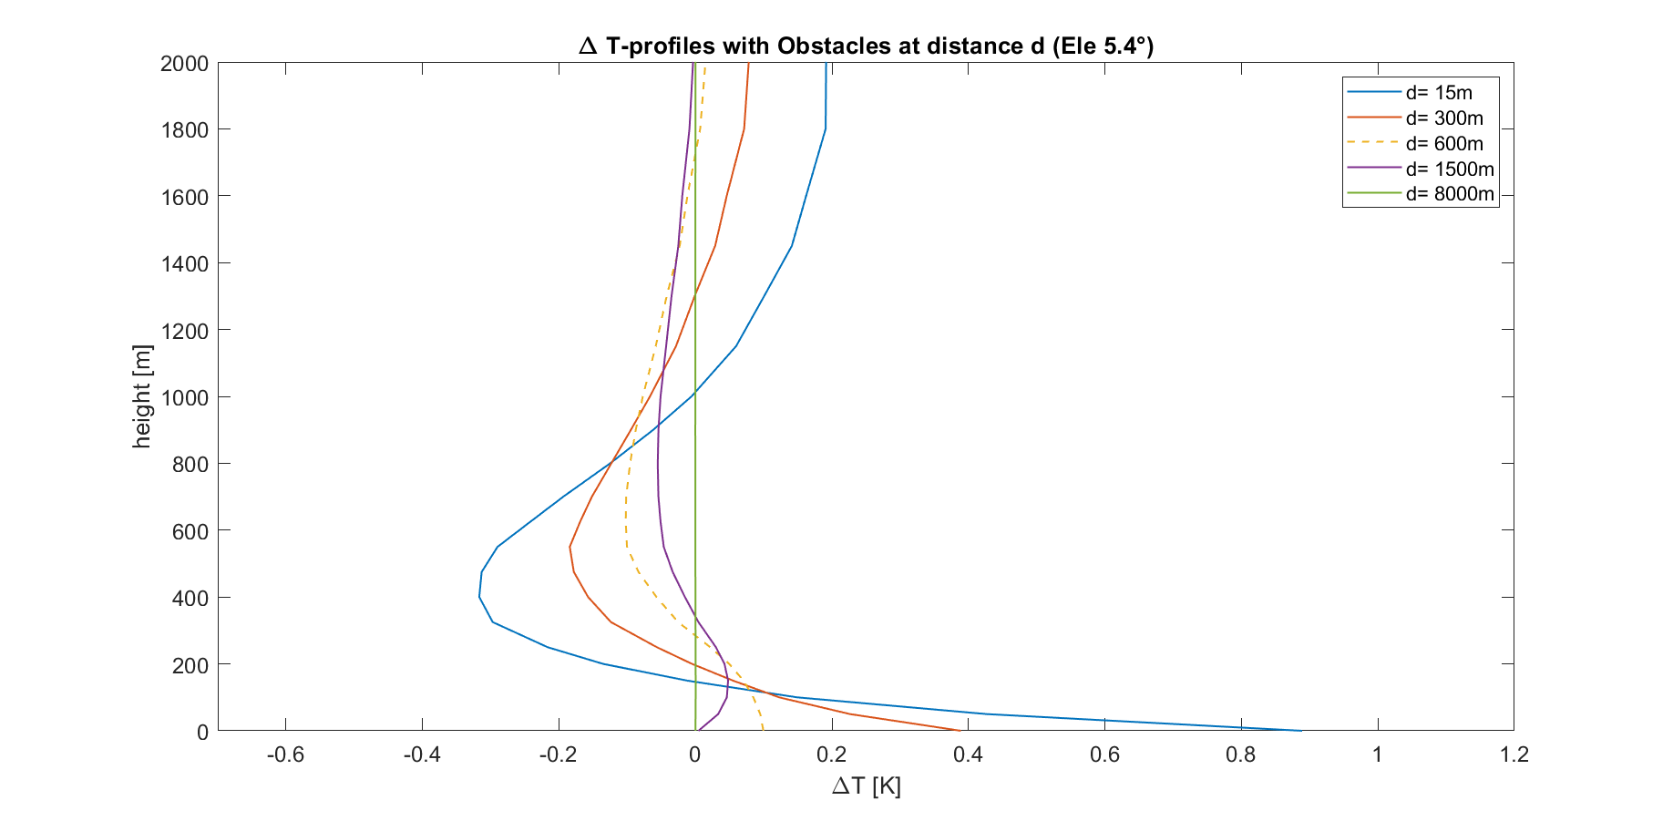
∆T-profiles caused by obstacles in well mixed ABL
≤|0.1K|
15

Slide 16
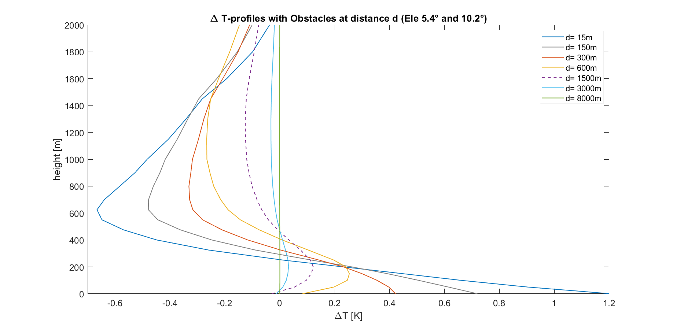
∆T-profiles caused by obstacles in well mixed ABL
≤|0.1K|
16

Slide 17
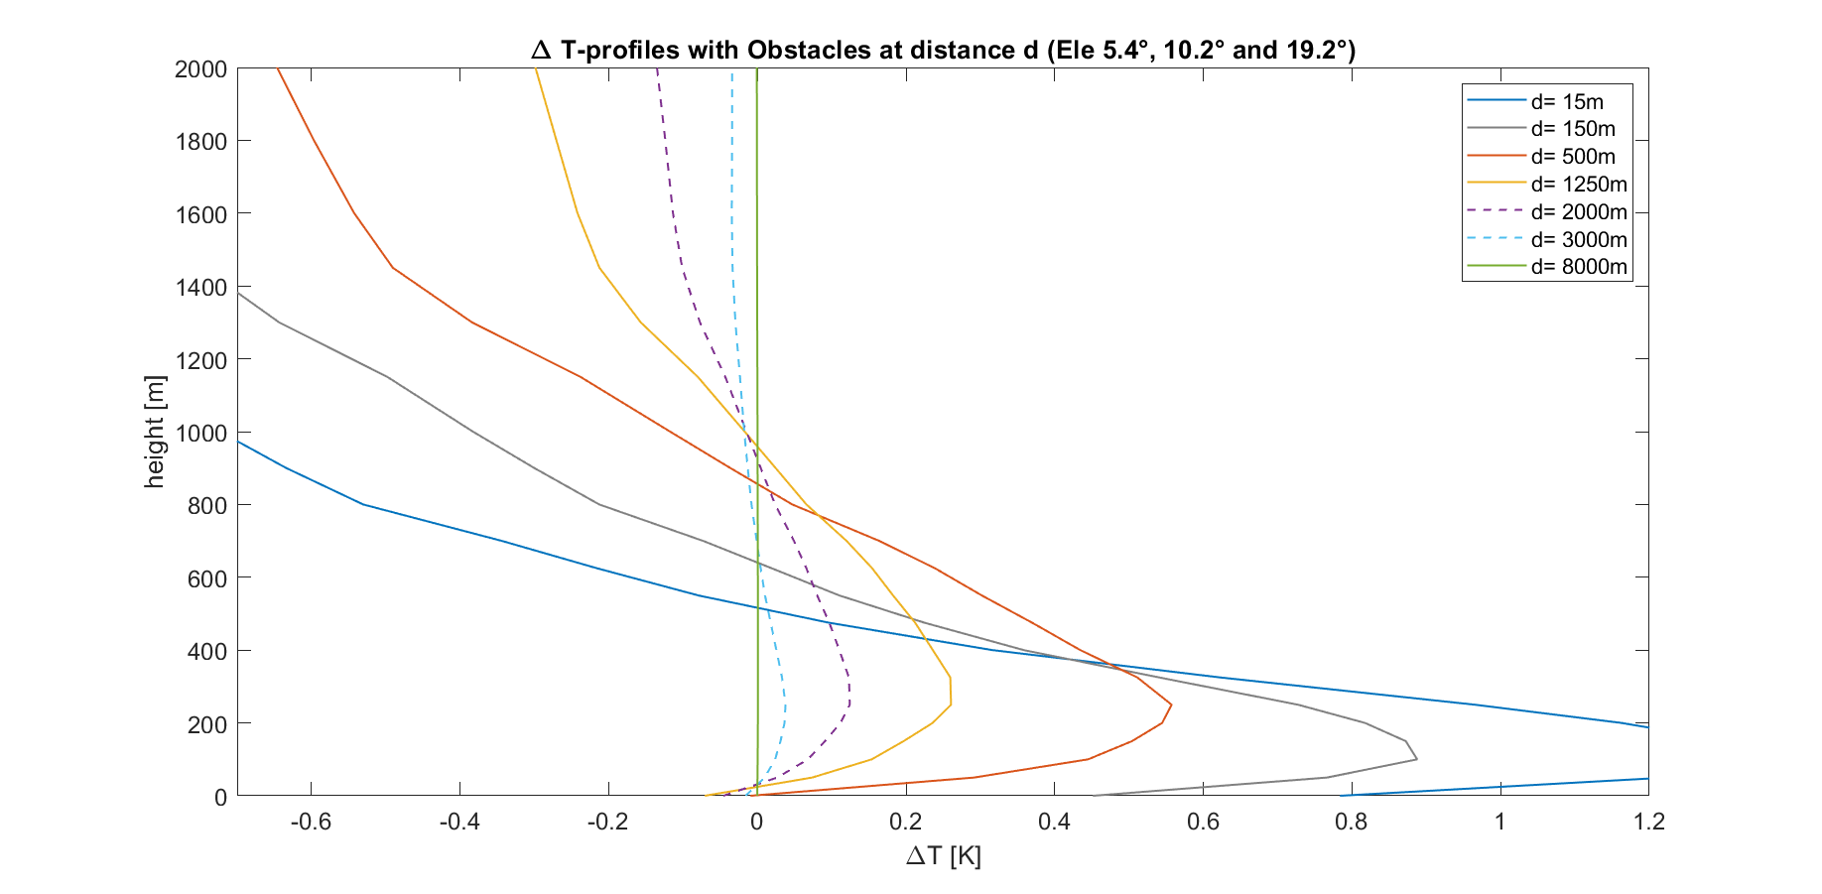
∆T-profiles caused by obstacles in well mixed ABL
≤|0.1K|
17

Slide 18
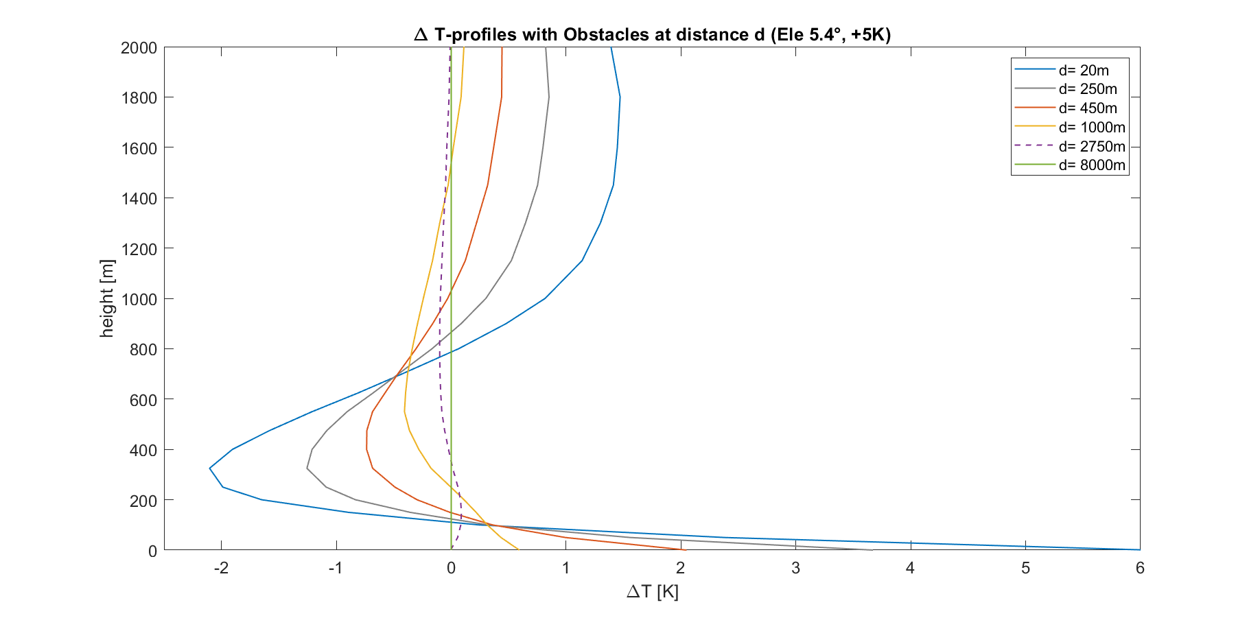
∆T-profiles caused by warmer obstacles (+5K)
≤|0.1K|
18

Slide 19
Main Conclusions
For T-profiling: At what distance is impact of obstacle ≤ 0.1K?
Worst case scenarios for obstacle at ambient temperature:
At 5° elevation: ≥ 600m (mostly trees or buildings)
At 5° and 10° elevation: ≥ 1500m (mostly buildings and mountains)
At 5°, 10° and 20° elevation: ≥ 2500m (mostly mountains)
If obstacle is 5K warmer than its surroundings:
At 5° elevation: ≥ 2700m (trees, buildings or mountains)
At 5° and 10° elevation: ≥ 3500m (mostly buildings and mountains)
At 5°, 10° and 20° elevation: ≥ 4000m (mostly mountains)
19

Slide 20
Thank you for your attention!
Contact:
tobias.boeck@uni-koeln.de
20

Slide 21
Bonus Slides
21

Slide 22
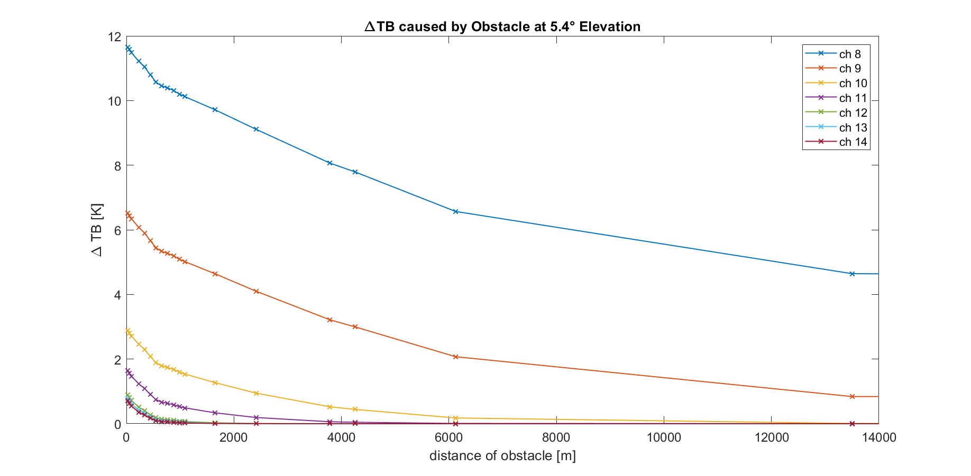
∆TB caused by obstacle in a well mixed ABL
22

Slide 23
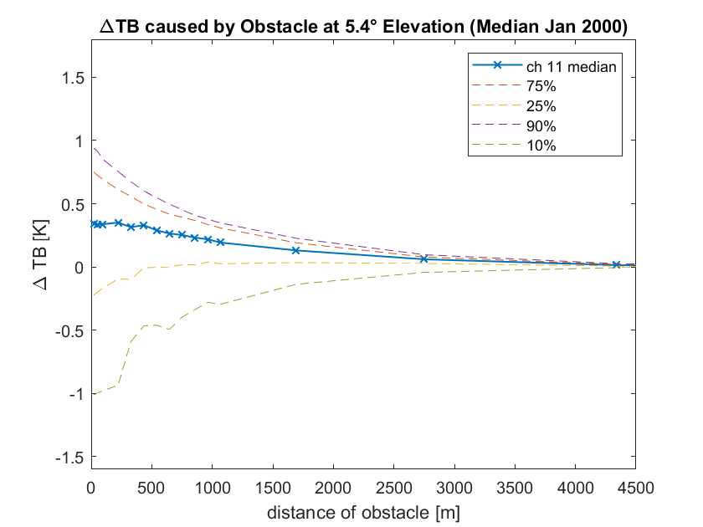
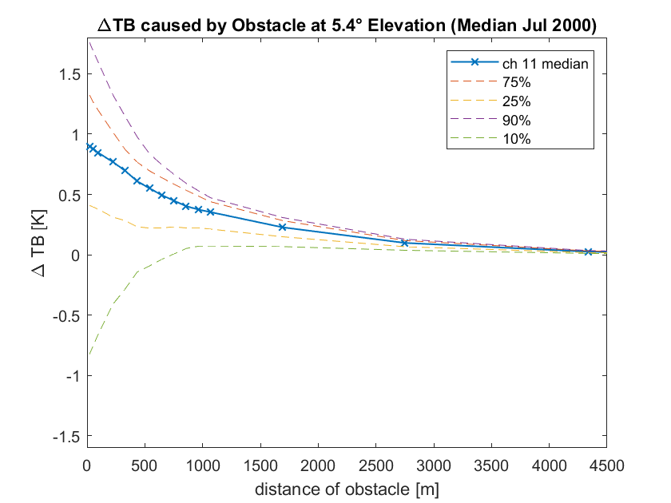
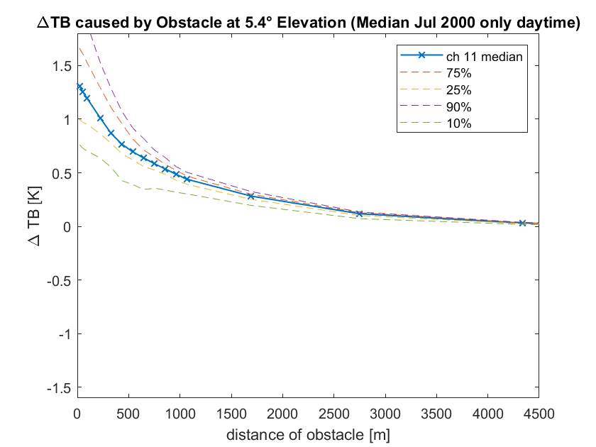
∆TB caused by obstacle (Medians)
23

Slide 24
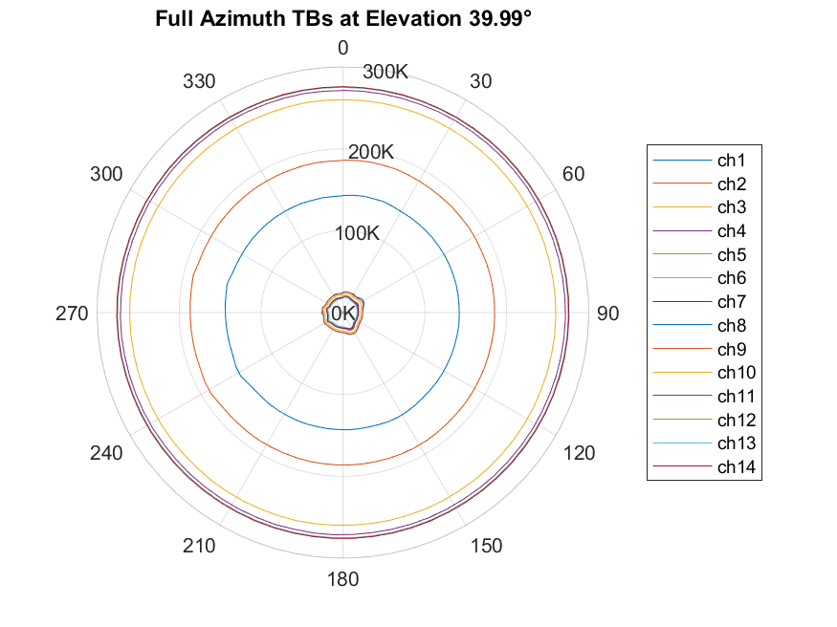
FOGHAT at Köln: Azimuth Scans (Obstacles and external Interference)
24

Slide 25
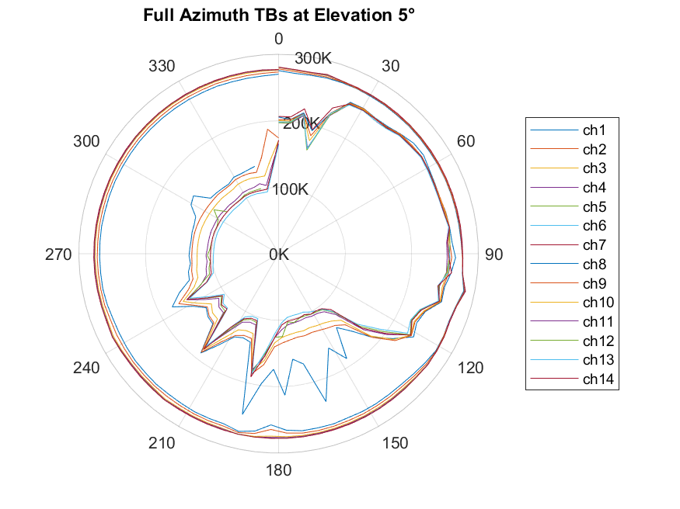
FOGHAT at Köln: Azimuth Scans (Obstacles and external Interference)
wall from building
between
NE and SE
EM interference?
25

