Slide 1
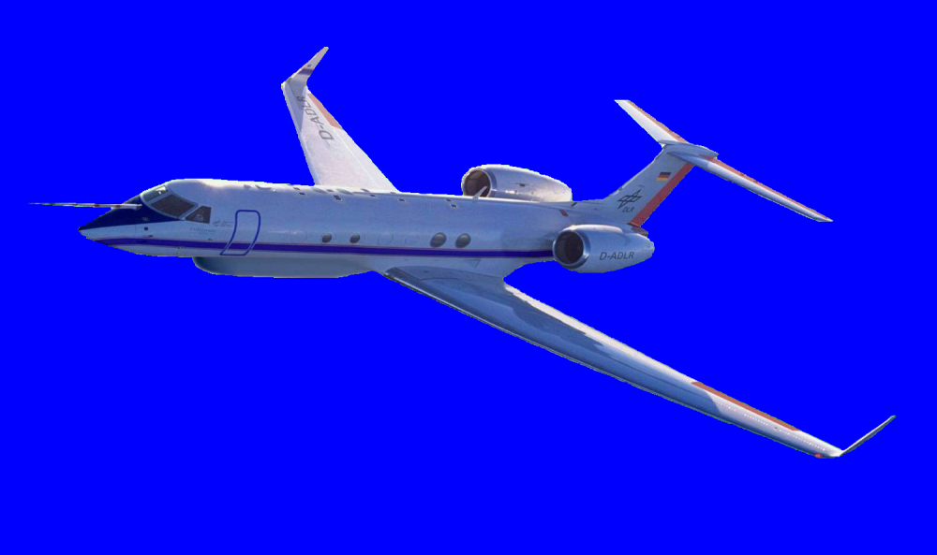
Attitude and Motion Correction for the HALO Cloud Radar
Martin Hagen

Slide 2
Topic
Correction of Doppler velocity of HALO cloud radar to estimate vertical motions (fall speed + air motion) of cloud particles
Assessment of pointing errors of HALO cloud radar
using return from earth surface
using pitch, roll, ground-speed, vertical velocity of HALO
Understanding residual terms
angular velocity (pitch rate, roll rate, yaw rate)
precision of IRS/IGI velocities and angles
accuracy of Doppler velocity from ground echoes
timing issues

Slide 3
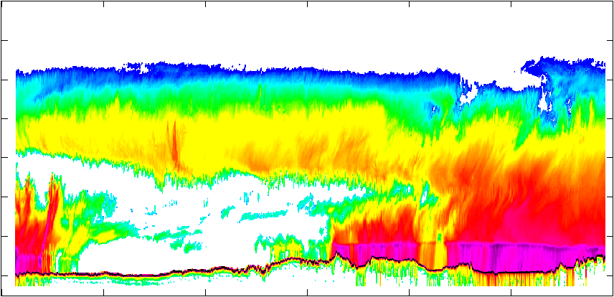
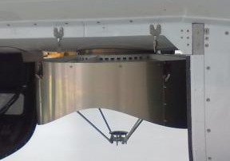
Principle
HALO cloud radar is mounted fixed at the rear view-port looking downward
Cloud radar measures reflectivity of clouds and precipitation beneath HALO aircraft
1130
1115
1100
1045
DWD (PM) 1045 - 1130 Reflectivity

Slide 4
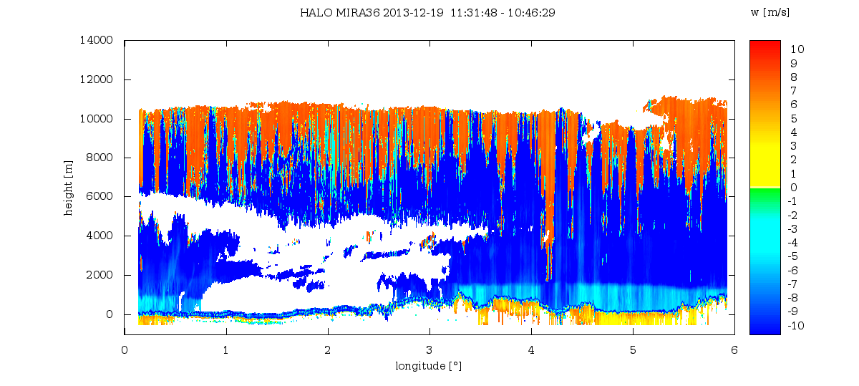
Principle
Cloud radar measures only motion along radar beam, motion perpendicular to radar beam is not seen
“Doppler velocity”
“line-of-sight velocity”
HALO MIRA36 2013-12-19 11:31:48 – 10:46:29
w [m/s]
what we see

Slide 5
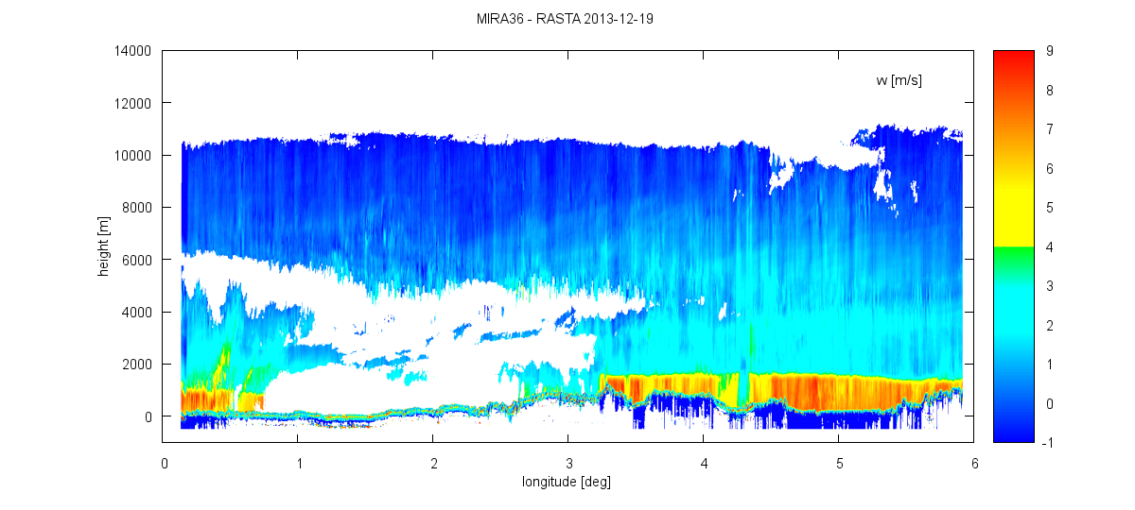
Principle
Cloud radar measures only motion along radar beam, motion perpendicular to radar beam is not seen
“Doppler velocity”
“line-of-sight velocity”
HALO MIRA36 2013-12-19 11:31:48 – 10:46:29
w [m/s]
what we want to see

Slide 6
Contribution of Aircraft Motion
Main contribution
pitch
ground speed (relevant for ground echo)
true airspeed (relevant for clouds)
vertical aircraft motion
Doppler velocity of ground echo should be zero v_{r} = GS * sin(θ) = 210 m/s * sin(3°) = 10.99 m/s
Doppler velocity of ground is used to asses pointing direction of radar
pitch
θ
GS
TAS
vertical aircraft velocity
wind
pitch
V_{ground} = 0

Slide 7
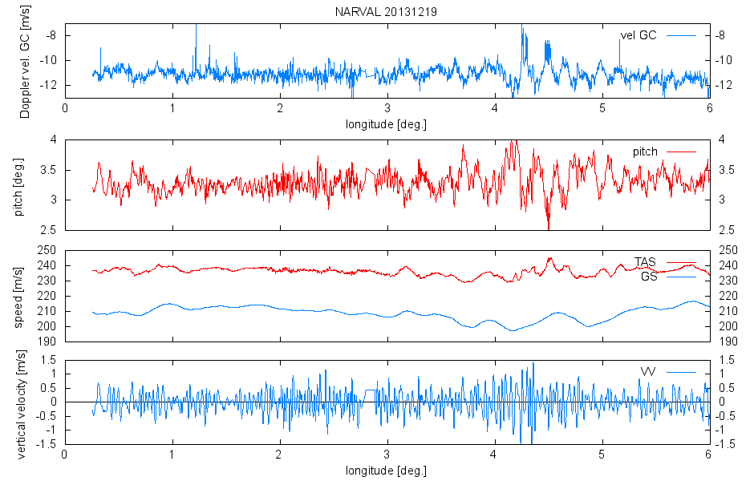
Contribution of Aircraft Motion

Slide 8
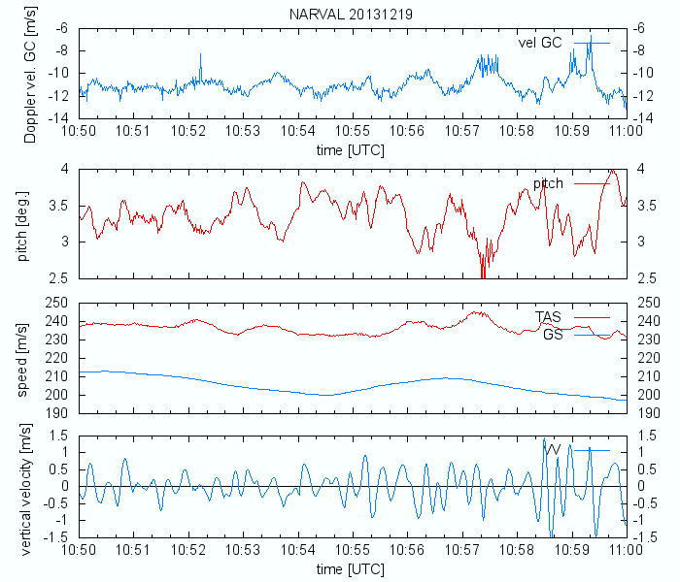
Contribution of Aircraft Motion

Slide 9
Contribution of Aircraft Motion
and
$$\left(\begin{matrix}v_{ax} \\ v_{ay} \\ v_{az}\end{matrix}\right)=\left(\begin{matrix}\cos{θ} & \sin{θ}\sin{φ} & \sin{θ\cos{φ}} \\ 0 & \cos{φ} & −\sin{φ} \\ −\sin{θ} & \cos{θ\sin{φ}} & \cos{θ\cos{φ}}\end{matrix}\right)\left(\begin{matrix}v_{x} \\ v_{y} \\ v_{z}\end{matrix}\right)$$
$$\left(\begin{matrix}v_{x} \\ v_{y} \\ v_{z}\end{matrix}\right)=\left(\begin{matrix}\sin{ψ} & \cos{ψ} & 0 \\ \cos{ψ} & −\sin{ψ} & 0 \\ 0 & 0 & 1\end{matrix}\right)\left(\begin{matrix}v_{WE} \\ v_{SN} \\ v_{z}\end{matrix}\right)$$

Slide 10
Contribution of Aircraft Motion
and
$$\left(\begin{matrix}v_{ax} \\ v_{ay} \\ v_{az}\end{matrix}\right)=\left(\begin{matrix}\cos{θ} & \sin{θ}\sin{φ} & \sin{θ\cos{φ}} \\ 0 & \cos{φ} & −\sin{φ} \\ −\sin{θ} & \cos{θ\sin{φ}} & \cos{θ\cos{φ}}\end{matrix}\right)\left(\begin{matrix}v_{x} \\ v_{y} \\ v_{z}\end{matrix}\right)$$
$$\left(\begin{matrix}v_{x} \\ v_{y} \\ v_{z}\end{matrix}\right)=\left(\begin{matrix}\sin{ψ} & \cos{ψ} & 0 \\ \cos{ψ} & −\sin{ψ} & 0 \\ 0 & 0 & 1\end{matrix}\right)\left(\begin{matrix}v_{WE} \\ v_{SN} \\ v_{z}\end{matrix}\right)$$
plus further (partly unknown) terms: angular velocities, SNR-radar, noise, …
ideal world

Slide 11
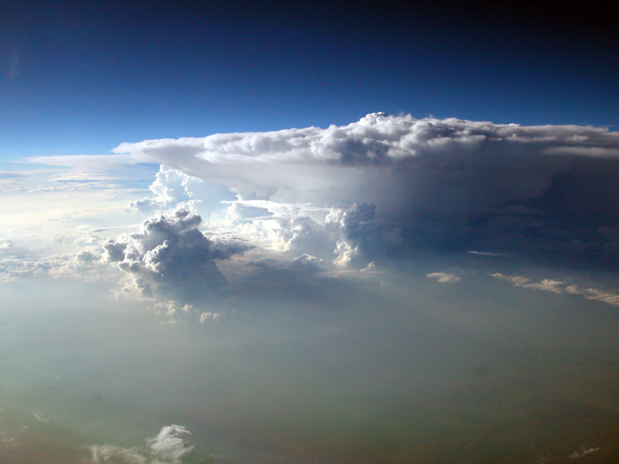
Coordinate Systems
lateral axis y_{a}
normal axis z_{a}
longitudinal axis x_{a}
pitch θ
horizon
horizon
radial velocity v_{r}
roll ϕ
up z_{g}
flight ground track
west
projection of longitudinal axis x_{a} to ground
south
north y_{g}
track
drift
heading ψ
east x_{g}

Slide 12
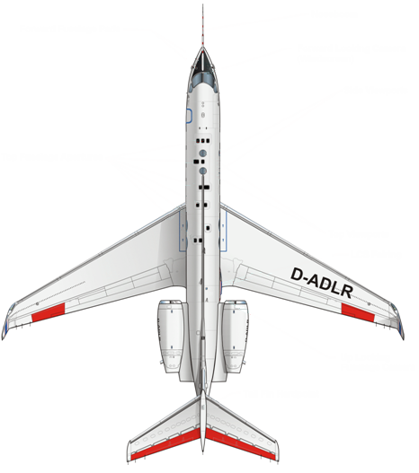
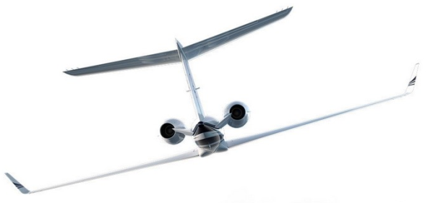
Coordinate Systems: Transformations
Heading ψ
Pitch θ
Roll ϕ
angle between longitu-dinal axis and fixed earth reference system
angle between longitu-dinal axis and horizon
angle between lateral axis and horizon
$y$_{g}
$$y$$
$$z$$
$$za$$
$$x$$
$$z$$
$$za$$
$$xa$$
$$y$$
$x$_{g}
θ
$$x$$
ϕ
ψ
$$ya$$
$$\left(\begin{matrix}x \\ y \\ z\end{matrix}\right)=\left(\begin{matrix}\sin{ψ} & \cos{ψ} & 0 \\ \cos{ψ} & −\sin{ψ} & 0 \\ 0 & 0 & 1\end{matrix}\right)\left(\begin{matrix}x_{g} \\ y_{g} \\ z_{g}\end{matrix}\right)$$ $$X=H{ X}_{g}$$
$$\left(\begin{matrix}x \\ y \\ z\end{matrix}\right)=\left(\begin{matrix}\cos{θ} & 0 & \sin{θ} \\ 0 & 1 & 0 \\ −\sin{θ} & 0 & \cos{θ}\end{matrix}\right)\left(\begin{matrix}x_{a} \\ y_{a} \\ z_{a}\end{matrix}\right)$$ $$X=P{ X}_{a}$$
$$\left(\begin{matrix}x \\ y \\ z\end{matrix}\right)=\left(\begin{matrix}1 & 0 & 0 \\ 0 & \cos{φ} & −\sin{φ} \\ 0 & \sin{φ} & \cos{φ}\end{matrix}\right)\left(\begin{matrix}x_{a} \\ y_{a} \\ z_{a}\end{matrix}\right)$$ $$X=R{ X}_{a}$$

Slide 13
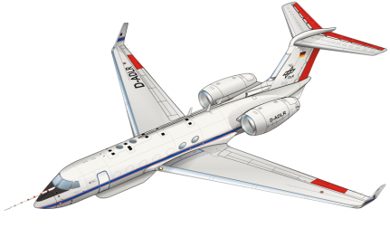
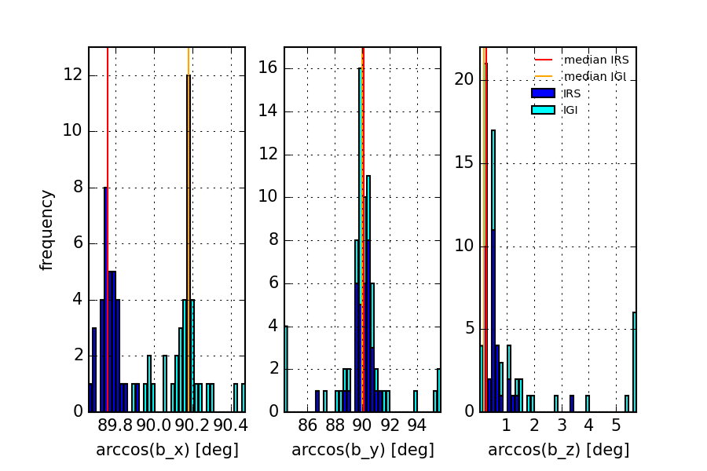
Pointing Direction of Cloud Radar
Doppler velocity v_{r} is parallel to v_{az} and perpendicular to x_{a} and y_{a} v_{r} = -v_{az}
evaluation of NARVAL 2013/2014 flights (73 segments 15-35 minutes from 6 research flights) indicates offsets from z_{a}
offset between IRS and IGI confirmed by A. Giez
v_{ay}
v_{az}
v_{ax}
v_{r}
offset | pitch | roll
IRS | -0.24° | 0.09°
IGI | 0.18° | -0.02°

Slide 14
Topic
Correction of Doppler velocity of HALO cloud radar to estimate vertical motions (fall speed + air motion) of cloud particles
Assessment of pointing errors of HALO cloud radar
using return from earth surface
using pitch, roll, ground-speed, vertical velocity of HALO
Understanding residual terms
angular velocity (pitch rate, roll rate, yaw rate)
precision of IRS/IGI velocities and angles
accuracy of Doppler velocity from ground echoes
timing issues

Slide 15
Angular Velocity: Pitch Rate
pitch rate
$${ω_{y}=∂θ}/{∂t}$$
range to surface changes when pitch is changing
$$r=h/{\cos{θ}}$$
$$v_{Rz}=\frac{∂r}{∂t}=\frac{h}{\cos\left(θ+\frac{∂θ}{∂t}\right)}−\frac{h}{\cos{θ}}$$
r
h
$$Δr$$

Slide 16
Angular Velocity: Pitch Rate
pitch rate
$${ω_{y}=∂θ}/{∂t}$$
range to surface changes when pitch is changing
h = 12 km
$$r=h/{\cos{θ}}$$
$$v_{Rz}=\frac{∂r}{∂t}=\frac{h}{\cos\left(θ+\frac{∂θ}{∂t}\right)}−\frac{h}{\cos{θ}}$$
$$ω_{y}$$
$$v_{Rz}$$
r
h
$$Δr$$

Slide 17
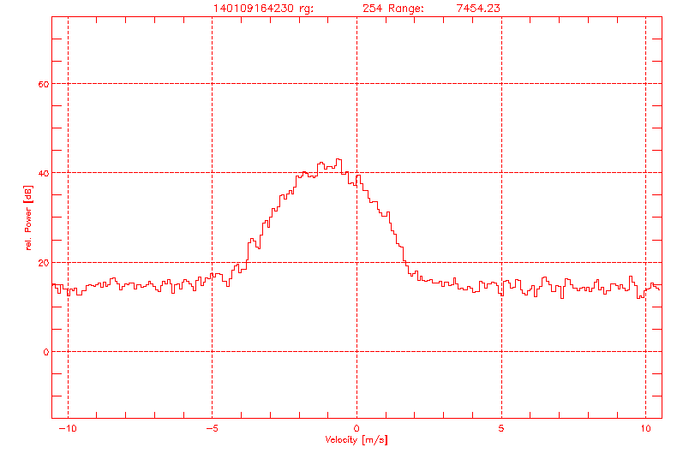
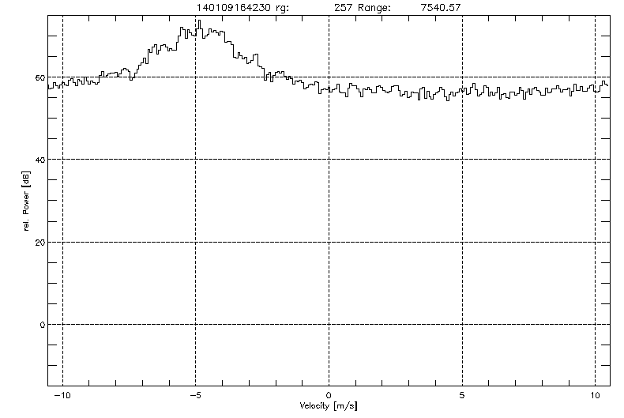
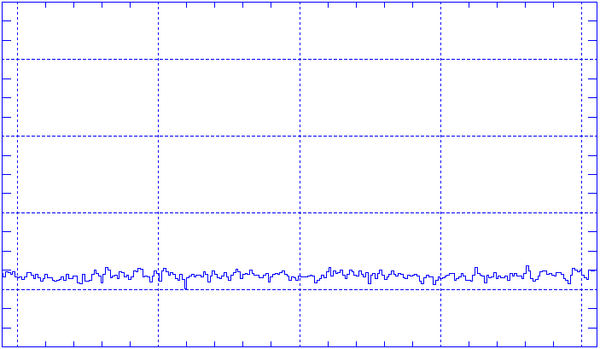
Doppler Velocity Noise
Radar receiver is close to saturation with return from surface
SNR of ground clutter is small
Spectral Width of ground clutter is wide; should be narrow
Doppler velocity of ground clutter has large uncertainty
additional spectral broadening by speed and pitch effects both spectra
60
40
20
0
ground clutter
rain 90 m above surface
relative power [dB]
“clear air”
-10 -5 0 5 10
velocity {m/s]
FFT 256 with pulses; averaged spectrum over 20 FFT PRF 5000 Hz -> 1.024 s

Slide 18
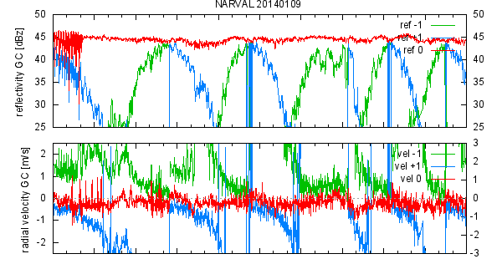
Doppler Velocity of Ground Clutter
Range bin (28.8 m) with strongest echo is considered as ground clutter
NARVAL flight over sea towards low pressure system (changing altitude)
ground clutter +- 1 range bin
reflectivity [dB]
velocity[m/s]
spectr. w. [m/s]
range [m]

Slide 19
Timing of Data
cloud radar samples FFT 256 with pulses; averaged spectrum over 20 FFT pulse rate PRF 5000 Hz → data rate 1.024 s
time stamp after averaged spectrum
PC uses HALO network time (synchronization ????)
BAHAMAS data
pitch, roll, velocity average over last second
pitch rate averaged over last second
time pitch pitch_rate vertical_velocity ground_speed
39048.450 3.57 -0.01 0.83 212.41
39049.450 3.54 -0.04 0.80 212.35
39050.450 3.45 -0.08 0.70 212.29
39051.450 3.44 -0.01 0.55 212.24

Slide 20
Conclusion
Correction of Doppler velocity of HALO cloud radar to estimate vertical motions (fall speed + air motion) of cloud particles is possible
Retrieval of vertical velocities in clouds and precipitation requires knowledge of wind profile
Residual terms due to
precision of IRS/IGI velocities and angles
accuracy of Doppler velocity from ground echoes
timing issues
need BAHAMAS data with higher data rate (10 Hz)
higher data rate for radar data (?? storage issue on radar computer ??)
Future option: adjust average pitch (2.5 – 3°) at radar antenna (also for radiometer, WALES)

