Slide 1
Ground based microwave radiometer – exploring model based LWP retrievals and artificial sky-clearing
Moritz Löffler^{1,2}, Christine Knist ¹, Jasmin Vural ¹, Ulrich Löhnert ²
¹ Deutscher Wetterdienst, ² Universität zu Köln

Slide 2
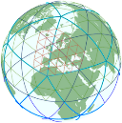
Motivation
“Improving the initial state of the atmospheric boundary layer by assimilation of ground-based microwave radiometer observations”, J.Vural, C. Merker in preparation
HATPRO G5 at observatory in Lindenberg (DWD)
Notes:
QJRMS

Slide 3
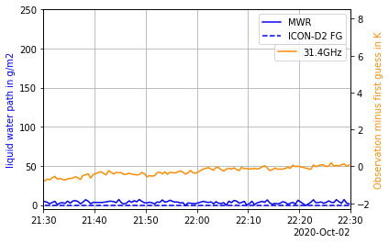
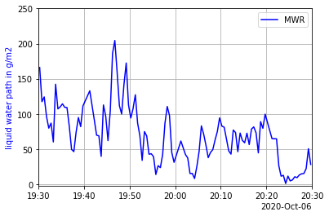
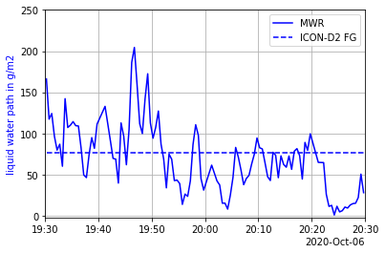
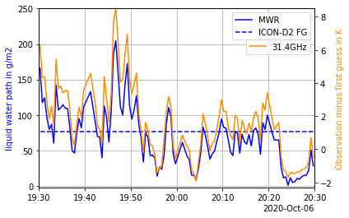
Reduced representativeness when cloudy
LWP varies in clouds
random differences in model comparisons
random differences also in observation space (T_{B})
increased representativeness error between observation and model reduces the possible impact in data assimilation.
Cloudy
Clear
MWR observation and first guess (ICON-D2) of LWP and difference of obs. and first guess at 31.4GHz; A clear and a cloudy case.

Slide 4
Research focus
Exploration of cloud detection at all elevation angles
Performance of corresponding liquid water path (LWP)
Feasability of removing cloud signal and obtain artificial clear-sky signal

Slide 5
Method
Train/tune/validate retrieval
Verification
Radiative transport model
Brightness temperatures (T_{B})
MWR Observations
(T_{B})
ICON-D2 Background (T_{B})
Retrieval
ERA5 (Reanalysis)
clear-sky T_{B}
Cloud detection
clear-sky T_{B}
Observations
Retrievals
Model
liquid water path
liquid water path

Slide 6
ERA5 global reanalysis ICON-D2
Atmospheric Models
Copernicus climate data store (CDS)
2010-01 to 2022-12
1/hour
37 pressure levels
31km grid spacing
Limitited area model for NWP
Operational since 2020
1/hour
65 model levels
2.1 km grid spacing
Used here for observation minus background statistics

Slide 7
Radiative Transport
Cosmic Background
2.73 K
O
Rosenkranz 2022
Rosenkranz 2022
Ellison 2007
O
$$\sum{= }$$
AbsorptionEmission
O
H
H

Slide 8
Training and Selecting Neural Network
Machine learning library: sklearn
MLPClassifier
MLPRegressor
Input data:
Brighness temperatures
Sin and cos of day-of-year
Sin and cos of hour-of-day
Chronological split of dataset:
Train, test, validate ( 8 : 2 : 2 )
Output
Cloud detection
Liquid water path
Clear-sky brightness temperatures

Slide 9
Results: LWP Retrieval & Cloud Detection
Cloud detection
Test and validation agree reasonably well
Cloud detection
false alarm rate of 1%
probability of detection of 97%
LWP retrieval
mean absolute error of 5 g/m²
RMSE of ~10 g/m²
test
validation
LWP retrieval
test
validation

Slide 10
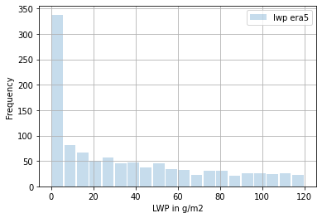
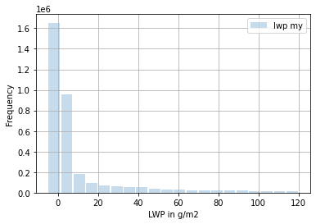
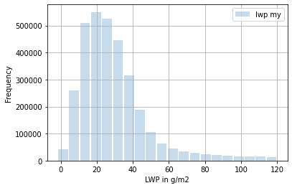
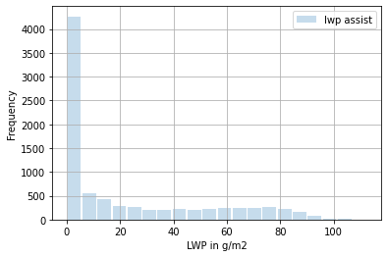
LWP Statistics
(A)
(B)
LWP retrieval trained only with ERA5 TB is biased
The clear-sky peak is
centered at 20 g/m²
FWHM ~ 40 g/m²
σ ~ 17 g/m²
After adding „day-of-year“ and „hour of day“ as input to the retrieval the statistical similarity to the references improves
The clear-sky peak is then
centered at ~ 0 g/m²
σ ~ 2.7 g/m²
(C)
(D)
Histograms of liquid water path during FESSTVaL campaign Mai to Aug. 2021
From ERA5 (A), new MWR retrieval (B), manufacturer MWR retrieval (C) and retrieved from a hyperspectral IR sounder (ASSIST) (D)

Slide 11
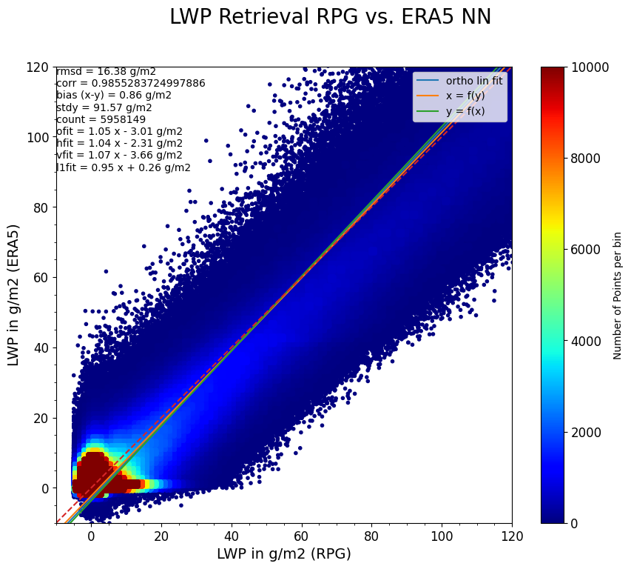
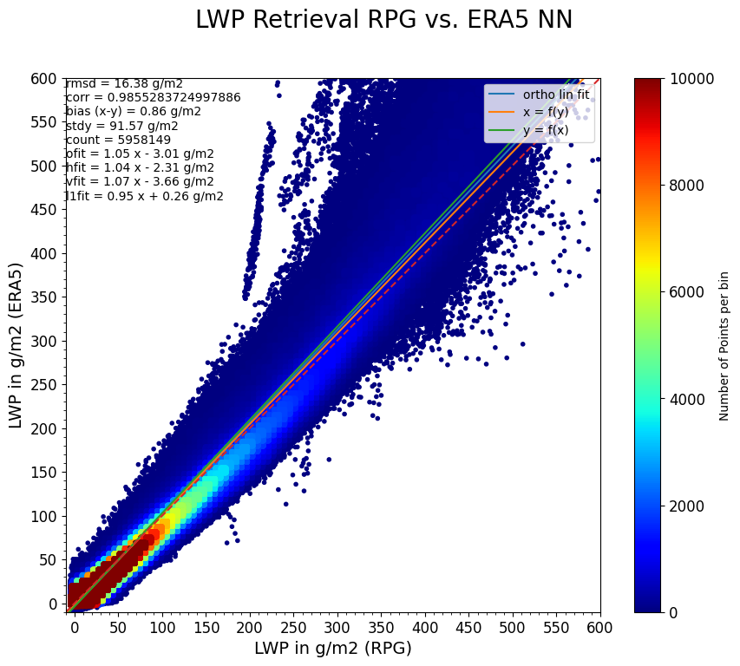
LWP Retrievals for same Instrument
LWP retrieval by manufacturer is highly correlated corr = 0.99
σ_{D} = 11 g/m²
RMSD = 16 g/m²
bias = 1 g/m²

Slide 12
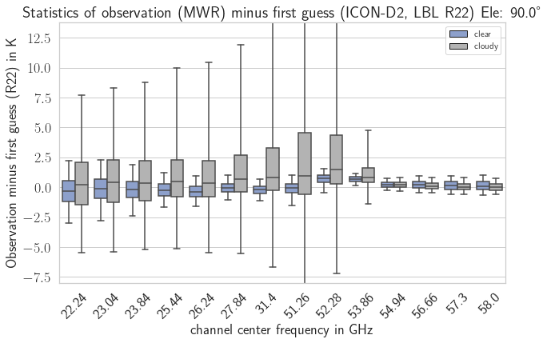
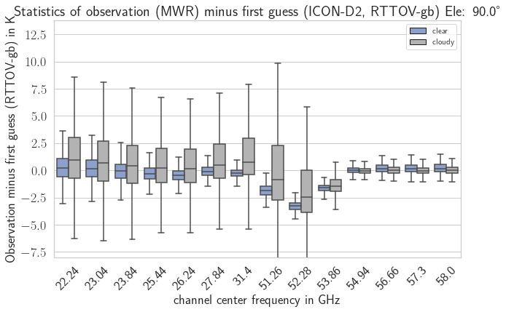
Observation minus Background (OmB) statistics R22 Zenith
OmB stats of detected clouds
are asymmetric (skew)
have large random differences
have a different bias than clear-sky
Improvements when using Rosenkranz-22 oxygen and water-vapor absorption coefficients
Boxplot of cloudy minus clear OmB statistics with ICON-D2 at Lindenberg. Observations classified as cloudy and clear by selected MLPClassifier. Boxes are inner quartiles and whiskers are 5% and 95% quantiles.

Slide 13
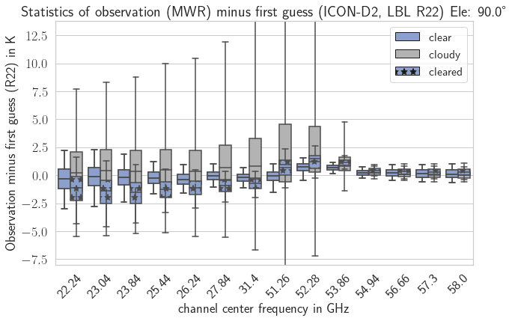
OmB results sky clearing
Artificial clear-sky OmB stats.
are symmetric
have small random differences
have random differences similar to native clear-sky observations
have an increased systematic bias
Representativeness error is significantly reduced
Boxplot of cloudy minus clear OmB statistics with ICON-D2 at Lindenberg. Observations classified as cloudy (grey) and clear (blue). Boxes are inner quartiles and whiskers are 5% and 95% quantiles. Cloudy cases were artificially cleared after detection of cloud (blue box with stars).

Slide 14
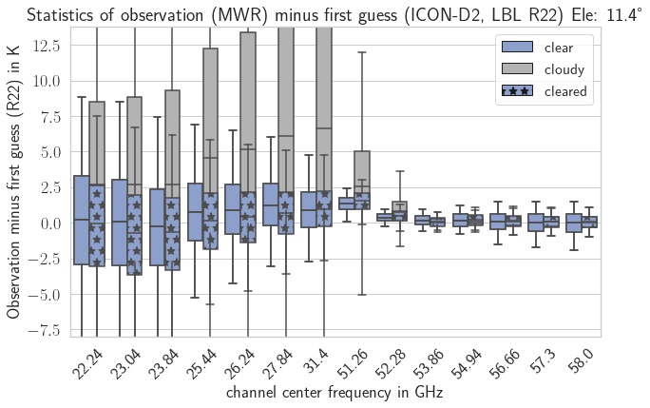
OmB results sky clearing 11.4° elevation
Cloud detection and sky-clearing performs well down to 11° elevation
Below 11° elevation the observed T_{B} are systematically higher than the modelled T_{B}
Boxplot of cloudy minus clear OmB statistics with ICON-D2 at Lindenberg. Observations classified as cloudy (grey) and clear (blue). Boxes are inner quartiles and whiskers are 5% and 95% quantiles. Cloudy cases were artificially cleared after detection of cloud (blue box with stars).

Slide 15
Summary
Rosenkranz 2022 line-by-line O₂ and water-vapor absorption coefficients significantly improve agreement between observation and model
All retrievals provided agreeable results without additional debiasing
Simple neural network trained with ERA5 T_{B} is sufficient to detect clouds for data assimilation purposes
The LWP retrieval agrees well with the manufacturers retrieval
Further validation against an independant LWP reference is required
Sky-clearing shows promising results: it reduces the random differences between model and observation in cloudy situations

Slide 17
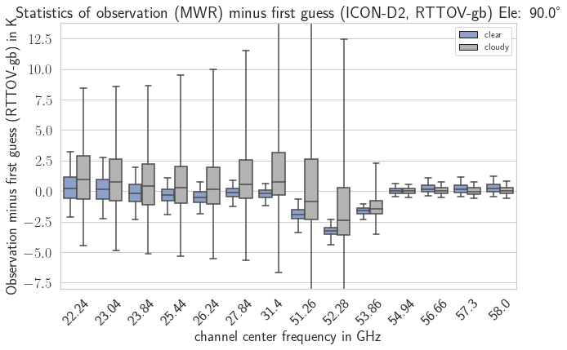
Observation minus Background (OmB) statistics Zenith
OmB-stats. are symmetric for clear-sky
OmB-stats. have a smaller variability for clear-sky
Channels above 54GHz unaffected by liquid clouds
Clouds detected by NN classifier statistically reflect the expected increase of representativity error
NN detects relevant clouds
Boxplot of cloudy minus clear OmB statistics with ICON-D2 at Lindenberg. Observations classified as cloudy and clear by selected MLPClassifier. Boxes are inner quartiles and whiskers are 5% and 95% quantiles.
Notes:
Introduce Boxplot

Slide 18
Training and Selecting Neural Network
Machine learning library: sklearn
MLPClassifier
MLPRegressor
Preprocessing of data
Dimensionality reduction (PCA)
Scaling of input data
LWP limit for presence of cloud
Variation of model parameters:
Hidden layer size and number
Learning rate
Solver and activation
…
Input data:
Brighness temperatures
Sin and cos of day-of-year
Sin and cos of hour-of-day
Chronological split dataset:
Train, test, validate ( 8 : 2 : 2 )

Slide 19
Comparison with infrared hysperspectral sounder (ASSIST)

Slide 20
Comparison with ERA5

Slide 22
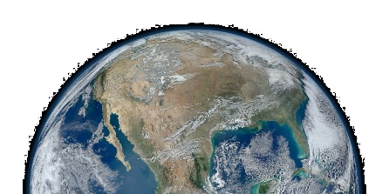
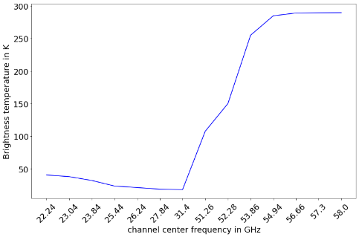
Radiative Transport
Cosmic Background
2.73 K
Air-mass correction
O
Rosenkranz 2022
Rosenkranz 2022
Ellison 2007
O
$$\sum{= }$$
AbsorptionEmission
O
H
H
Relevant for elevation angles smaller 90°
Account for refraction and earth curvature
Refractive index according to Rüeger 2002
After downward propagation, resulting TB spectrum.
*https://www.pexels.com/de-de/foto/planet-erde-nahaufnahme-foto-45208/

