Slide 1
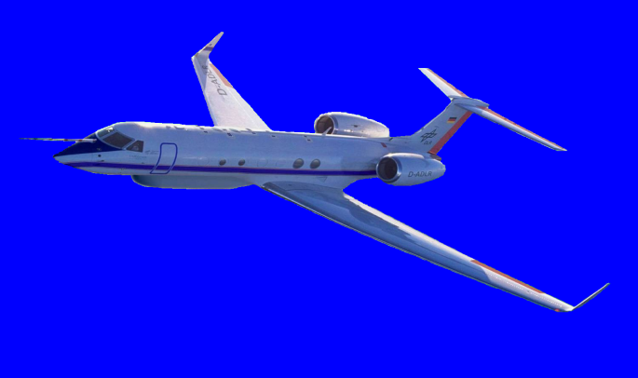
HAMP – HALO Microwave Package – Cloud Radar –
Martin Hagen , Florian Ewald, Lutz Hirsch, Heike Konow and many others

Slide 2
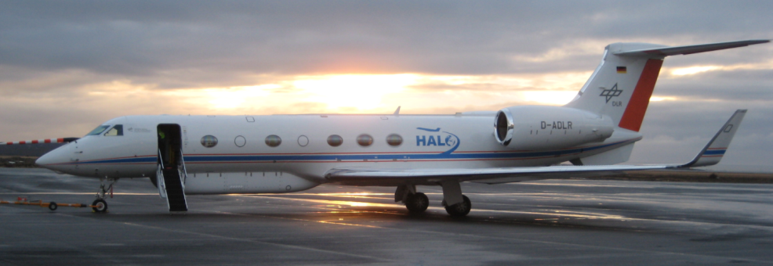
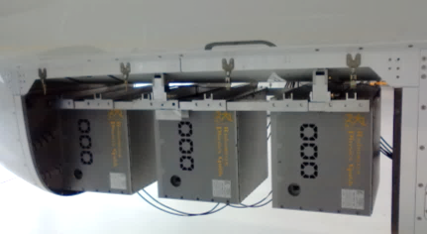
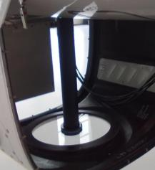
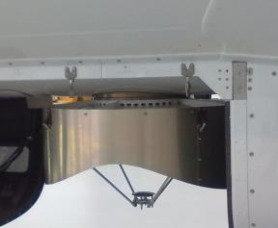
HAMP – HALO Microwave Package / NARVAL configuration
METEK MIRA-35 cloud radar
RPG microwave radiometers
WALES / HRSL water vapour lidar
drop sondes
HALO-SR
specMACS
Microwave radiometer 90/119 22/58 183 GHz
WALES / HRSL
Cloud radar 35 GHz

Slide 3
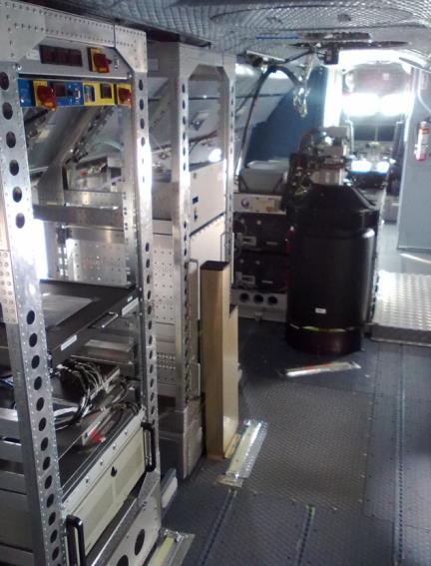
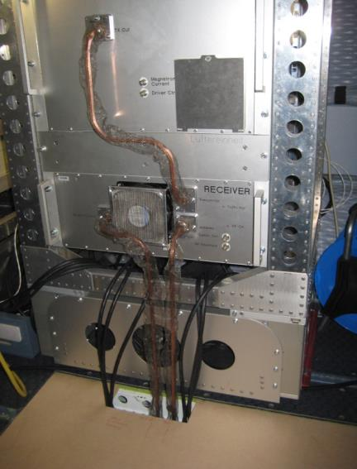
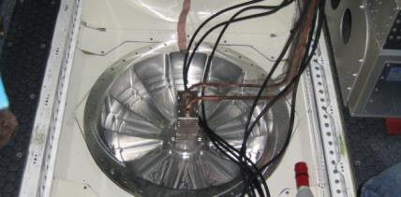
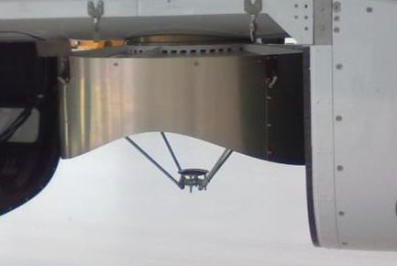
HALO Cloud Radar
Characteristics MIRA-35
Frequency | 35.2 GHz
Wavelength | 8 mm
Tx power | 30 kW
Pulse length | 0.2 µs
PRF | 5 kHz
Antenna dia. | 1 m
Beam width | 0.6°
Footprint @ 13km | 136 m
Max. range | 15 km
Range resolution | 30 m
Integration time | 1 s
Min. det. sig. @ 5km, 1 s integration | -38 dBz
Modified MIRA-35 for aircraft use
EMC compatibility
mitigation of electromagnetic radiation in cabin or to avionics
adapted clutter fence
any technical modification requires paper work, costs, delays, …
no modifications based on NARVAL 2013/14
TX
dryer
display keyboard KVM switch
TX
WALES
RX
RX
3 PC’s radiometer
PC radar
1 m antenna with clutter fence

Slide 4
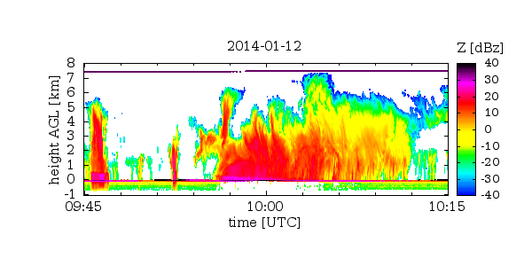
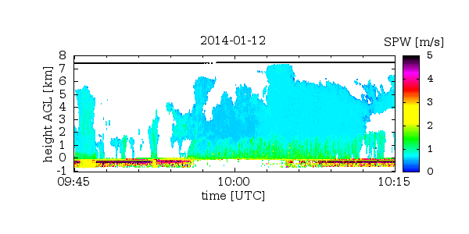
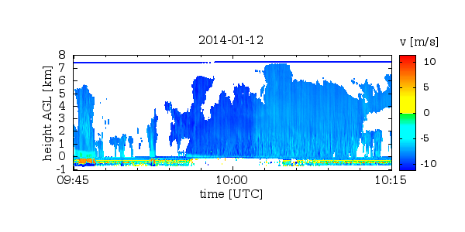
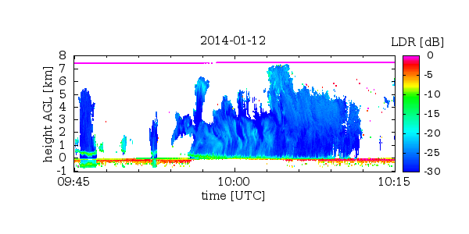
HALO Cloud Radar – Measured Parameters
Reflectivity Z
Doppler velocity v
Spectral Width w
Linear Depolarization ratio LDR

Slide 5
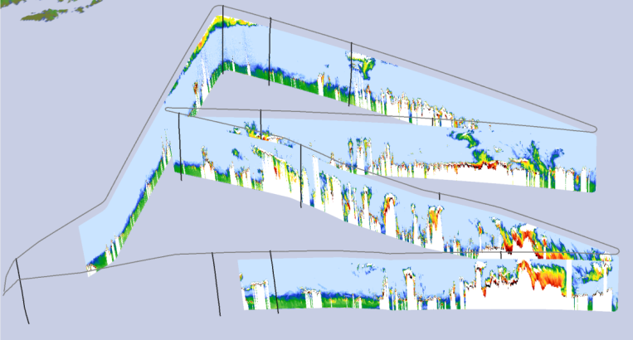
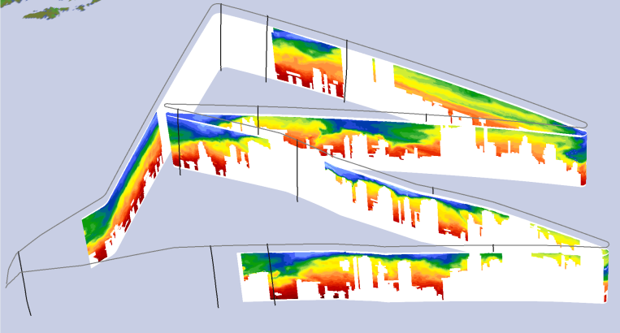
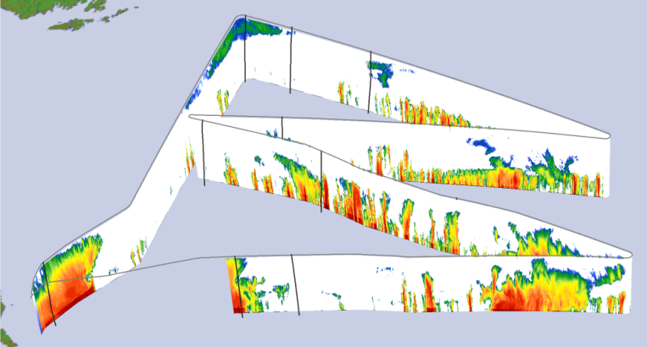
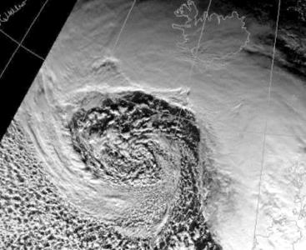
NARVAL Next-generation Aircraft Remote Sensing for Validation Studies
Flight 12 January 2014 out of Keflavik (Iceland)
Lidar Backscatter ratio
1064 nm
Lidar Water vapour
mixing ratio
Radar Reflectivity
N
o

Slide 6
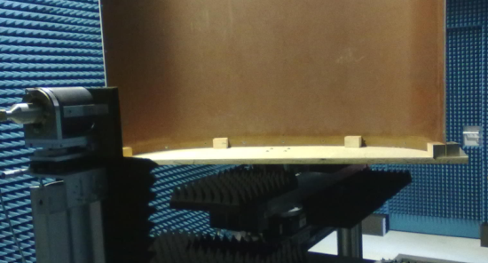
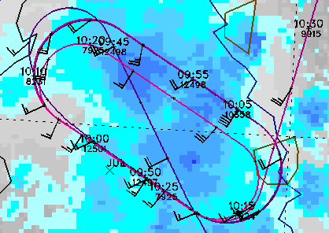
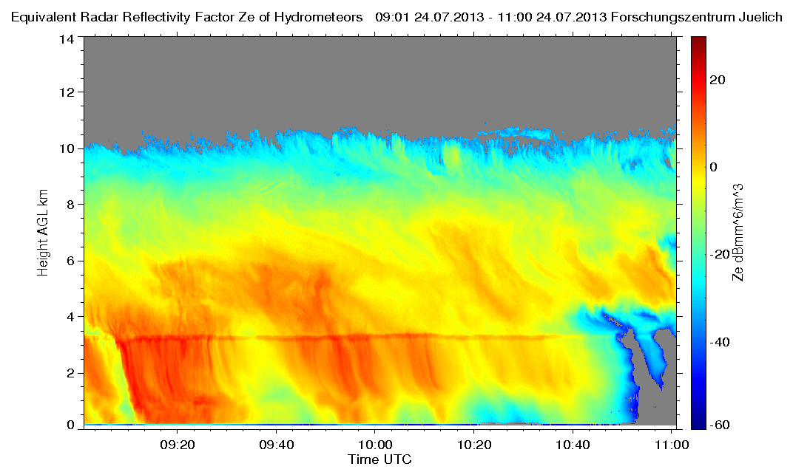
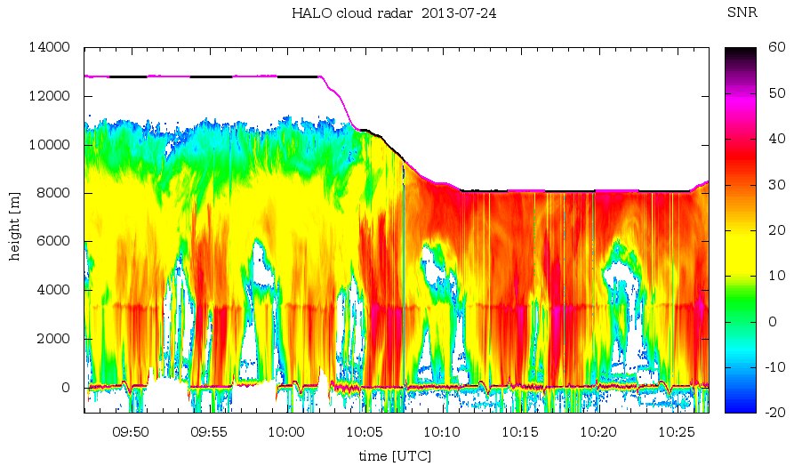
Calibration Issues
Radar calibration
Manufacturer calibration for trailer version
Rearrangement for aircraft usage (avoidance of leakages)
Longer and bended wave guides (0.7 dB/m one-way)
Losses by radome plate (1.2 dB one-way)
Comparison during flights over ground- based MIRA-35, Cloudsat underpass, joint flight HALO – French Falcon (2013), or calibration using sea-scatter
Jülich Cloud Radar
HALO Cloud Radar

Slide 7
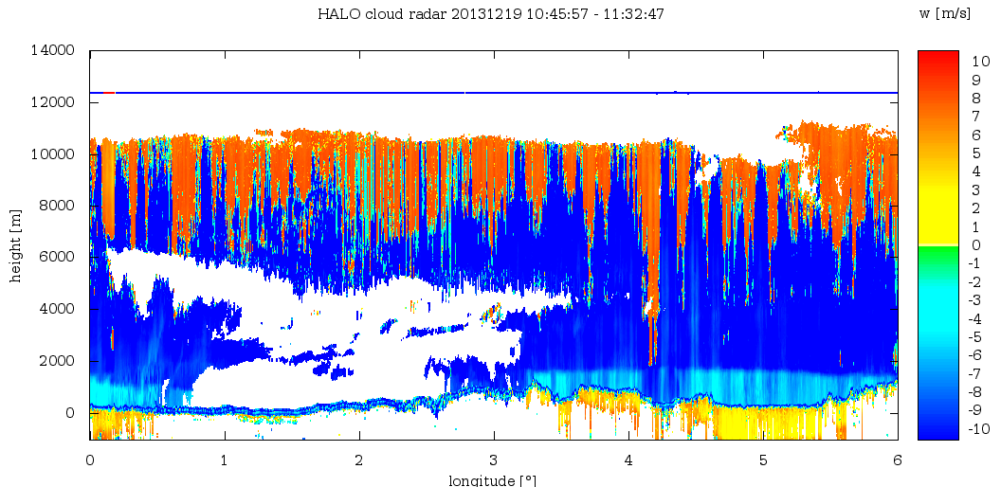
HALO Cloud Radar Challenges
Calibration
loss through radome plate 1.5 dB one-way (different estimations, measurements at one point in radome only)
intercomparison with other MIRA35, but also other radars
Sensitivity issues: boundary water clouds are 10 – 14 km away from radar; broadening of spectra reduces power in spectral peak
Doppler velocity = vertical air motion + fall speed of hydrometeors
HALO aircraft motion does contaminate Doppler velocities
folding of Doppler spectra → spectral data processing
wind profile required

Slide 8
HAMP Operational Constraints
Two operator(s) for cloud radar + radiometers
Pre-heating before operation:
Cloud radar: approx. 5 minutes
Radiometers: approx. 2 hours before take-off calibration (30 minutes) with liquid nitrogen before each flight
Saturation of radar receiver by sea (earth) surface ➔ minimum flight height: FL 160 (5 km) (we don’t know the real lowest height, but we don’t want to burn the receiver)
Maximum range of radar 15 km; but ground echo preferred; forward pitch to be considered ➔ maximum flight height: FL 450 (13.7 km)

Slide 9
HAMP Radar Calibration
Radar calibration:
inter-comparison with Cloudsat and GPM satellites: underpasses of satellites during research flights
NAWDEX: inter-comparison with French F20 RASTA 95 GHz cloud radar: joint underpasses of Cloudsat with French F20
NAWDEX: inter-comparison with ground-based cloud radars: overpasses over Mace Head (Ireland), Chilbolton (UK), Jülich (DE), Cabauw (NL)
dedicated calibration patterns: circles over sea with 10° bank (approx. 15 minutes per circle) preferred during one or two research flights (maybe over calm and over rough sea)

