Slide 1
Paper Review Satellite based cloud profiling radars
Lamer et al, 2020 – AMT,
Mind the gap part 1 - Accurately locating warm marine boundary layer clouds and precipitation using spaceborne radars
Battaglia et al, 2020 – AMT,
Mind the gap part 2 – Improving quantitative estimates of cloud and rain water path in oceanic warm rain using spaceborne radars
Battaglia et al, 2020 – Review of Geophysics,
Spaceborne Cloud and Precipitation Radars: Status, Challenges, and Ways Forward

Slide 2
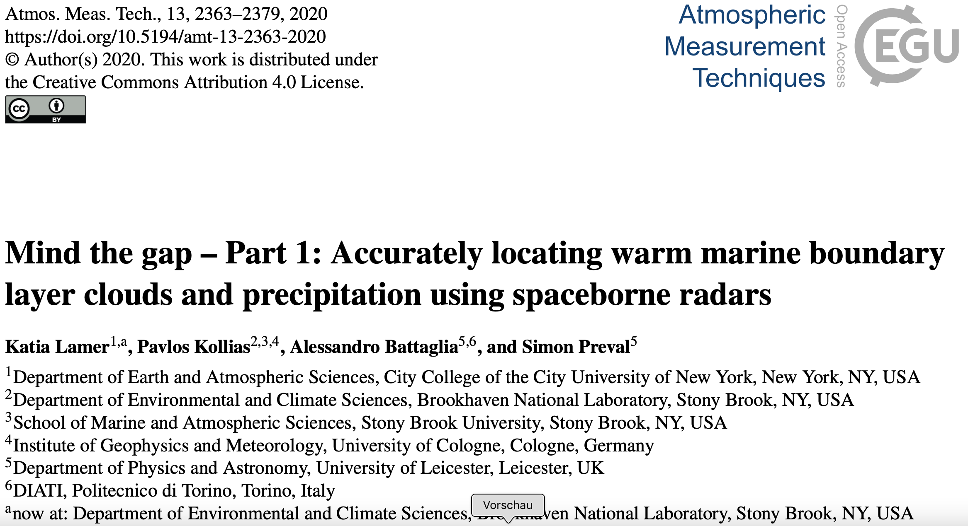
Paper Review Satellite based cloud profiling radars

Slide 3
Introduction/Motivation:
Warm Marine Boundarylayer Clouds (WMBC) are important for global radiation budget – high uncertainty
Milimeter cloud radars are able to detect these clouds – cloud structure, precipitation onset, disdtibution
2006 first space born radar - CloudSat
2006 first space born radar - CloudSat
30% - 50% of all columns contain WMBC are detected
Ground based data suggest 70% - 80% WMBC
Not all are detected – detection limit to low, surface clutter, to large food print (1.4 km to 0.24km)
Can future space born missions improve the detection?

Slide 4
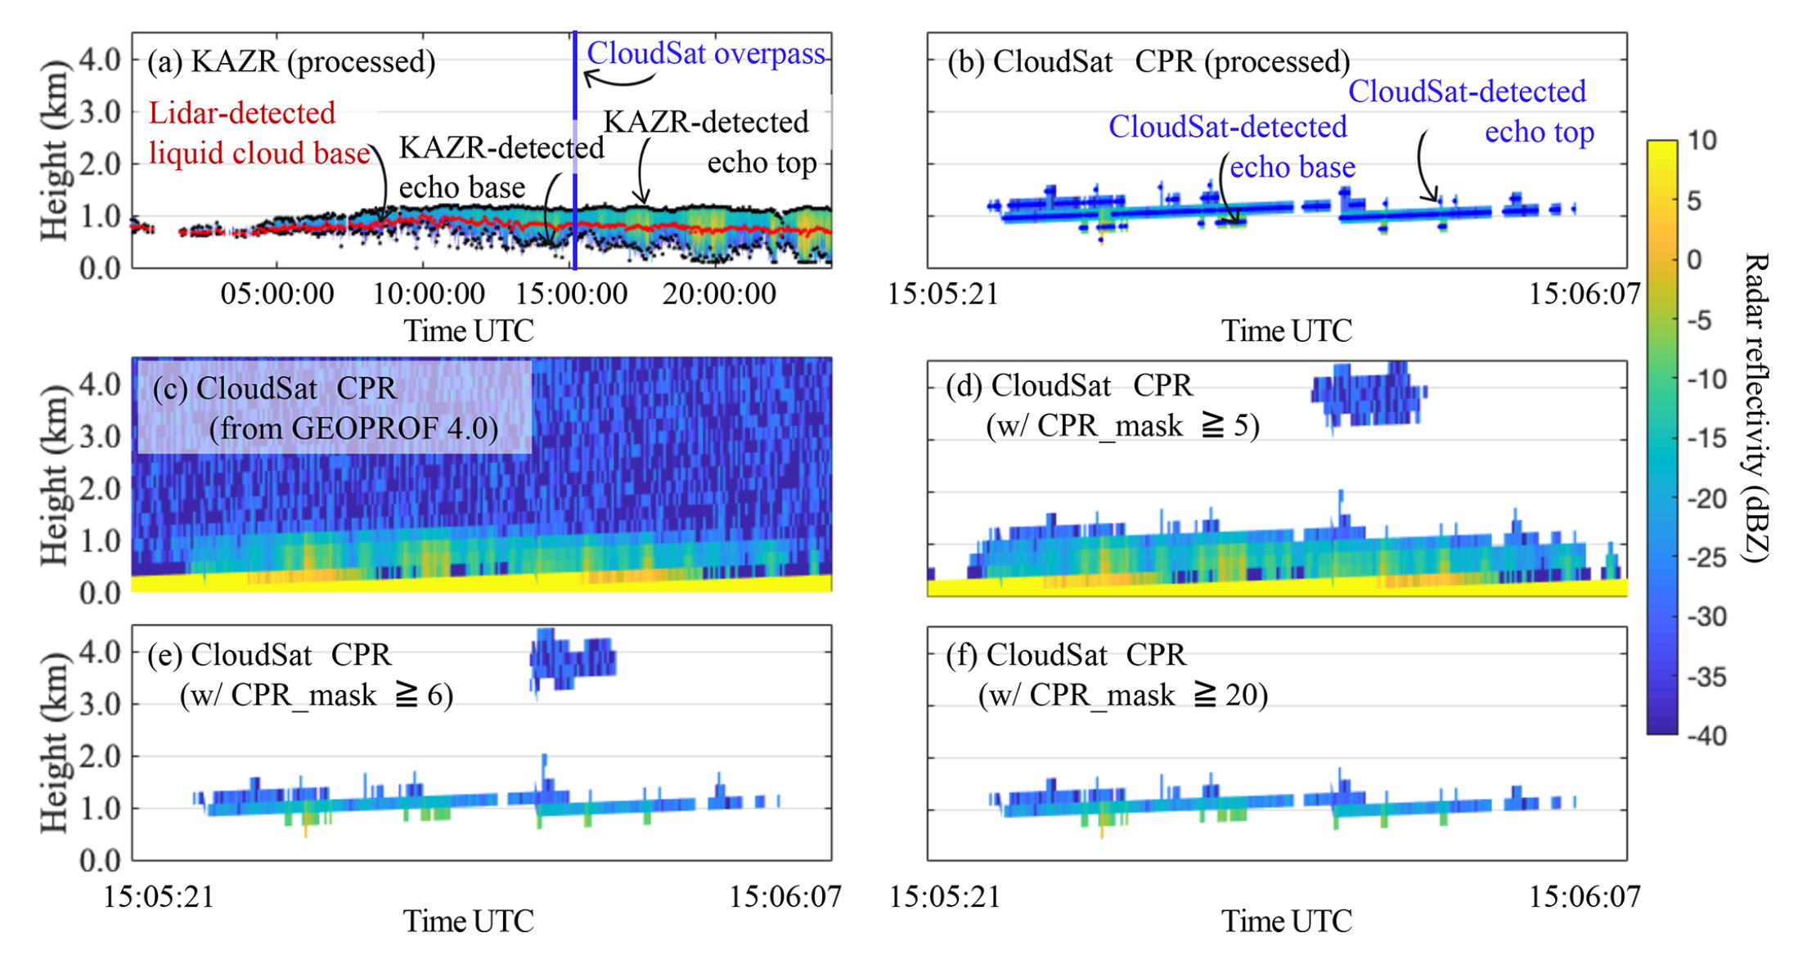
CloudSat and ground based data sets:
a) Ground-based Radar
Conservative filtering of the CloudSat data GEOPROF V4
Finally in this study are analyzed
~138 CloudSat overpasses
~719 days of ground based data
To find out:
characterize the properties of WMBL clouds and precipitation
evaluate the performance of theoretical radar architectures in detecting those clouds

Slide 5
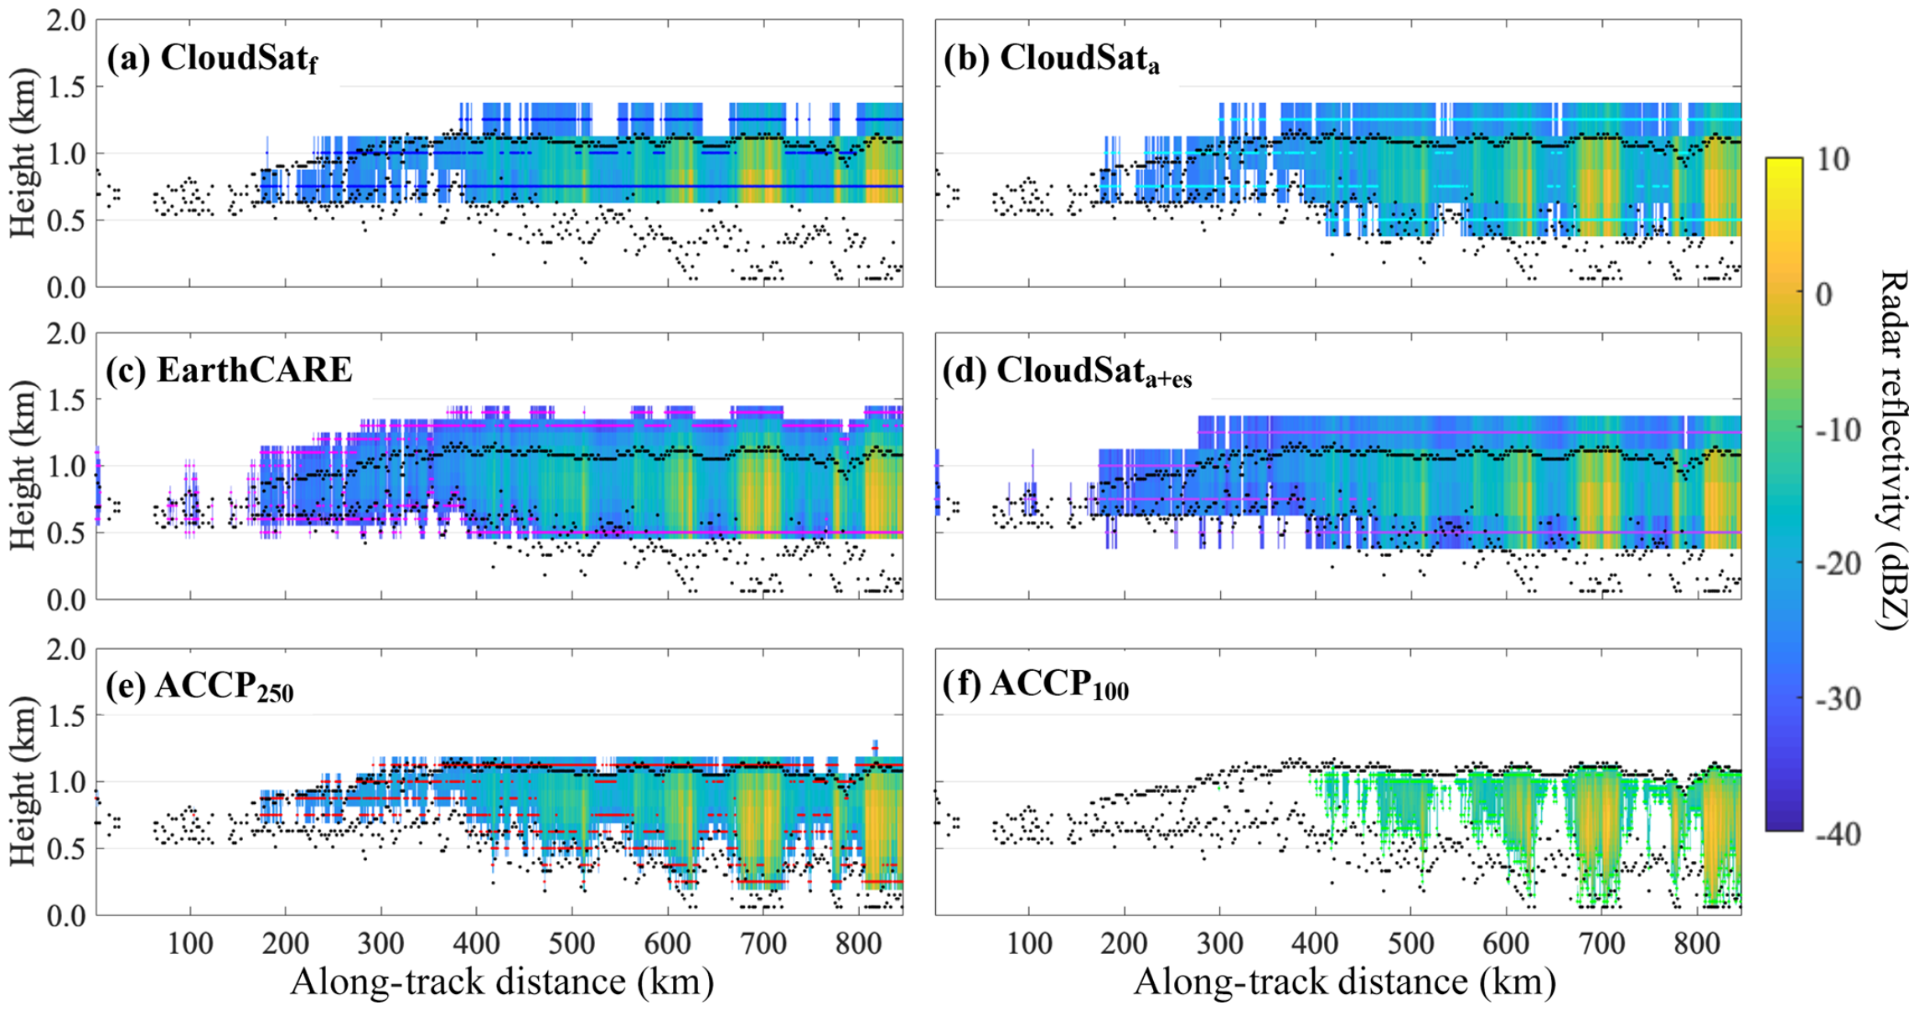
Forward simulation of ground based to Sat view:
Take ground based data and resample them based on know or possible satellite born radar specifications
Enhance sensitivity
Enhanced horizontal and vertical sampling
Different point target response
Statistical analysis of the data sets to evaluate detection of WMBC from scape

Slide 6
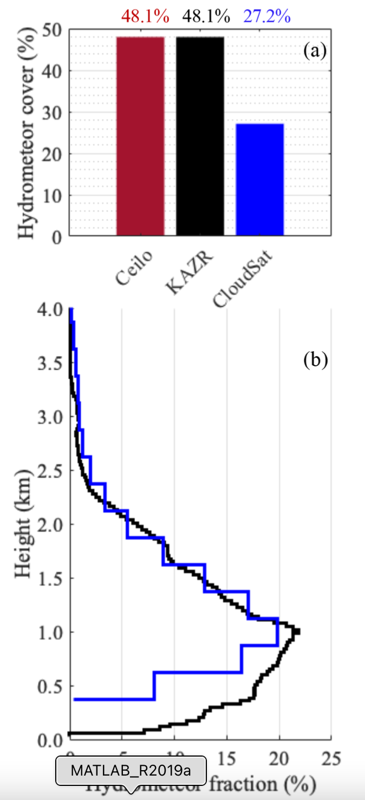
CloudSat vs ground
Compare 138 overpasses with comparable measurements from ground
Only 40% of clouds detected from CloudSat
Profile is represented good

Slide 7
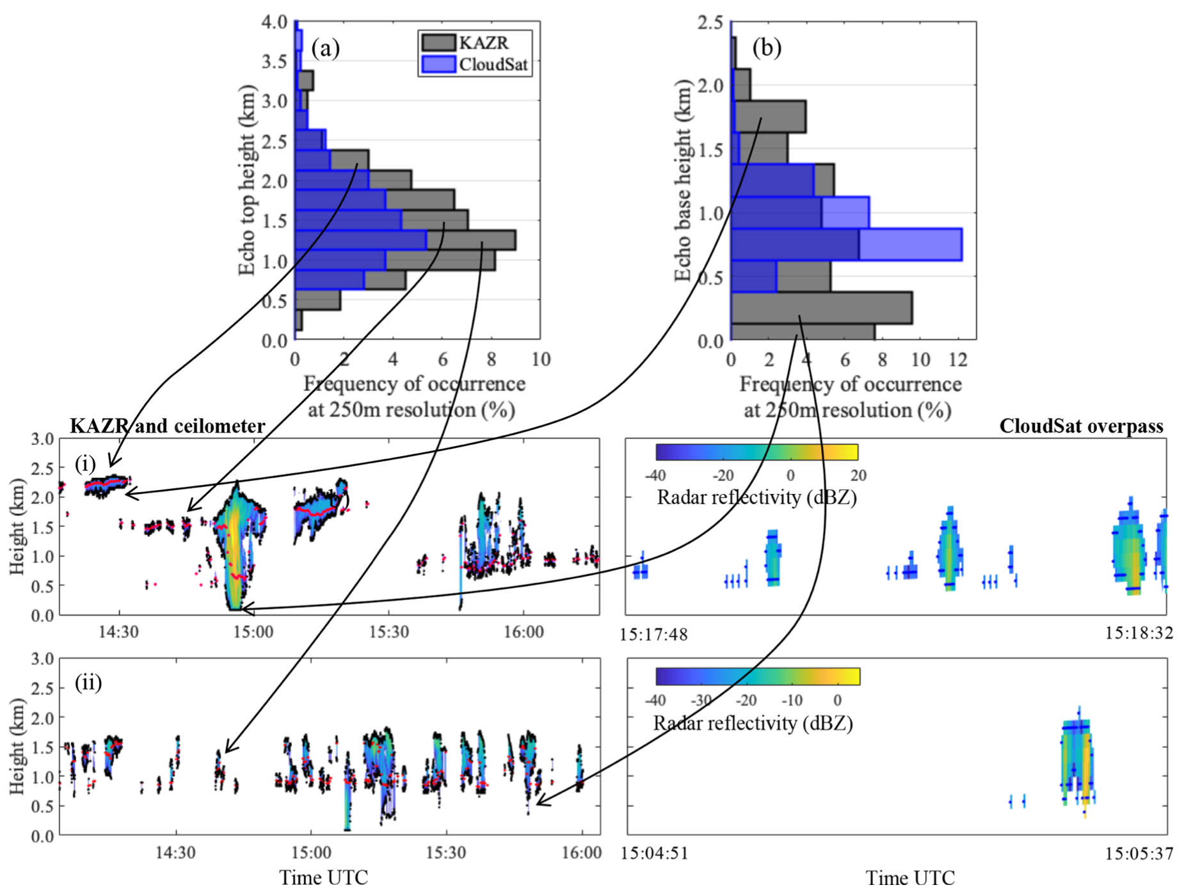
CloudSat vs ground
Compare 138 overpasses with comparable measurements from ground
Only 40% of clouds detected from CloudSat
Profile is represented good
A closed look identifies:
broken cloud decks are challenging for CloudSat (a)
Missing of low reflectivity clouds (a)
CloudSat misses low clouds – misses true cloud base ~50% (b)
Surface clutter can enhance detection of low clouds (b)

Slide 8
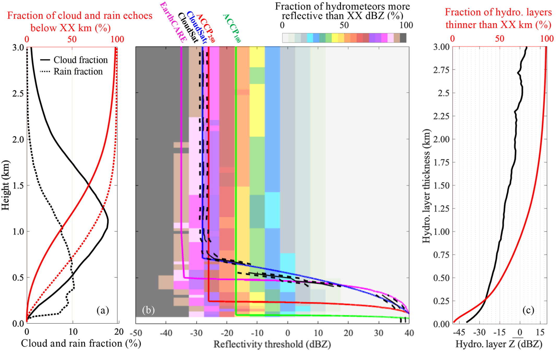
CloudSat vs ground
Analyzing ground based data set shows:
CloudSat miss 80% of all clouds below 0.75 km (b)
Which are 20% of all clouds
~50 % of all rain (b)
Surface clutter can enhance detection of low clouds (b)
Which configuration would be the best to improve detection?
Simulations based on 719 days data set.

Slide 9
Forward simulation of ground based to Sat view:
Take ground based data and resample them based on know or possible satellite born radar specifications
Enhance sensitivity
Enhanced horizontal and vertical sampling
Different point target response
Statistical analysis of the data sets to evaluate detection of WMBC from scape

Slide 10
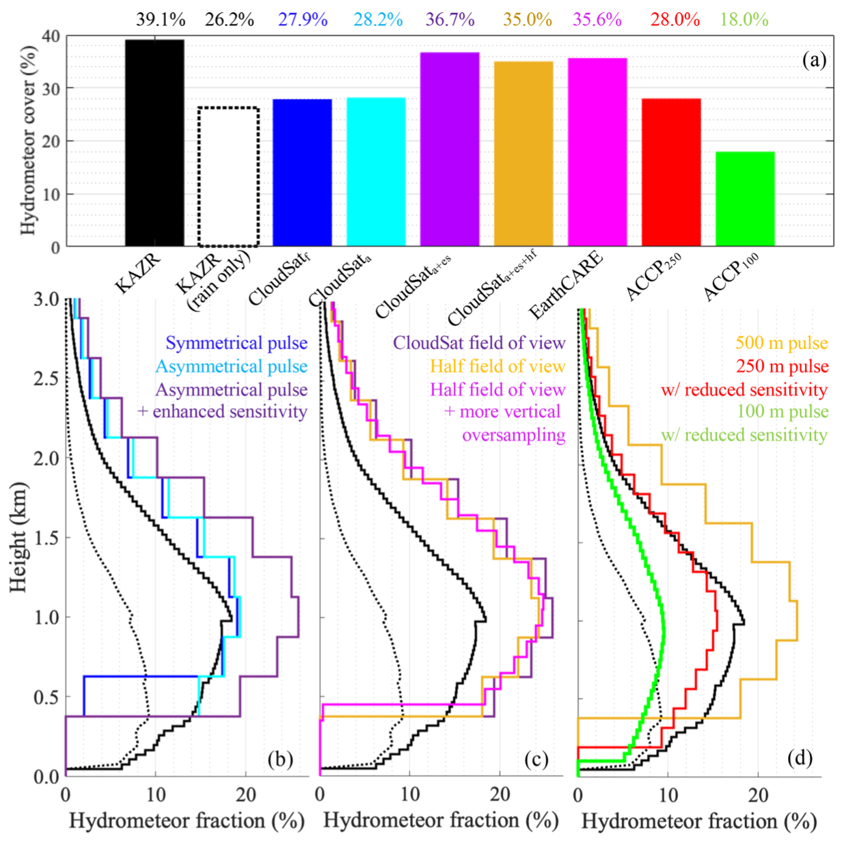
Simulation vs ground
Different pulse forms:
The pulse shape alone does not increase the detectability of WMBC
Enhanced sensitivity introduces partial beam filling and more clouds detected (+7% cloud detection)
Different resolutions:
Oversampling creates higher range resolution
Connection between the range gates soothes out these effect
Different sensitivities:
Shorter pulse -> higher range resolution -> accurate cloud boundaries but decrease sensitivity
Different
pulse
Different
resolutions
Different
sensitivity

Slide 11
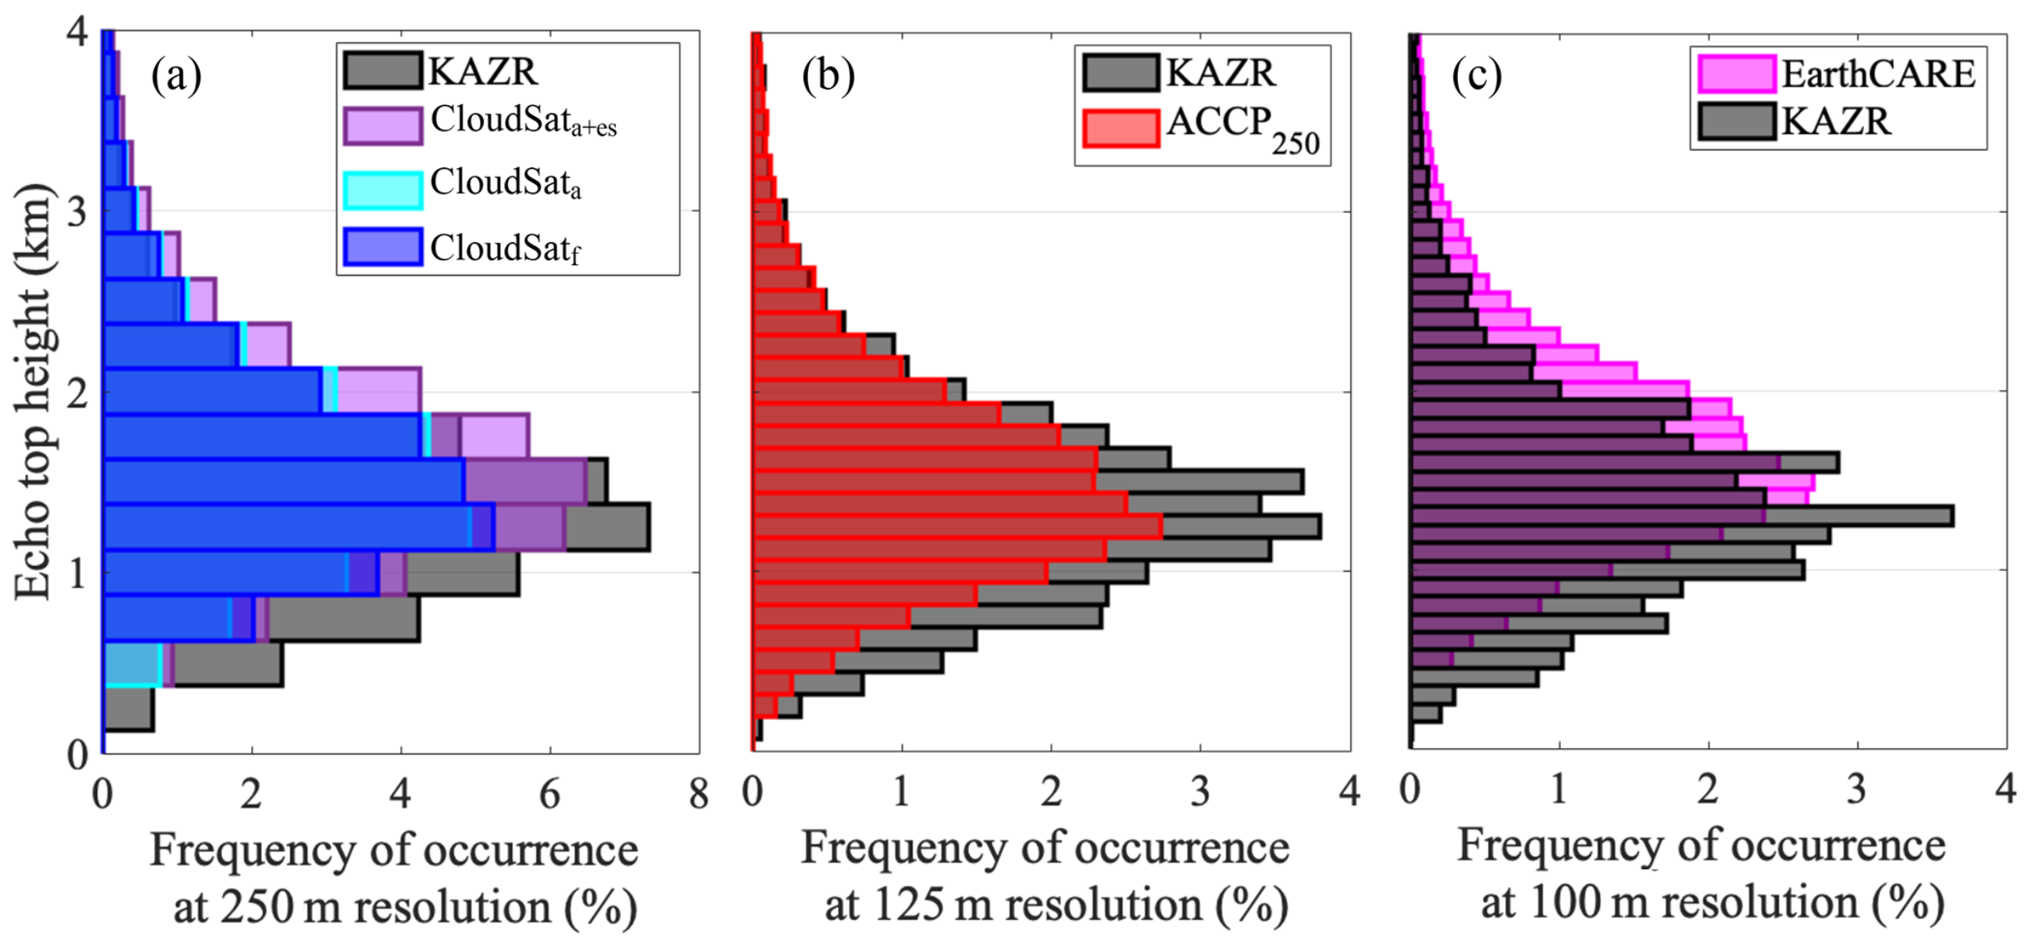
Conclusion:
Warm Marine Boundary layer Clouds will remain a hard to detect cloud
50% below 400m in the ground based data set
50% have Ze < -22 dBZ hard to detect from space
Sum cloud rain might overlap all the time with the ground echo
All configurations come with benefits and disadvantages
So before launch the target of interest has to be know so that the right configuration can be chosen
EarthCare will be able to detect about 7% more clouds then CloudSat
However the vertical profile is all and all represented good – over sampling leas to higher cloud tops
Future satellite missions might think of a combination of configuration to improve the detection of low clouds

