Slide 1
New cloud detection method for a stand-alone ground based microwave radiometer
Moritz Löffler^{1,2}, Christine Knist ¹, Jasmin Vural ¹, Ulrich Görsdorf ¹, Ulrich Löhnert ²
¹ Deutscher Wetterdienst, ² Universität zu Köln

Slide 2
Microwave radiometer (MWR)
MWR are passive remote sensors
Used for water vapor (WV) & temperature (T) profiling and determining liquid water path (LWP)
DWD is exploring cost & benefit of operation
UP1.5 – 7.9. 9:00 „DWD Pilotstation“ C. Knist et al.
HATPRO G5 at observatory in Lindenberg (DWD)

Slide 3
Theory of MWR operation
Oxygen
Thermal emissions of atmosphere are recorded as brightness temperatures (Tb)
WV- and T-profiles and LWP retrieved with inverse radiative transfer models
Profile retrieval possible in cloudy-sky conditions
However, a cloudy/clear-sky classification is valuable for data assimilation
Water vapor
Liquid water
Contributions to spectral absorption coefficient by liquid water, water vapor and oxygen. Grey lines indicate spectral position of MWR (HATPRO G5) receiver frequencies.

Slide 4
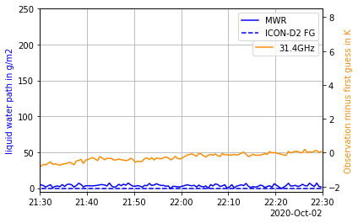
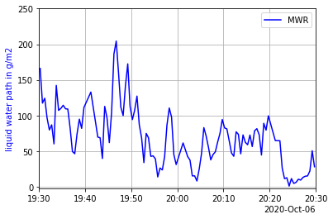
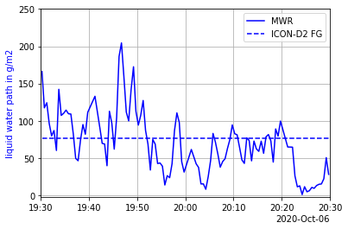
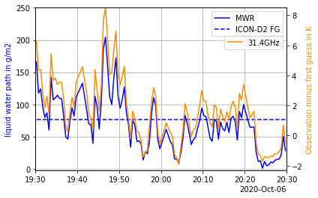
Clear-sky vs. cloudy variability (LWP & Tb)
LWP varies in clouds
This leads to random differences in model comparisons
Also in observation space (Tb)
This representativity error of the observation minus first guess (model equivalent) is important for data assimilation
OSA1.5: “Assimilating MWR and Doppler-lidar observations”, J.Vural, Wed. 7.9.’22 11:30
Cloudy
Clear
MWR observation and first guess (ICON-D2) of LWP and difference of obs. and first guess at 31.4GHz; A clear and a cloudy case.

Slide 5
State of the art cloud detection
“empirical method” relies on threshold of variability of LWP or Tb and IR-radiometer observations.
Limited to zenith observations only
Elevation scans increase information content of MWR retrieval products
New cloud detection required for elevation scans
Scheme of MWR boundary layer scan.
UP 1.5 – 7.9.‘22 14:30, „Influence of obstacles on MWR“, T. Böck

Slide 6
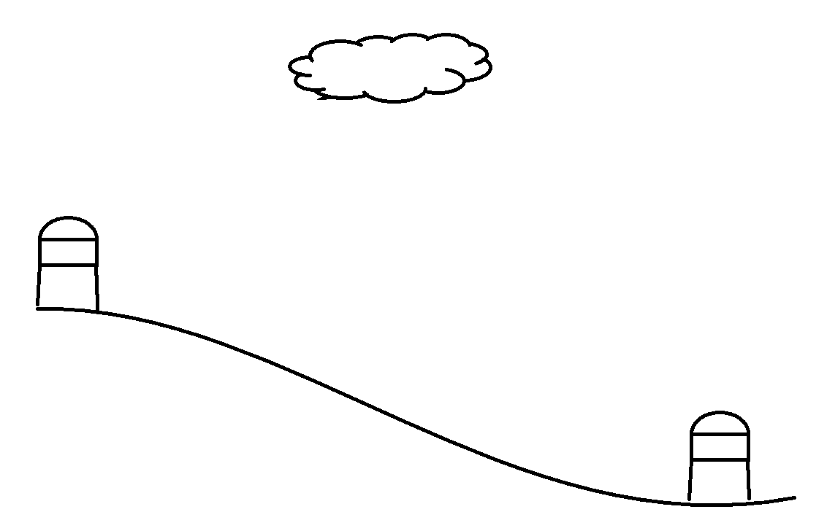
Objectives for cloud detection
Liquid cloud detection for a stand alone MWR
Adapted to site specific climate and geography
Relying on ubiquitous data (e.g. reanalysis)
Applicable also to off-zenith observations

Slide 7
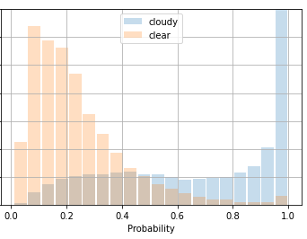
Implementation of a machine learning classifier
Datasets
Tb(IR, MW)
Std(Tb)
…
Cloud cover
CloudNet target class.
Prediction
threshold
Probability
Input
train
Clear/
no-liquid
classifier
predict
Random forest
Neural network
…
Ground truth
test
Cloudy/ liquid

Slide 8
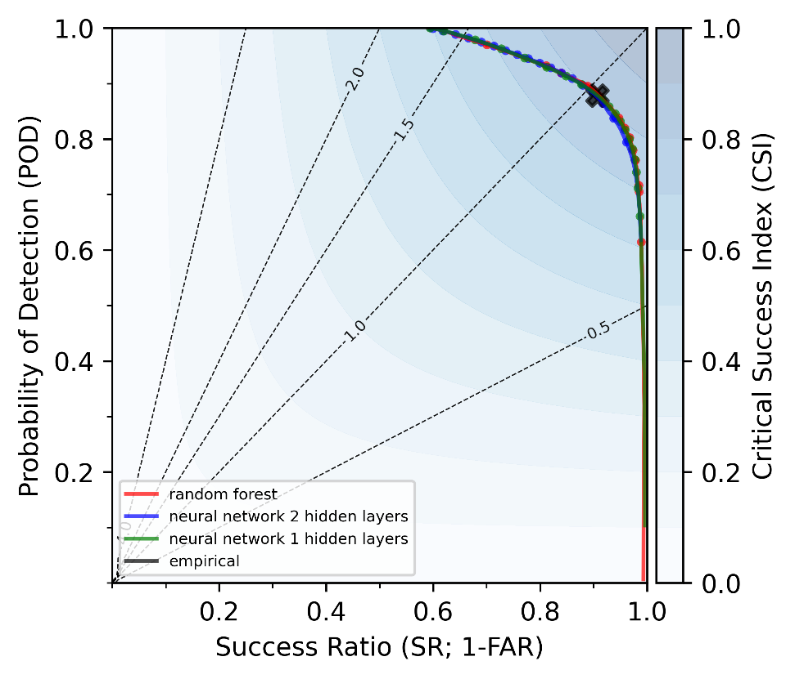
Cloud detection trained with zenith observations
Input:
MWR observations: Tb_IR & Std(Tb@31.4GHz)
(Length dataset: ~870 000 times, ~1.5 y)
Ground truth:
CloudNet target classification
(Synergy product of cloud radar, ceilometer and MWR, with cloud properties and profile information. See www.cloudnet.fmi.fi )
Intercomparison of classifiers:
(Empirical method, neural network (NN) with 1 hidden layer, NN with 2 hidden layers, random forest)
Performance of all classifiers similar to another (also empirical classifier)
Similar results with higher dimensional input
ML approach and training dataset are suitable to replace empirical method in zenith
Performance diagram of machine learning based classifiers for cloud detection. Black cross is empirical method.

Slide 9
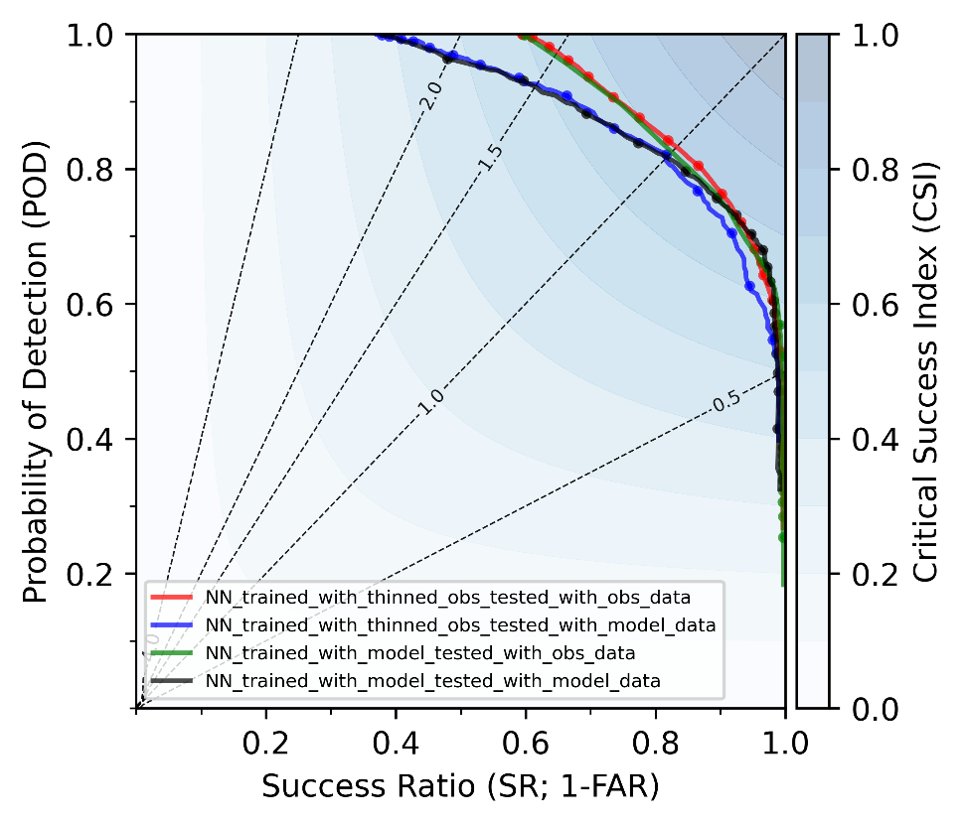
Cloud detection trained with modelled zenith observation
Input:
Tb all 14 channels computed radiative transfer model RTTOV-gb from ICON-D2 first guess model fields
or MWR observations: Tb all 14 channels
(Length dataset: ~15 000 times, ~1.5 y)
Ground truth:
ICON-D2 model fields
or CloudNet target classification
Intercomparison of classifiers:
Only NN with 2 hidden layers
Larger dataset required for training NN classifier
After thinning: classifier trained with observed data has similar performance as classifier trained with modelled data.
Performance diagram of ML based classifiers for cloud detection. Tested on datasets with different event rates

Slide 10
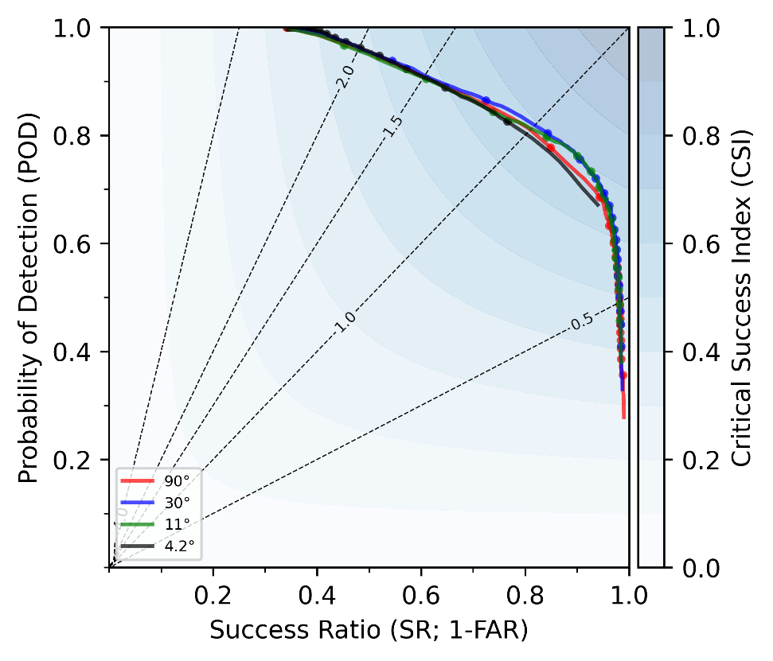
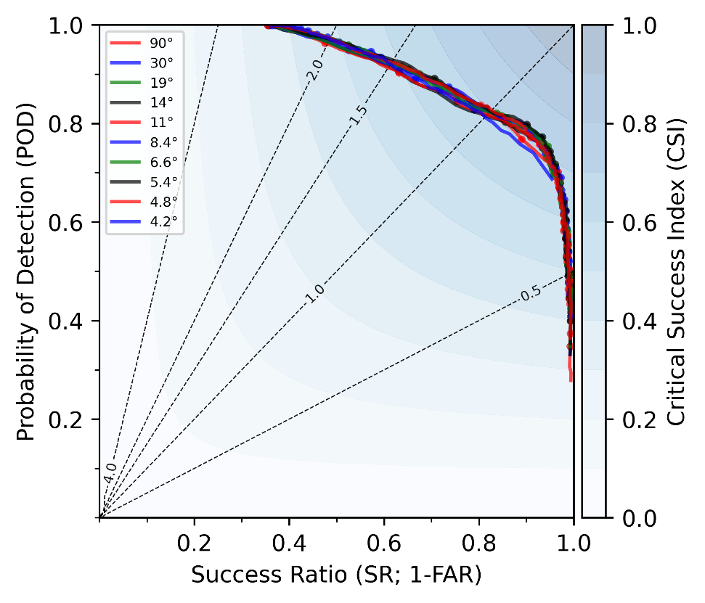
Cloud detection trained with modelled elevation scans
Input:
Tb all 14 channels computed radiative transfer model RTTOV-gb from ICON-D2 first guess model fields
(Length dataset: ~15 000 times, ~1.5 y)
Ground truth:
ICON-D2 model fields
Intercomparison of classifiers:
Only NN with 2 hidden layers
Promising results for all elevation angles
Worse performance at lowest elevation angles and zenith
High probability of detection leads to high false alarm rate
Modification of ground truth might help symmetry
Performance diagram of ML based classifiers for cloud detection. Tested and trained on ICON-D2 first guess dataset. Moved to observation space (Tb) with RTTOV-gb.

Slide 11
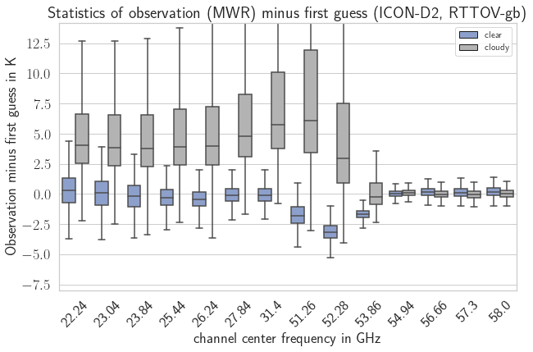
Observation minus Model-equivalent (OMe) statistics Zenith
OMe-stats. is symmetric for clear-sky
Ome-stats. have a smaller variability for clear-sky
Channels above 54GHz unaffected by liquid clouds
Expectations are met
NN detects relevant clouds

Slide 12
Outlook
Train cloud detection with a large reanalysis dataset (e.g. ERA5)
For this use more precise line by line radiative transfer model
Assimilation experiments with cloud flagged elevation scans

Slide 13
Summary
Off-Zenith: Liquid cloud detection for ground-based MWR is not available.
In Zenith: Machine learning based cloud detection can keep up with empirical cloud detection
Also if they are trained with NWP predictions
Off-Zenith: First results indicate the applied machine learning approach can detect clouds sufficiently.
Better interpretability of MWR observations.
Possibly benefit the impact of assimilating ground based MWR.

