Slide 1
ExOb Meeting 4.4.2022
Retreat
MIA: Tobias Böck
…
1

Slide 2
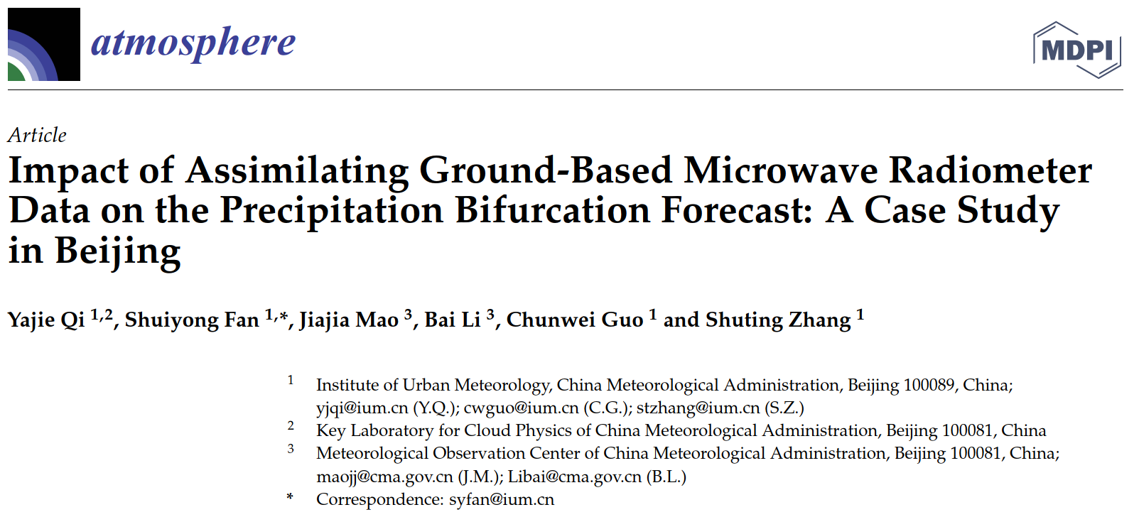
ExOb Meeting 4.4.2022: MIA TB
Impact of Assimilating Ground-Based Microwave Radiometer Data on the Precipitation Bifurcation Forecast: A Case Study in Beijing (2021)
Yajie Qi, Shuiyong Fan, Jiajia Mao, Bai Li, Chunwei Guo and Shuting Zhang
2

Slide 3
My Motivation
My PhD work:
Integration of ground-based thermodynamic profilers into the DWD forecasting system (TDYN-PRO)
EMF III: The potential of ground-based thermodynamic profilers for improving short-term weather forecasts
Q1: Are the considered state-of-the-art ground-based profilers accurate and reliable enough for data assimilation at DWD?
Q2: Do these profilers provide enough information content to have a measurable impact on the short-term forecast?
Also important for E-PROFILE (EUMETNET)
3

Slide 4
Paper Overview
T- and H- profiles assimilated into the rapid-refresh multi-scale analysis and prediction system-short term (RMAPS-ST)
The precipitation bifurcation prediction that occurred in Beijing on 4 May 2019 was selected as a case
belt-shaped radar echo splitting (→bifurcation: “Gabelung”)
Experiment 1: DA of conventional data and radar
Experiment 2: DA of conventional data and radar plus MWR data
4

Slide 5
Prior studies
“Caumont et al. (2016) assimilated the proﬁles retrieved by multiple ground-based microwave radiometers into the mesoscale prediction system, the results showed that the impact was neutral and only works for large-scale precipitation.”
5

Slide 6
Their Motivation
Beijing:
embraced on three sides by mountains
urban heat island effect
other urban effects
this increases the difficulty and uncertainty of precipitation forecast.
At the moment, forecast is incapable of predicting local rainfall reliably
6

Slide 7
Methods
Instruments:
5 MWRs
level 2 data (T- and H-profiles)
retrieval by manufacturer
2min resolution
what instrument model, manufacturer, retrieval used?
Model:
rapid-refresh multi-scale analysis and prediction system-short term (RMAPS-ST). → DA: 3DVar
Resolution: 9km China wide, 3km over northern China, nested into ECMWF medium-range forecast model
3h cycling runs
7

Slide 8
Results Overview belt-shaped radar echo splitting over Beijing on 4 May 2019 (case study)
8

Slide 9
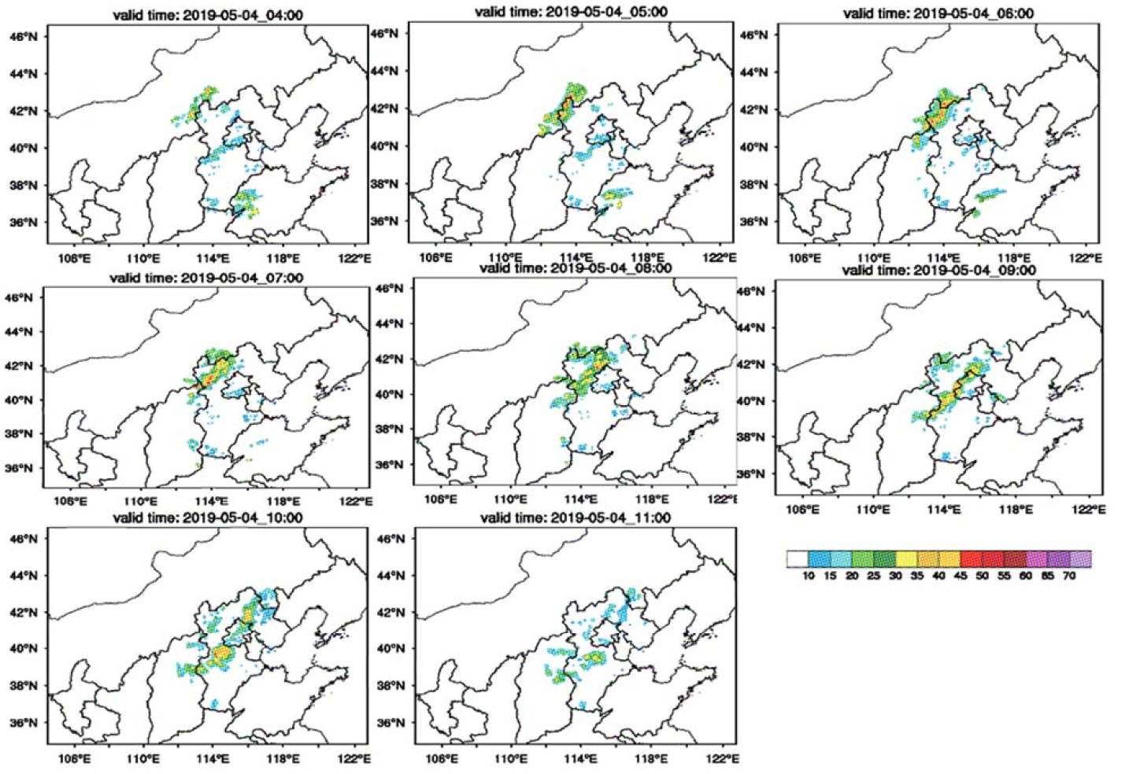
Observed Radar Reflectivity
9

Slide 10
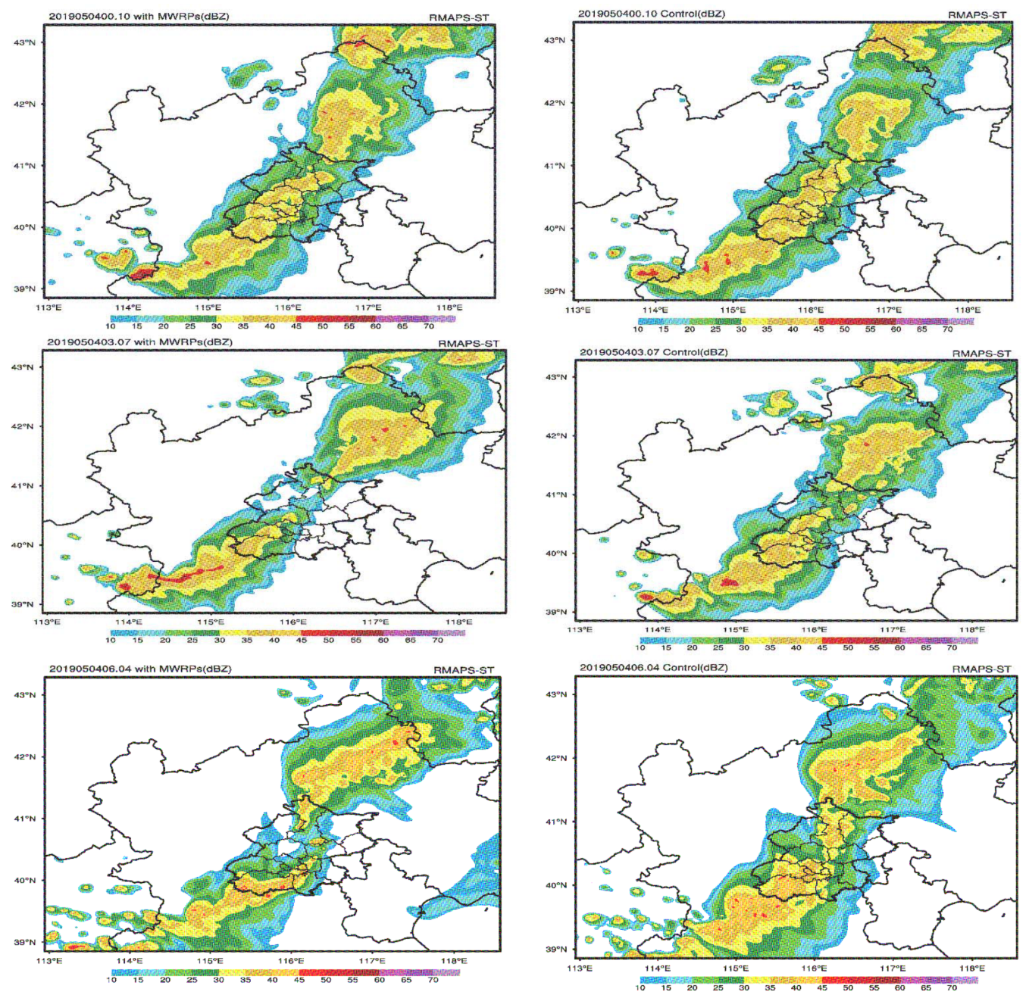
Composite Radar Reflectivity Forecast
with MWRs
without MWRs
belt-shaped echo splitting is better reproduced
cannot reproduce the observed belt-shaped echo splitting
10

Slide 11
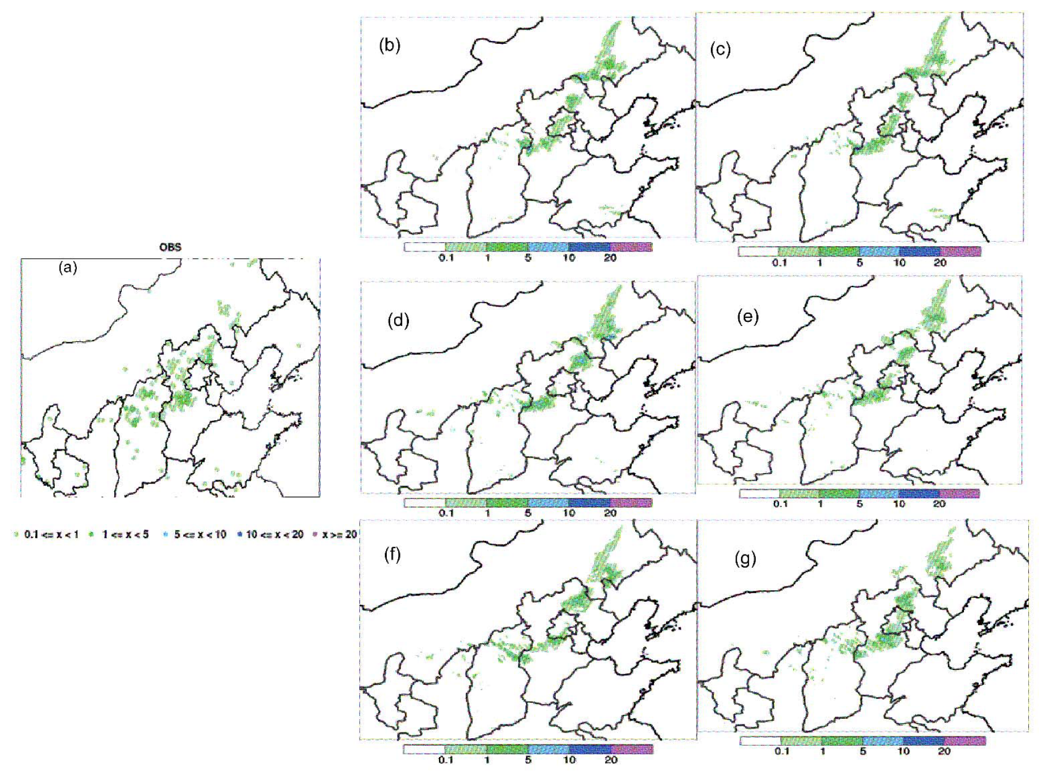
1h accumulated Precipitation Forecast
with MWRs
without MWRs
OBS
Forecast with MWRs matches better with the observed precipitation intensity than forecast without MWRs
11

Slide 12
Paper Summary
RESULTS: Forecasts with MWRs:
reasonable adjustments for the thermal conditions in time, better reproducing the weak heat island phenomenon in the observation prior to the rainfall
improved the skills of the precipitation forecast in both the distribution and the intensity of rainfall precipitation, capable of predicting the process of belt-shaped radar echo splitting
improved the skills of the quantitative precipitation forecast to a certain extent
12

Slide 13
Thank you for your attention!
13

