Slide 1
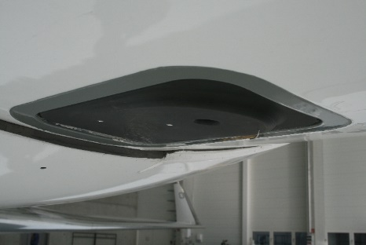
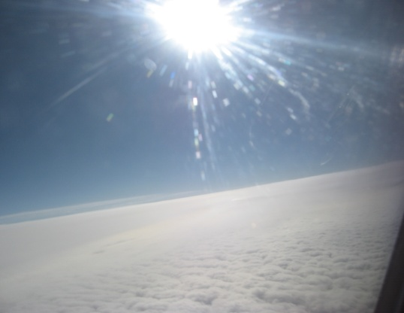
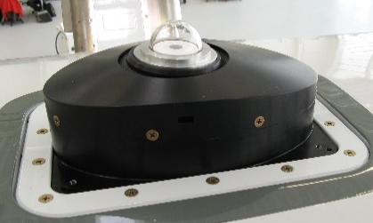
Remote sensing of clouds
with
SMART-HALO
Institute for Meteorology
Kevin Wolf,
André Ehrlich,
Manfred Wendisch
NARVAL-II, Cologne, 11.-12.05.2016

Slide 2
current status:
mounting for SMART-HALO optical inlets ready for assembly
„radiometric“ calibration by end of May
instrument checkup at Enviscope begin of June
NARVAL-II, Cologne, 11.-12.05.2016

Slide 3
Requirements and constrains:
passive remote sensing -> daytime measurements
avoid low solar elevation (15°) (08.08.: 06:50 – 17:15 AST*)
(31.08.: 06:55 – 17:05 AST*)
cabin temperature (T < 30°C)
Preferred flight pattern:
straight legs (min. 5 minutes)
-> covering several ECMWF IFS gridpoints ( 9 km )
no / minimum spirals, turns or circles
above clouds (at least 500 ft)
coordination with satellite overpass
*AST = Atlantic Standard Time (UTC-4)
NARVAL-II, Cologne, 11.-12.05.2016

Slide 4
Calibration (flight):
radiation box (for downward Irradiance)
4 x 2 min legs
ground calibrations (~1 h, between flights)
NARVAL-II, Cologne, 11.-12.05.2016

Slide 5
References:
ECMWF- Atmospherics Physics (http://www.ecmwf.int/en/research/modelling-and-prediction/atmospheric-physics)
ECMWF - Detailed information of implementation of IFS cycle 41r2 (https://software.ecmwf.int/wiki/display/FCST/Detailed+information+of+implementation+of+IFS+cycle+41r2)
ECMWF IFS DOCUMENTATION - Cy40r1 (http://www.ecmwf.int/sites/default/files/elibrary/2014/9204-part-iv-physical-processes.pdf)
Morcrette, J.-J., Mozdzynski, G., Leutbecher, M.: A Reduced Radiation Grid for the ECMWF Integrated Forecasting System, Mon. Weath. Rev., 2008
NARVAL-II, Cologne, 11.-12.05.2016

