Slide 1
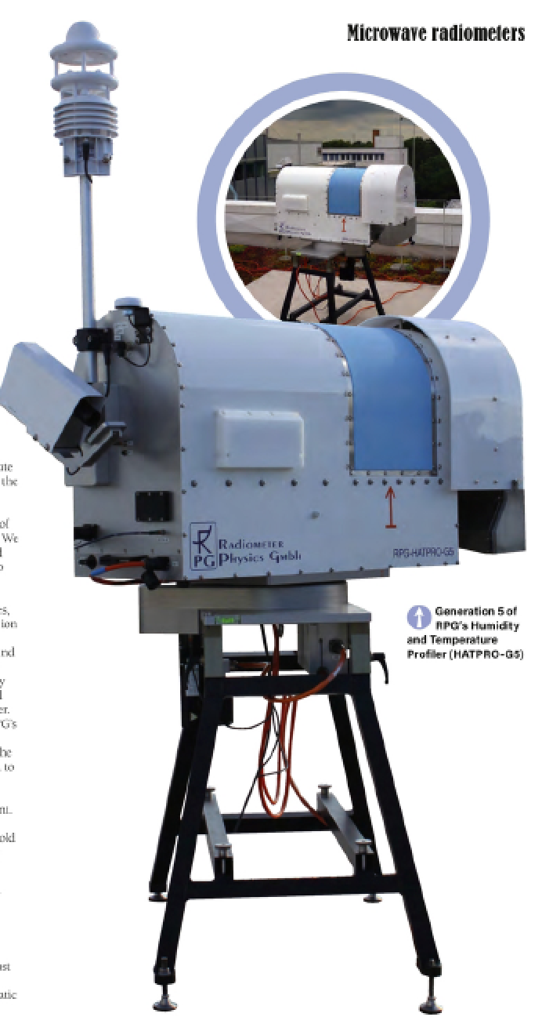
DACH2022 Meteorologie Tagung, Mar. 25th 2022
Session topic DACH-7: Research infrastructures in weather and climate research
Uncertainty Assessment for HATPRO Microwave Radiometer Measurements and Calibrations
Institute for Geophysics and Meteorology, University of Cologne | Tobias Böck, Bernhard Pospichal, Ulrich Löhnert

Slide 2
Motivation
The atmospheric boundary layer (ABL) is the most important under-sampled part of the atmosphere*
For NWP applications, the top-priority atmospheric variables like temperature (T) and humidity (H) profiles are not currently adequately measured**
T and H profiles can be obtained by ground-based microwave radiometer (MWR) observations
Yet MWR observations are not assimilated by any operational NWP system
*US National Research Council Reports **WMO guidance on observations for NWP: https://www.wmo.int/pages/prog/www/OSY/GOS-RRR.html
2

Slide 3
Goals
Integration of ground-based thermodynamic profilers into the DWD forecasting system (TDYN-PRO)
EMF III: The potential of ground-based thermodynamic profilers for improving short-term weather forecasts
Q: Are the considered state-of-the-art ground-based profilers accurate and reliable enough for data assimilation at DWD?
Also important for E-PROFILE (EUMETNET)*
Related talks and posters here at DACH2022:
Jasmin Vural et al.: Assimilation von bodengebundenen Profiler-Messungen der atmosphärischen Grenzschicht
Moritz Löffler et al.: Cloud detection algorithm for a standalone microwave radiometer
*https://www.eumetnet.eu/activities/observations-programme/current-activities/e-profile/
3

Slide 4
Instrument: HATPRO MWR
Humidity And Temperature PROfiler from Radiometer Physics GmbH
Measures thermal emissions from the atmos-phere in 14 different frequencies (H₂O-band and O₂-band)
Converts these radiances into Brightness Temperatures TBs [K] (through Planck’s law)
allows investigation of (via inversion):
rudimentary humidity profiles
temperature profiles
integrated water vapor (IWV)
liquid water path (LWP)
commercially available for ~10 years, ready for network applications (in principle)
continuous data in all-sky conditions: resolution of seconds to minutes
4

Slide 5
Accuracy of HATPROs (Instrument Errors)
Characterized
systematic errors:
absolute calibration errors, biases
drifts (instrument stability, TB leaps between calibrations)
random errors:
radiometric noise (e.g. via covariance matrices)
through coordinated experiments at JOYCE in Jülich and RAO in Lindenberg (FESSTVaL)
Assessed repeatability of calibrations
Objective: Define & apply procedure for MWR measurement uncertainty characterization for TBs (level1) per channel
→ necessary for data assimilation applications
5

Slide 6
HATPRO Calibration
For calibration, 2 blackbodies are necessary: Coldload and Hotload
Absolute calibration with liquid nitrogen (LN2), Coldload
~77.2 K boiling point
Relative calibration on Hotload every 5 min (automatic; target inside radiometer; a bit above ambient temp.)
6

Slide 7
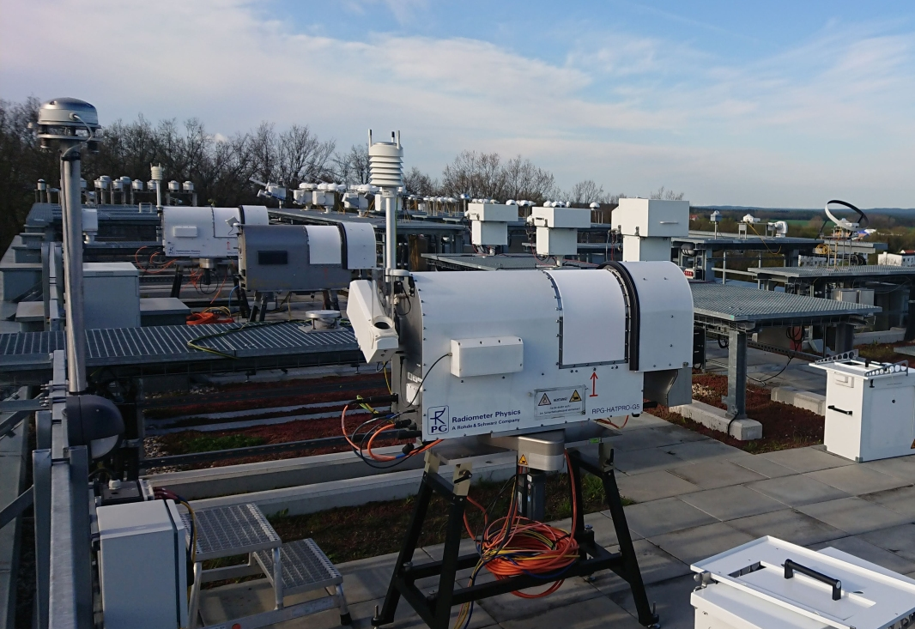
Calibration Campaign at RAO in Lindenberg during FESSTVaL 2021
4 HATPROs on site (FOGHAT G5, DWDHAT G5, SUNHAT G2, HAMHAT G2)
Comparisons of zenith and blackbody measurements (to find out biases, drifts, noise levels, repeatability)
Thanks to Christine Knist for helping with the campaign and to the DWD Observatory in Lindenberg for providing the location and part of the data.
7

Slide 8
Results Overview
8

Slide 9
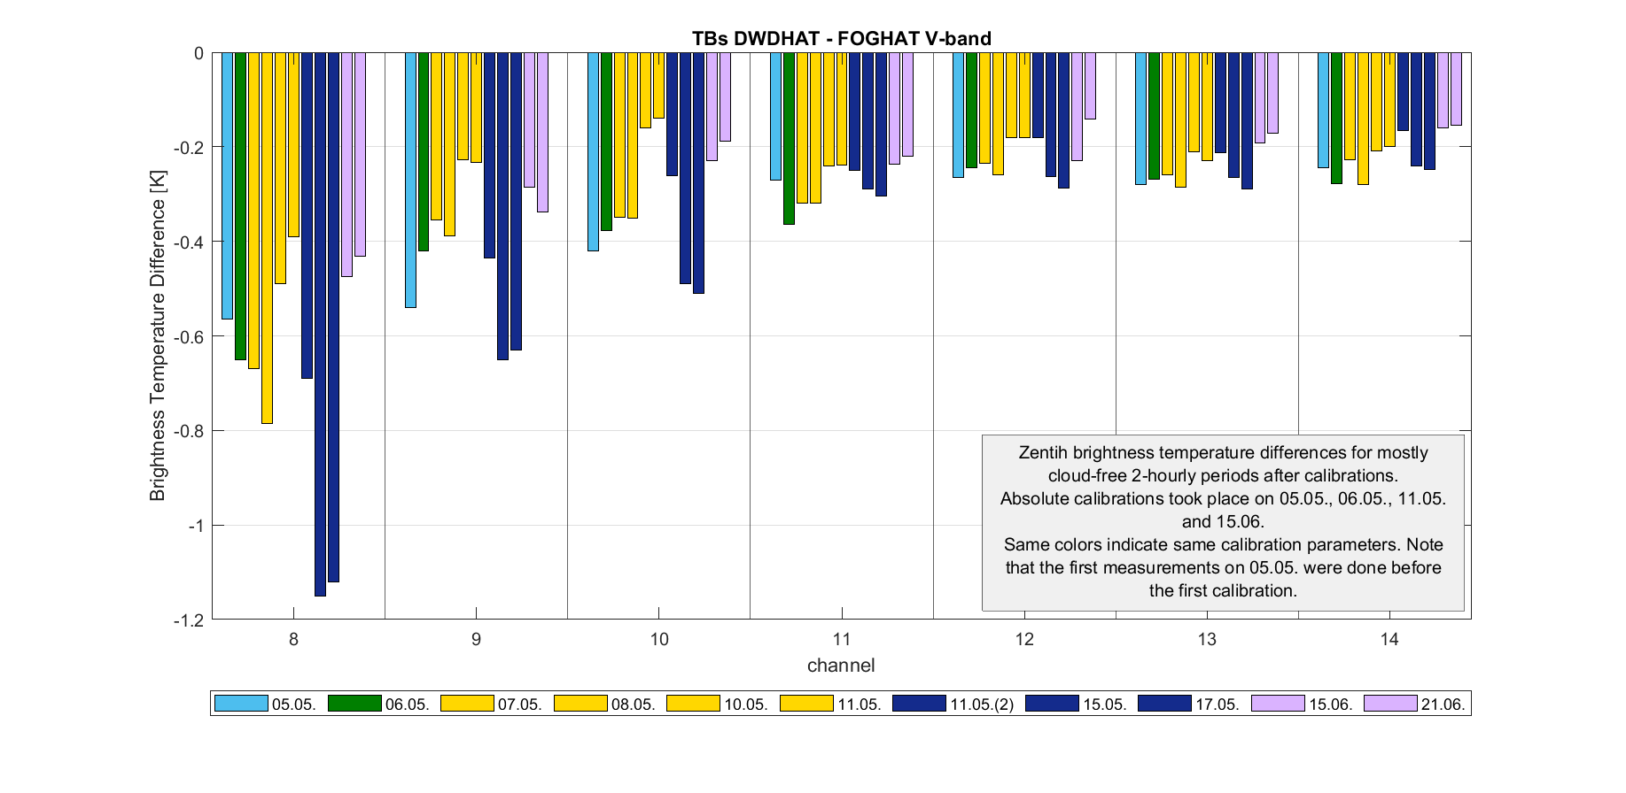
Biases (Differences between newest model HATPROs) via Zenith Comparisons
ok
Systematic differences
All errors are relative, there is no perfect absolute reference
critical
9

Slide 10
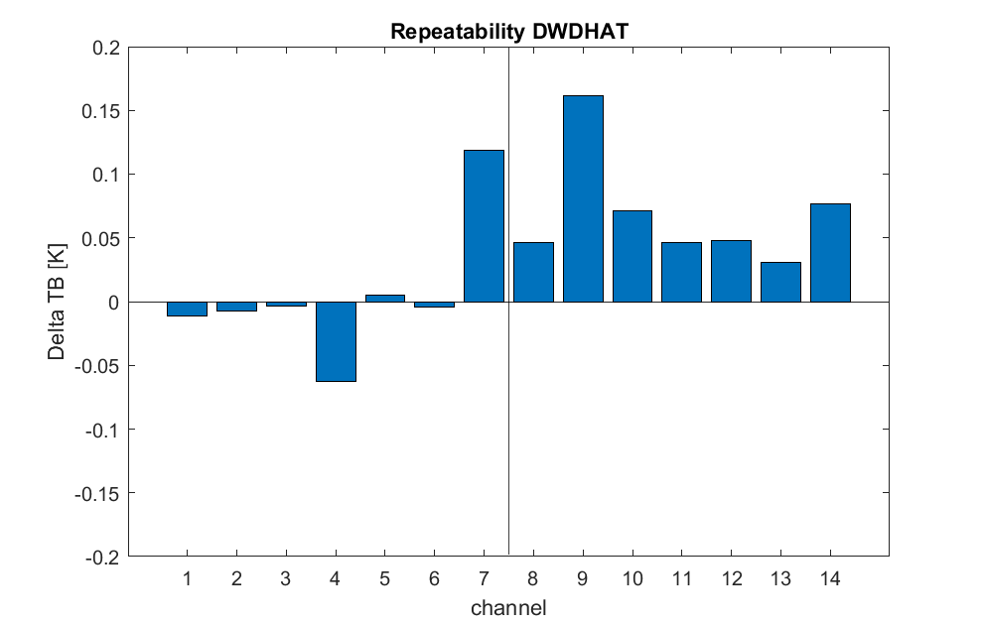
Repeatability: Leaps at Zenith between Calibrations compared to a reference
Is influenced by the quality of the calibration
Can only be done this way when there are at least two MWRs on the same site simultaneously
Meaningful values can only be achieved with the same conditions for each calibration (same day, same weather, same target,…)
≤ 0.12 K
H₂O-band
≤ 0.16 K
O₂-band
10

Slide 11
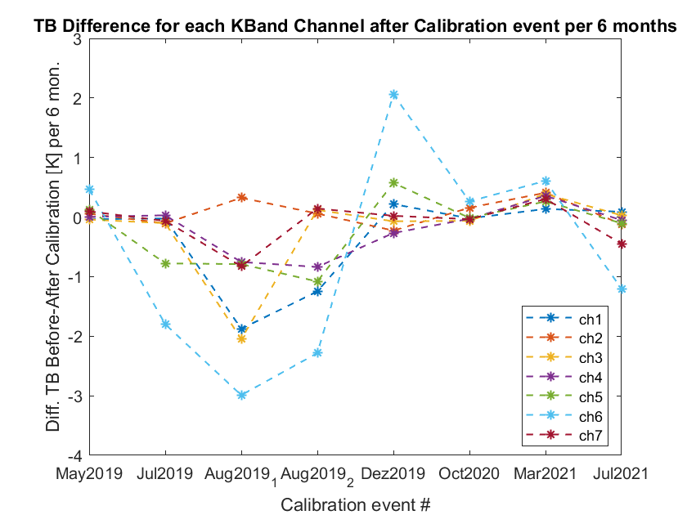
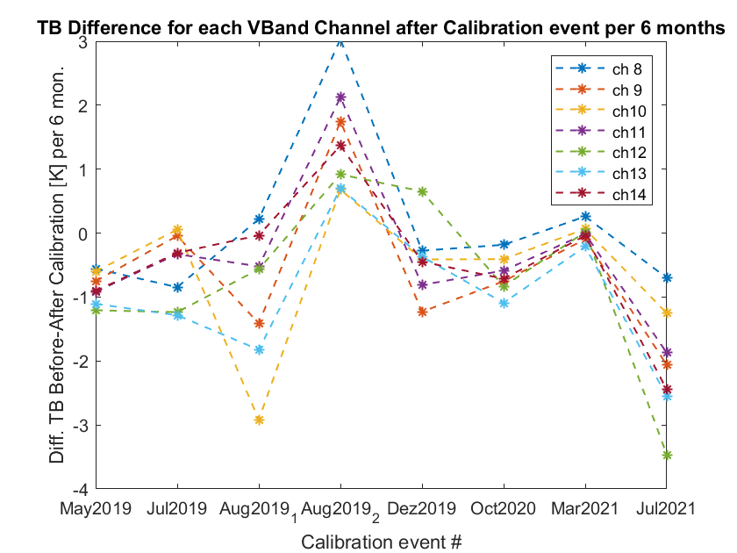
Drifts (via Coldload Leaps)
Cannot be directly influenced by operator
Is also influenced by biases!
Need to wait a certain amount of time between calibrations to get meaningful data
11

Slide 12
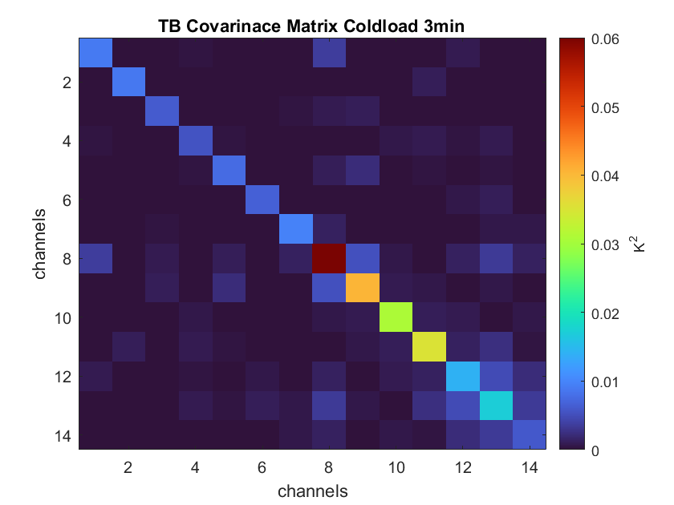
Short Reminder: Covariance Matrix
Correlated radiometric noise for all 14 channels (shows dependency of these channels)
The radiometric noise for a single channel can be determined by calculating the variance when looking on a stable blackbody target
Highly correlated channels are of no use for retrievals and data assimilations as they don‘t contain additional information
12

Slide 13
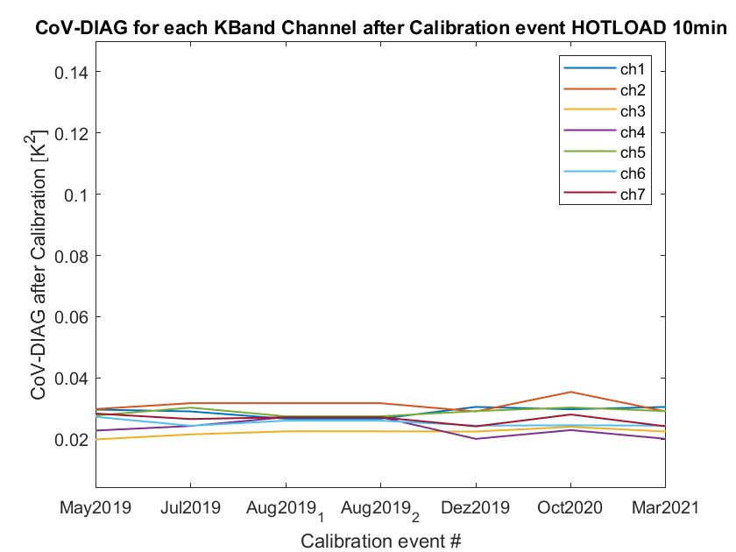
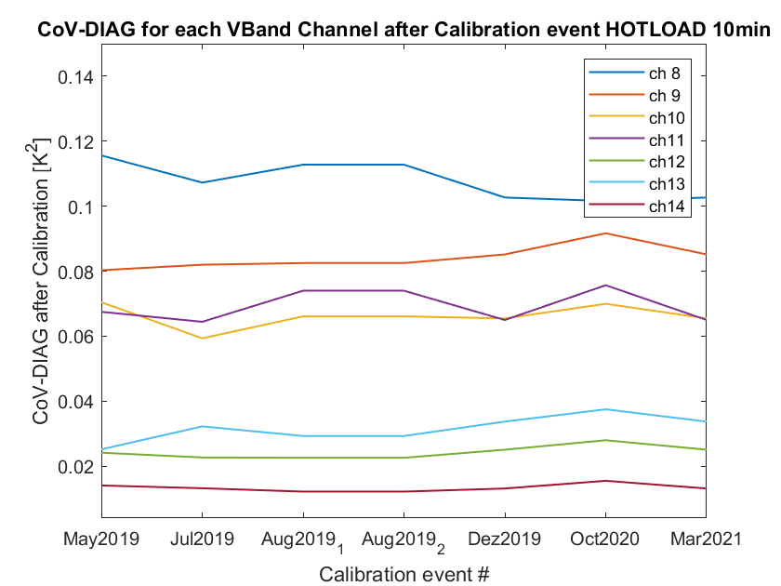
Noise Levels for Hotload
Coldload and Hotload Covariances similar for all Gen5 HATPROs, significantly higher values for Gen2
Operator independent, instrument specific
Square root of diagonals is the same as standard deviation
13

Slide 14
Summary
Results Overview (for Gen5 HATPROs):
Type of Error | Typical Error Values H₂O-band | Typical Error Values O₂-band | Determined via
Biases | usually ≤ 0.3 K (up to 0.48 K) | usually ≤ 0.5 K (up to 1.15 K) | Zenith measurement differences between two MWRs
Calibration Repeatability | ≤ 0.12 K | ≤ 0.16 K | Leaps to zenith reference measurements after two immediate consecutive calibrations
Drifts (over 6 months) | usually ≤ 0.3 K (up to 0.8 K) | usually ≤ 0.8 K (up to 1.3 K) | Leaps at coldload after calibration
Noise Levels (coldload – hotload) (1s) | ≤ 0.11 K – 0.18 K | ≤ 0.27 K – 0.35 K | Standard deviation
Comparison to RPG manual:
→ absolute TB uncertainty 0.5 K, → noise 0.10 to 0.15 K
Suggestion for total maximum error per channel:
Bias mean + Repeatability + Drift (for retrievals noise is also important)
For minimal error: only Repeatability
14

Slide 15
Thank you for your attention!
Contact:
tobias.boeck@uni-koeln.de
15

Slide 16
Bonus Slides
16

Slide 17
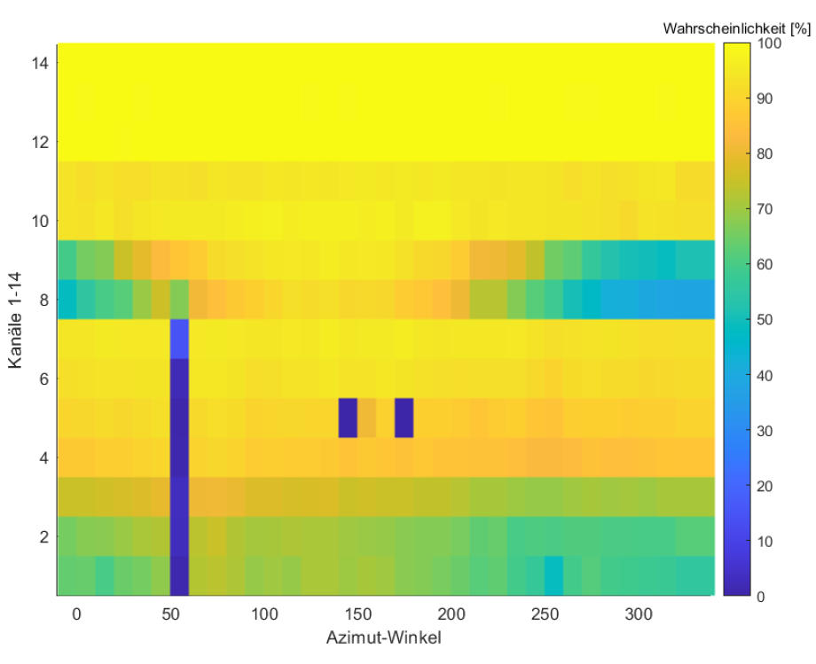
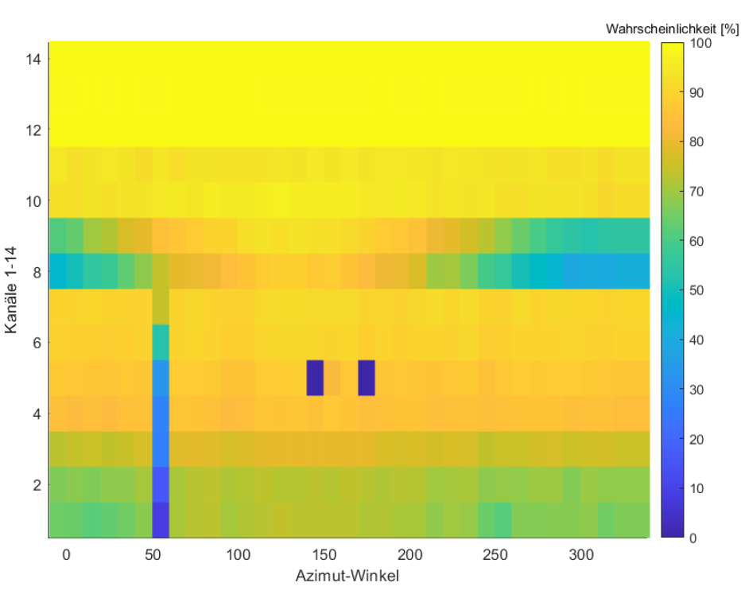
RFI TOPHAT Jülich: Azimuth Scans
30° Elevation Scan Interferences 14.04. – 18.05.2020
30° Elevation Scan Interferences 14.04. – 18.05.2021
17

Slide 18
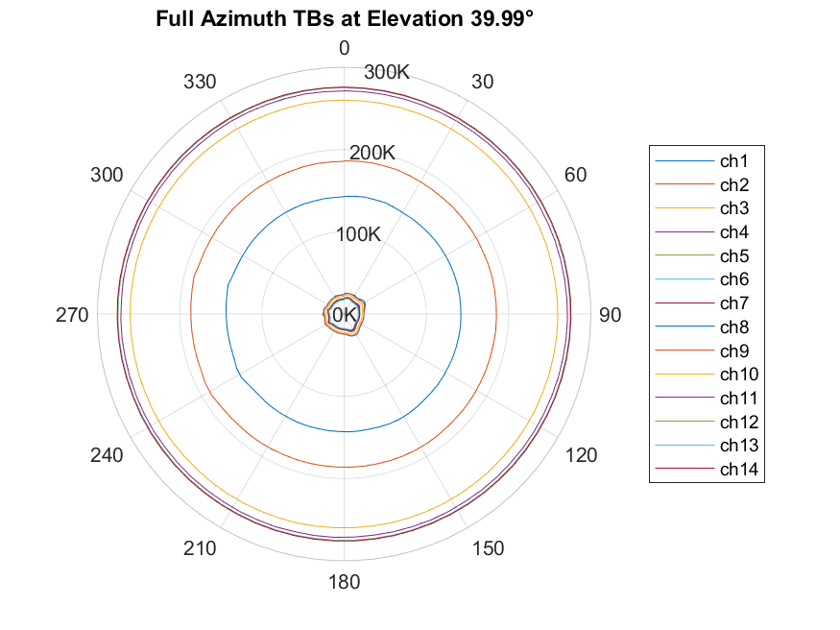
FOGHAT at Köln: Azimuth Scans (Obstacles and external Interference)
18

Slide 19
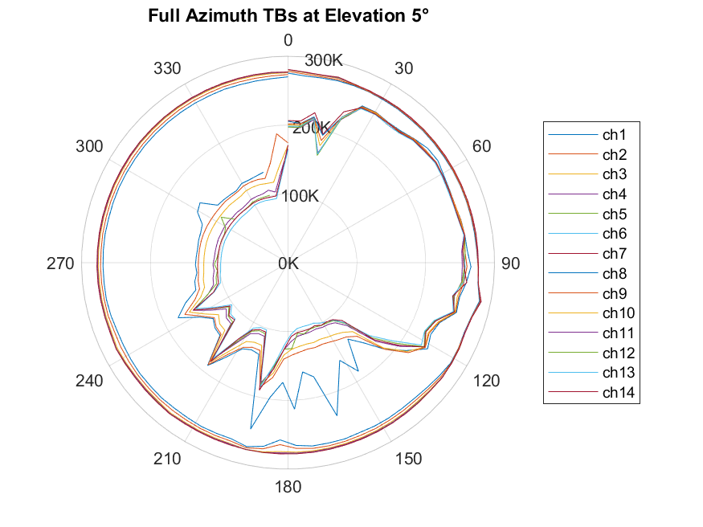
FOGHAT at Köln: Azimuth Scans (Obstacles and external Interference)
wall from building
between
NE and SE
EM interference?
19

Slide 20
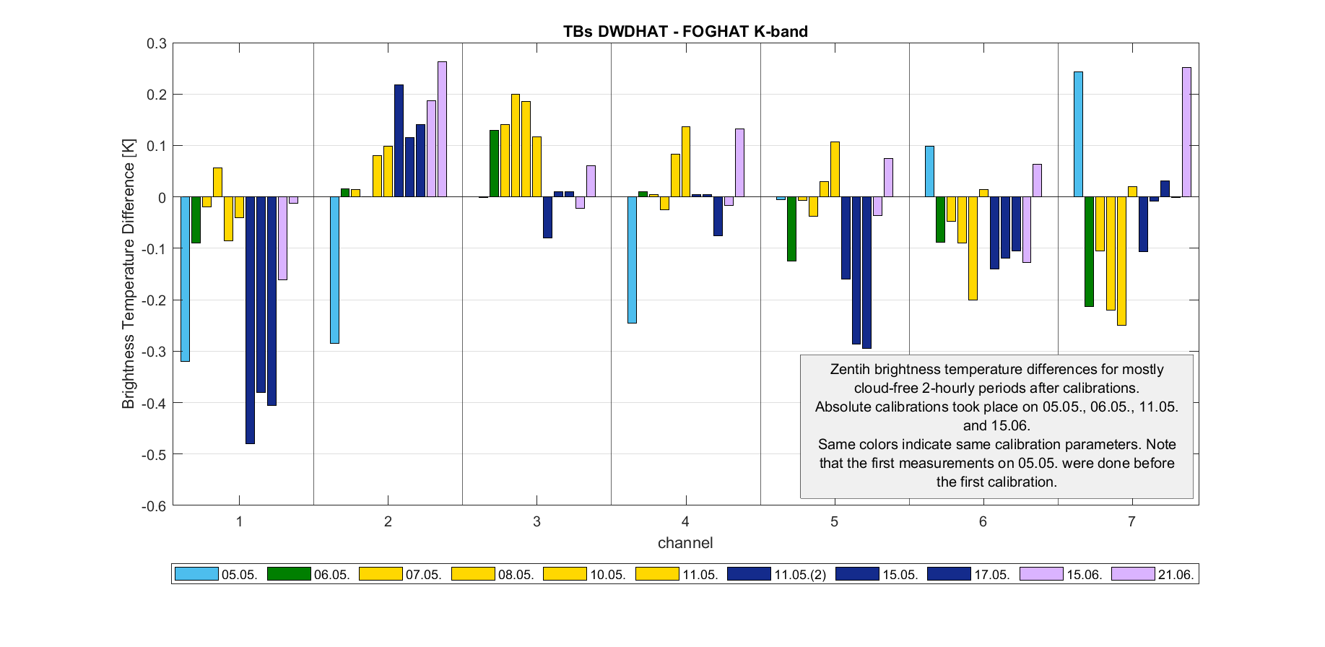
Biases/Offsets via Zenith Comparisons
20

Slide 21
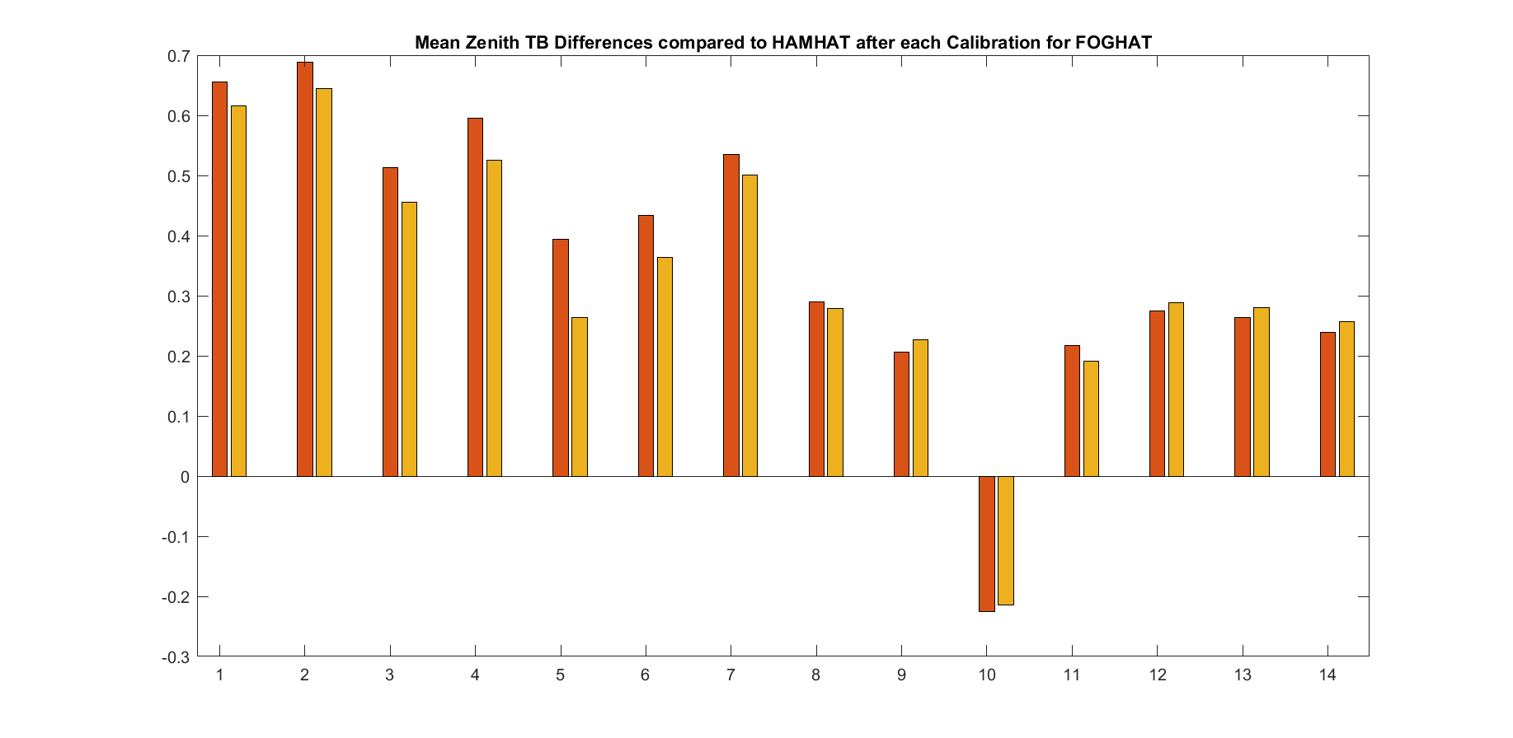
Leaps at Zenith between calibrations FOGHAT (Repeatability)
21

Slide 22
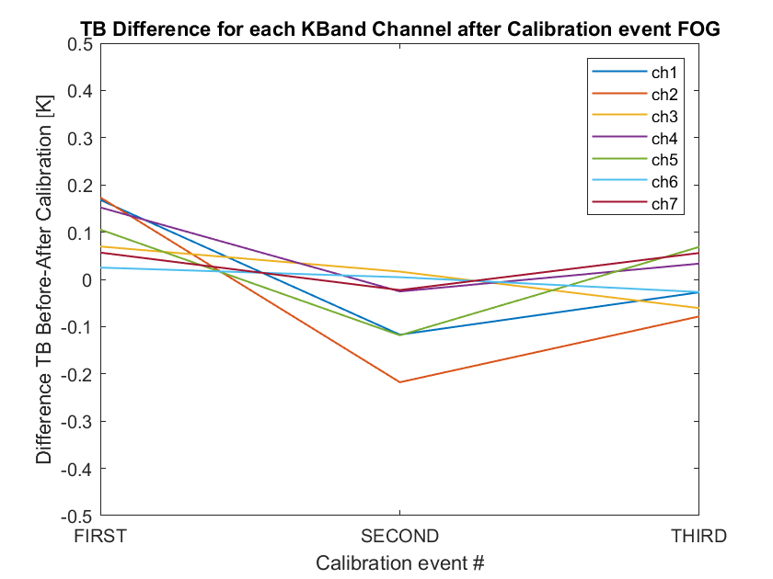
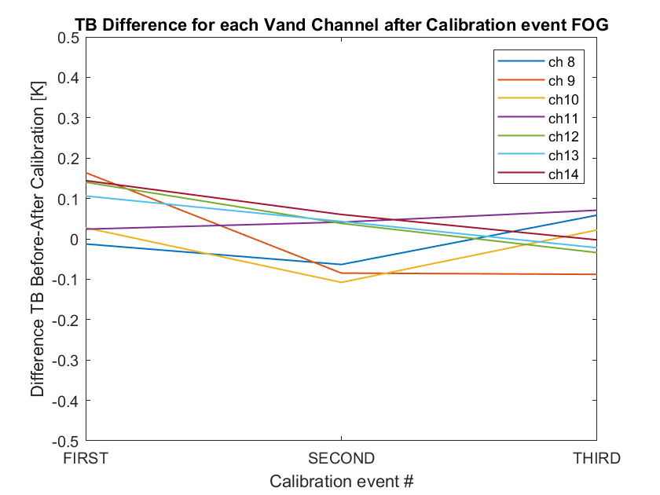
Leaps on Coldload between calibrations FOGHAT
22

Slide 23
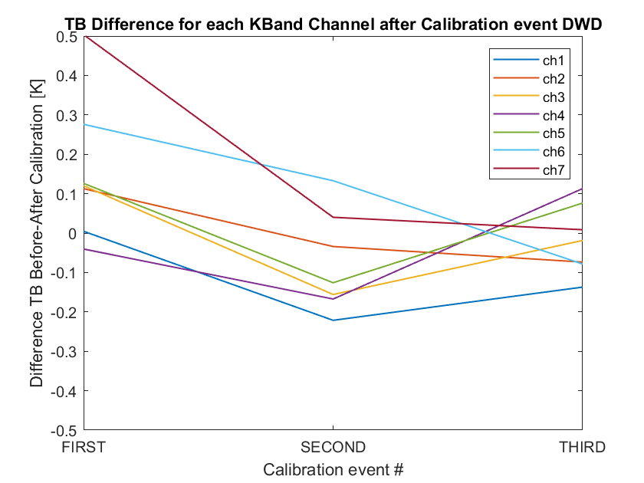
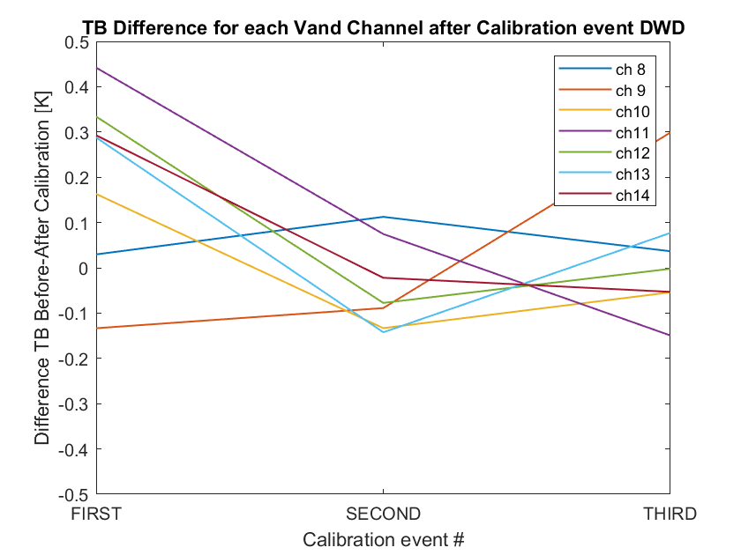
Leaps on Coldload between calibrations DWDHAT
Can also be used for repeatability check (consecutive calibrations on the same day)
Mean over 3min
23

Slide 24
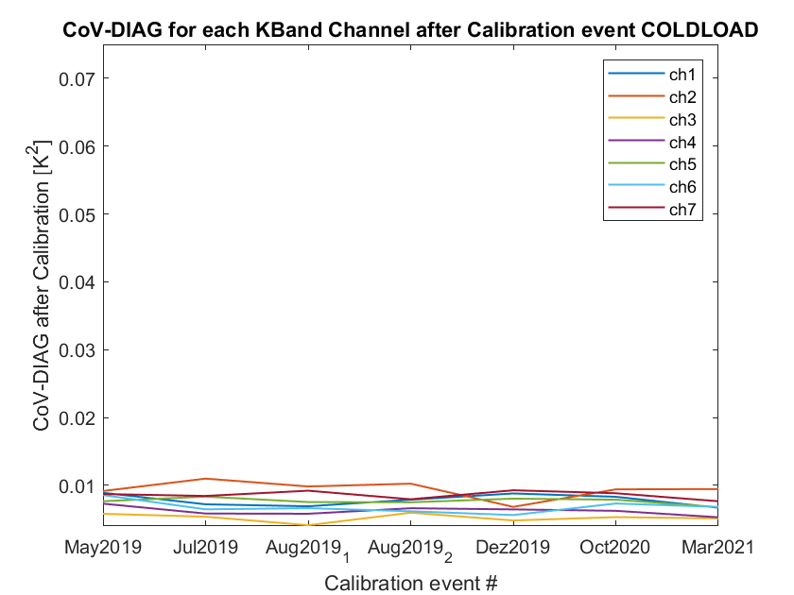
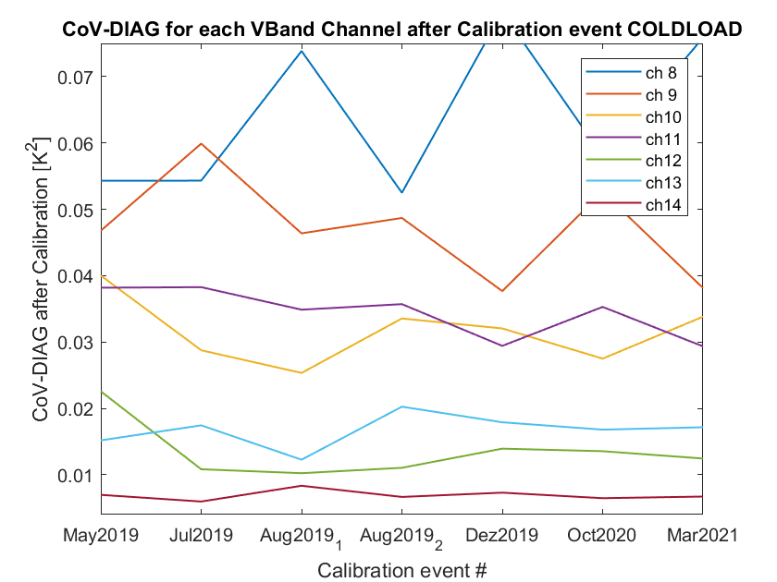
TOPHAT at JOYCE: Covariance Diagonals Coldload
24

