Slide 1
Hatpro scans
Searching for disturbances in tophat scan (30° elevation angle)
New Code is faster and shorter
Different way of filtering for clearsky
Checking if the mean (LWP) of the 120-second intervall before and after the scan is below 10 g/m^2
Calculating measurement(azi) – min(scan) for each azimuth of each channel
In what percentage of cases is the difference less than 1K?

Slide 2
New Code – Comparison Clearsky vs. Non-Clearsky Data

Slide 3
Comparison with vs. Without Mira36
14.04. – 18.05.2021
14.04. – 18.05.2020

Slide 4
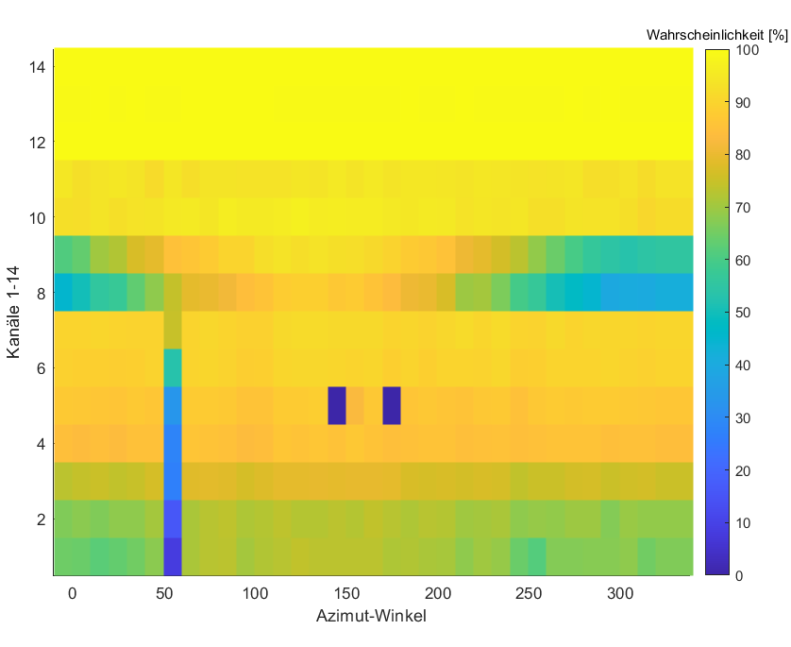
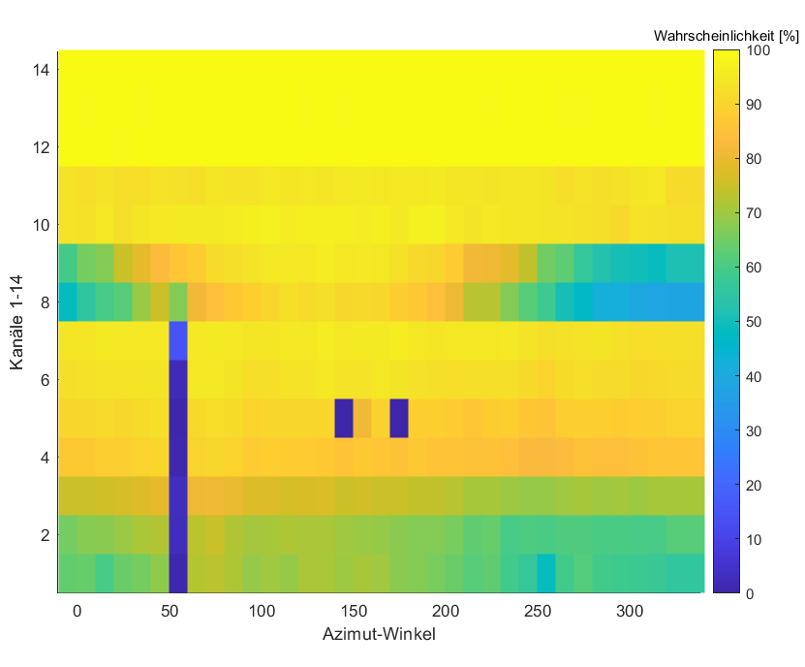
Comparison with vs. without Mira36
14.04. – 18.05.2021
14.04. – 18.05.2020

Slide 5
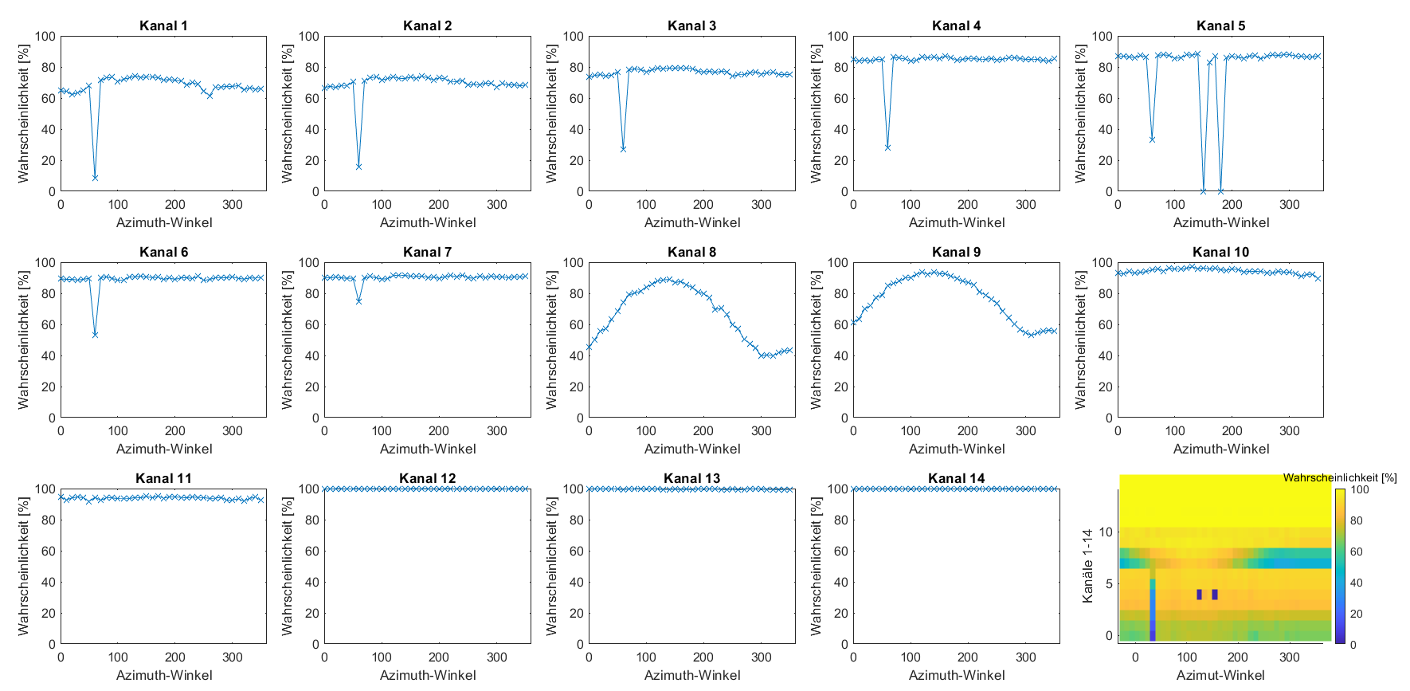
(mit Mira36) 14.04. – 18.05.2020

Slide 6
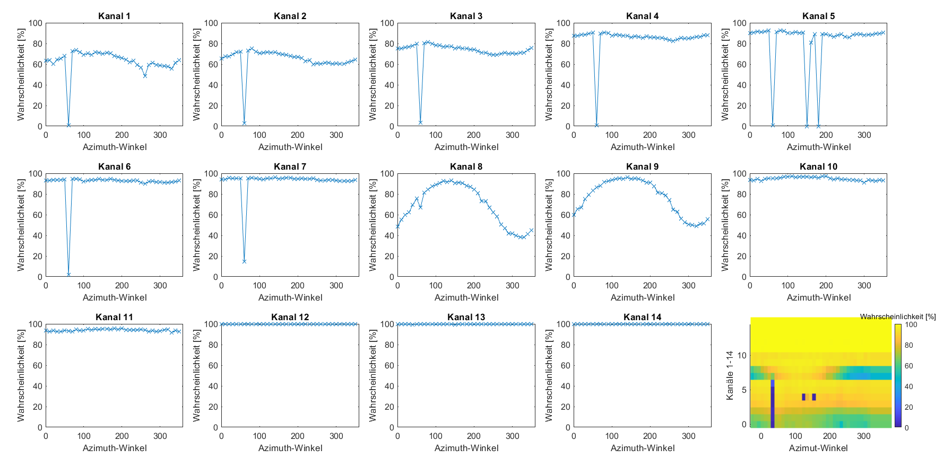
(ohne Mira36) 14.04. – 18.05.2020

