Slide 1
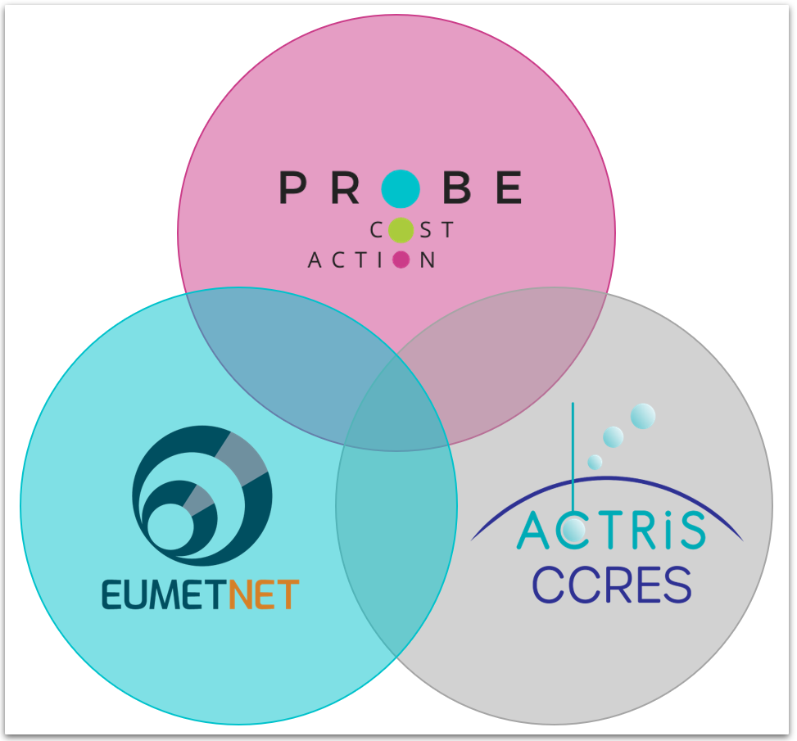
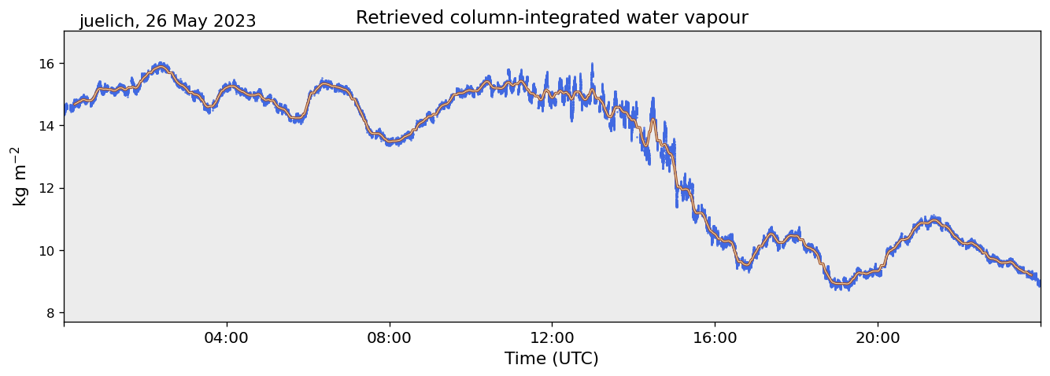
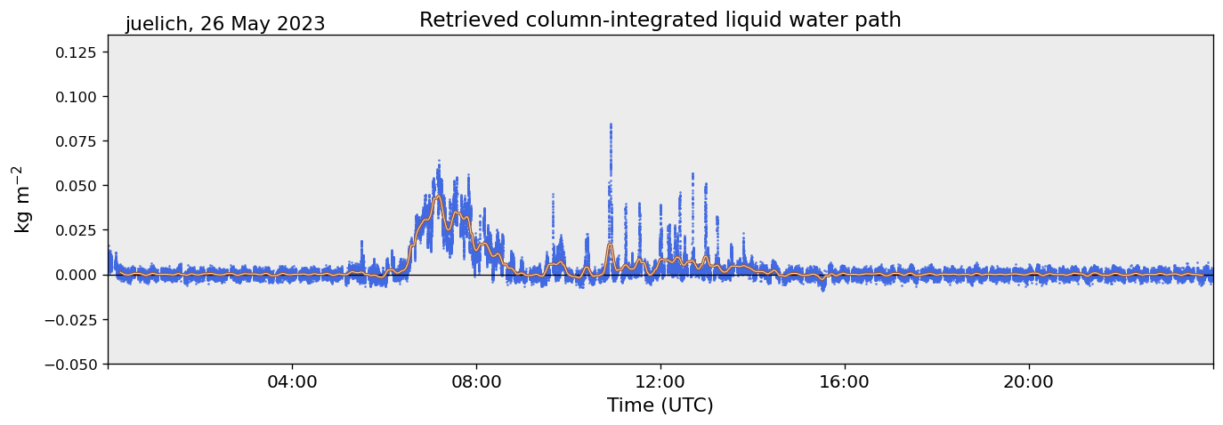
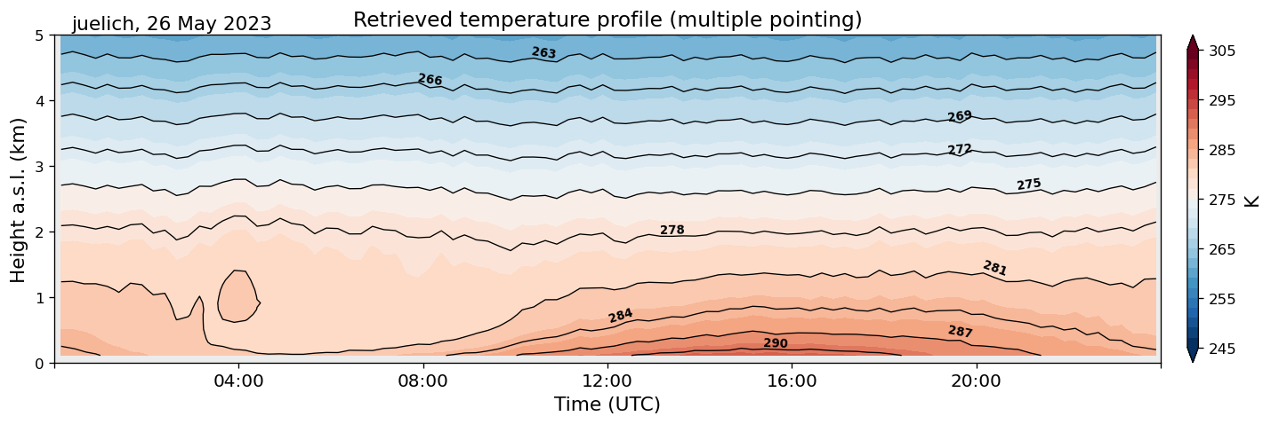
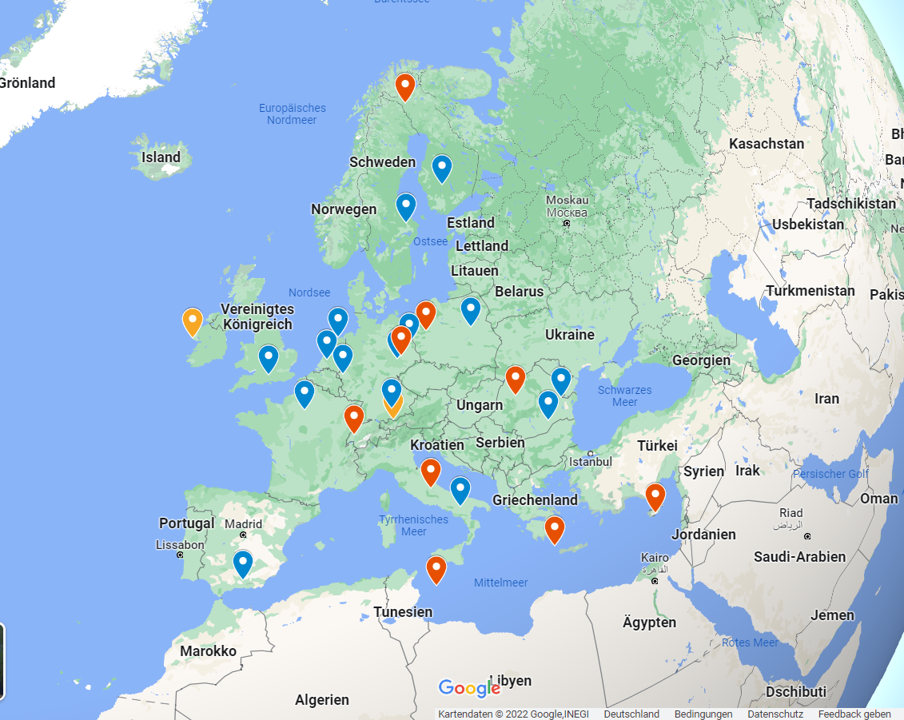
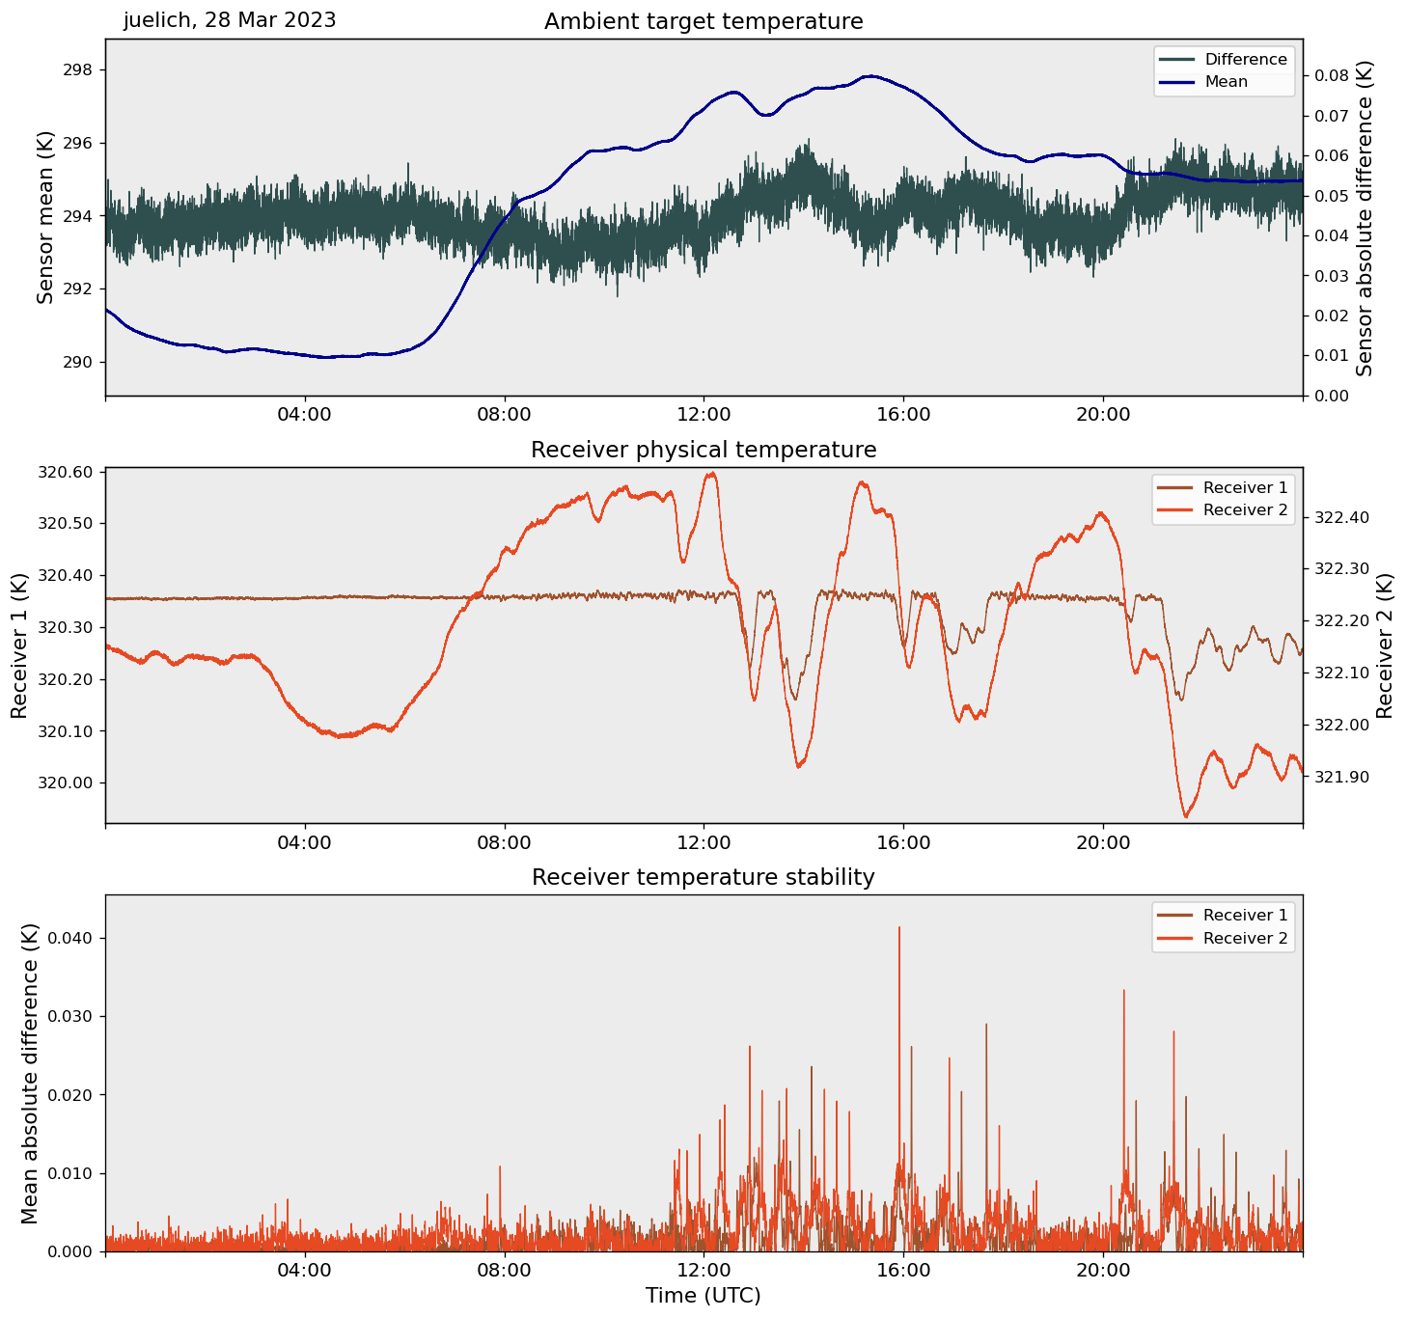
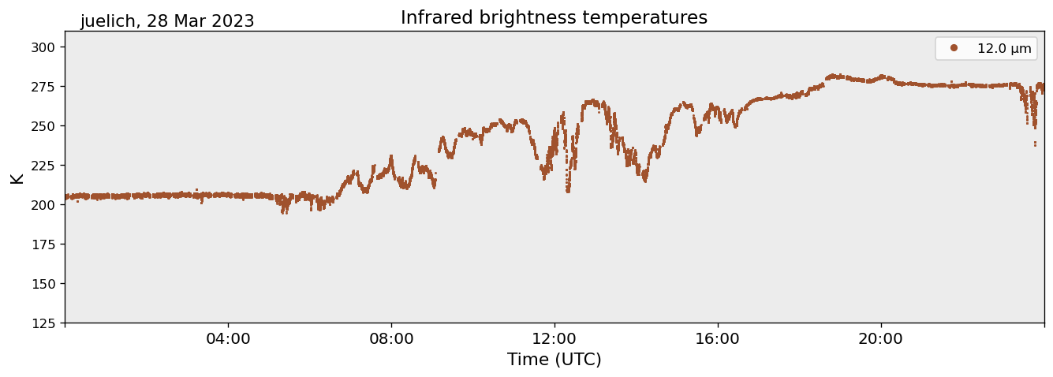
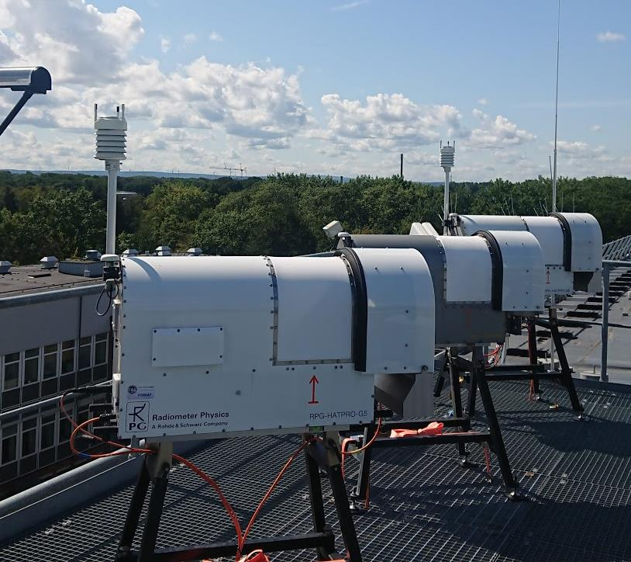
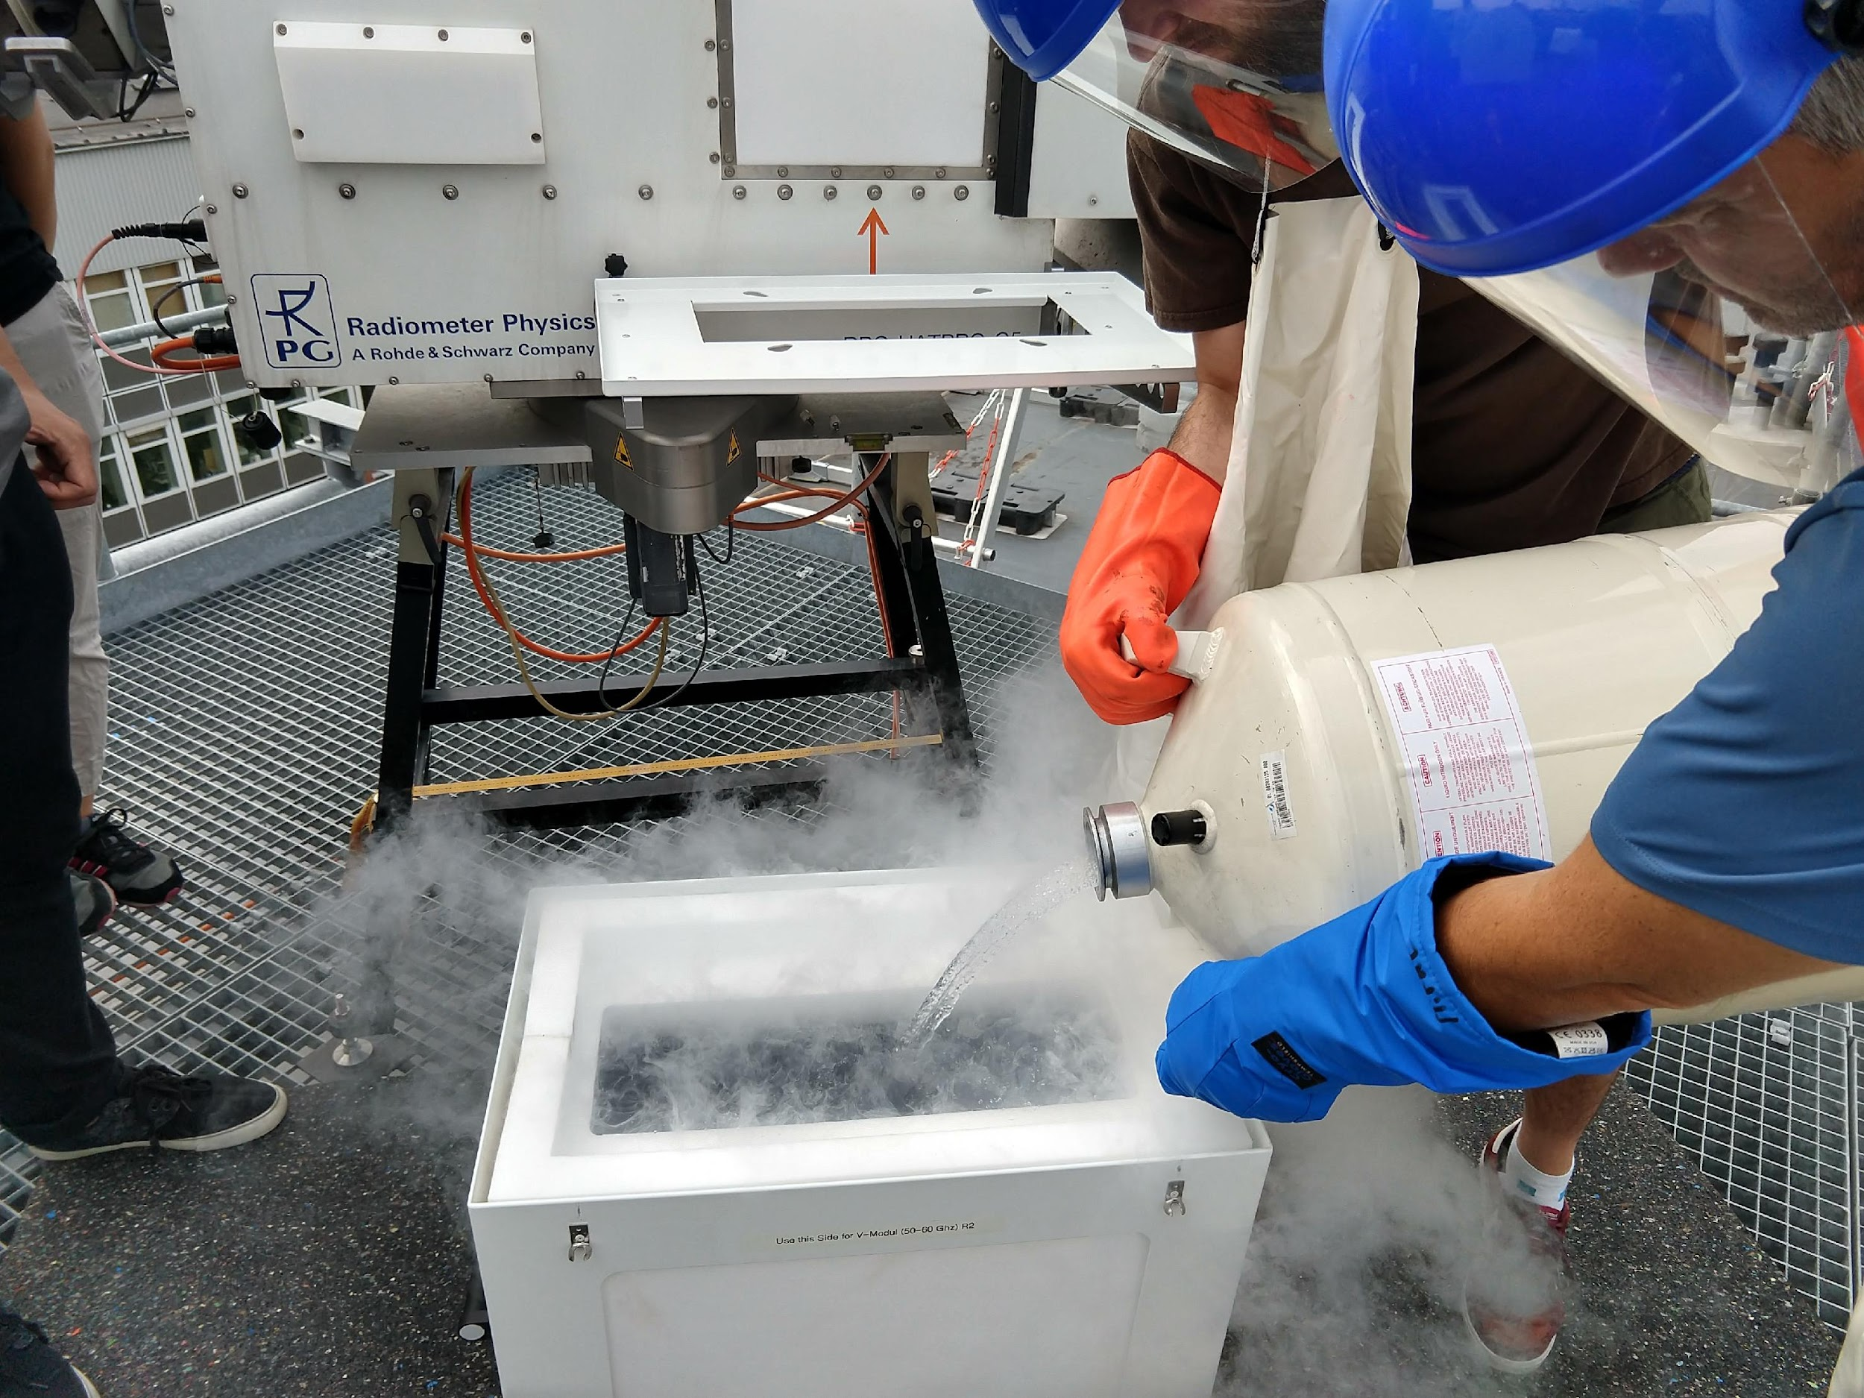
Harmonized and quality-controlled microwave radiometer observations in the ACTRIS cloud remote sensing network
Marke, T., L. Pfitzenmaier, and B. Pospichal
Institute of Geophysics and Meteorology, University of Cologne
1. Products from Microwave Radiometer Observations
4. Links to Other Networks
ACTRIS-CCRES closely collaborates with EUMETNET’s program for surface-based profile observations E-PROFILE which is establishing a network of MWR for operational purposes. Overlap also exists with the COST action "Profiling the atmospheric boundary layer at European scale" (PROBE).
Microwave radiometers (MWR) measure radiances in two frequency ranges along absorption lines of water vapor and oxygen, as well as in window regions for clouds. The following products are retrieved:
Integrated quantities, like cloud liquid water path (LWP) and integrated water vapor (IWV) from vertical stare measurements with high-temporal resolution of 1s
Profiles of atmospheric humidity and temperature (temperature profile with enhanced ABL accuracy using elevation scans)
IWV
LWP
Enable stations to be part in different networks
Cross network collaboration to establish common operation procedures and data formats
Abs. humidity
Temperature
5. Data Processing and Quality Control
Station operators transfer raw data to CCRES data center unit (CLU)
Read in transferred raw data
Apply retrieval method
Store data to common netcdf format
Quality control
Visualize on CLU website
Data serve as input to synergy products
Python package MWRpy
github.com/actris-cloudnet/mwrpy
2. Overview: ACTRIS cloud remote sensing network
The Aerosol, Clouds and Trace Gases Research Infrastructure (ACTRIS) is establishing a ground-based remote-sensing network to provide long-term cloud observations through instrument synergy of cloud radars, lidars and MWR.
Therefore, the Centre for Cloud Remote Sensing (CCRES) is setting up a network of 20-25 National Facilities (NF).
The Jülich ObservatorY for Cloud Evolution (JOYCE), jointly operated by the University of Cologne and the Research Centre Jülich, is part of CCRES as NF and central unit for ground-based MWR (CCRES-DE).
cloudnet.fmi.fi
JOYCE
MWR data are incorporated in a synergistic cloud classification algorithm (Cloudnet)
Quality flags included in data files
Centralized monitoring of housekeeping data to identify malfunctions in near-real-time
blue: active, red: planned, orange: not yet in ACTRIS
3. Goals of Microwave Radiometer Unit (CCRES-DE)
Implement data processing chain, including near real-time online monitoring of data quality, together with CCRES data center
Provide standard operating procedures in collaboration with other networks concerning setup, calibration, maintenance, etc.
Ensure homogeneous data products by common retrieval approach
Organize workshops and hands-on training for MWR operators and allow physical/virtual access for testing of new instruments/methods
For these purposes, JOYCE provides continuous MWR observations since 2011 and is being equipped with reference instruments for testing and inter-comparison.
6. Retrieval Development
ERA5 input / comparison to retrievals based on radiosondes
Statistical retrieval method (Neural Network with auxiliary data)
Retrievals for low-humidity conditions with newly acquired RPG - LHUMPRO (frequencies at 89 GHz and at 183 GHz water vapor line)
Improving LWP retrieval by utilizing 89 GHz channel
Synergy retrieval of microwave and infrared radiometer for improvements in low LWP situations
actris.eu/topical-centre/ccres
7. Next Steps
MWR synergy products focusing on the atmospheric boundary-layer, including wind Doppler lidar, will be established in CCRES
Implement automated procedures for the long-term assessment of instrument performance and data quality
EMS Annual Meeting 2023, Bratislava – Sep 4 - 8, 2023, Poster Session UP1.5

