Slide 1
BAHAMAS Basic Meteorological Measurement
NARVAL II preparation workshop
Christian Mallaun, Martin Zöger, Andreas Giez, Volker Dreiling
DLR Oberpfaffenhofen, FX Sensor and Data Group

Slide 2
FX Sensor and Data Group
beginning
end
Technical support:
florian.gebhard@dlr.de
Technical support:
nico.hannemann@dlr.de
Data quality:
christian.mallaun@dlr.de
Data quality:
martin.zoeger@dlr.de
andreas.giez@dlr.de
volker.dreiling@dlr.de
christoph.grad@dlr.de
in Iceland

Slide 3
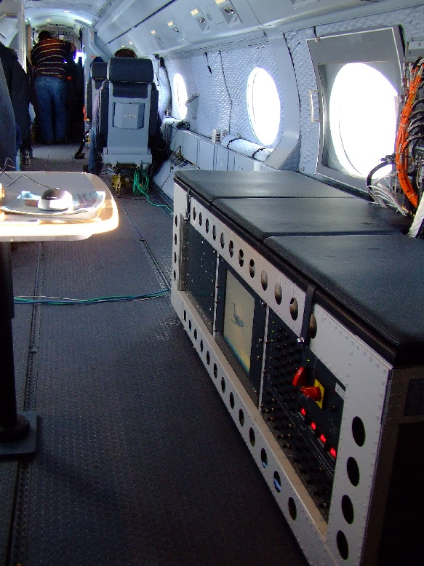
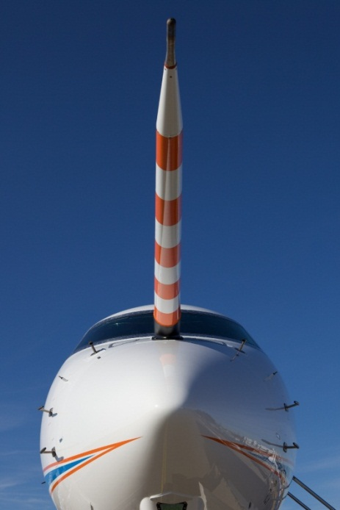
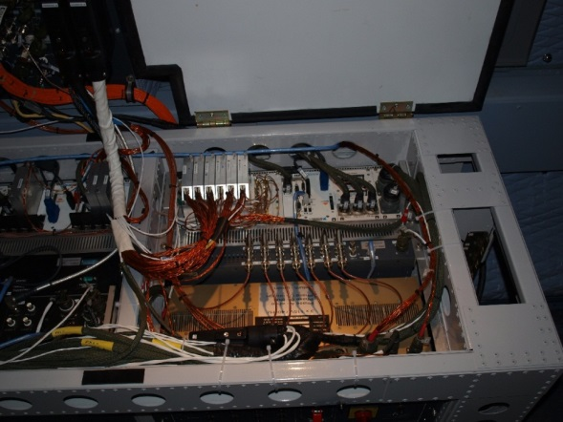
HALO data acquisition
BAHAMAS
(BAsic HALO Measurement And Sensor System)
Data acquisition (single button philosophy)
Basic meteorological sensors (T, P, wind, hum)
Position and atttitude (IGI)
Aircraft system interfaces (IRS, ADS, FMS)
Quicklook data
Cabin Ethernet network
Analog video storage
SHARC (water vapor TDL)
User interfaces (GPS, timeserver, ARINC429, user data input)
Notes:
Quality and reliability

Slide 4
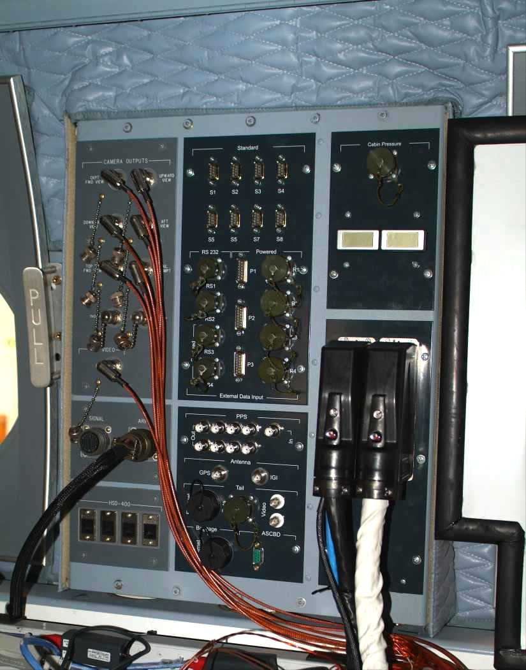
User Interfaces
Mission Interface Panel
Analog data input (32 channels, partly powered)
Serial data input (4x RS232)
PPS out (8x, time synchronization)
Video und data connection into rear compartment
Ethernet into the baggage compartment
SATCOM
ARINC 429 (5 optically separated client inlets)
Cabin
GPS Splitter (10 user interfaces)
Ethernet Ring (8x6 ports)
QL data (binary, IWG1 data stream)

Slide 5
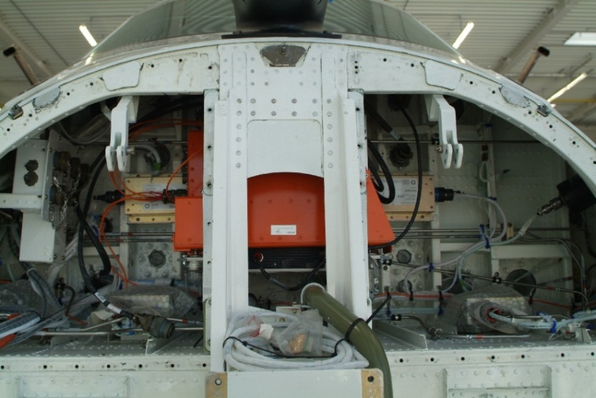
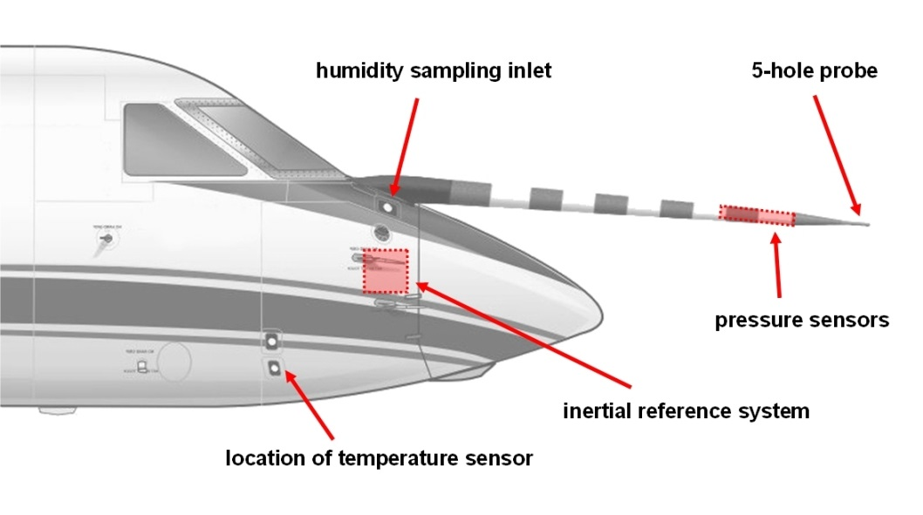
High Precision IRS
GPS + laser gyro head (IGI, Germany)
Realtime DGPS via satellite (OmniSTAR-HP)
NEW: DGPS postprocessing
- requires internet connection
- 2-4 days after the flight
Accuracy (postprocessed):
pitch/roll: < 0.01 deg RMS
position: < 0.1 m RMS
Laser gyro defines reference CS
We can help to calc position and velocity at different locations in the cabin
Fast data for SPECAMC?
Notes:
Omnistar Lizenz weltweit? WAAS?

Slide 6
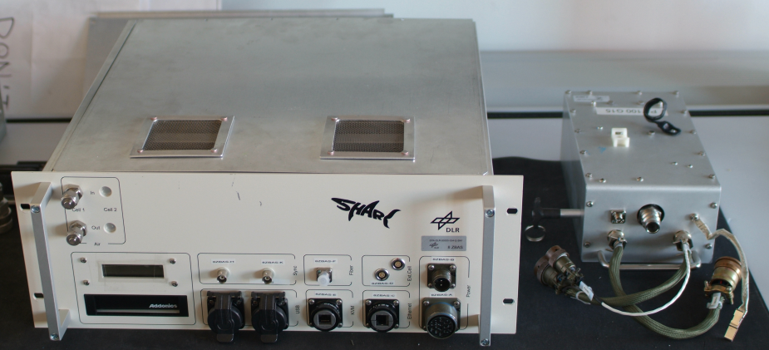
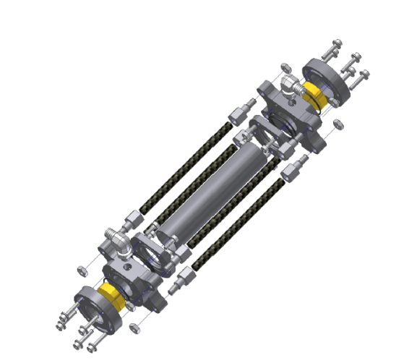
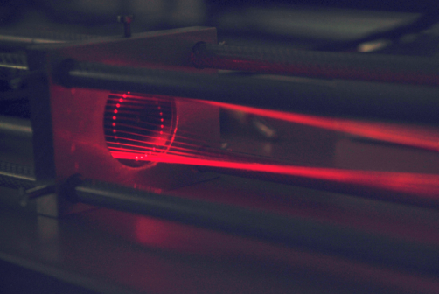
SHARC
Humidity measurement in Troposphere up to Tropopause (10… 40000 ppmv / 150… 1000 hPa)
Laser absorption measurement (TDL) @ 1370 nm
Dual path absorption cell (expanded measurement range)
Fiber coupled laser, all fiber design
Real time data processing (2Hz)
Needs a TGI Inlet (6mm backward, ApT#9/#10/#11)
Notes:
HAI gleich nur 2. Wellenlänge 2700 nm
TDL: tunable diode laser

Slide 7
Changes since NARVAL I
New nose boom pressure sensors: better temperature stability, less white noise
Flow angles: new inflight calibration method, calibration under dynamic conditions (Belly Pod config)
SHARC: fast and precise humidity measurements
Real time meteorological data via SATCOM (by Atmosphere)
ASCB-D data available (aircraft diagnostic data)
Open Items:
Pressure: static source error for Belly Pod unknown (Trailing Cone calibration)
SHARC: damaged during OMO, repair ongoing, no backup available
Electro magnetic influence (EMI) on data signals (as found during NARVAL I)

Slide 8
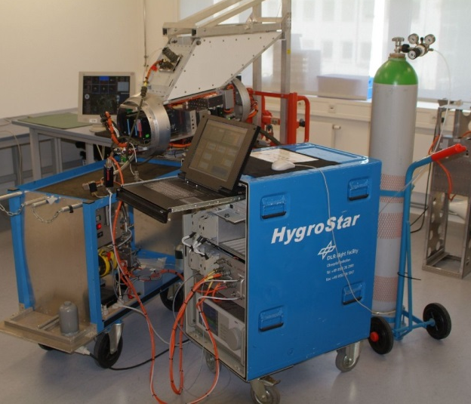
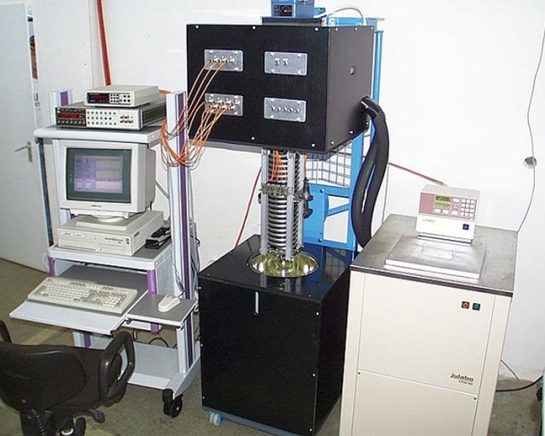
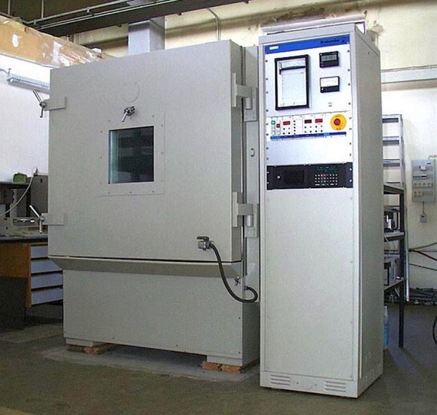
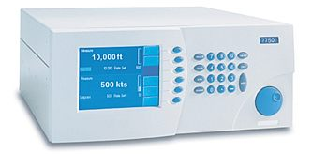
Summary of measurement uncertainties (standard processing):
Wind: 0.4 m/s vertical, 0.6 m/s horizontal
Pressure better then 0.3 hPa
Temperature better 0.5 K
Water Vapor Mixing Ratio better 5% with SHARC
Relative humidity (over ice) around 10% (5% from temperature, 5% from humidity)

Slide 9
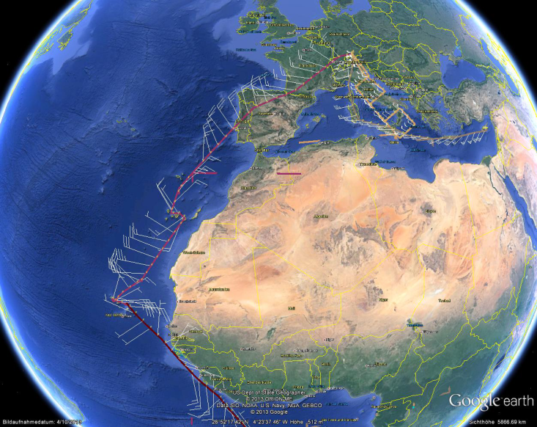
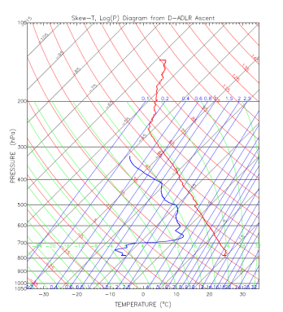
Postprocessing
1 Hz data in NASA-AMES-Format
~2h after landing
3-4d: Final data
Content (Parameter list at end of file)
Meteorological insitu data
(Temperature, Humidity, Pressure, Wind)
Aircraft data
(Position, Attitude, Aircraft state)
Overview Plots
KML-Track 3D (for Google Earth)
Video Files
Optional:
Diagnostic data (Power, …)
10Hz on request
Look into File Header
TBD before campaign start:
File name?
Data distribution?
Data frequency?
Extra Parameters?
Other requirements?

Slide 10
Data quality: Restrictions and Riscs I
Aircraft maneuvers:
Reduced accuracy during turns and height changes (pressure, flow angles and wind – esp. vertical wind)
High Aerosol concentration:
Sensor and inlet contamination by dust or salt during low level flights
Tropical climate and no hangar:
Hot and humid weather cause extreme conditions in the cabin (e.g. IGI overheating)
Cooling with APU is a risk for the SHARC instrument (condensation)
Precipitation/Clouds : Water / ice in the pressure tube:
Reduced data quality during the flight
Technician must clean tubes after the flight

Slide 11
Data quality: Restrictions and Riscs II
Lower Stratosphere: almost no humidity (special equipment required)
Inside clouds: temperature and humidity can be affected (water in inlets, evaporation)
Turbulence measurement: homogeneous conditions, long flight legs, no maneuvers
Contrails: strong turbulences – sensors might reach their maximum values
Special flight strategies can influence data quality!

Slide 12
BAHAMAS operation in cabin
We switch on the instrument before flight and check the system
We stop the system after landing
Designated operator has to check and handle instrument during flight
Any operator has to receive operation instructions from our technician!
External landing:
Designated operator is responsible for the system
We cannot check the function of the system
Operating error can lead to data lost
… and for sure, also the unexpected

Slide 13
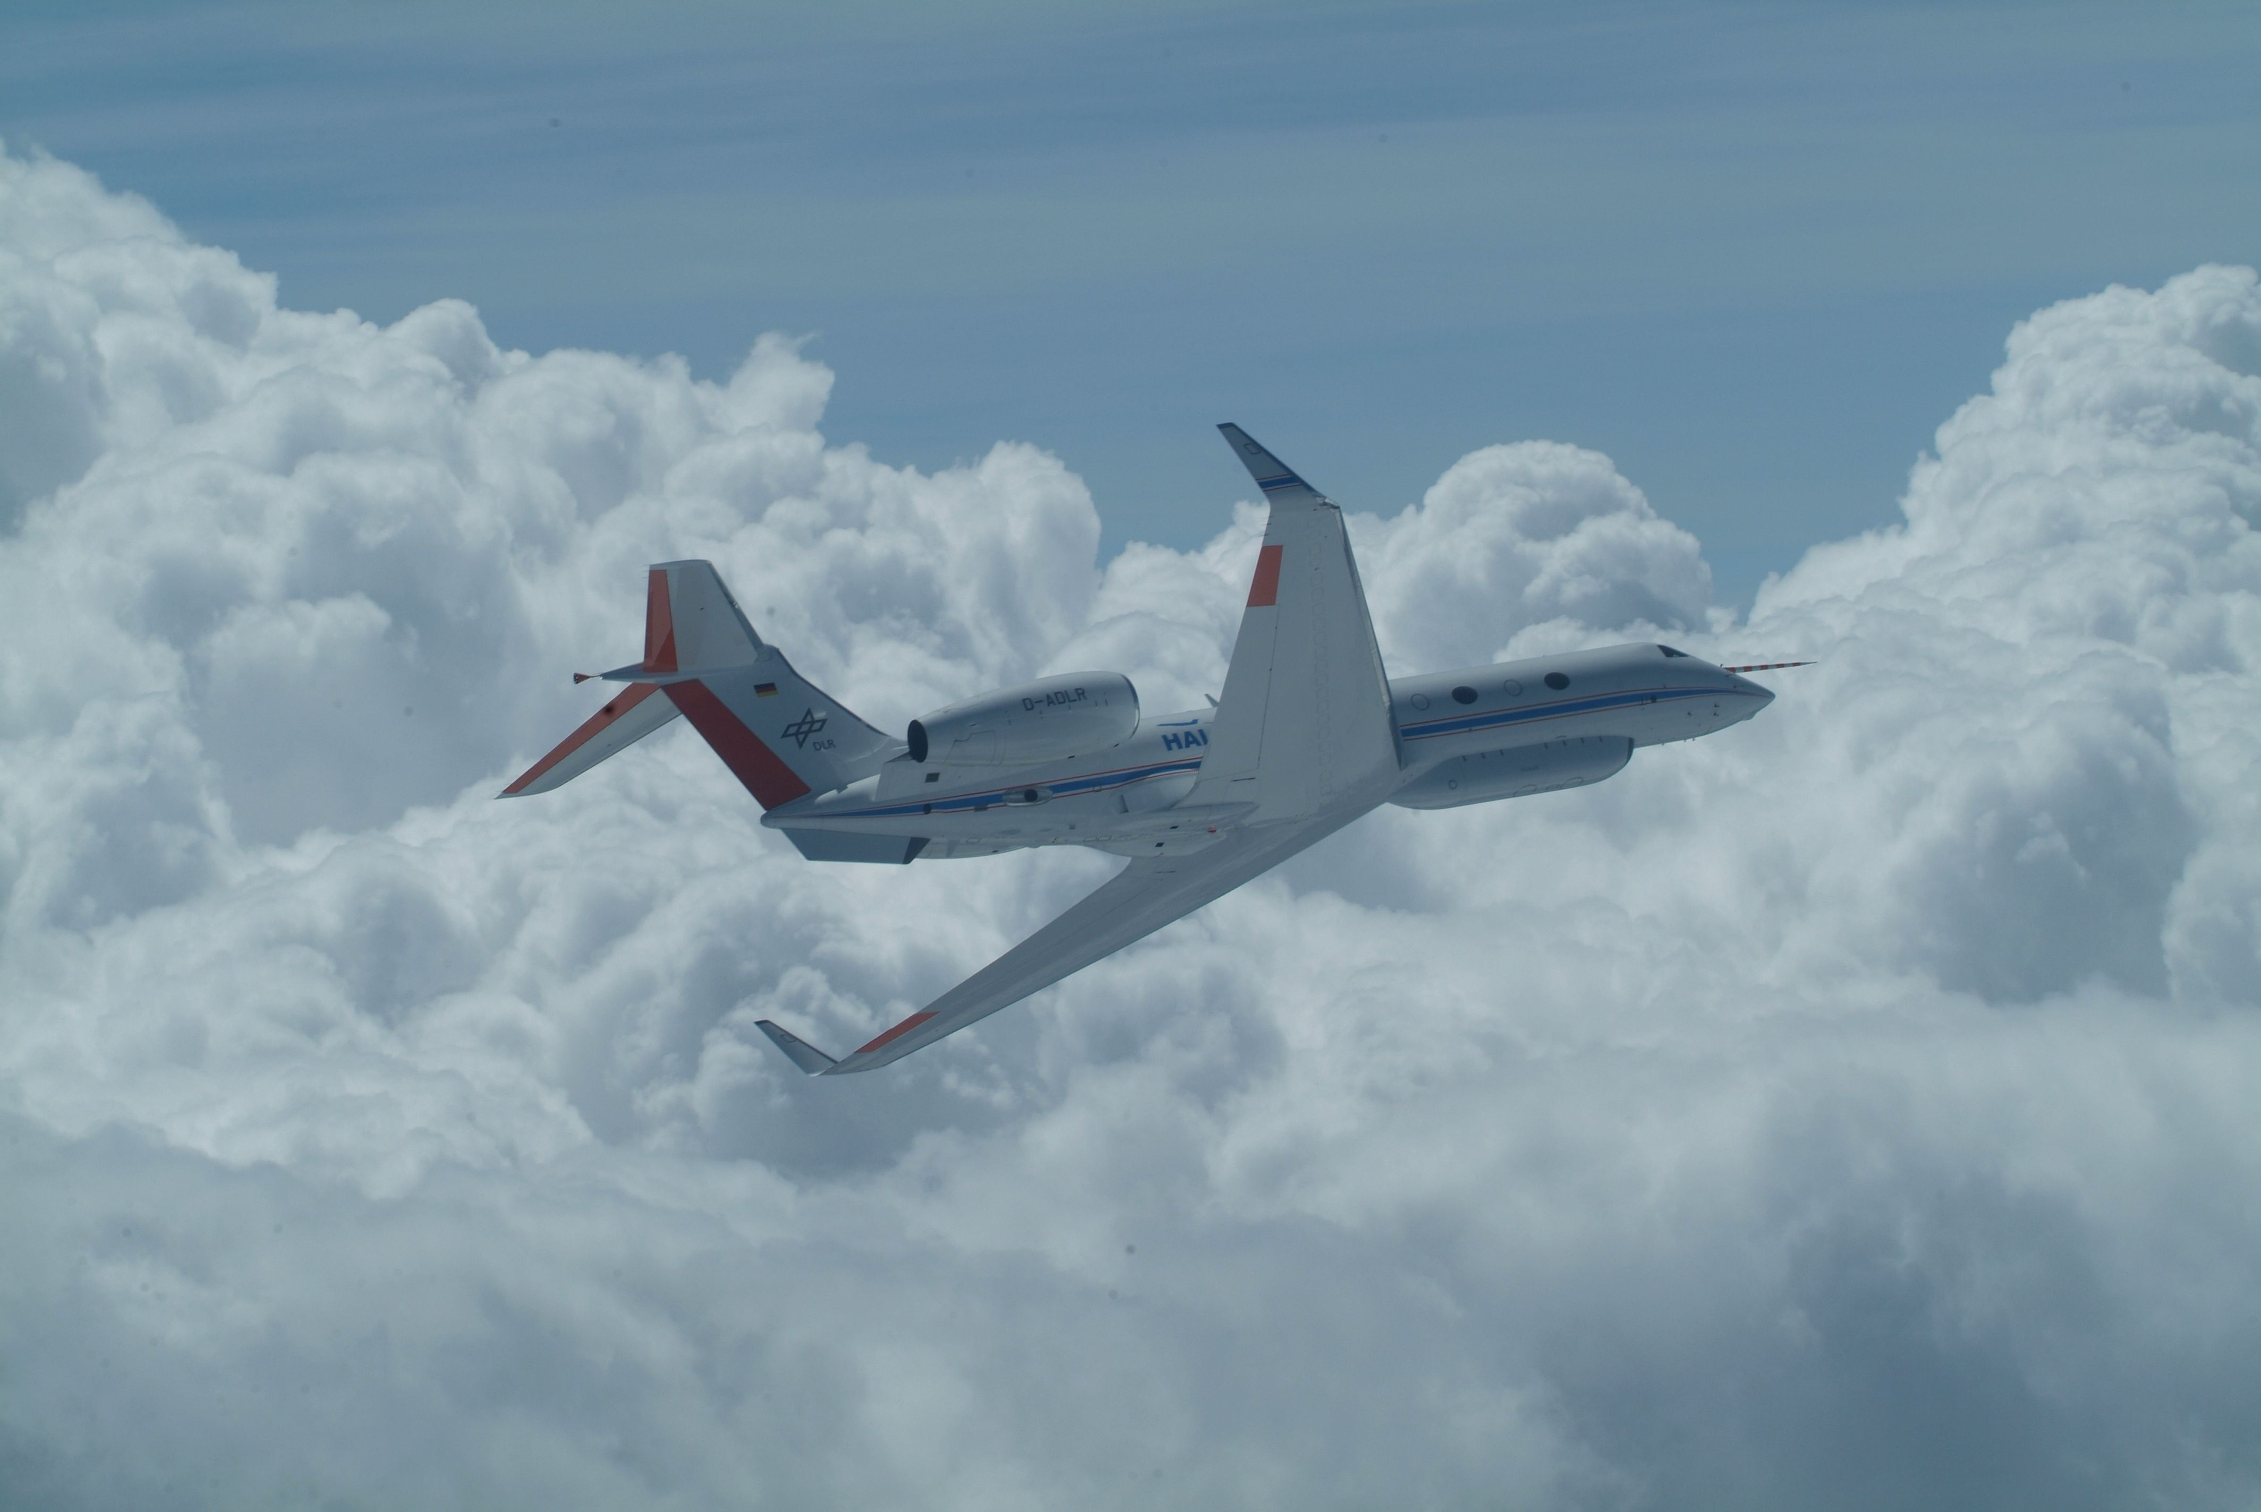
Thank you !

Slide 14
.nas File Parameter List
Absolute Humidity [g/m^3]
Angle of Attack [deg]
Angle of Sideslip [deg]
Height above Sea Level calculated from met. data (fast) [m]
Pressure Altitude [m]
Machnumber [Ma]
Static Pressure (from NB_PSIA) [hPa]
Dynamic Pressure [hPa]
Calculated True Airspeed [m/s]
Total Air Temperature (deicing corrected, from BDY-TTQ) [K]
Dewpoint Temperature [K]
Potential Temperature [K]
Virtual Potential Temperature [K]
Virtual Temperature [K]
Wind Vector East Component [m/s]
Wind Vector North Component [m/s]
Wind Vector Vertical Component [m/s]
Horizontal Wind Direction [deg+]
Horizontal Windspeed [m/s]
Static Air Temperature (from BDY-TTQ) [K]
Mass Mixing Ratio [g/kg]
Volume Mixing Ratio [micromol/mol]
Relative Humidity with Respect to Water [%]
IGI height above WGS84 ellipsoid [m]
IGI actual track angle [deg+]
IGI body x-axis acceleration [m/s^2]
IGI body y-axis acceleration [m/s^2]
IGI body z-axis acceleration [m/s^2]
IGI vertical acceleration [m/s^2]
IGI east west velocity [m/s]
IGI ground speed [m/s]
IGI true heading [deg+]
IGI latitude position above WGS84 [deg]
IGI longitude position above WGS84 [deg]
IGI north south velocity [m/s]
IGI body roll rate [deg/s]
IGI roll angle [deg]
IGI body pitch rate [deg/s]
IGI body yaw rate [deg/s]
IGI pitch angle [deg]
IGI vertical velocity [m/s]
IGI RMS value for position x [m]
IGI RMS value for position y [m]
IGI RMS value for position z [m]

