Slide 1
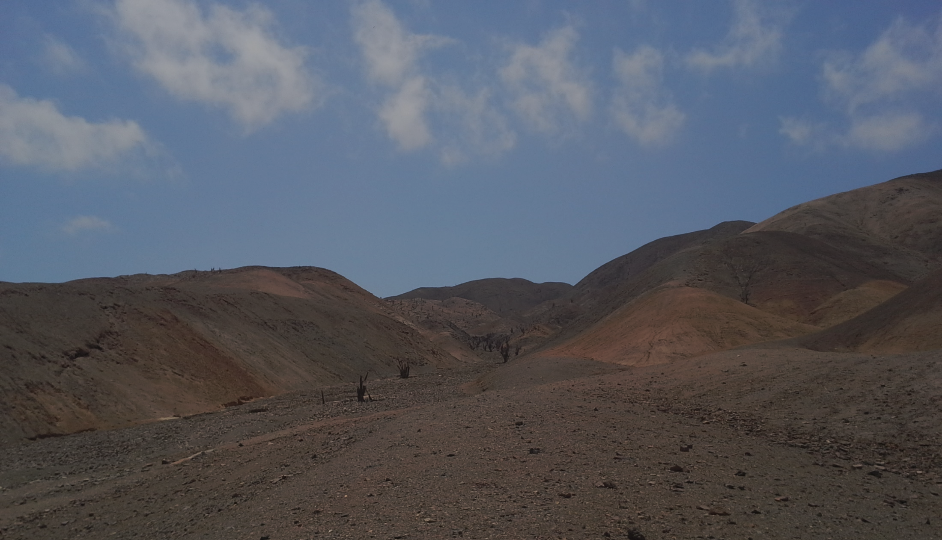
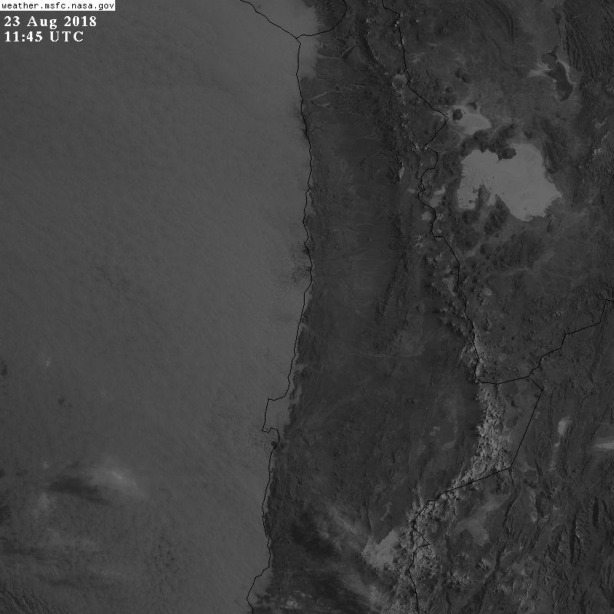
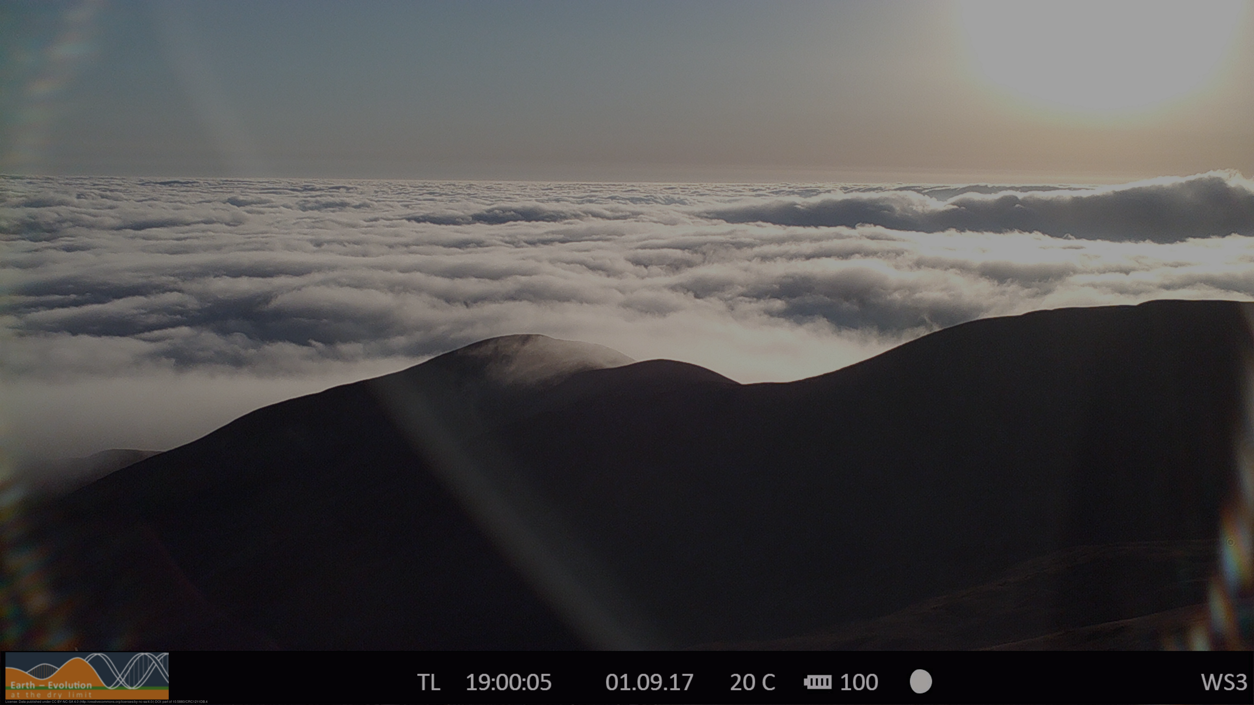
Water vapor transport into the Atacama desert simulated with a high resolution atmospheric model
Jan H. Schween, Vera Schemann, Ulrich Löhnert
Institute for Geophysics und Meteorology University of Cologne

Slide 2
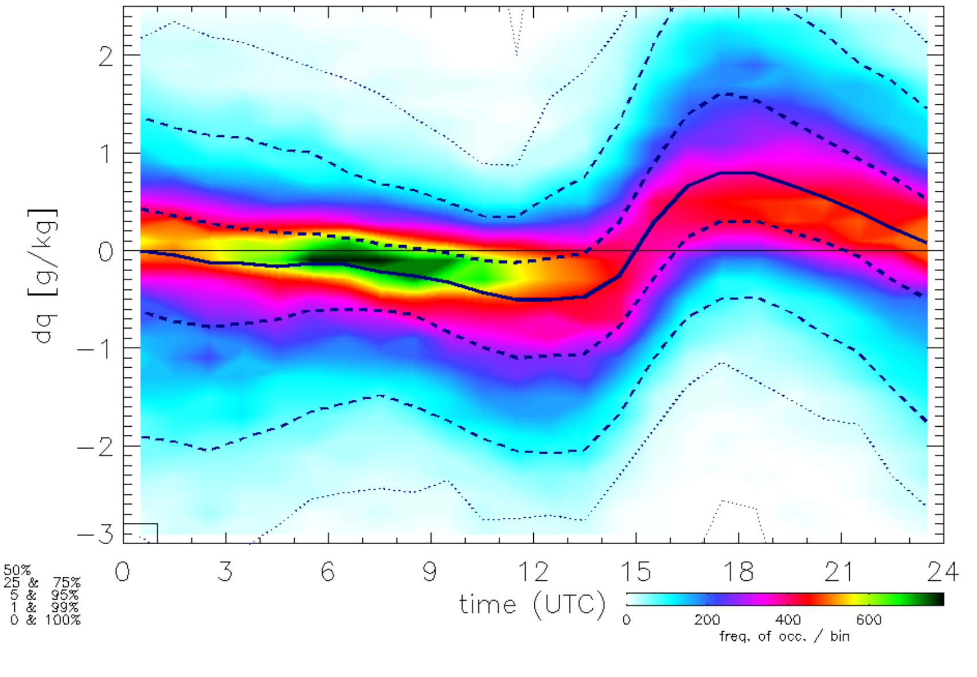
Water vapor transport by the „Rutllant Cell“?
Observations
During daytime strong inland wind at surface, moisture input Atacama
During night, weak outflow → dry desert air towards the ocean
Moisture
Day: moist air from the ocean
Night: dry air from the desert
Issues
How far does moisture propagate land-inward?
Dew or fog deposition: potential 0.2 mm/day to the central depression (not observed)
→ Where does the moisture go?
Day, evening
3000m
subsidence
Water vapor
1000m
Pacific
Coastal cliff
Andes

Slide 3
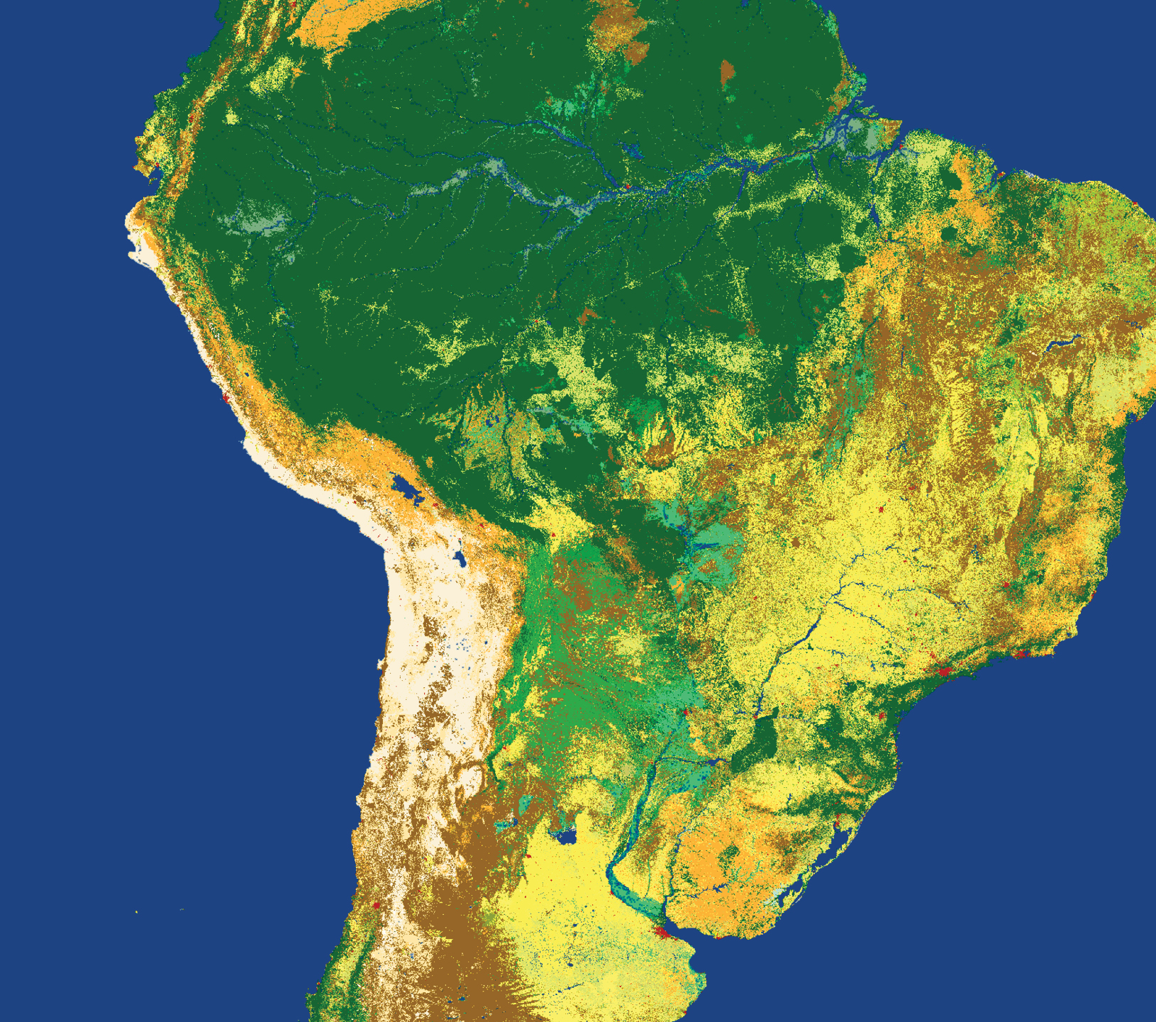
Model run
ICON-LEM of the DWD ICOsahedral Nonhydrostatic Modell permitting Large scale turbulence
Two days in winter no large scale disturbances 22+23. Aug. 2018
~300x300km
~624m horizonal resolution
200Lev. up to 20km
Forcing by ICON-Global
Domain covers
Pacific Ocean
coastal mountain range (~1400m asl.),
Central depression (~900m),
‚Precordillera‘ (~2000-5800m),
Altiplano (~3800m)
Altiplano
Precordillera
Pacific Ocean
Central depression
Salar Grande
Rio Loa
X-z-section @ 21.4°S

Slide 4
Surface specific humidity
Moist air from ocean is channelled through valleys in the coastal mountains
It reaches to the Precordillera but not higher
It flows back in the evening / night.
It remains in valleys and basins during night, eventually forms fog.

Slide 5
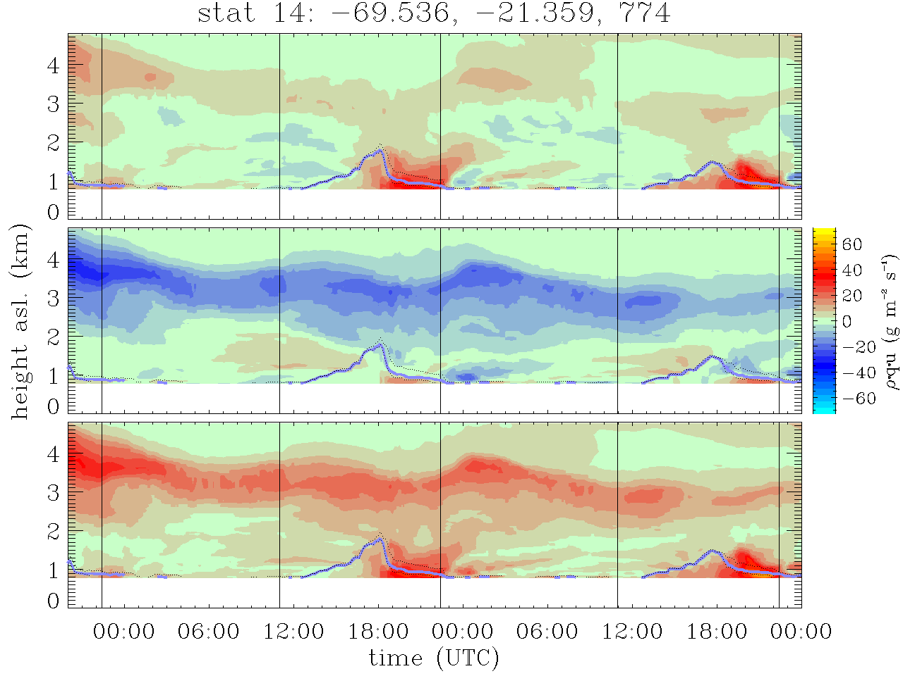
moisture transport above station 14
ρq_{v}
q_{v} ⋅ u
z_{BL}(Ri_{b})
W to E transport
u
1m²
Product ρ ⋅ q_{v} ⋅ u gives vapor transport in g/(m2 s)
W-wind during daytime (~9h 17-02UTC) below 2km asl is main W-E transport
N-S transport of moist air at 3-4km asl. is larger (same absolutum but layer thicker and whole time present)
q_{v} ⋅ v
N to S transport
q_{v} ⋅ |v|
Total absolut transport
00LT
12LT
00LT
12LT
22.8.
23.8.

Slide 6
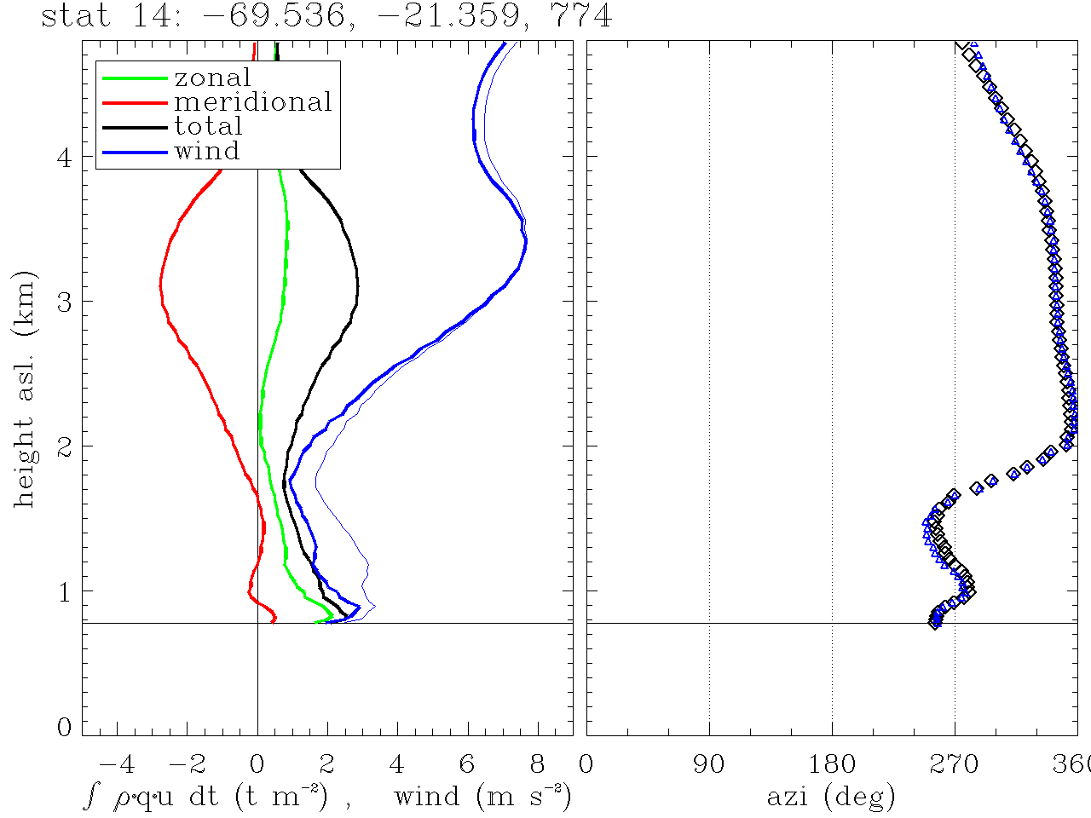
Total vapor transport over both days
Transport in t/m² as function of height
Transport from W to E up to 1km agnd.
Above 1km transport from N to S with maximum in 3.2km asl.
More moisture transport to the south in upper layer than to east in lower layer (area under curves is larger)
=> not a continous transport
Direction of wind and transport
N to S transport
W to E transport
Ground level

Slide 7
Circulation scheme
afternoon, evening
night, early morning
3000m
3000m
1000m
1000m
strato cumulus
Fog
Pacific
Coastal cliff
Andes
Pacific
Coastal cliff
Andes
morning - noon
3000m
^^
1000m
Pacific
Coastal cliff
Andes

Slide 8
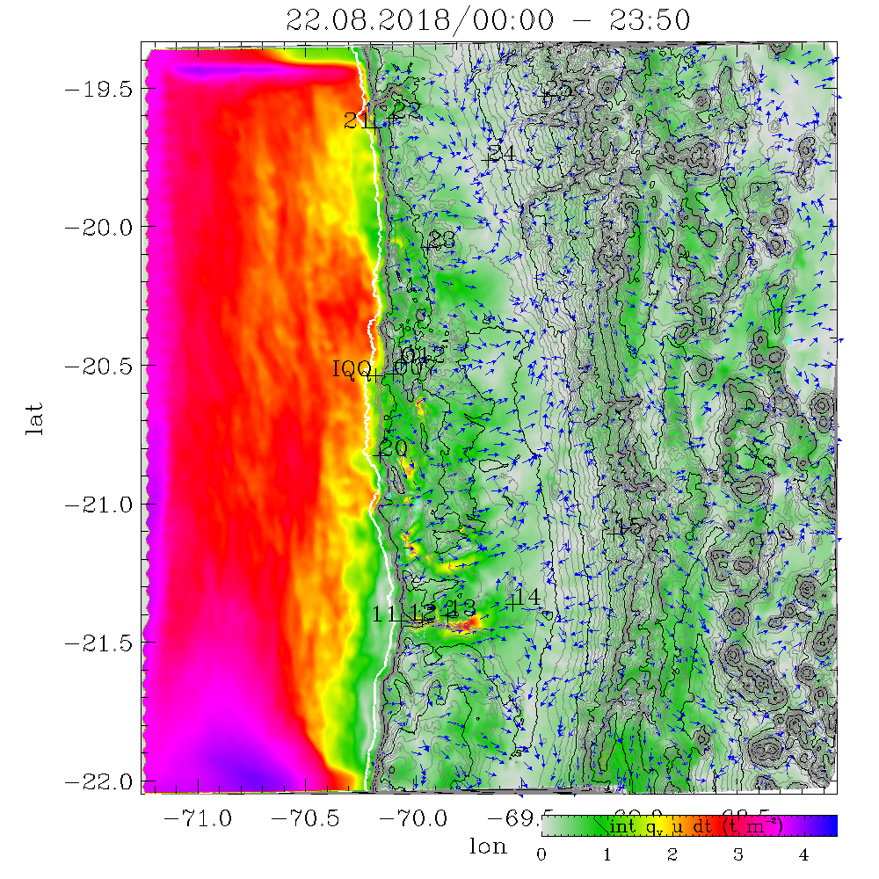
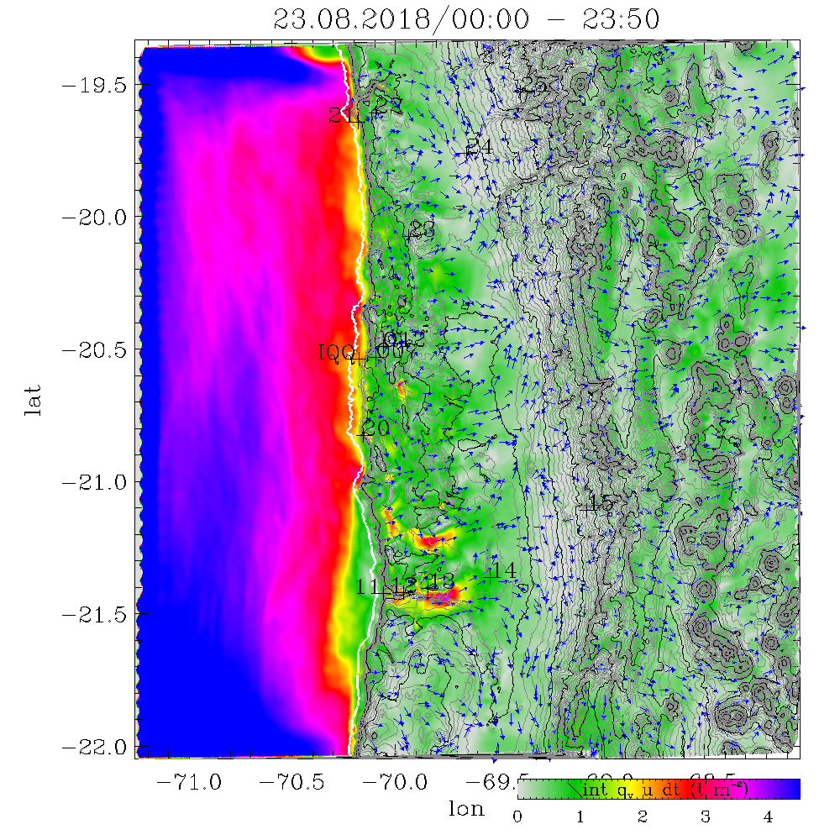
water vapor pathways
Total transport of water vapor in t/m2 over one day (color shading)
Direction of transport (arrows)
Valleys and basins provide pathways through the coastal mountains connecting the central depression to ocean air, e.g.:
Rio Loa mound – Central depression
Punta Chomache – Salar Grande – Salar de Llamara
Alto Patache – Salar Grande – Salar de Llamara – Central depression
Alto-Patache – Officina Victoria – Central depression
Caleta Buena – Pampa de la Perdiz – Pozo Almonte – Central depression …
E
D
C
B
A

Slide 9
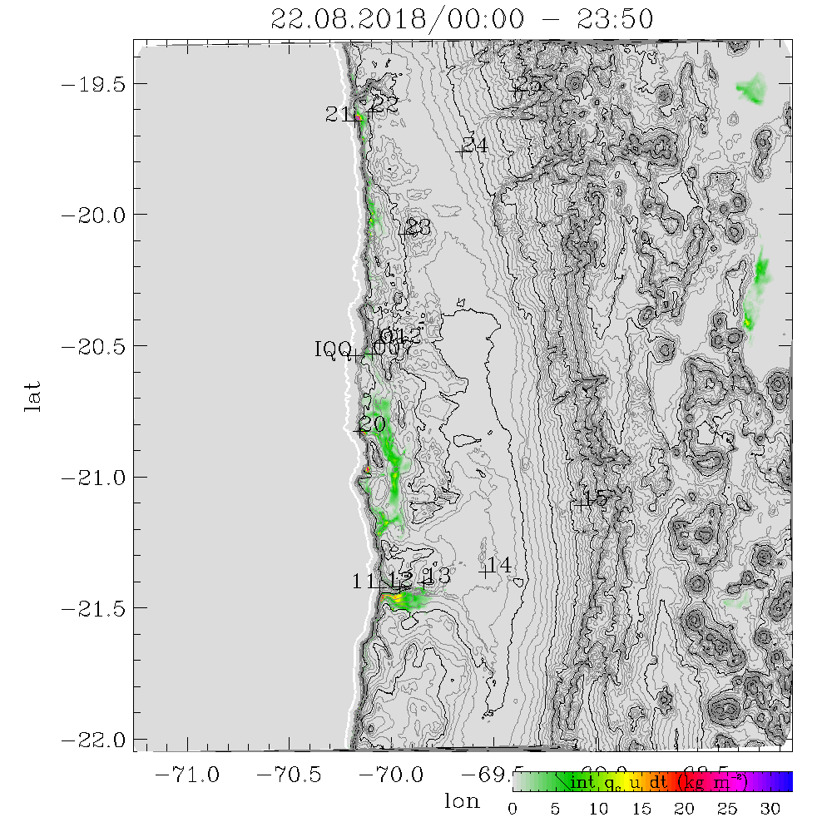
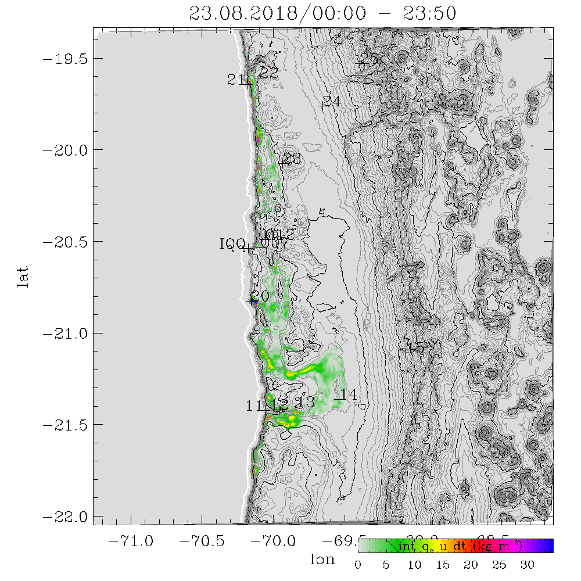
Fog => Liquid Water Transport
During fog the air transports droplets of liquid water.
When the flow encompasses an obstacle the air can move around but not all droplets can follow and would deposit on that surface.
A theoretical fog collector with 100% efficiency, would have collected these amounts of water.
Additonally turbulence can deposit a part (~1/100) of this water directly to the surface => in the order of 0.15mm for this (model) day (estimate based on Taylor (et al.) 2021 a,b)

Slide 10
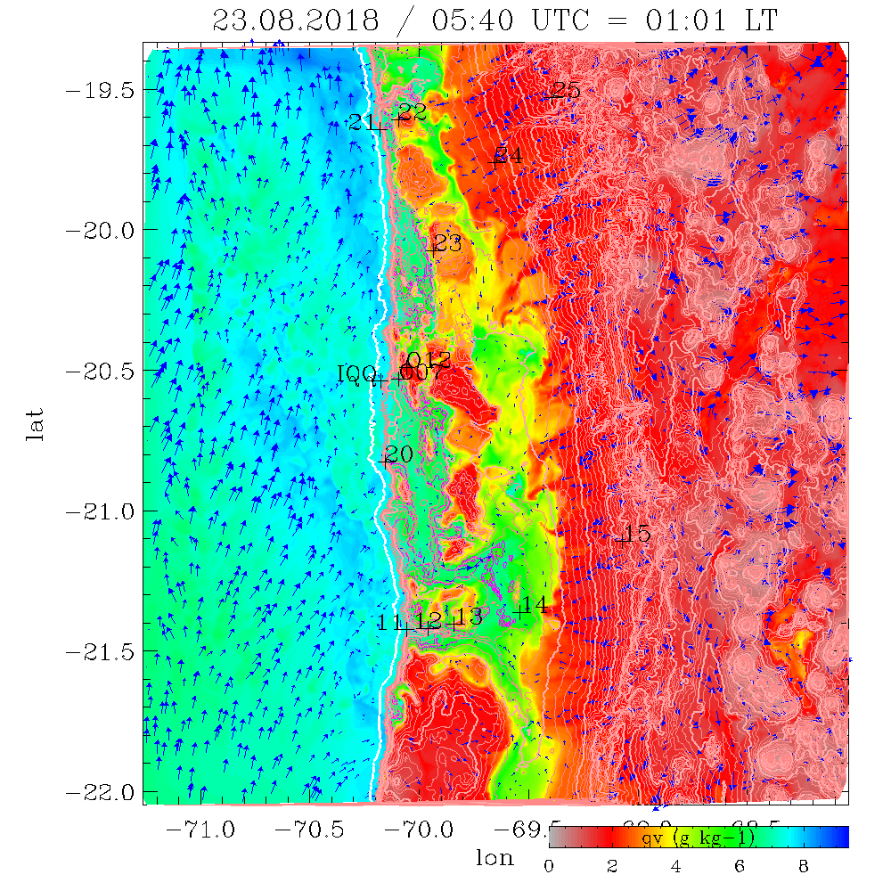
Summary and conclusions:
Water vapor transport into the Atacama is a rather complex interplay of back and forth movements and not a continous flow.
Water vapor is injected into the free troposhere (FT) at ‚sea breeze front‘ and ‚slope wind front.‘
Vapor transport at the W-side of the Andes at 3km persistent over whole year.
During night form pools of moist air in basins and valleys. They may eventually lead to formation of fog.
A rough estimate of fog deposition by turbulence gives in maximum values in the order of 0.15mm/fog event
morning - noon
3000m
^^
1000m
Pacific
Coastal cliff
Andes

Slide 11
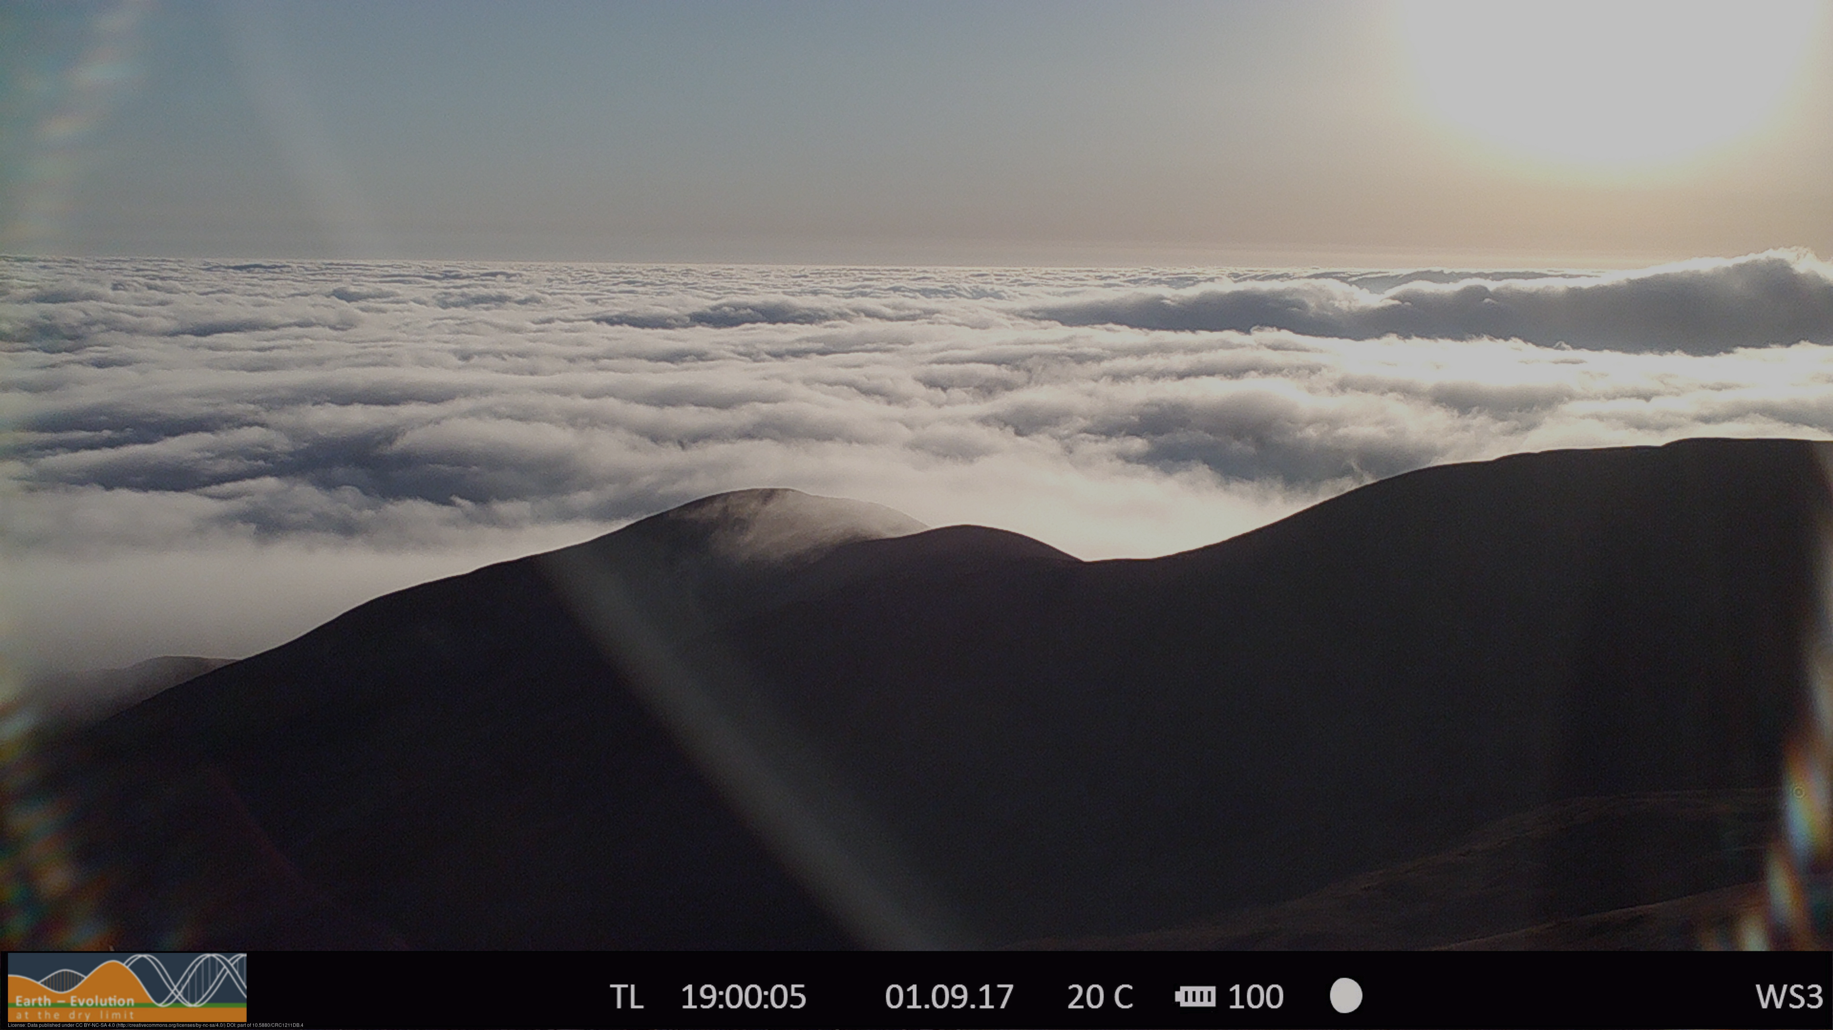
Thank you!

