Slide 1
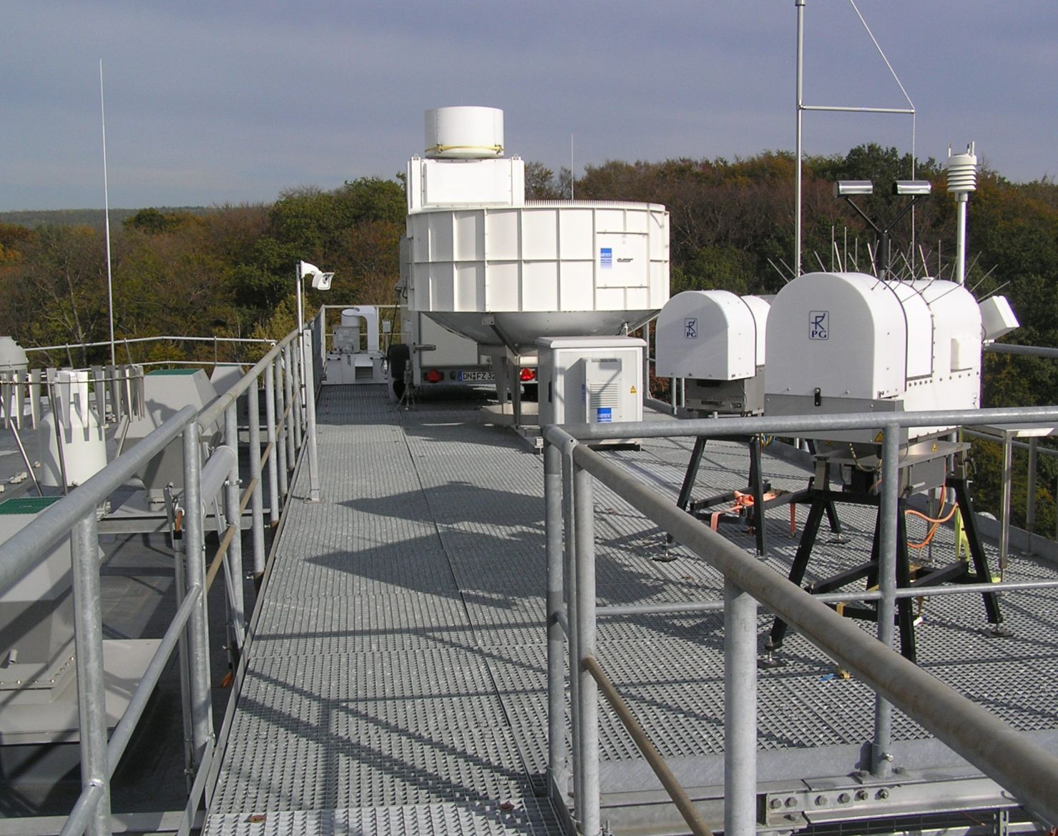
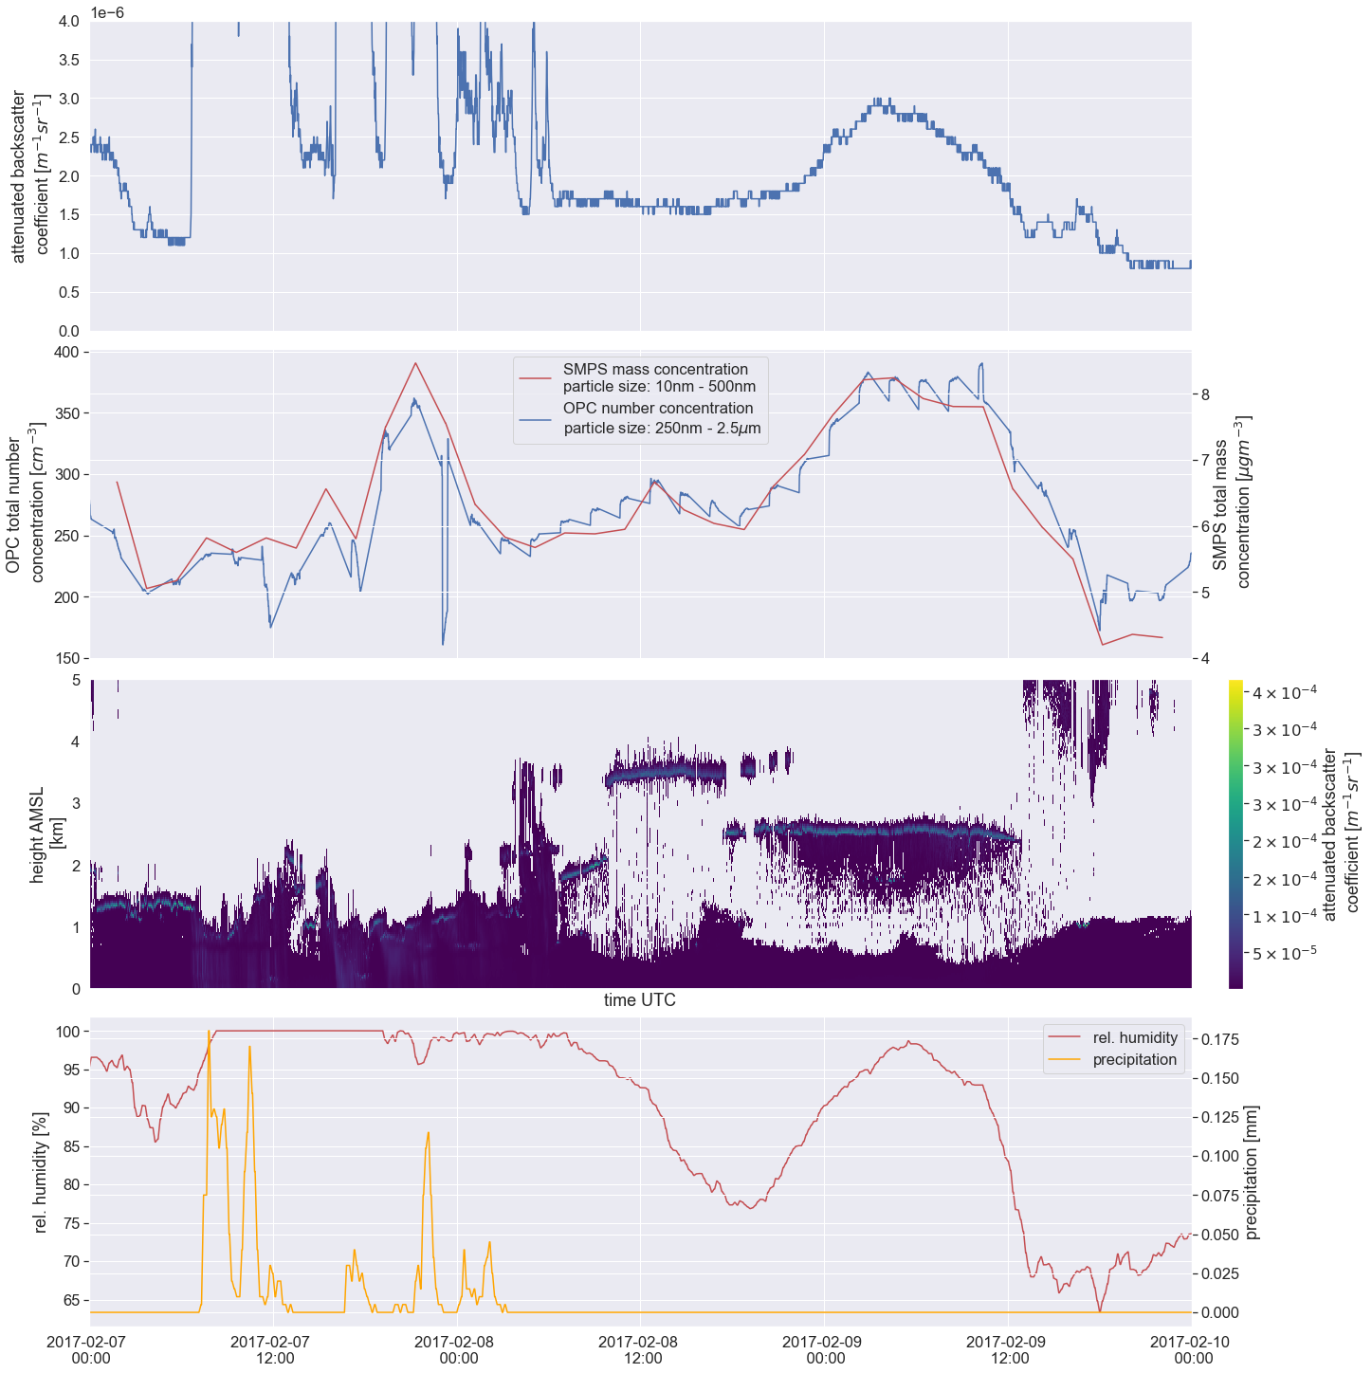
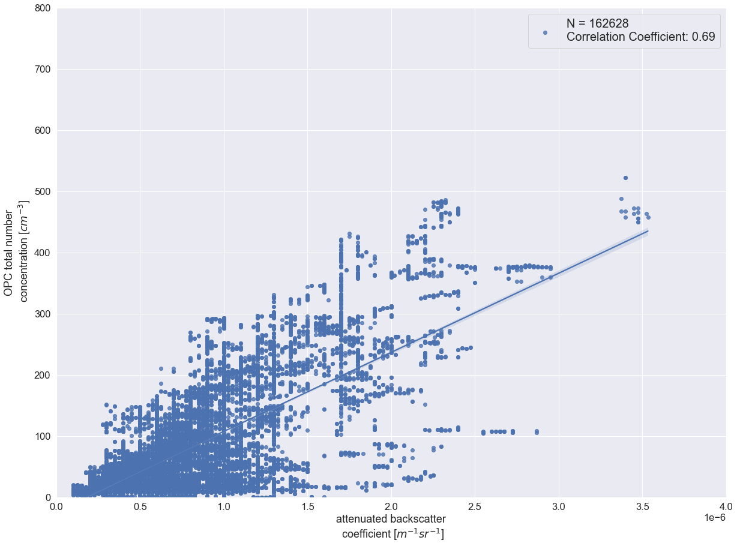
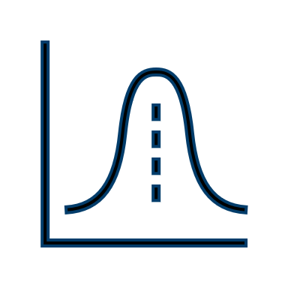
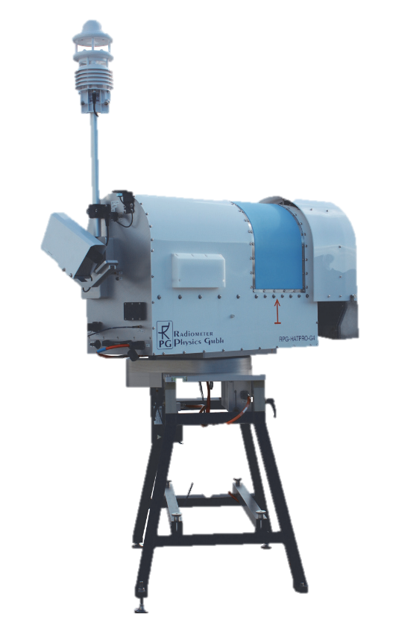
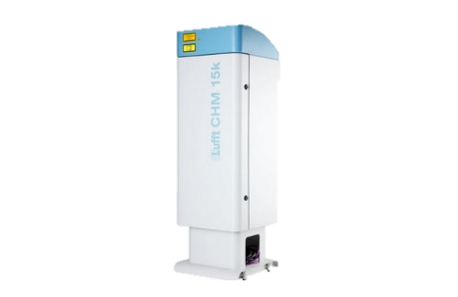
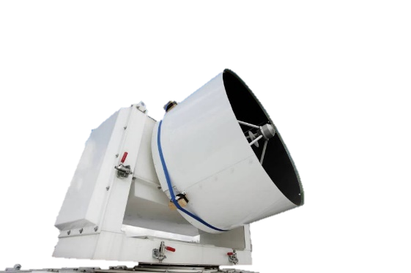
AEROSOL-CLOUD INTERACTIONS
AT JOYCE USING ACTRIS DATA
Marcus Müller¹, Ulrich Löhnert², Birger Bohn¹
¹Institute for Energy- and Climate Research: Troposphere (IEK-8), Forschungszentrum Jülich GmbH, Germany
²Institute for Geophysics and Meteorology, University of Cologne, Germany
contact: marc.mueller@fz-juelich.de
Motivation
JOYCE
Case Study
Comparison of aerosol in-situ and remote sensing measurements in the period 2017-02-07 to 2017-02-10 at JOYCE (120 m AGL)
Today the physical mechanisms of Aerosol-Cloud Interaction (ACI) are well known (Twomey, 1977). Nevertheless, the magnitude of ACI and the scales on which it acts in radiative transfer are still reasons of uncertainty in climate models (IPCC, 2022). A method for the calculation of ACI-metrics, using ground-based cloud remote sensing and the backscatter signal of a ceilometer, already exists (Sarna et. al., 2015). A multi-year application and a detailed analysis of this method is still missing. The JOYCE site allows the use of a unique data set of collocated aerosol in-situ and cloud remote sensing observations.
Jülich ObservatorY for Cloud Evolution
Multi-year tower measurements of aerosol
Cloud & aerosol remote sensing
Ceilometer
Cloud Radars
Microwave Radiometer
Sun Photometer
Research Questions
Data Selection
Is the attenuated backscatter signal (ATB) of a ceilometer suitable to represent aerosol concentration?
Is it possible to confirm and quantify ACI-effects on a long-term JOYCE dataset?
The ACI algorithm (Sarna et. al. 2015) will be applied to data characterized by:
Low-level liquid water clouds
Well mixed conditions (Manninen et. al., 2018)
Cloud base in range 500 m – 2000 m AGL
Only profiles with liquid cloud droplets and aerosols (based on Cloudnet classification)
Goals
Adapt the method (Sarna et. al., 2015) and apply it to long-term JOYCE data.
Compare the ceilometer attenuated backscatter signal to in-situ aerosol-measurements to verify the applicability of the method.
Integrate a Planetary Boundary Layer (PBL) classification (Manninen et. al., 2018).
Set ACI-metrics in context to environmental conditions (temperature, humidity, pressure, weather type classification).
ACI Metrics
Calibration is applied to ceilometer signal (O’Connor et. al., 2004)
OPC Comparison
Comparison of aerosol in-situ (total number concentration) and remote sensing (ATB) measurements in the year 2017 at JOYCE (120 m AGL). Only data, where the rolling STD is smaller $8∙{10}^{−8}m^{−1}{sr}^{−1}$, are shown.
Schedule
vertically integrated
attenuated backscatter:
α(t)
droplet effective radius: $r_{e}$
droplet number concentration: $N_{d}$
Liquid Water Path: LWP
Stage 1
Comparison of Ceilometer ATB and Aerosol In-situ-Measurements
Stage 2
Calculation of ACI-metrics from Multi-Year JOYCE Dataset
Stage 3
Complementary Analyses
Calculation of ACI-metrics
Sarna et. al. (2016)
$${\left.{ACI}_{N}=\frac{d ln{(N}_{d})}{d ln⁡(α)}\right|}_{LWP}$$
$${\left.{ACI}_{r}=\frac{d ln{(r}_{e})}{d ln⁡(α)}\right|}_{LWP}$$
$$r_{α,r_{e}}=\frac{cov(α,r_{e})}{s_{α}s_{r_{e}}}$$
Concept
In-situ Observation
References
Aerosol Number Concentration from Optical Particle Counter¹
Aerosol Size Distribution from Scanning Mobility Particle Sizer²
CCN-Concentration from Cloud Condensation Nuclei Counter²
Transmittance from Nephelometer¹
Sarna, K., & Russchenberg, H. W. J. (2016). Ground-based remote sensing scheme for monitoring aerosol-cloud interactions. Atmospheric Measurement Techniques, 9(3), 1039–1050. https://doi.org/10.5194/amt-9-1039-2016
Twomey, S. (1977). The Influence of Pollution on the Shortwave Albedo of Clouds. Journal of the Atmospheric Sciences, 34(7), 1149–1152. https://doi.org/10.1175/1520-0469(1977)034<1149:TIOPOT>2.0.CO;2
O’Connor, E. J., Illingworth, A. J., & Hogan, R. J. (2004). A Technique for Autocalibration of Cloud Lidar. Journal of Atmospheric and Oceanic Technology, 21(5), 777–786. https://doi.org/10.1175/1520-0426(2004)021<0777:ATFAOC>2.0.CO;2
Manninen, A. J., Marke, T., Tuononen, M., & O’Connor, E. J. (2018). Atmospheric Boundary Layer Classification With Doppler Lidar. Journal of Geophysical Research: Atmospheres, 123(15), 8172–8189. https://doi.org/10.1029/2017JD028169
IPCC, 2022: Climate Change 2022: Impacts, Adaptation, and Vulnerability. Contribution of Working Group II to the Sixth Assessment Report of the Intergovernmental Panel on Climate Change [H.-O. Pörtner, D.C. Roberts, M. Tignor, E.S. Poloczanska, K. Mintenbeck, A. Alegría, M. Craig, S. Langsdorf, S. Löschke, V. Möller, A. Okem, B. Rama (eds.)]. Cambridge University Press. In Press.
processing
Calculation of ACI-Metrics
Sarna et. al.
JOYCE-Instruments
aci_monitoring.py
JOYCE ACI-DB
evaluation
Images
https://www.otthydromet.com
https://www.radiometer-physics.de
storage
¹data by Andreas Petzold and coworkers
²data by Caiquin Yan, Defeng Zhao, Jian Xu, and Thomas F. Mentel
Notes:
Überschriften 72
Text 22

