Slide 1
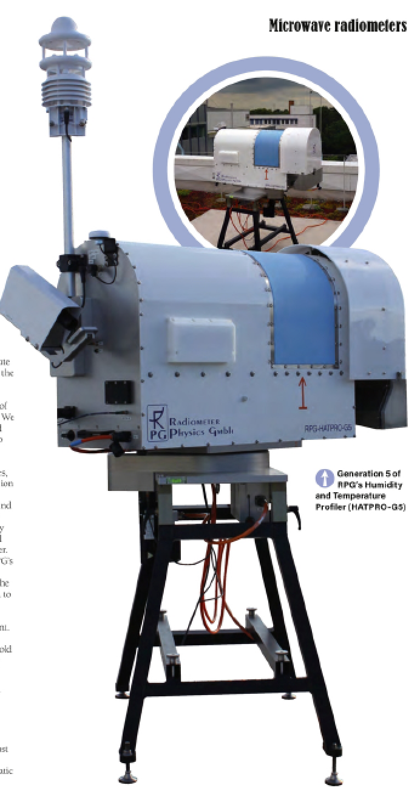
EMF Lecture Day, May 17th 2022
Session
Uncertainty Assessment for HATPRO Microwave Radiometer Measurements and Calibrations
Institute for Geophysics and Meteorology, University of Cologne | Tobias Böck, Bernhard Pospichal, Ulrich Löhnert

Slide 2
Motivation
The atmospheric boundary layer (ABL) is the most important under-sampled part of the atmosphere*
For NWP applications, the top-priority atmospheric variables like temperature (T) and humidity (H) profiles are not currently adequately measured**
T and H profiles can be obtained by ground-based microwave radiometer (MWR) observations
Yet MWR observations are not assimilated by any operational NWP system
*US National Research Council Reports **WMO guidance on observations for NWP: https://www.wmo.int/pages/prog/www/OSY/GOS-RRR.html
2

Slide 3
Goals
Integration of ground-based thermodynamic profilers into the DWD forecasting system (TDYN-PRO)
EMF III: The potential of ground-based thermodynamic profilers for improving short-term weather forecasts
Q: Are the considered state-of-the-art ground-based profilers accurate and reliable enough for data assimilation at DWD?
Also important for E-PROFILE (EUMETNET)* and ACTRIS
*https://www.eumetnet.eu/activities/observations-programme/current-activities/e-profile/
3

Slide 4
Instrument: HATPRO MWR
Humidity And Temperature PROfiler from Radiometer Physics GmbH
Measures thermal emissions from the atmos-phere in 14 different frequencies (H₂O-band and O₂-band)
Converts these radiances into Brightness Temperatures TBs [K] (through Planck’s law)
allows investigation of (via inversion):
rudimentary humidity profiles
temperature profiles
integrated water vapor (IWV)
liquid water path (LWP)
commercially available for ~10 years, ready for network applications (in principle)
continuous data in all-sky conditions: resolution of seconds to minutes
4

Slide 5
HATPRO Calibration
For calibration, 2 blackbodies are necessary: Coldload and Hotload
Absolute calibration with liquid nitrogen (LN2), Coldload
~77.2 K boiling point
should be done every 6 months
Relative calibration on Hotload every 5 min (automatic; target inside radiometer; a bit above ambient temp.)
5

Slide 6
Accuracy of HATPROs (Instrument Errors)
Characterized
systematic errors:
absolute calibration errors, biases (systematic differences between instruments
drifts (instrument stability, TB differences before and after calibrations)
random errors:
radiometric noise (e.g. via covariance matrices)
through coordinated experiments at JOYCE in Jülich and RAO in Lindenberg (FESSTVaL)
Assessed repeatability of calibrations
Objective: Define & apply procedure for MWR measurement uncertainty characterization for TBs (level1) per channel
→ necessary for data assimilation applications
6

Slide 7
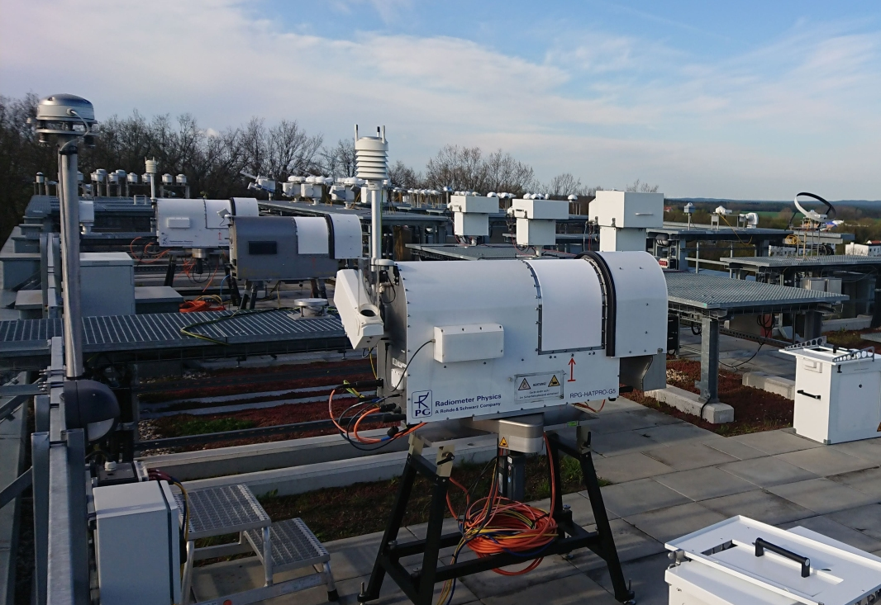
Calibration Campaign at RAO in Lindenberg during FESSTVaL 2021
4 HATPROs on site (FOGHAT G5, DWDHAT G5, SUNHAT G2, HAMHAT G2)
Comparisons of zenith and blackbody measurements (to find out biases, drifts, noise levels, repeatability)
Thanks to Christine Knist for helping with the campaign and to the DWD Observatory in Lindenberg for providing the location and part of the data.
7

Slide 8
Results Overview (instrument errors)
8

Slide 9
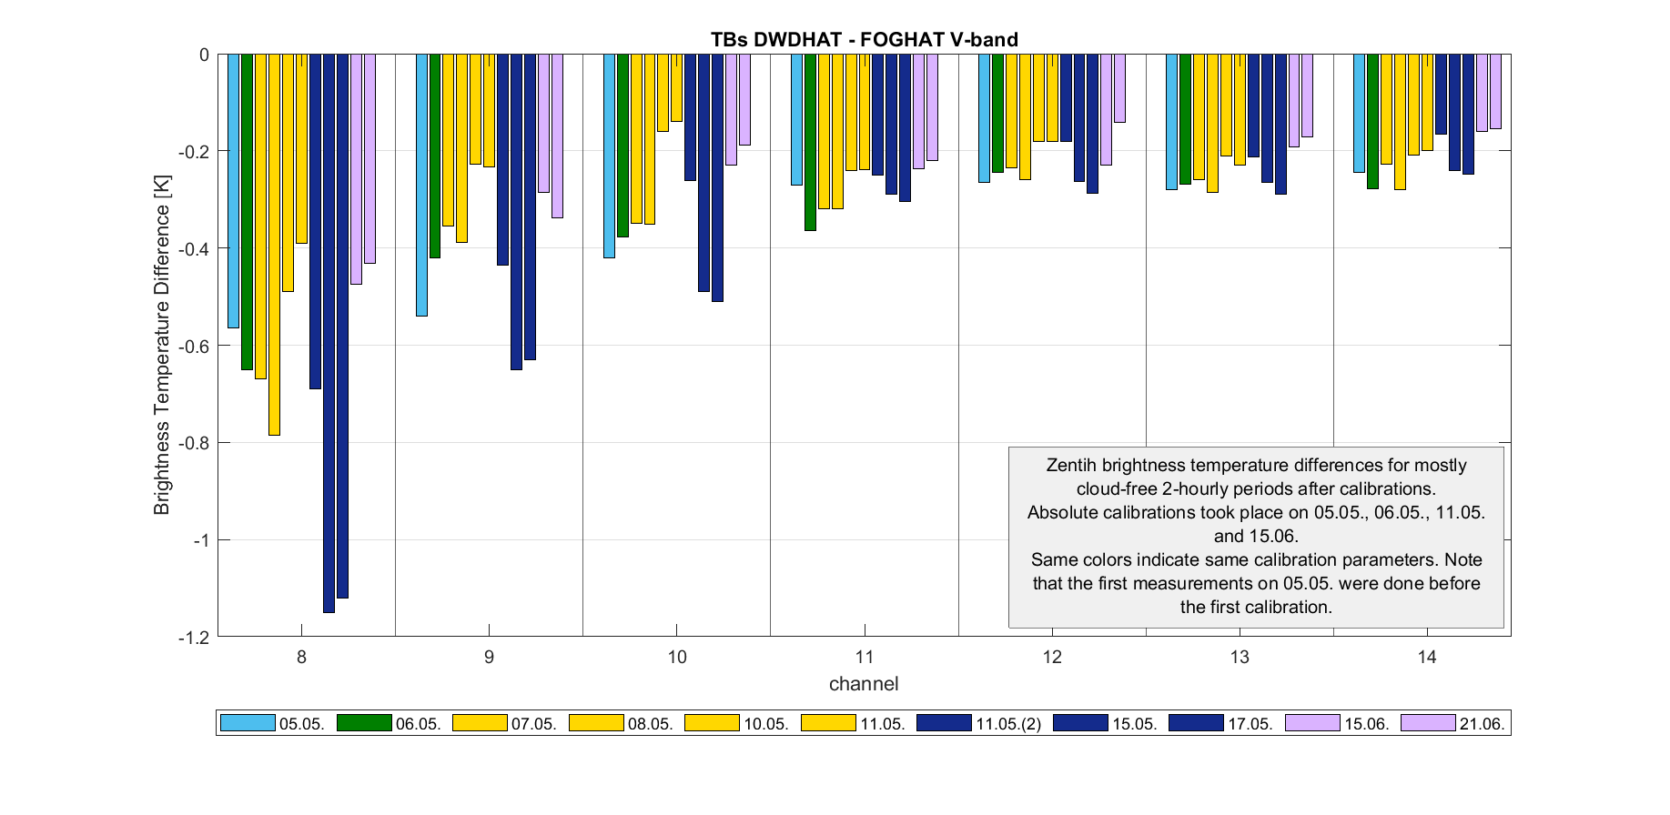
Biases (Differences between newest model HATPROs) via Zenith Comparisons
ok
Systematic differences
All errors are relative, there is no perfect absolute reference
critical
9

Slide 10
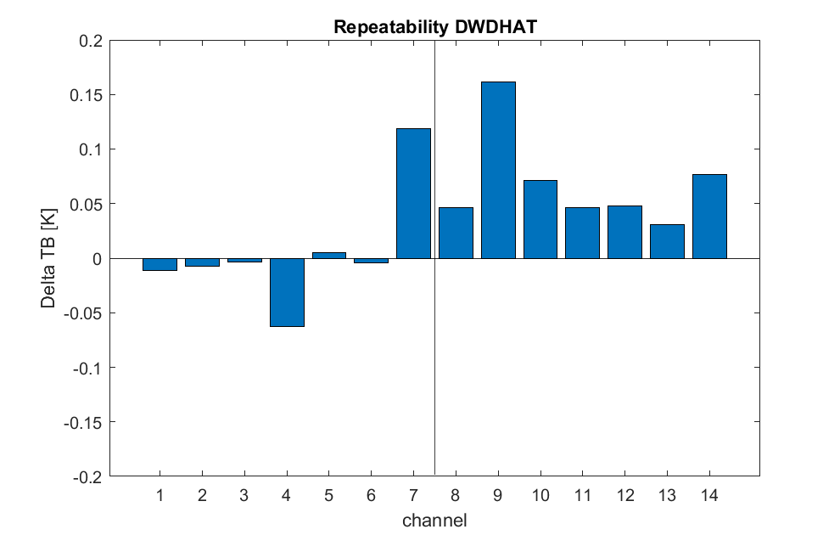
Repeatability: Differences at Zenith between Calibrations compared to a reference
Is influenced by the quality of the calibration
Can only be done this way when there are at least two MWRs on the same site simultaneously
Meaningful values can only be achieved with the same conditions for each calibration (same day, same weather, same target,…)
≤ 0.12 K
H₂O-band
≤ 0.16 K
O₂-band
10

Slide 11
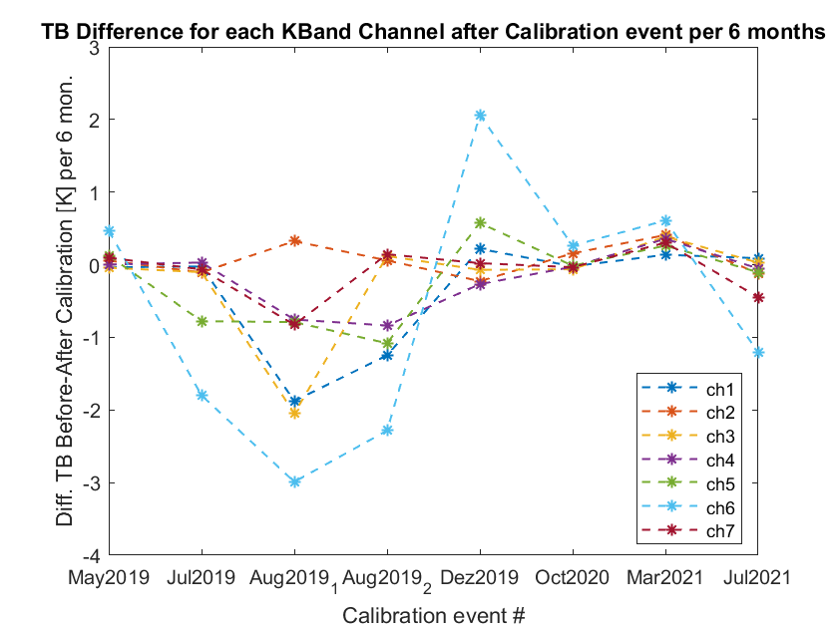
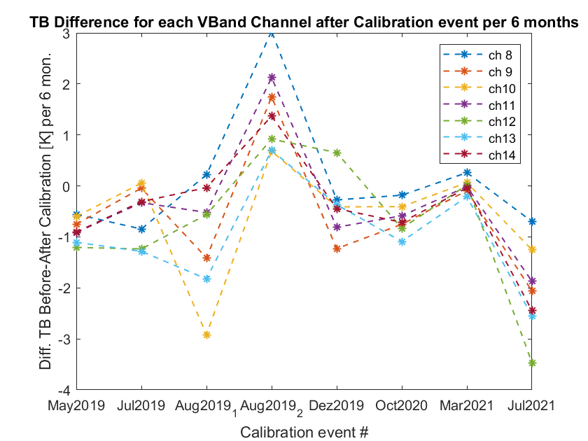
Drifts (via Coldload Differences between Calibrations)
Cannot be directly influenced by operator
Is also influenced by biases!
Need to wait a certain amount of time between calibrations to get meaningful data
11

Slide 12
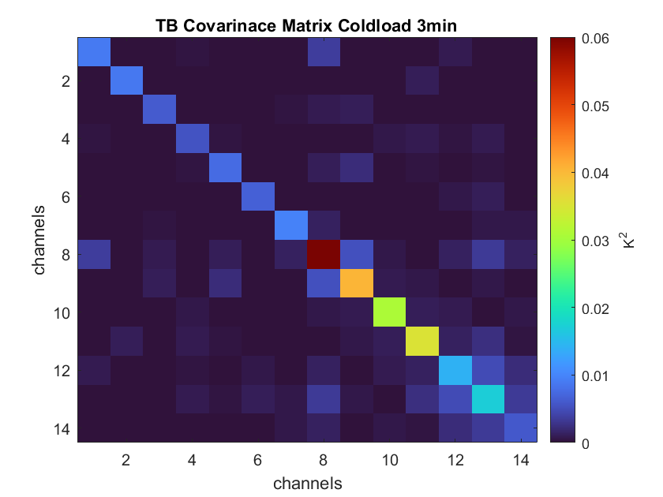
Short Reminder: Covariance Matrix
Correlated radiometric noise for all 14 channels (shows dependency of these channels)
The radiometric noise for a single channel can be determined by calculating the variance when looking on a stable blackbody target
Square root of diagonals is standard deviation
12

Slide 13
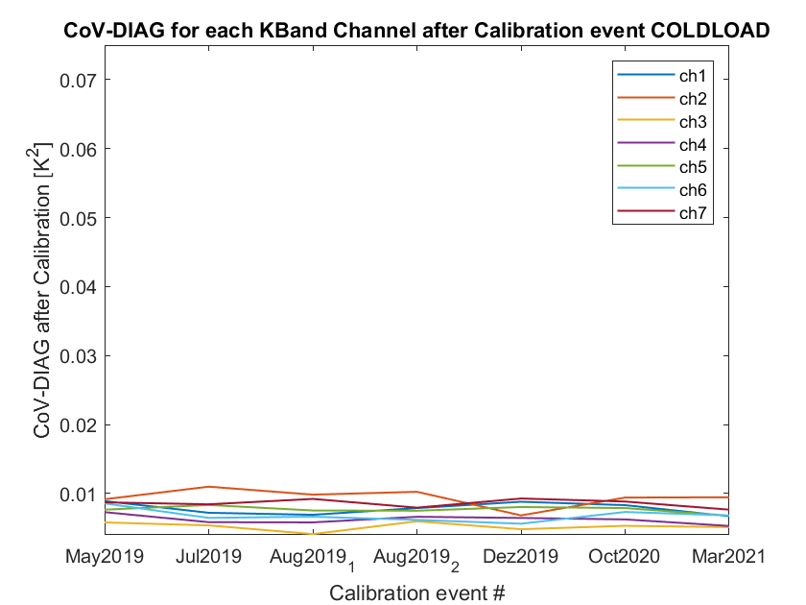
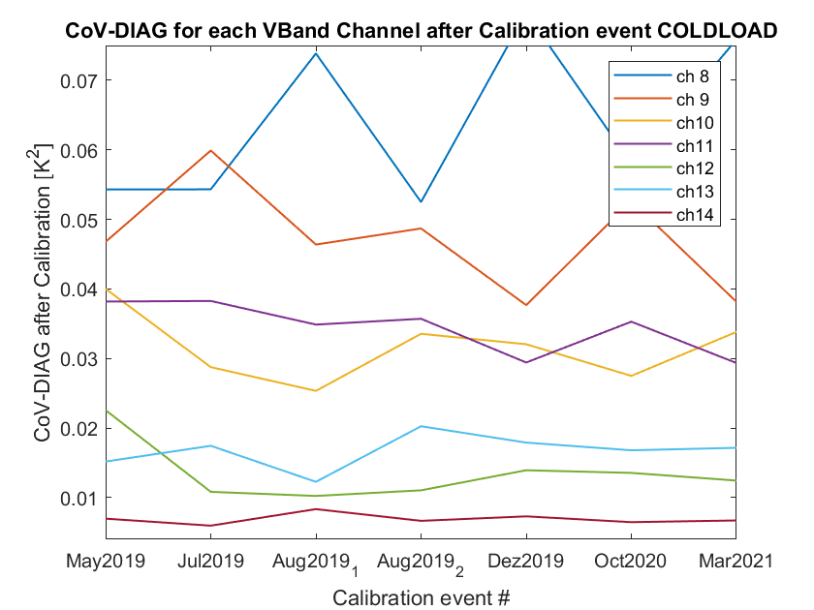
Noise Levels for Coldload
13

Slide 14
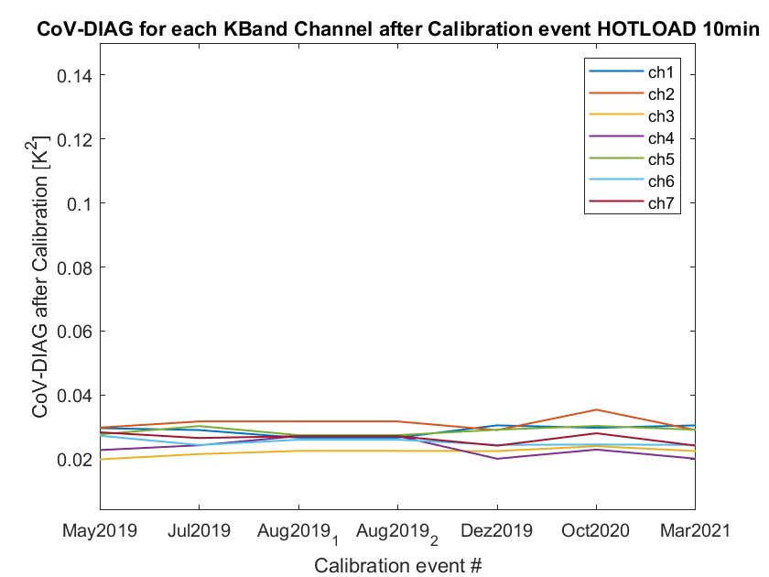
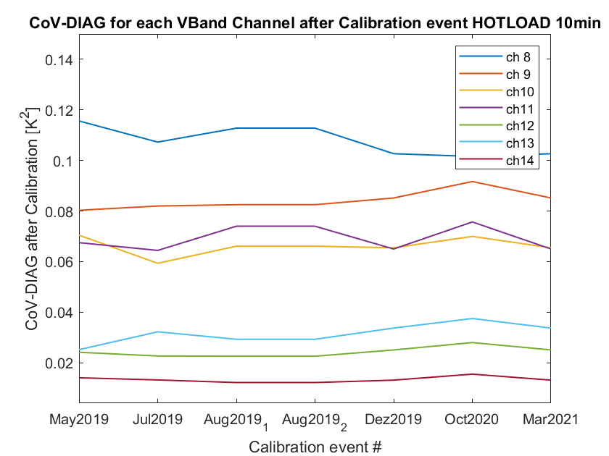
Noise Levels for Hotload
Coldload and Hotload Covariances similar for all Gen5 HATPROs, significantly higher values for older Gen2 instruments
Operator independent, instrument specific
14

Slide 15
Summary Instrument Errors
Results Overview (for Gen5 HATPROs):
Type of Error | Typical Error Values H₂O-band | Typical Error Values O₂-band | Determined via
Biases | usually ≤ 0.3 K (up to 0.48 K) | usually ≤ 0.5 K (up to 1.15 K) | Zenith measurement differences between two MWRs
Calibration Repeatability | ≤ 0.12 K | ≤ 0.16 K | Leaps to zenith reference measurements after two immediate consecutive calibrations
Drifts (over 6 months) | usually ≤ 0.3 K (up to 0.8 K) | usually ≤ 0.8 K (up to 1.3 K) | Differences at coldload after calibration
Noise Levels (coldload – hotload) (1s) | ≤ 0.11 K – 0.18 K | ≤ 0.27 K – 0.35 K | Standard deviation
Comparison to RPG manual:
→ absolute TB uncertainty 0.5 K, → noise 0.10 to 0.15 K
Suggestion for total maximum error per channel:
Bias mean + Repeatability + Drift (for retrievals noise is also important)
For minimal error: only Repeatability
15

Slide 16
Location dependent Errors: Radio Frequency Interference (RFI) and Obstacles
16

Slide 17
MW-profiling: How does it work theoretically?
K-Band
H₂O vapor
(channel 1-7)
V-Band
O₂
(channel 8-14)
pressure broadened WV line → total water vapor & weak profile information
WV channels are optically thin:
MWR can “see” far into the atmosphere
Is more susceptical to external errors like RFI and far away obstacles
Oxygen absorption → constant VMR, so only temperature dependent
O2-band channels are optically thick, especially ch 11-14:
MWR does not penetrate very far into the atmosphere
Measured TBs are Ts near the ground
cloud contribution
17

Slide 18
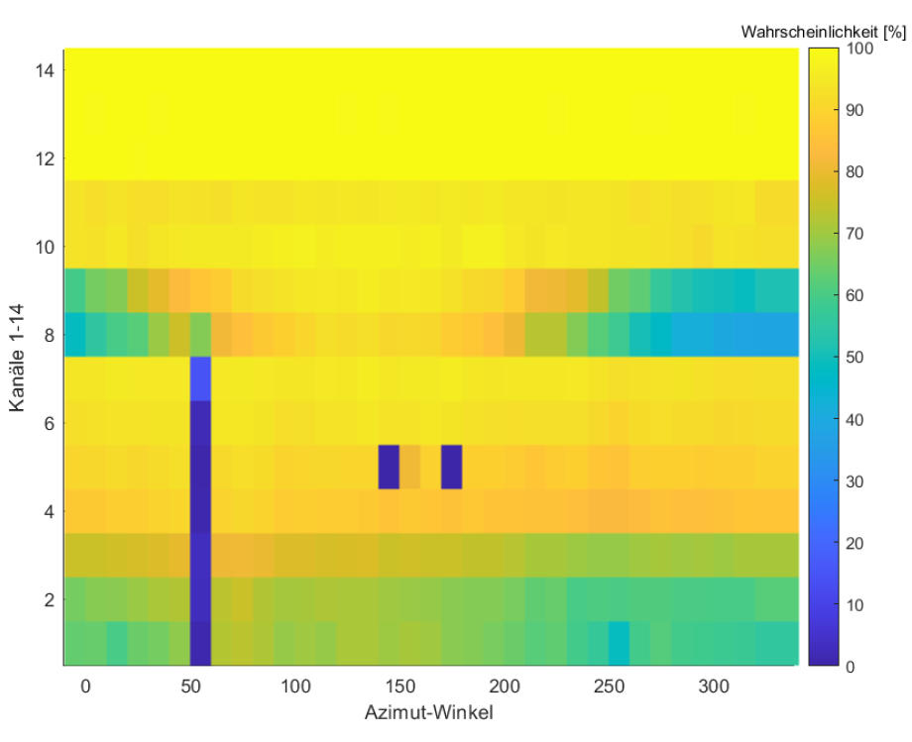
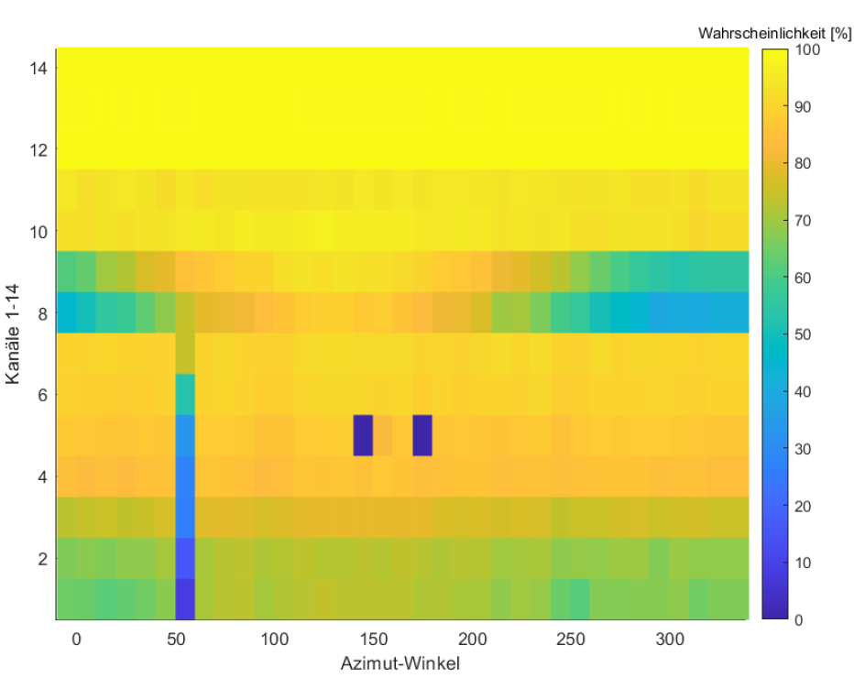
Obstacles and RFI at Jülich
30° Elevation Scan Interferences 14.04. – 18.05.2020
30° Elevation Scan Interferences 14.04. – 18.05.2021
Higher fluctuation of water vapor
RFI (communication links?)
courtesy of Johanna Drude
mast
Full 360° azimuth scans at 30° elevation for all 14 channels in clear-sky conditions
Probability of difference of: (azimuth step – azimuth minimum) < 1K
18

Slide 19
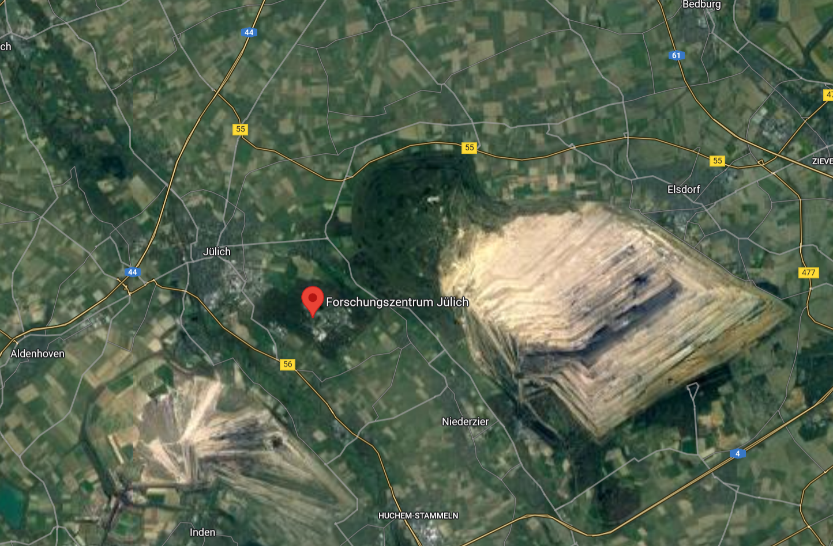
Location of Research Center Jülich
WV and T fluctuations in different compass directions maybe due to this big open-cast mining pit near Jülich
19

Slide 20
Impact of Obstacles on T-profiling
lower
optical thickness τ of atmosphere
90°
30°
5°
higher
20

Slide 21
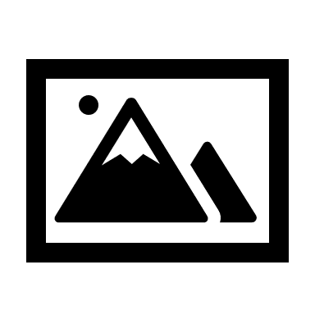
Sensitivity Study: Simulate Obstacles in Line of Sight
Simulate obstacles by increasing optical thickness to very high values in a LBL-RT model
lower
distance x₂^{30°}
optical thickness τ of atmosphere
distance x₁^{90°}
distance x₁^{30°}
90°
30°
5°
higher
distance x₁^{5°}
distance x₂^{5°}
21

Slide 22
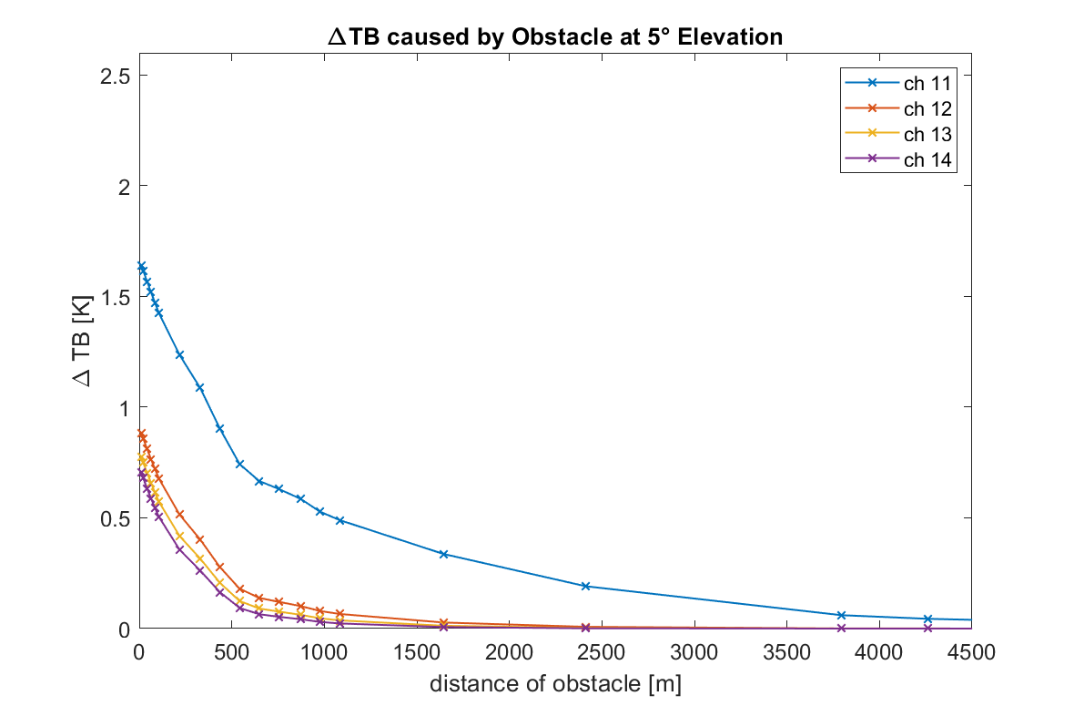
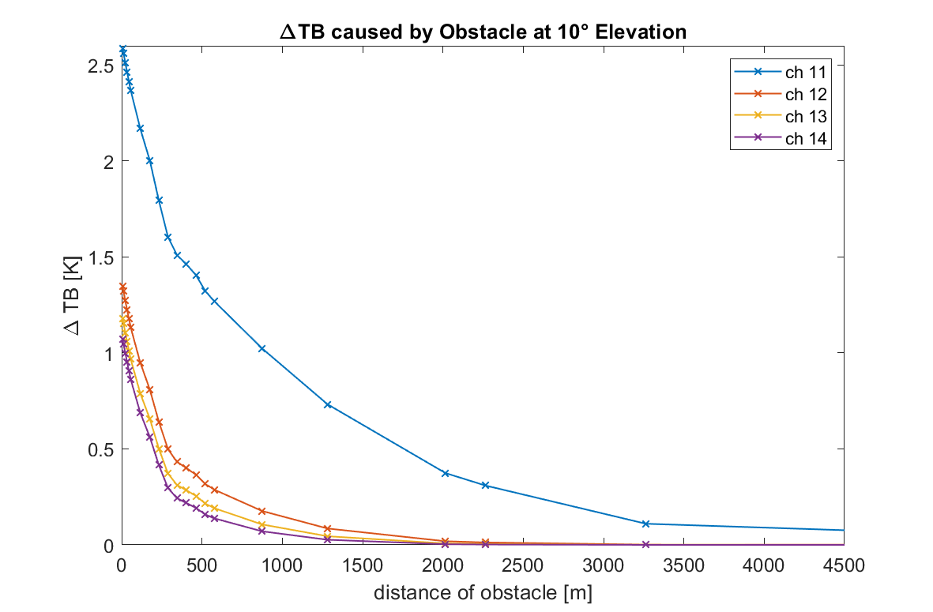
Simulated Obstacles
For T-profiles, elevation scans are conducted in ch 11-14
Ch 11 should maybe not be used when an obstacle is nearby
22

Slide 23
Outlook: Next Steps
Make retrievals (T-profiles) from TBs generated by the simulated obstacles and compare them with retrievals without obstacles
→ paper?
Change lv1-files in incorporate biases, repeatability, drifts and noise levels and a total maximum and minimum error
Getting to know RTTOV-gb and use it with different elevation angles to create O-B statistics
Data Assimilation of MWR data into DWD forecast system
23

Slide 24
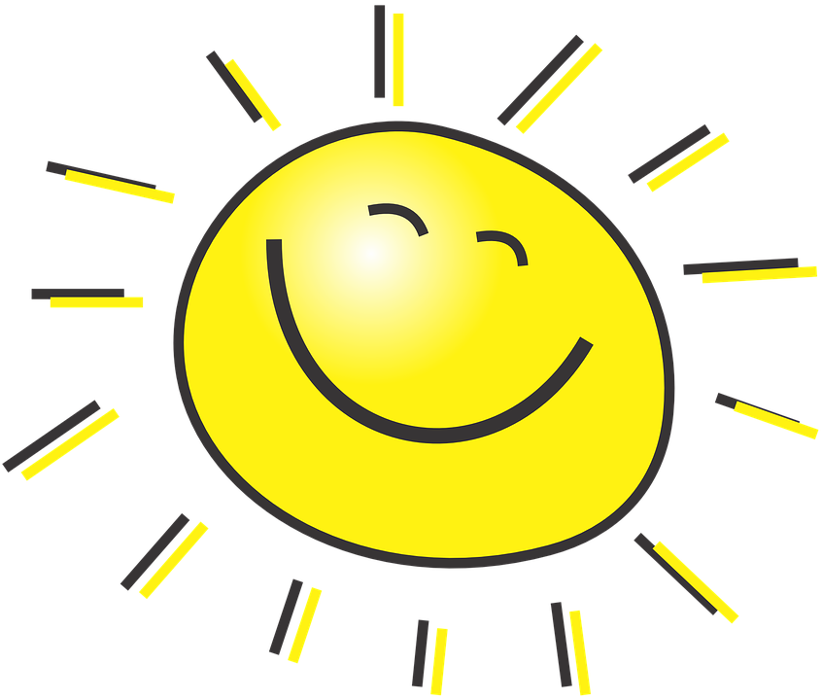
Thank you for your attention!
Contact:
tobias.boeck@uni-koeln.de
24

Slide 25
Bonus Slides
25

Slide 26
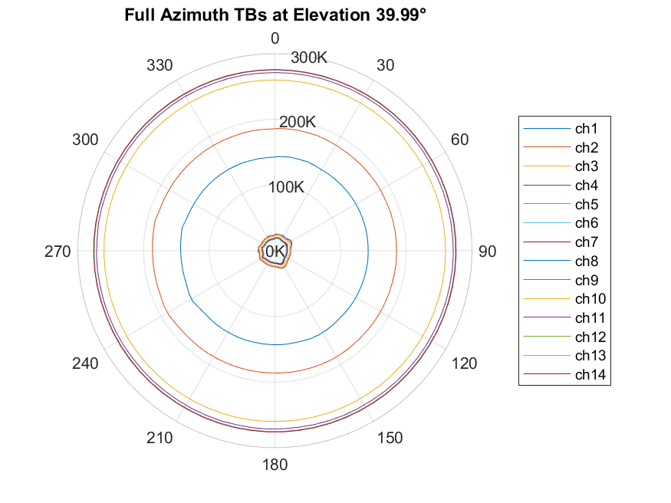
FOGHAT at Köln: Azimuth Scans (Obstacles and external Interference)
26

Slide 27
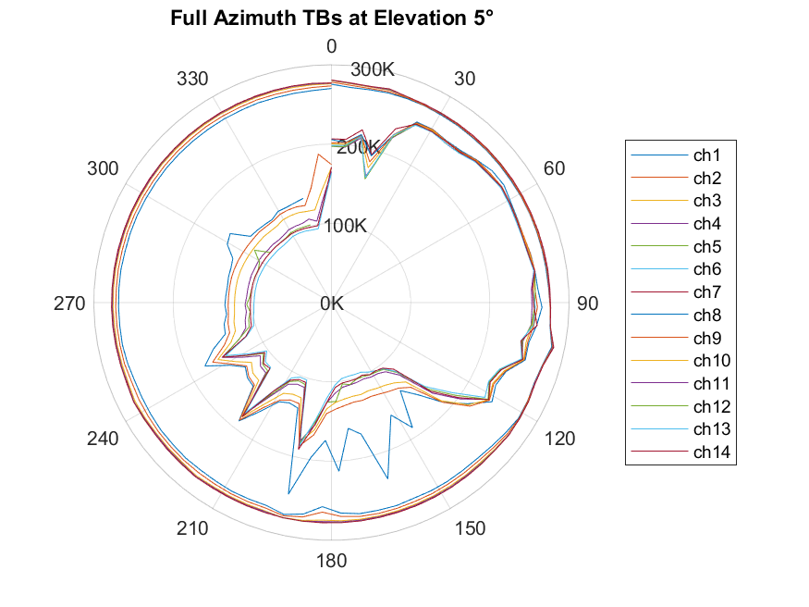
FOGHAT at Köln: Azimuth Scans (Obstacles and external Interference)
wall from building
between
NE and SE
EM interference?
27

Slide 28
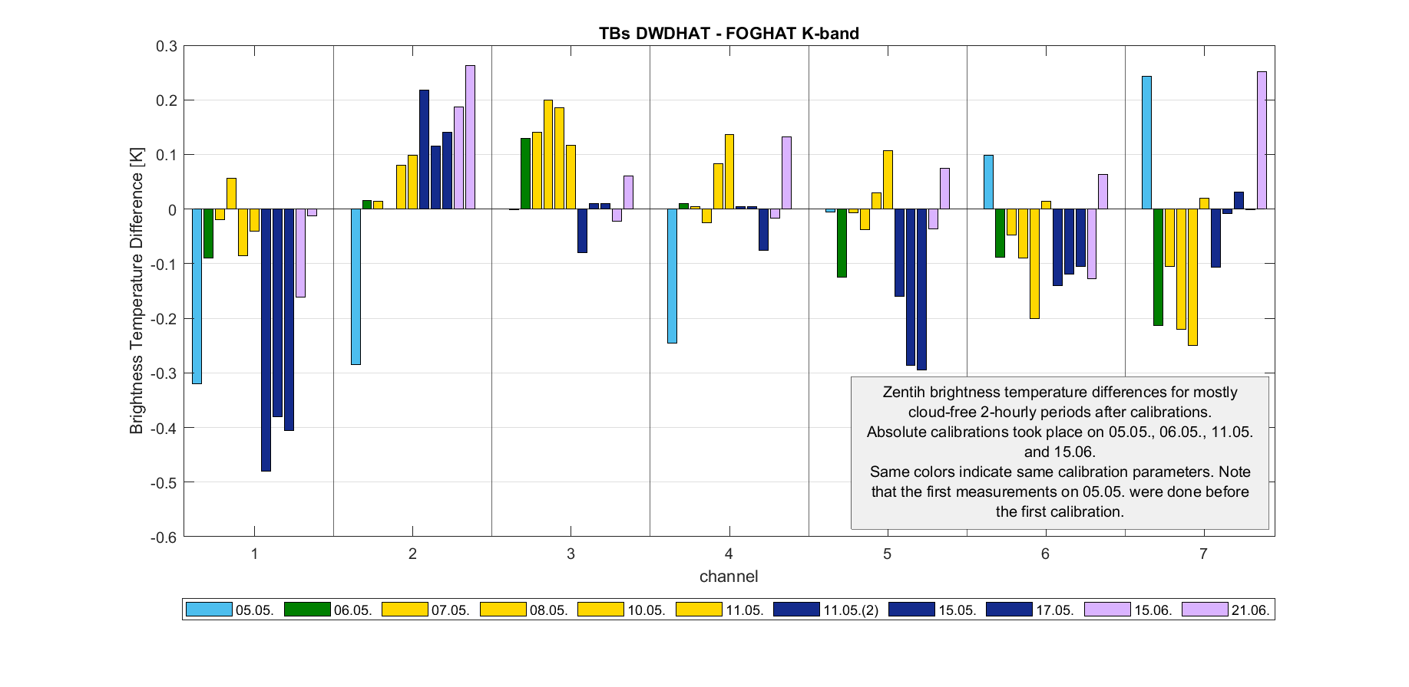
Biases/Offsets via Zenith Comparisons
28

Slide 29
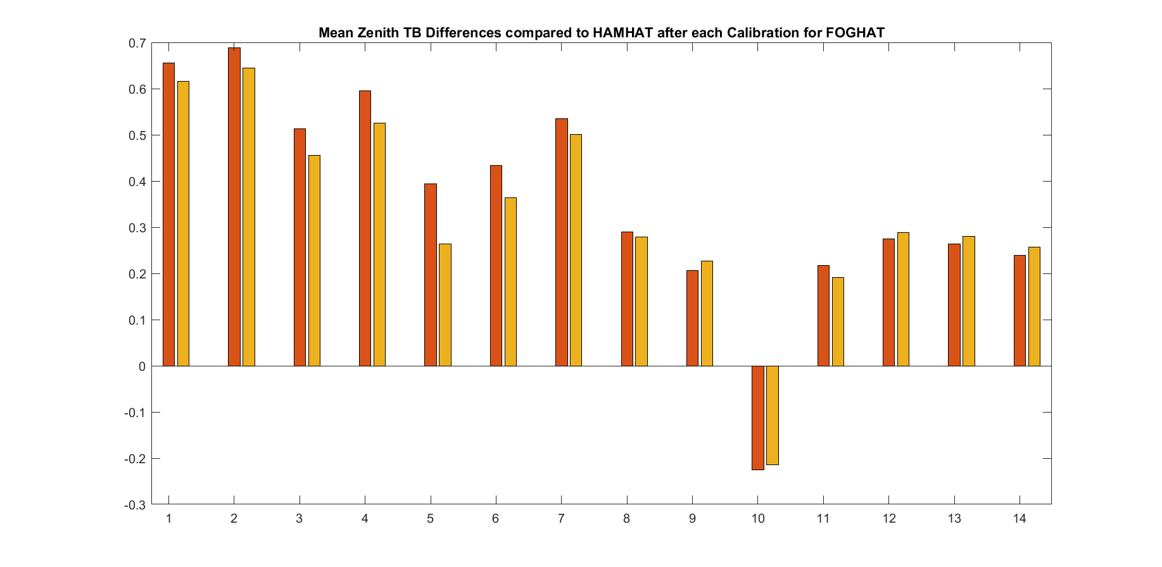
(Repeatability FOGHAT)
29

