Slide 1
BOUNDARY LAYER CLASSIFICATION
Antti Manninen
University of Helsinki, Finland
Tobias Marke
University of Cologne, Germany
Ewan O’Connor
Finnish Meteorological Institute

Slide 2
Contents
1. Motivation and introduction
2. Pre-processing of Halo Doppler lidar data
3. Calculation of the required lidar quantities
4. Identification of the main drivers causing mixing
5. Case studies: Hyytiälä, Finland and Jülich, Germany

Slide 3
Contents
1. Motivation and introduction
2. Pre-processing of Halo Doppler lidar data
3. Calculation of the required lidar quantities
4. Identification of the main drivers causing mixing
5. Case studies: Hyytiälä, Finland and Jülich, Germany

Slide 4
Motivation for boundary layer (BL) classification
Classifying the BL into set of types helps to understand the combination of complex mixing processes and their evolution
Identify issues with BL mixing schemes in models, separate into component processes
Surface-atmosphere interactions can be investigated
Identify coupled/decoupled cloud layers

Slide 5
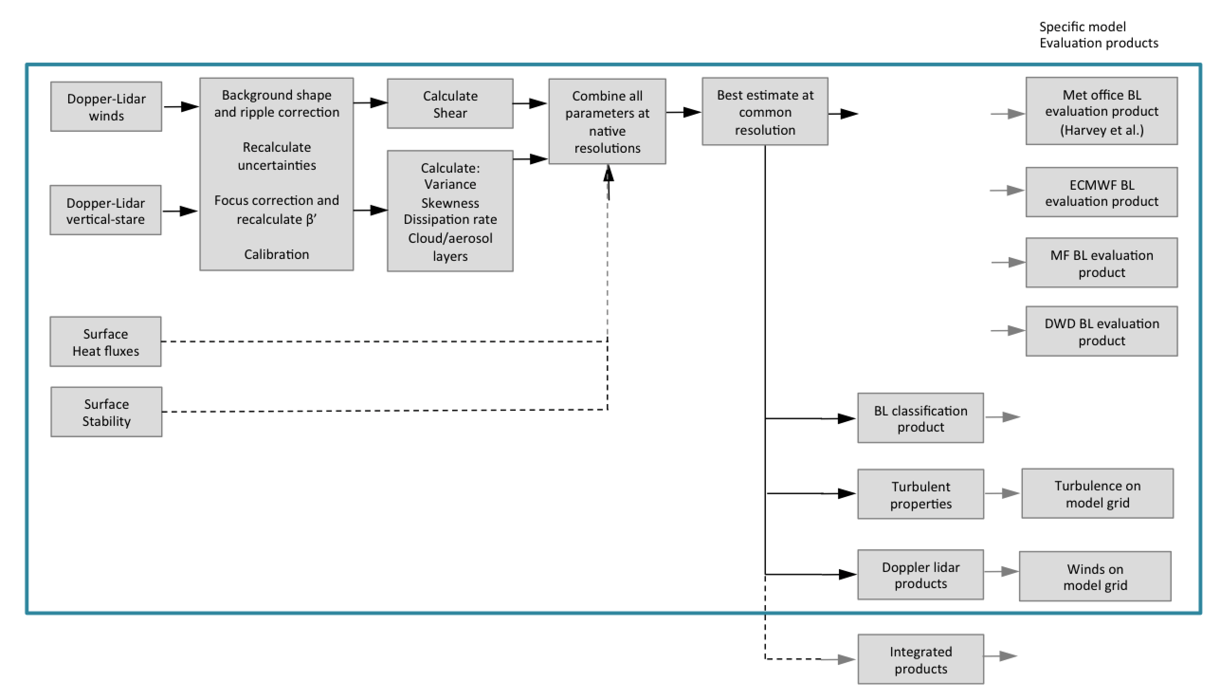
BL classification will be a Cloudnet data product

Slide 6
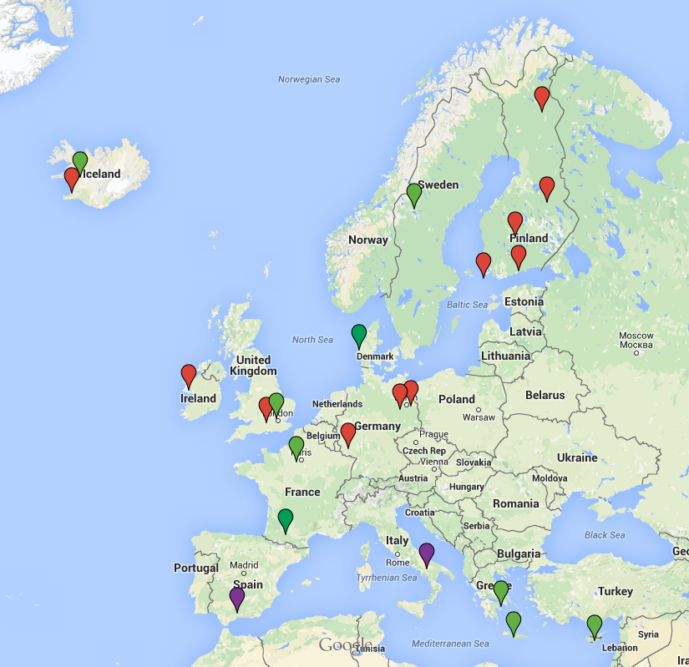
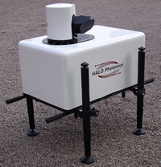
Halo Photonics Streamline scanning Doppler lidar
Vertical and horizontal radial wind velocities
Co- and cross-polarized attenuated backscatter coefficient profiles
Turbulent properties from variation in velocities
DL network:
Operational
Campaigns
Future operational
Wavelength 1.5 µm
Range 105-9600 m with 30 m vertical resolution
Hemispheric scanning ability
halo-photonics.com
Ewan O’Connor

Slide 7
Contents
1. Motivation and introduction
2. Pre-processing of Halo Doppler lidar data
3. Calculation of the required lidar quantities
4. Identification of the main drivers causing mixing
5. Case studies: Hyytiälä, Finland and Jülich, Germany

Slide 8
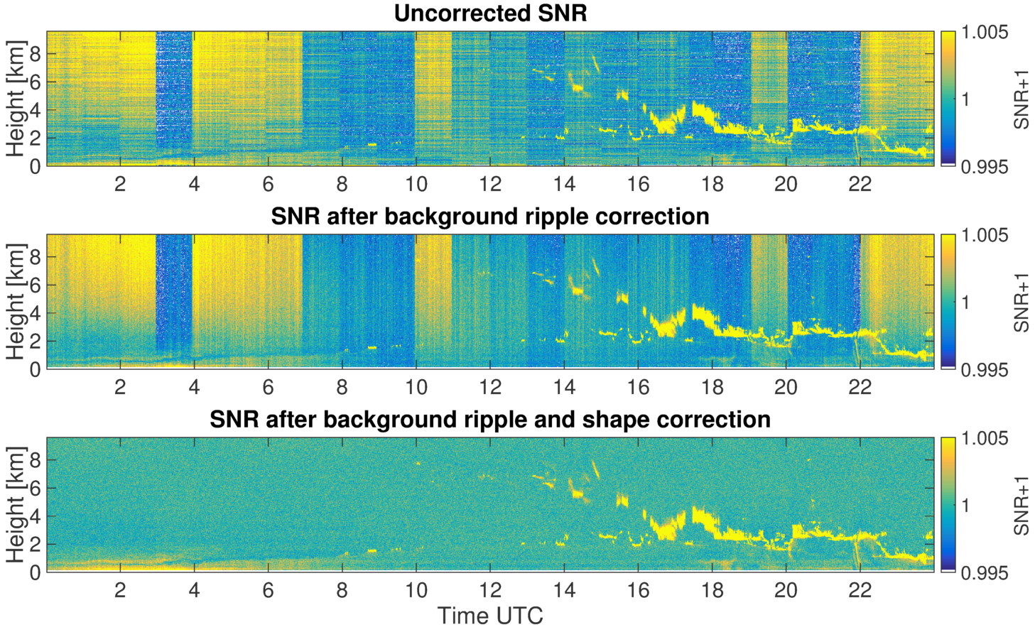
Halo data requires pre-processing
Hyytiälä, 9 June 2014
SNR = signal-to-noise ratio
Shape and stripe correction Manninen et al. (2016, AMT) Vakkari et al. (2017, to submit)
Focus correction (Hirsikko et al., 2014) calculate new attenuated backscatter coefficients
Recalculation of uncertainty estimates
Notes:
The background determination in the current software version is not handled optimally.
Accurate information essential especially in low signal regions.

Slide 9
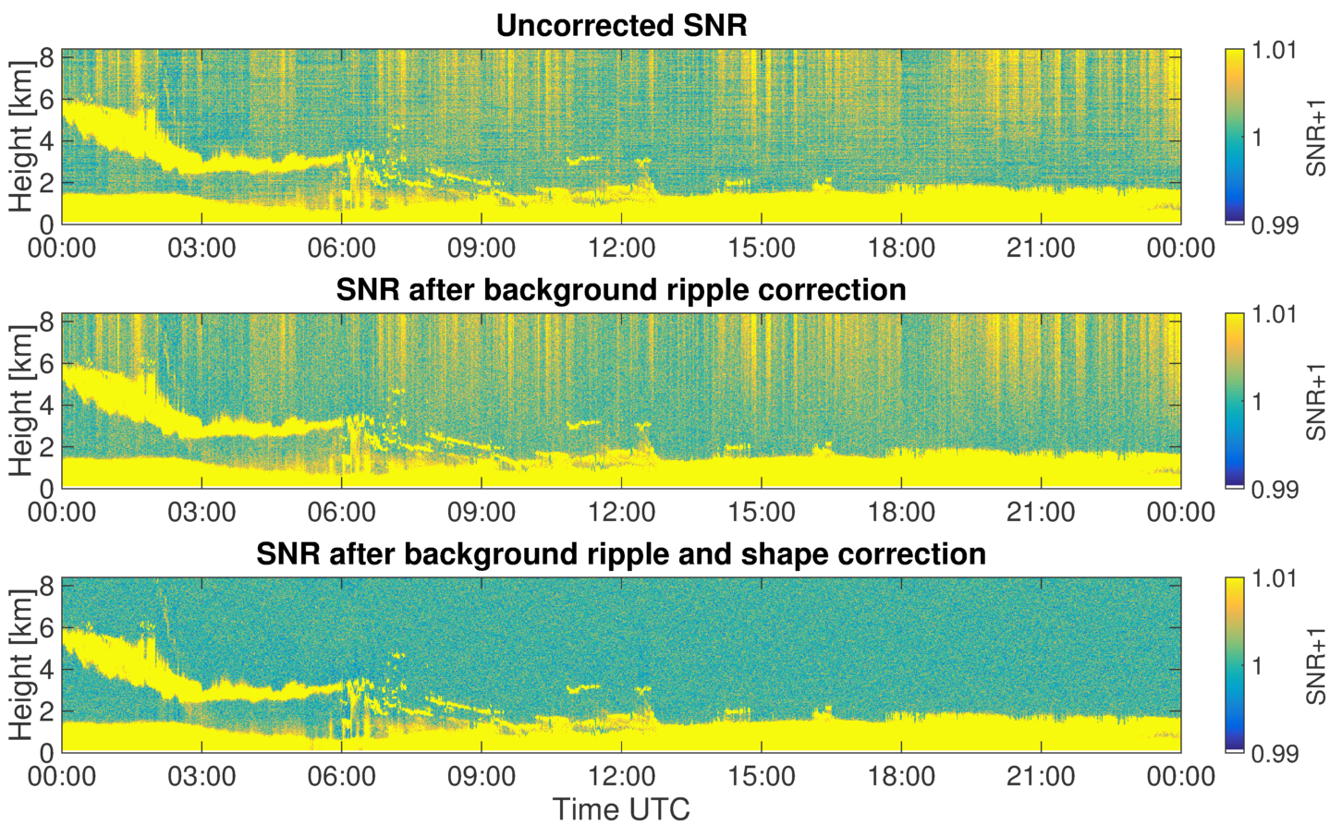
Halo data requires pre-processing
Juelich, 2 June 2014
SNR = signal-to-noise ratio
Shape and stripe correction Manninen et al. (2016, AMT) Vakkari et al. (2017, to submit)
Focus correction (Hirsikko et al., 2014) calculate new attenuated backscatter coefficients
Recalculation of uncertainty estimates
Notes:
The background determination in the current software version is not handled optimally.
Accurate information essential especially in low signal regions.

Slide 10
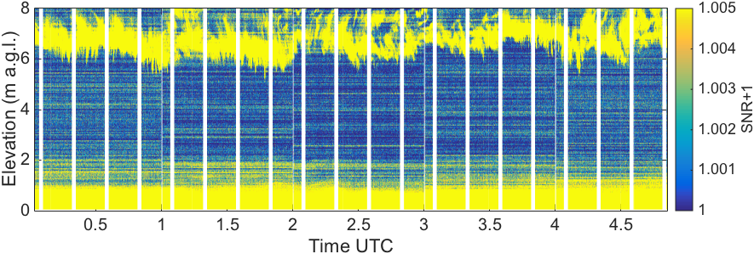
Halo data requires pre-processing
Limassol, 27 March 2017 – last Monday
SNR = signal-to-noise ratio
Notes:
The background determination in the current software version is not handled optimally.
Accurate information essential especially in low signal regions.

Slide 11
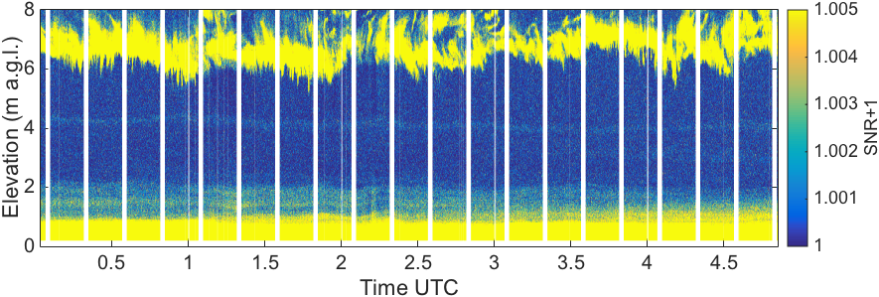
Halo data requires pre-processing
Limassol, 27 March 2017 – last Monday
SNR = signal-to-noise ratio
Notes:
The background determination in the current software version is not handled optimally.
Accurate information essential especially in low signal regions.

Slide 12
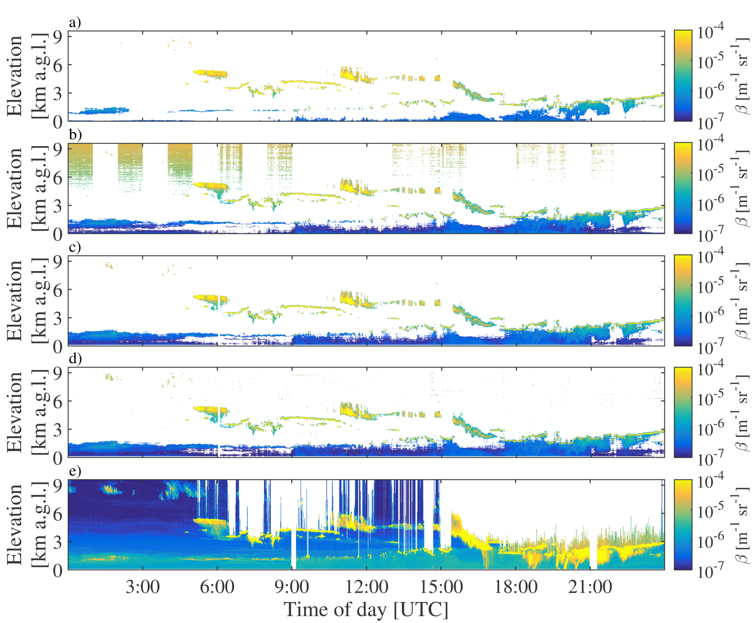
The background correction allows setting a much lower SNR threshold
Pearson et al. (2010)
-17 dB (0.020)
StreamLine Photonics -18.2 dB (0.015)
Päschke et al. (2014) -20 dB (0.010)
After correction
-21.2 dB (0.0075)
or even
-23 dB (0.005)
uncorrected
uncorrected
corrected
corrected

Slide 13
Background noise behavior is a limiting factor for the sensitivity especially in low aerosol load regions
Uncertainty estimates are directly related to the SNR.
Thus any bias in the SNR becomes a bias in the turbulent properties.
Observed velocity variance = true variance + uncertainty variance
has to be known accurately is which you want
So, modifying the uncertainties has a direct impact on the turbulence estimate! (calculated from observed velocity variance)

Slide 14
Contents
1. Motivation and introduction
2. Pre-processing of Halo Doppler lidar data
3. Calculation of the required lidar quantities
4. Identification of the main drivers causing mixing
5. Case studies: Hyytiälä, Finland and Jülich, Germany

Slide 15
Attenuated backscatter coefficients
Height of the aerosol layer – only used to limit the method to the boundary layer.
In practice, at least at high latitude sites, the height where signal can’t be extracted reliably from the background noise anymore is lower than the boundary layer height.
Cloud detection using the Cloudnet detection scheme.

Slide 16
Vertical velocity skewness
$$s= \frac{\overline{w^{′3}}}{{\overline{w^{′2}}}^{3/2}}$$
w’ variation from the mean and overbars temporal and vertical means
Used for detecting cloud-driven turbulence and its extent

Slide 17
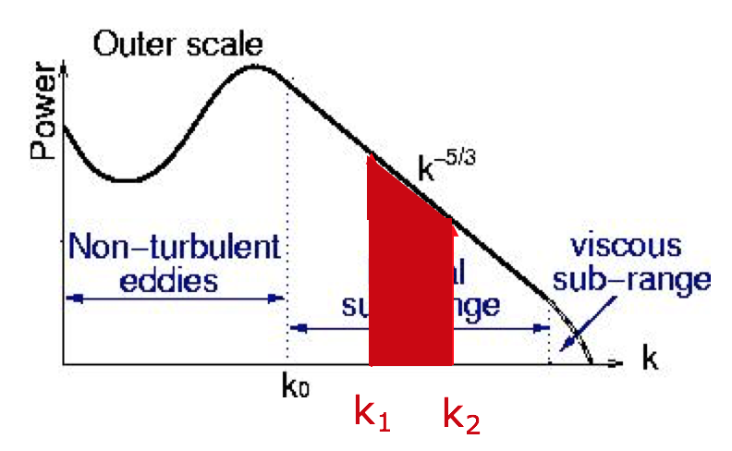
Dissipation rate of turbulent kinetic energy (TKE)
O’Connor et al. (2010)
Derived directly from vertical velocity variance
Length scales derived from wavenumbers

Slide 18
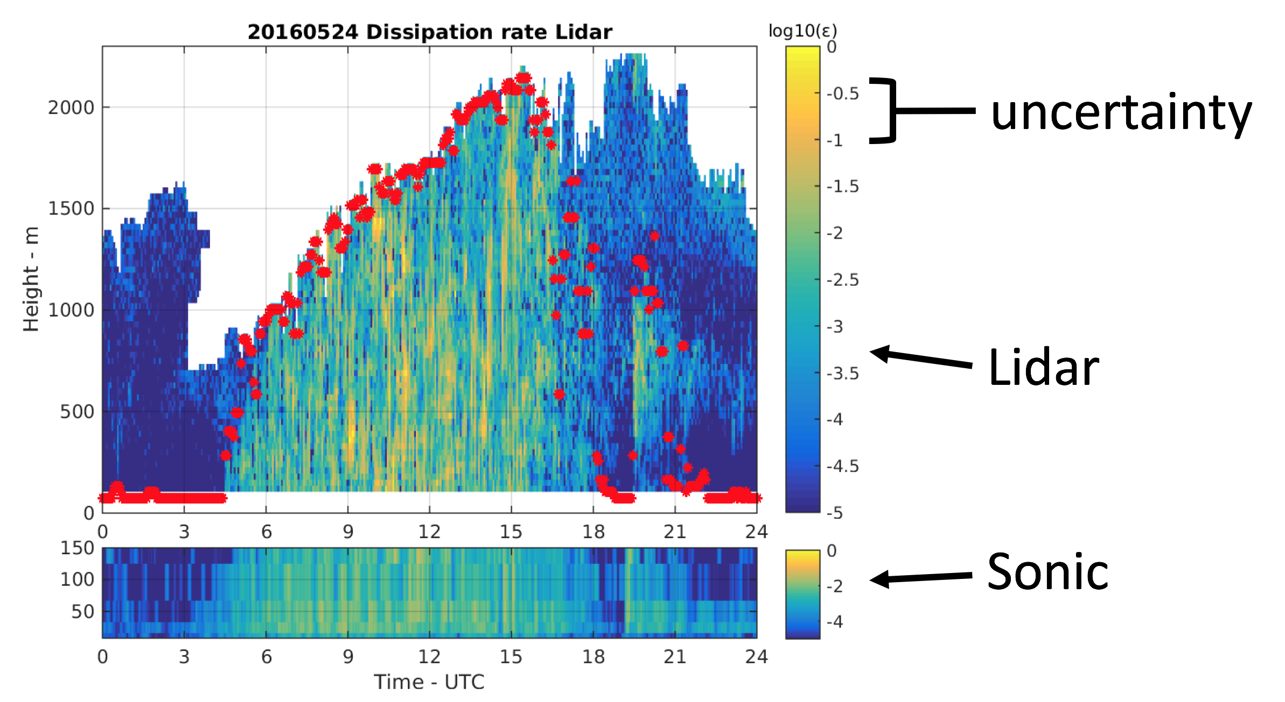
Comparison of TKE from lidar & sonic anemometers (mast)

Slide 19
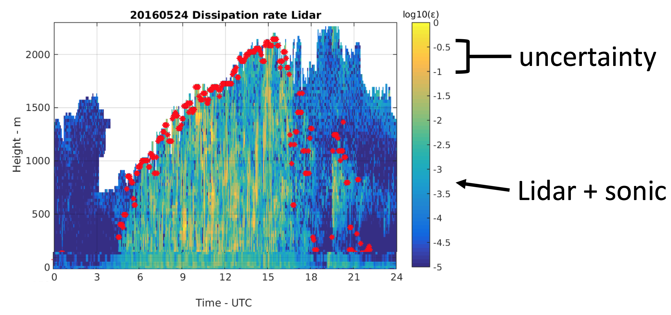
Comparison of TKE from lidar & sonic anemometers (mast)

Slide 20
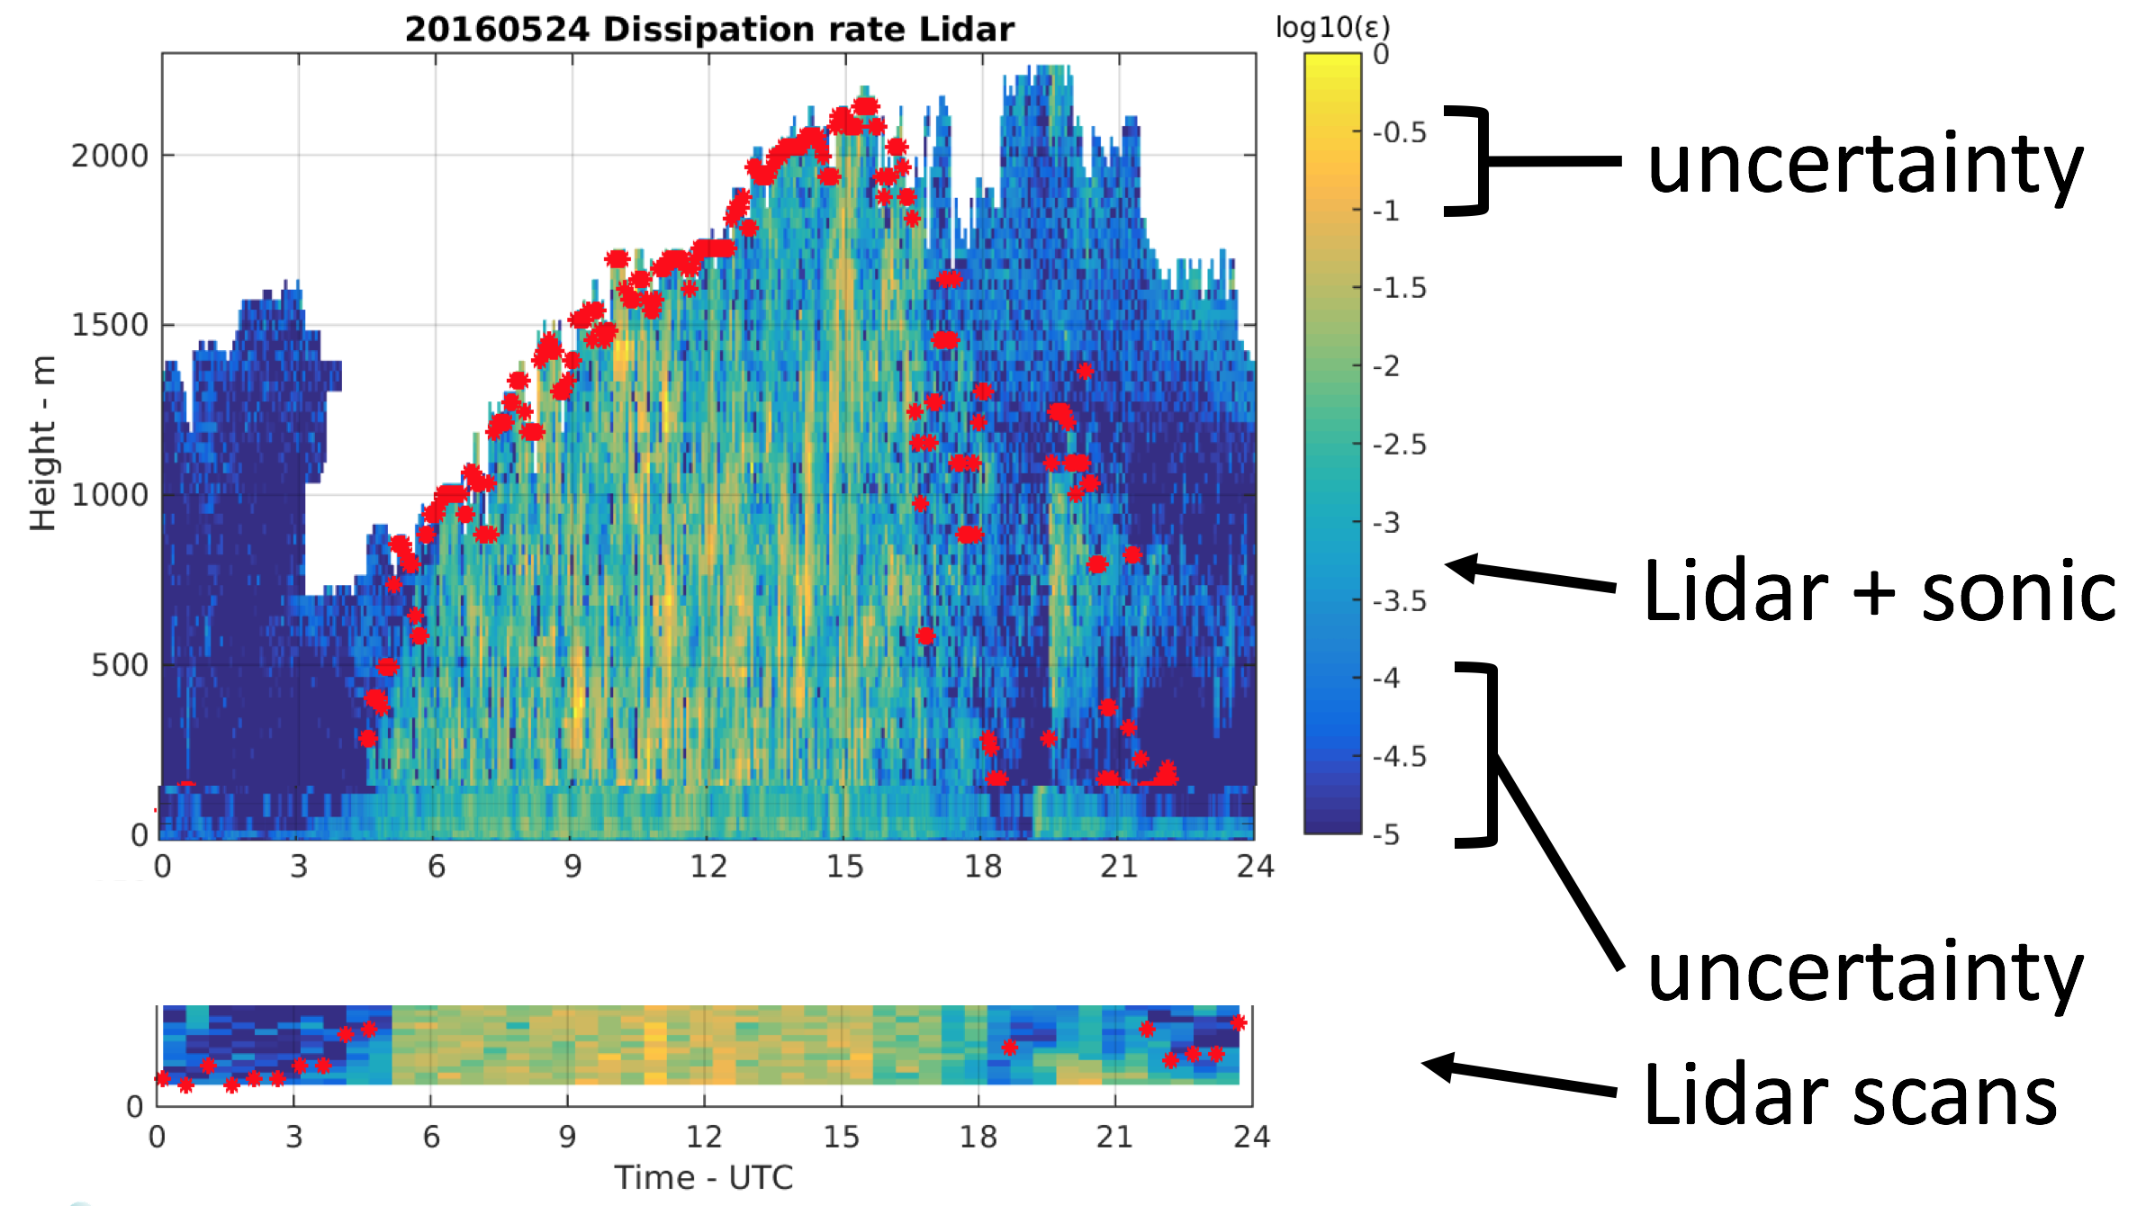
Comparison of TKE from lidar & sonic anemometers (mast)

Slide 21
Vector wind shear
High temporal and vertical resolution winds from DL allow identification of another potential source for turbulence

Slide 22
Contents
1. Motivation and introduction
2. Pre-processing of Halo Doppler lidar data
3. Calculation of the required lidar quantities
4. Identification of the main drivers causing mixing
5. Case studies: Hyytiälä, Finland and Jülich, Germany

Slide 23
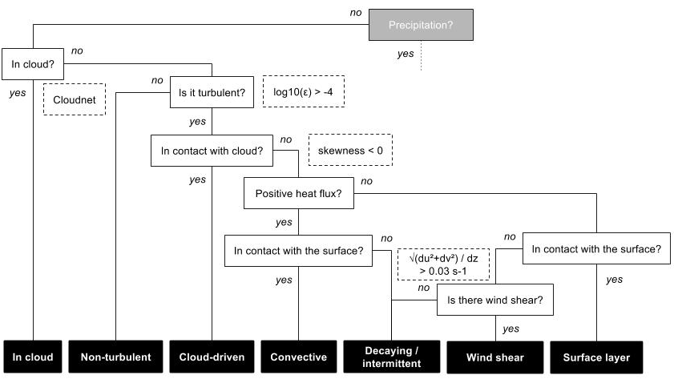
Decision tree for non-precipitating days

Slide 24
Contents
1. Motivation and introduction
2. Pre-processing of Halo Doppler lidar data
3. Calculation of the required lidar quantities
4. Identification of the main drivers causing mixing
5. Case studies: Hyytiälä, Finland and Jülich, Germany

Slide 25
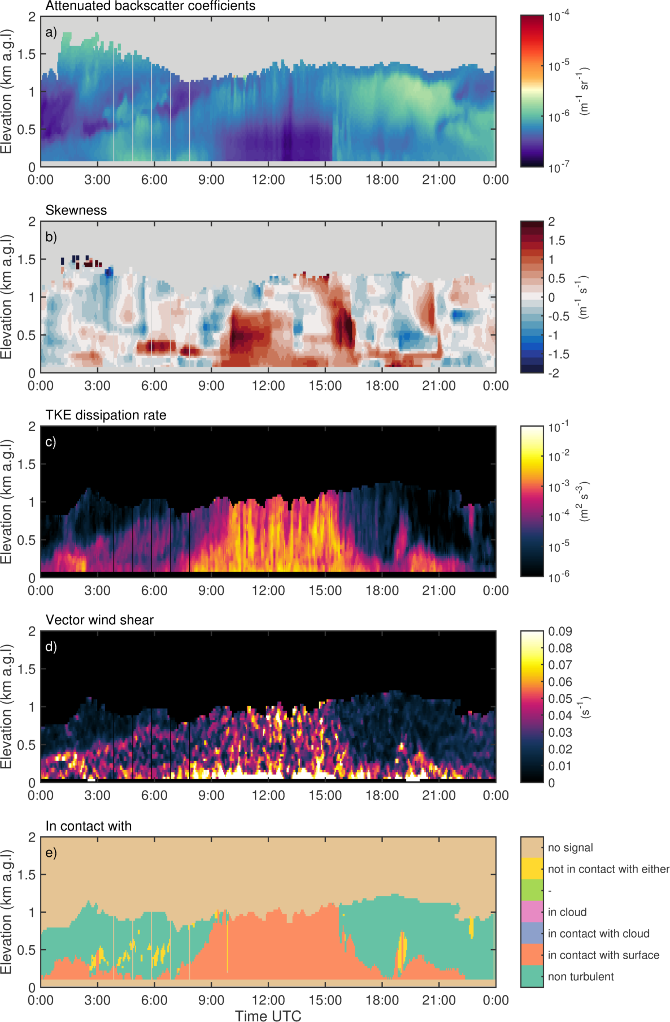
2016-3-9, Jülich, Germany clear sky case

Slide 26
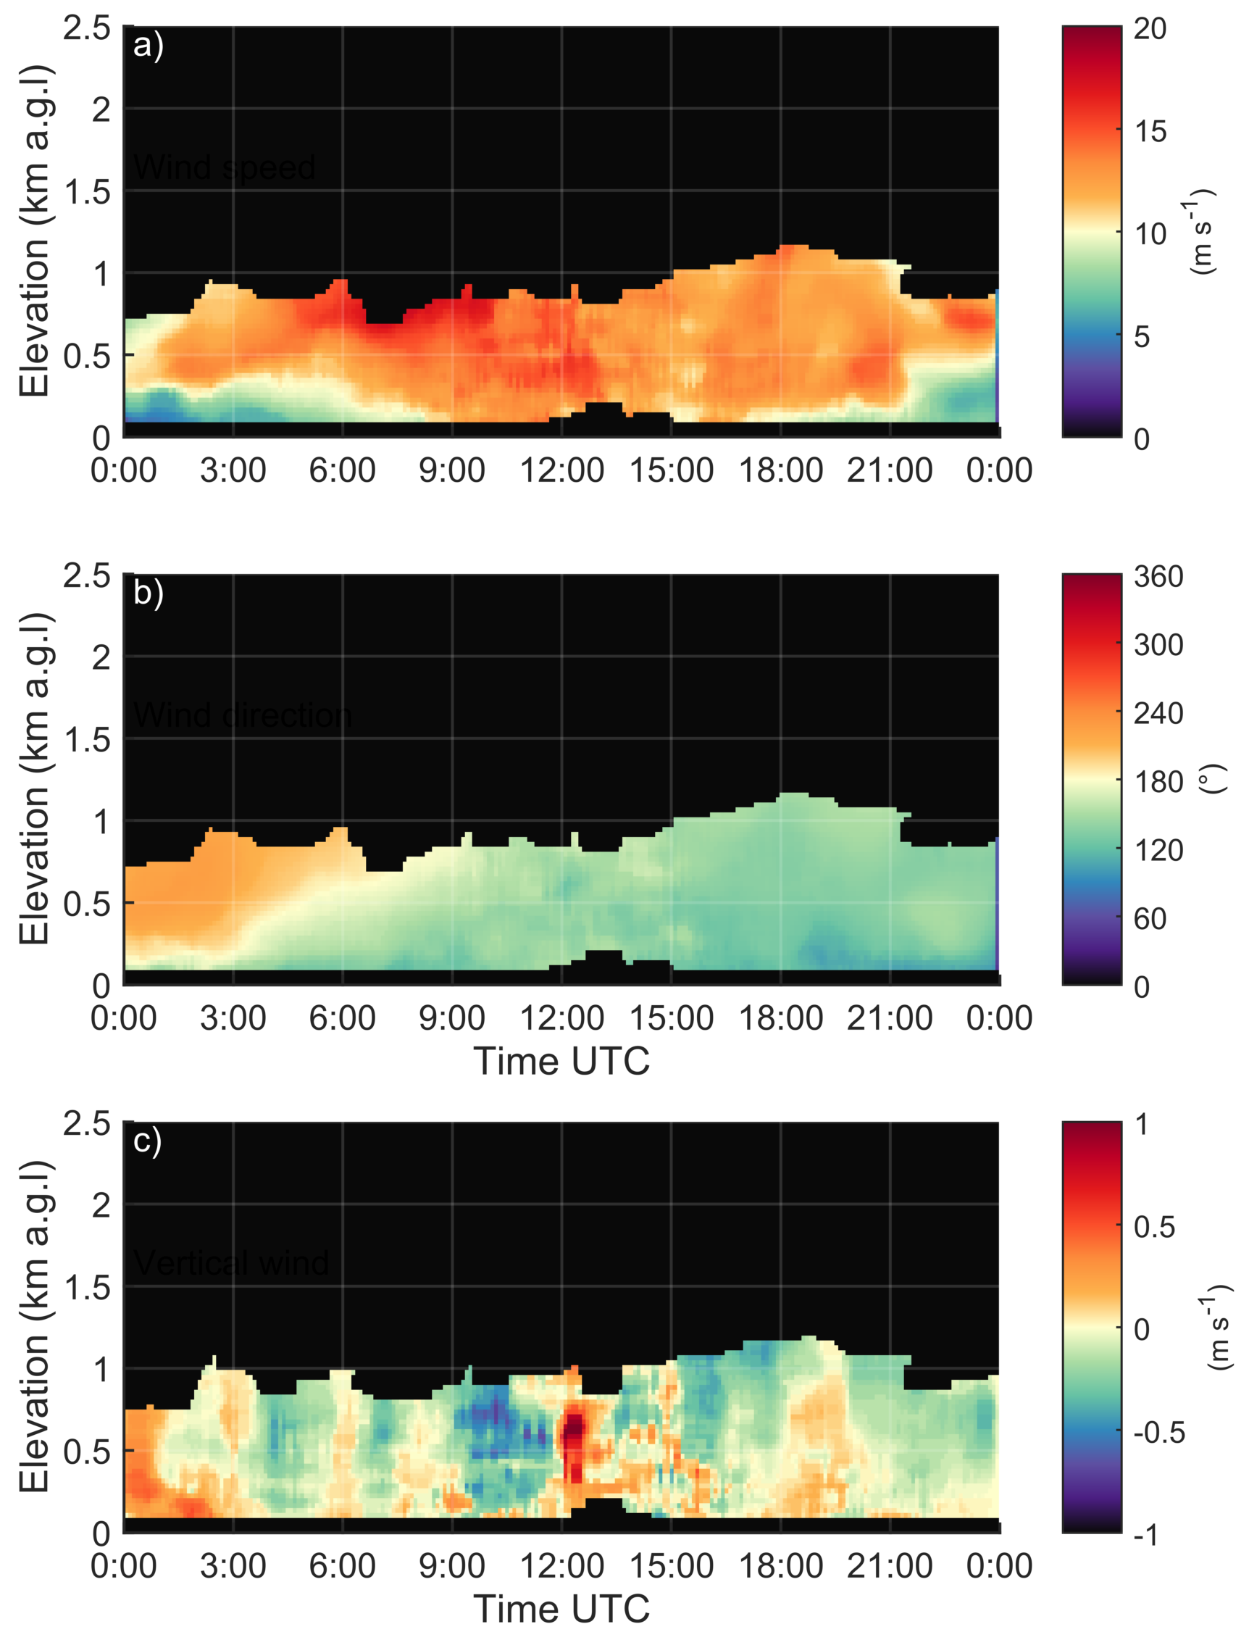
2016-3-9, Jülich, Germany clear sky case

Slide 27
2016-9-22, Hyytiälä, Finland cloud-topped

Slide 28
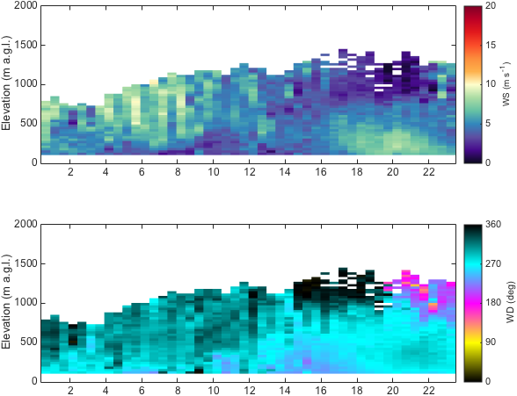
2016-9-22, Hyytiälä, Finland cloud-topped

Slide 29
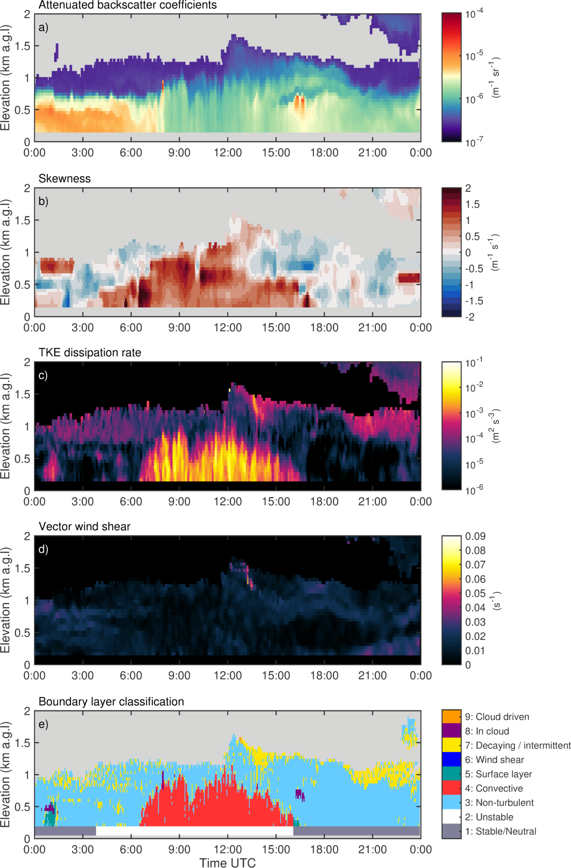
27 March 2017, Limassol Cyprus, cloud free

Slide 30
27 March 2017, Limassol Cyprus, cloud free

Slide 31
27 March 2017, Limassol Cyprus, cloud free

Slide 32
Outlook
Test and apply to more sites in different locations
Define probabilities for classes
Include precipitation
Analyze longer data sets
Model comparison
Combine with Cloudnet products and other masks

