Slide 1
NARVAL-II Workshop Köln 11./12.05.2016
Andrea Hausold, FX-OPO

Slide 2
NARVAL II, August 2016
Aircraft: G550, D-ADLR
Based at: Bridgetown, Barbados (TBPB)
from 08 to 31 August, 2016
Budget: 95 hours block time (including transfers)
Flights: ~12 flights (including 2 transfers)
Measurement area:
from EDMO to TBPB; Dropsondes over sea
South Atlantic East of Barbados

Slide 3
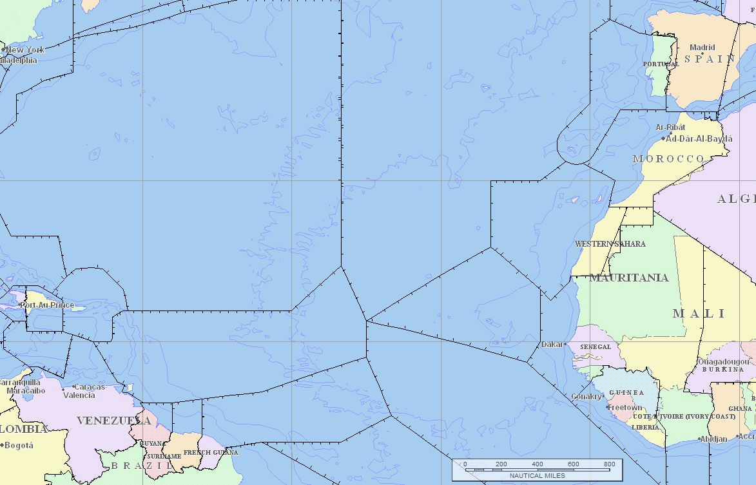
NARVAL II, August 2016
Lisbon
Madrid
Santa Maria
Oceanic
Casablanca
New York Oceanic FIR
Canaries
San Juan
Oceanic
Santo
Domingo
Sal
Curacao
Piarco
TBPB
Dakar
Oceanic
Maiquetia
Paramaribo
Cayenne
Georgetown

Slide 4
NARVAL II, August 2016 – approx. max. range for straight flight at high altitude – profiles/special patterns/low altitude etc. will reduce the radius!
Santa Maria
Oceanic
Lisbon
Madrid
New York Oceanic FIR
Casablanca
~ 2000 NM
Canaries
San Juan
Oceanic
Santo
Domingo
Sal
Piarco
Curacao
TBPB
Dakar
Oceanic
Maiquetia
Paramaribo
Cayenne
Georgetown

Slide 5
NARVAL II, August 2016
Chosen FIRs/UIRs and countries
Madrid: Spain
Lisbon: Portugal
Casablanca: Marocco
Canaries: Spain
Sal: Cape Verde, „Western Sahara“
Dakar Oceanic: administered by Senegal
Santa MariaOceanic: administered by Portugal
Piarco: Babados, Antigua and Barbuda, Trinidad and Tobago, other independent islands, islands administered by The Netherlands, UK, U.S.A., France, …
New York Oceanic: administered by the U.S.
Cayenne: French Guyana
Of course Germany, Austria, Switzerland, France mainland for the transfers (no dropsondes)
TBPB

Slide 6
airspace and politics – safety and security
Spain, Portugal
Marocco
Cape Verde
„Western Sahara“ – better to be avoided (territory)
Senegal
Mauritania – better to be avoided (territory)
Babados, Antigua and Barbuda, Trinidad and Tobago
other independent islands, islands administered by The Netherlands, UK, U.S.A., France, …
USA, Puerto Rico (USA)
French Guiana
Current situation will be checked regularly, sources are for example:
http://www.auswaertiges-amt.de/DE/Laenderinformationen/01-Reisewarnungen-Liste_node.html
http://www.faa.gov/air_traffic/publications/us_restrictions/#restrictTD
http://www.bmvi.de/DE/VerkehrUndMobilitaet/Verkehrstraeger/Luft/Krisenmanagement/krisenmanagement-luft_node.html
http://www.icao.int/czir/Pages/default.aspx

Slide 7
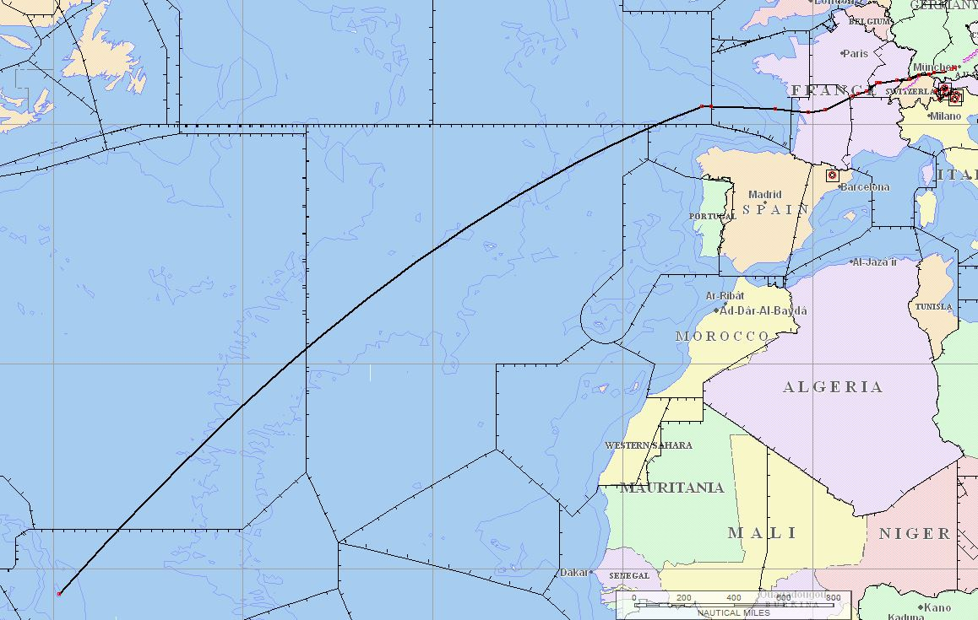
Return to EDMO at end of the campaign - routing
To be discussed; comments:
Additional FIR (Shanwick Oceanic)
Experience so far: no dropsondes in French airspace, not even over sea
Dropsondes over sea in Madrid FIR: tbd
Shanwick Oceanic

Slide 8
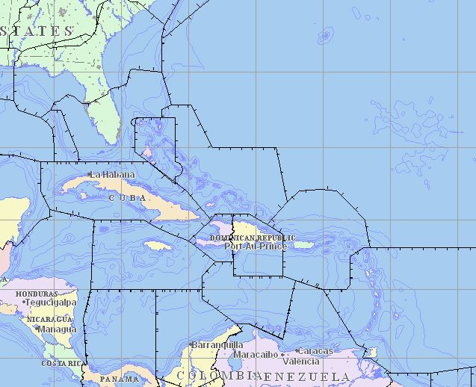
Flight towards the U.S.?
To be discussed; comments:
Additional FIRs/countries?
All written in red: so far not within the scope of the project, no application for permits
New York Oceanic
Miami
Nassau
Miami
Oceanic
Port au
Prince
San Juan
Santo
Domingo
Piarco

Slide 9
Airport (Grantley Adams International Airport (BGI/TBPB)
Requirements/infrastructure:
Storage area for liquid nitrogen (tank or dewars), preferrably inside, outside storage ok (shade)
Storage area for other equipment
GPU: available for rent at USD 96,00 / hour plus tax (probably no exclusive usage)
according to CAH, Email 18 Jan 2016:
“Currently there is not a great demand on the 115V GPU and ACU given the increasing reliability of aircraft. However, these pieces are used whenever a customer has an APU inop on their aircraft. At this stage, we cannot say for sure what the level of activity will be over the summer as over the last summer period, these pieces of GSE were hardly utilized.”
- GPU of DLR will be sent by sea freight
Optionally aircon: available for rent at USD 200,00 / hour plus tax (probably no exclusive usage);
Aircon was not requested so far. Rent from local provider if needed. Taking DLR’s aircon would require second sea freight container.

Slide 10
Airport (cont.)
Requirements/infrastructure (cont.):
Parking of aircraft, close to Concorde hangar
Access to aircraft 24/7, access badges: scan of passport and letter of employer required
Office rooms (?) as far as available (few persons) – Concorde hangar or Terminal building; Internet required?
Aircraft handling (like in 2013): Caribbean Aircraft Handling (CAH)
Hangar: not available
Access with equipment via Spencer‘s gate.
Access for persons via Terminal, transport airside by CAH -> build groups for access
IMPORTANT:
No DG can be stored airside.
Transport of equipment landside/airside should be limited as fas as possible.
Suggestion: sea freight container airside

Slide 11
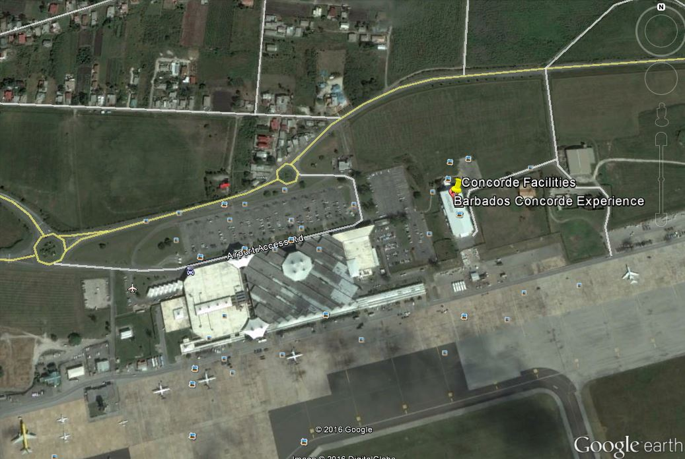
possible office areas
possible container areas (no dangerous goods airside)
car access via Spencer‘s gate
persons‘ access
via terminal
container?
container?
landside
HALO
airside

Slide 12
hotel
Hotel: Divi Southwinds Hotel, Christchurch, Barbados
http://www.diviresorts.com/divi-southwinds-beach-resort-babados.htm
Room rate: 110 USD plus tax plus service charge (internet included)
Rooms will be reserved without breakfast (45 BBD). All rooms have fully equipped kitchen
One-night deposit per room required in advance – credit card from everybody?, wire transfer? It is a real payment, not only a guarantee.
Conference room for up to 20 persons
Extra room for data processing next to conference room
Internet speed in conference room: upload 6 MB, download 25 MB
.
Final travel dates required end of May.

Slide 13
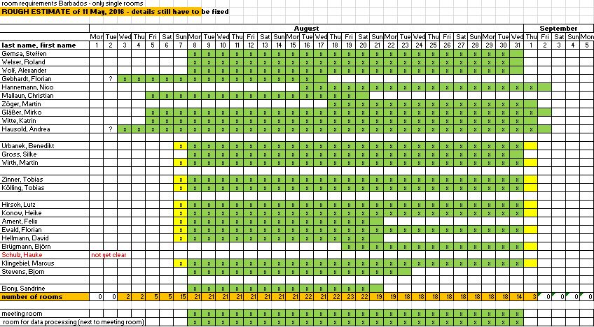
Team – room at Divi Southwinds Hotel

Slide 14
Team @Barbados and rooms
DLR-FX:
S.Gemsa, R. Welser, A.Wolf, F.Gebhardt, N.Hannemann, Ch.Mallaun, M.Zöger, M.Glässer, K.Witte, A.Hausold
DLR-IPA:
B.Urbanek, S.Gross, M.Wirth, F.Ewald
LMU München:
T.Kölling, T.Zinner
Uni Leipzig:
M.Wendisch, A.Ehrlich, K.Wolf, NN
MPIM Hamburg:
B.Stevens, L.Hirsch, F.Jansen, F.Ament, B.Brügmann, D.Hellmann, H.Schulz?, M.Klingenbiel
Uni Hamburg:
Heike Konow
Uni Köln:
M.Mech
XXX: Sandrine Bony *) name in blue = room at the Divi Southwinds Hotel

Slide 15
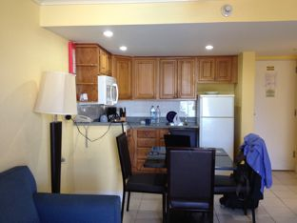
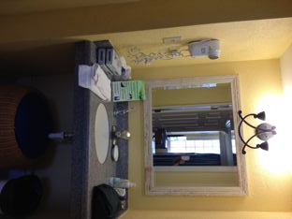
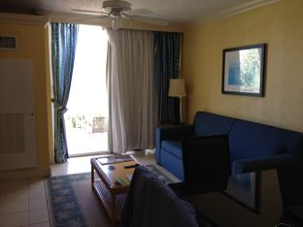
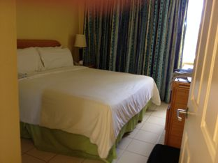
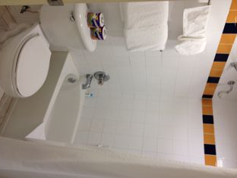
Hotel: Divi Southwinds Hotel, Christchurch, Barbados

Slide 16
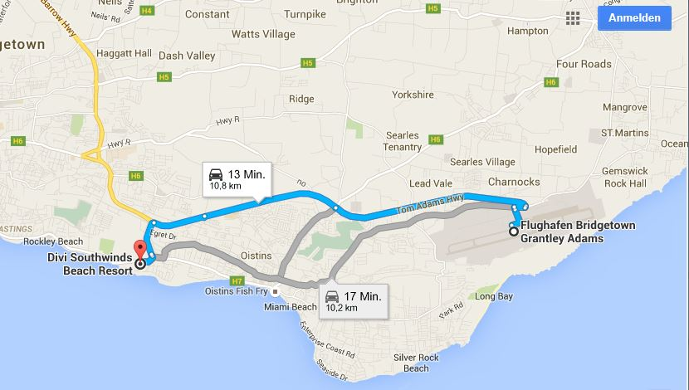

Slide 17
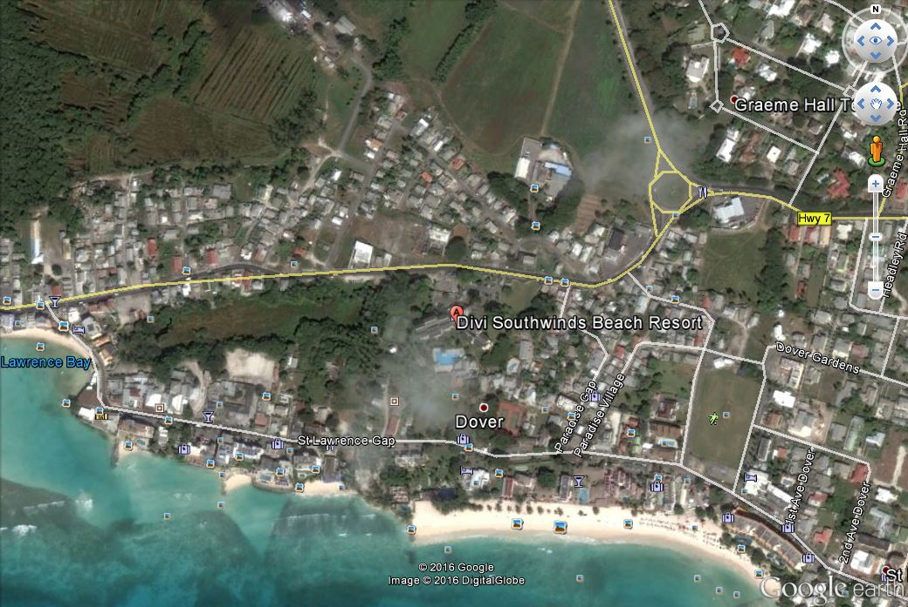
restaurants and bars
restaurants and bars

Slide 18
freight
FX will send one sea freight container. Some space available for scientific equipment. Details tbd (depending on overall freight).
Please check if / which equipment will also be needed for NAWDEX in Keflavik and when it can be sent (airfreight) – not much time available between the two campaigns.
Check for BAFA / EAR restrictions. Send declaration to Katrin Witte.
Expected transit time ^{*)} for
Airfreight from MUC to BGI: 5 days plus customs; (max. height of items: 160 cm)
Airfreight from MUC to KEF: 3 days plus customs; (max. height of items in passenger aircraft: 110 cm, also freight aircraft available, probably at reduced frequency)
Airfreight from BGI to KEF: 8-10 days plus customs (no direct connection, sent via Germany; might take longer if freight aircraft required, see above)
Sea freight from Germany to Barbados: ~35 (new: 38) days plus customs; estimated cost: 8-10 k€
^{*)} estimates

Slide 19
freight
Current draft schedule for sea freight is as follows:
Wed 18 May: final freight lists sent to FX (Andrea Hausold)
Thu/Fri 02/03 June: packing/customs – possible earlier? Routing of ship changed, takes 3 days longer now
Mon 06 June: container pick-up at DLR Oberpfaffenhofen for transport to Hamburg
Sat 11 June: ship leaves Hamburg
Around 14 July: arrival of ship at Barbados
Gives us about 3 weeks for customs and land transport Barbados
Current draft schedule for air freight is as follows:
Wed 29 June: final freight lists sent to FX (Andrea Hausold)
Thu/Fri 14/15 July: packing/customs
Fri 15 July or Mon 18 July: pick-up at DLR Oberpfaffenhofen for transport to Barbados
Gives us about 2 weeks for customs at Barbados (hoping it will be quicker now as procedure was started already for the sea freight)
Barbados, at the end…:
Make sure that representatives from each group will be available to pack their freight before/after departure of D-ADLR!

Slide 20
Other logistics
Rental cars
It is suggested that each group rents the required cars individually.
Driving on left!
You need a local authorization, you get it at the rental car office, costs 10 BBD
Health precautions/vaccination, travel information, visa etc.:
http://www.auswaertiges-amt.de/DE/Laenderinformationen/00-SiHi/BarbadosSicherheit.html
Mosquitos – yes! Day and night. During the pre-visit more at night.
Zika is an increasing problem, also other kinds of fever – no vaccination possible, just treatment of the symptoms -> use repellent / wear long clothes
Money
Currency is Barbados Dollar (BBD); ATMs at airport, close to the hotel, at a bank next to big supermarket at Oistins ….
Hotel accepts credit card for payment.
Public transport
Regular buses all over the island; mini-buses between Bridgetown and different locations at the island; no fixed schedule/stops

Slide 21
Questions/next steps/deadlines
18.05.: final freight lists for sea freight (plus BAFA/EAR declaration)
30.05.: final travel details for everybody staying at the Divi Southwinds hotel
29.06.: final freight lists for air freight (plus BAFA/EAR declaration)
03.06.: passport scan plus confirmation of employment (airport access badges)
Location of sea freight container at airport / storage area for air freight <-> please determine what will be needed where
Email-distribution list
Internet at airport?

Slide 22
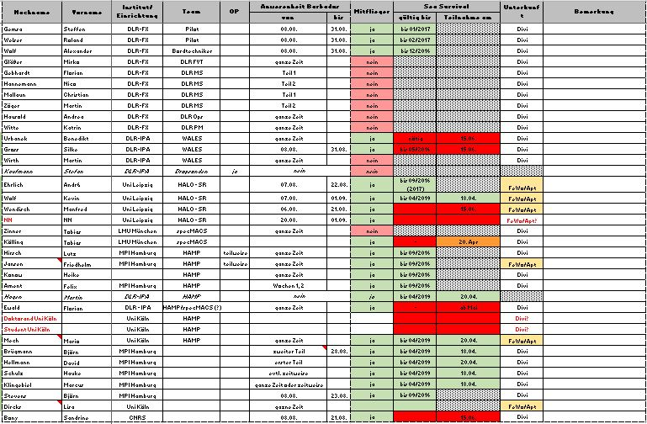
Team - general

