Slide 1
Automatic appraisal and classification of ground based MWR brightness temperature data
Moritz Löffler

Slide 2
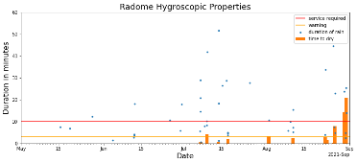
A concept for operational automatic quality checks of gb MWR data
Lv1 Tb data
Radome monitoring
Spectral consistency
Liquid water detection
Assimilation
Currently:
SPC retrieval (RPG)
NN Bernhard
Planned
All elevation angles
Case selection:
Wet radome
scattering?
RFI
All elevation angles
Training with ERA-5 data
Testing methods with model consistency.
OmB
TROPoe
BUFR - Format
Calibration monitoring (OmB)
LWP-retrieval
artificial sky-clearing

Slide 3
Spectral consistency
SPC-Retrieval (RPG) at 54 GHz has proven quite reliable (NN with 1 or 2 HL)
Bernhards NN spectral retrieval is also quite usefull for quick detection of outliers
Spectral retrieval for
Any elevation angle
Any site
Evaluate possibility to discriminate and classify the cause of the spectral inconsistency
Wet radome
Scatter processes on atmospheric rain droplets (Pamtra)
Is this effect detectable
RFI (Spectrum inconsistent but not the above)
Overall performance of spectral consistency check

Slide 4
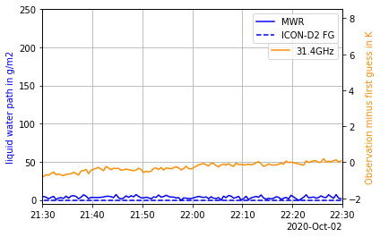
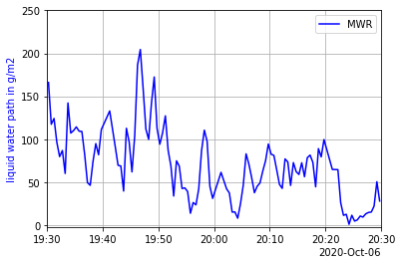
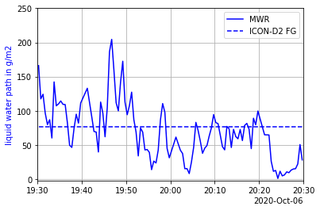
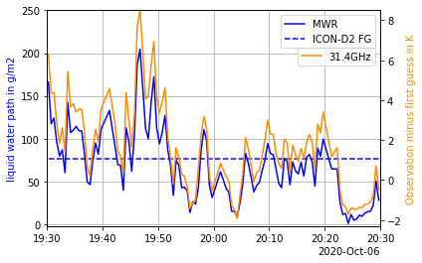
Clear-sky vs. cloudy variability (LWP & Tb)
LWP varies in clouds
This leads to random differences in model comparisons
Also in observation space (Tb)
This representativity error of the observation minus first guess (model equivalent) is important for data assimilation
Cloudy
Clear
MWR observation and first guess (ICON-D2) of LWP and difference of obs. and first guess at 31.4GHz; A clear and a cloudy case.

Slide 5
Liquid water detection
Neural Network classifier trained with ICON-2 first guess + RTTOV-gb
Comparison with empirical classifier & tested with observed data + cloudNet
Effect on OmB statistics
Training with ERA 5, avoid mixing training and test dataset randomly
Discuss possibilities to deal with LW affected data in assimilation
Averaging
Artificial sky-clearing
Typically lower LWP in modell than observed

Slide 6
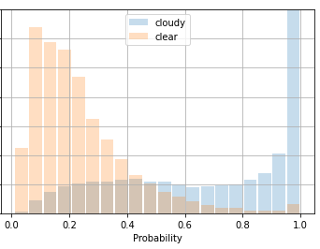
Implementation of a machine learning classifier
Datasets
Tb(IR, MW)
Std(Tb)
…
Cloud cover
CloudNet target class.
Prediction
threshold
Probability
Input
train
Clear/
no-liquid
classifier
predict
Random forest
Neural network
…
Ground truth
test
Cloudy/ liquid

Slide 7
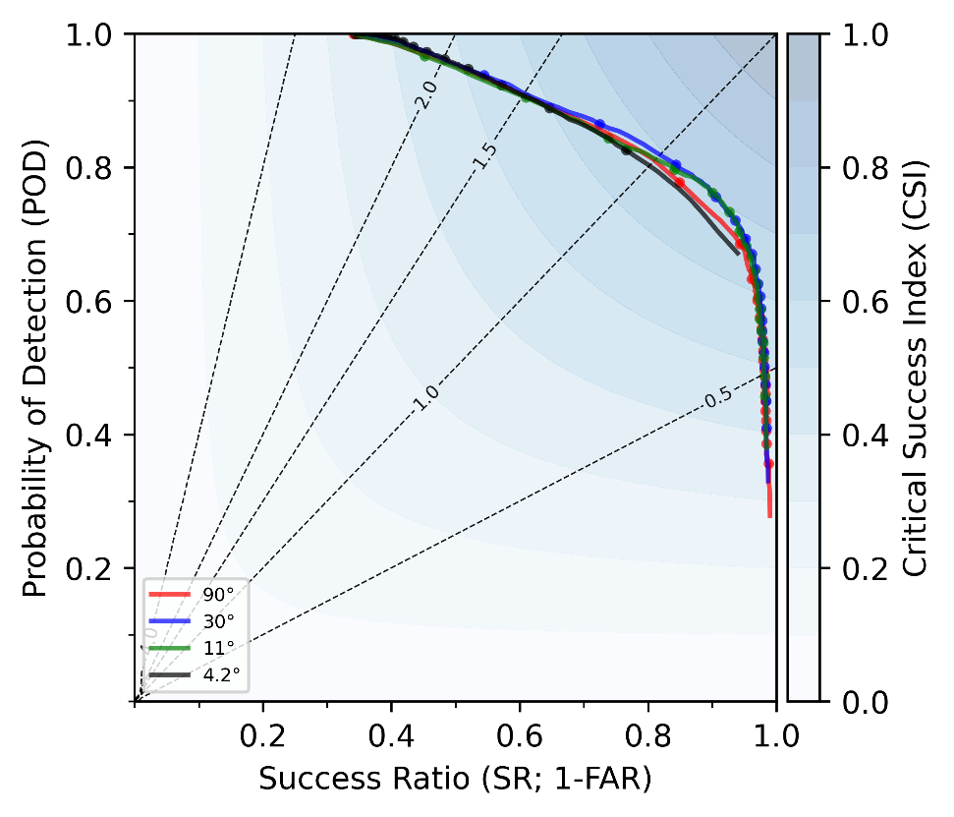
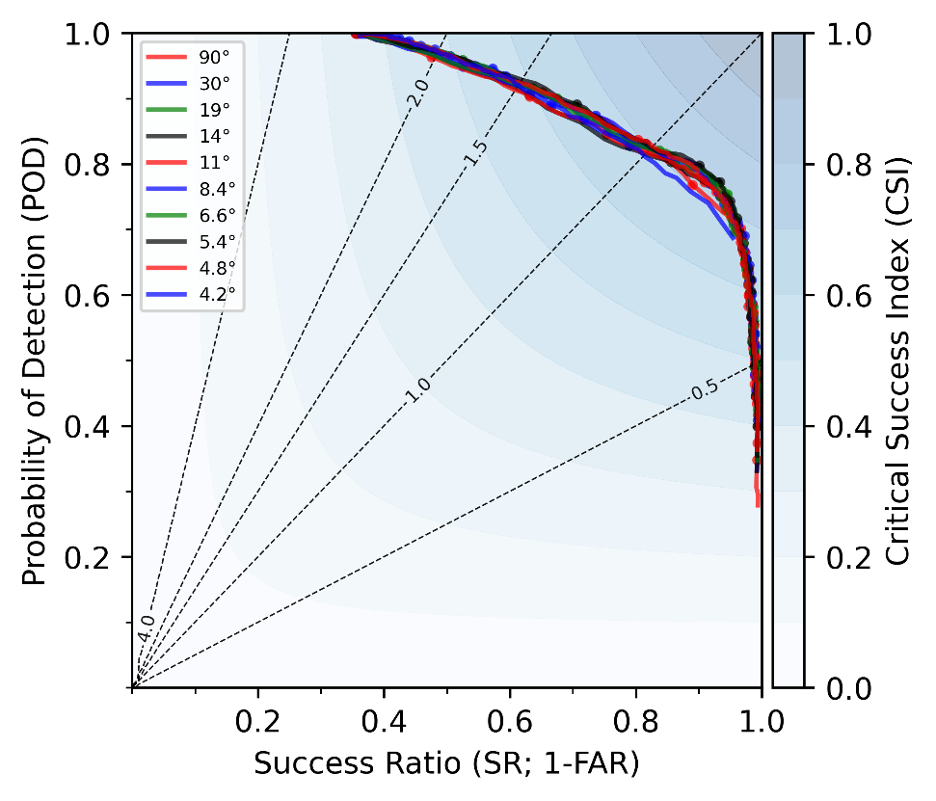
Cloud detection trained with modelled elevation scans
Input:
Tb all 14 channels computed radiative transfer model RTTOV-gb from ICON-D2 first guess model fields
(Length dataset: ~15 000 times, ~1.5 y)
Ground truth:
ICON-D2 model fields
Intercomparison of classifiers:
Only NN with 2 hidden layers
Promising results for all elevation angles
Worse performance at lowest elevation angles and zenith
High probability of detection leads to high false alarm rate
Modification of ground truth might help symmetry
Performance diagram of ML based classifiers for cloud detection. Tested and trained on ICON-D2 first guess dataset. Moved to observation space (Tb) with RTTOV-gb.

Slide 8
OmB at lower elevations are skew

Slide 9
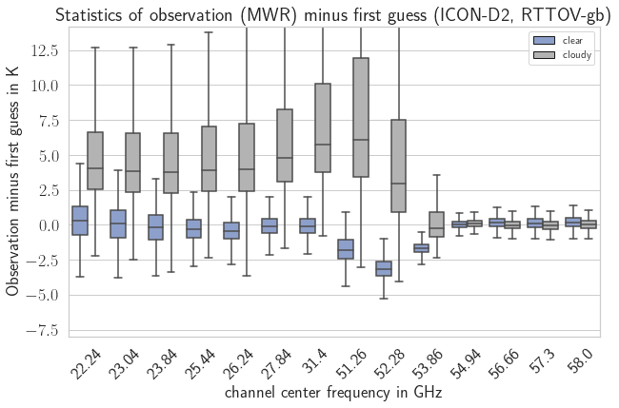
Observation minus Background (OmB) statistics Zenith
OmB-stats. is symmetric for clear-sky
OmB-stats. have a smaller variability for clear-sky
Channels above 54GHz unaffected by liquid clouds
Expectations are met
NN detects relevant clouds

Slide 10
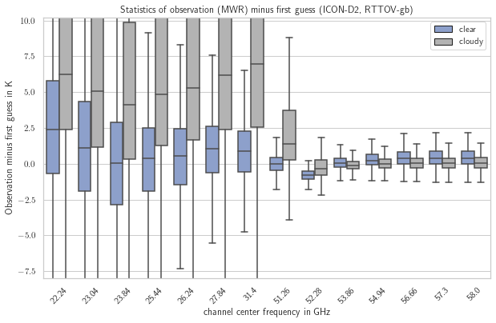
Observation minus Background (OmB) statistics 11.4° ele
Recall matrix (right) computed with modelled data as ground truth
Overall larger deviations
Similar effect as for zenith observation
53.7GHz less affected by cloud cover in contrast to zenith pointing obs.
Fig: Boxplot of O-FG statistics Oct 20 – Jun 22 at 11.4° elevation. Cloudy/clear

Slide 11
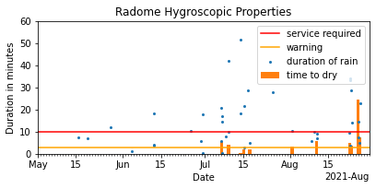
Radome monitoring and wet flag
buffer
Additional „wet-flag“ is required to avoid using biased data.
Especially for an old radome (or unknown) a bias becomes evident
Time-to-dry is an intuitive measure of the radome hygroscopic properties.
Radome monitoring is an additional info for a better timing of technical maintenance.
See link for more information
Code can be downloaded from GitHub

Slide 12
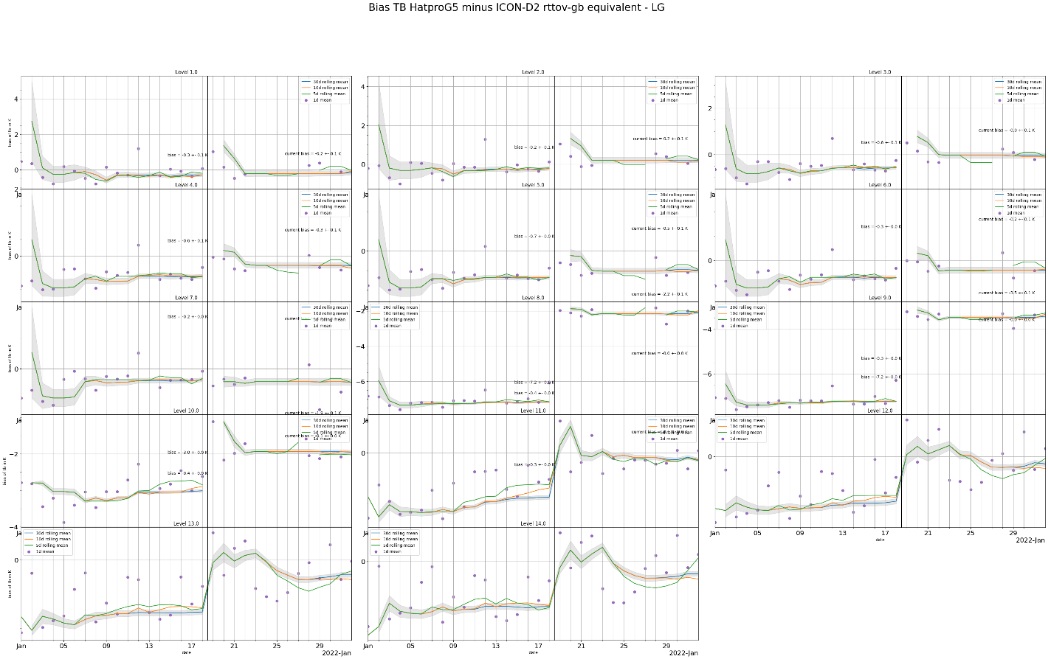
Calibration monitoring (OmB)
Suitable for a rough idea and for large biases
Less precise than checking calibration with cold load obs. before and after calibration
Large biases due to prediction errors esp. during convection.

Slide 13
A concept for operational automatic quality checks of gb MWR data
Lv1 Tb data
Radome monitoring
Spectral consistency
Liquid water detection
Assimilation
Currently:
SPC retrieval (RPG)
NN Bernhard
Planned
All elevation angles
Case selection:
Wet radome
scattering?
RFI
All elevation angles
Training with ERA-5 data
Testing methods with model consistency.
OmB
TROPoe
Calibration monitoring (OmB)
LWP-retrieval
artificial sky-clearing

