Slide 1
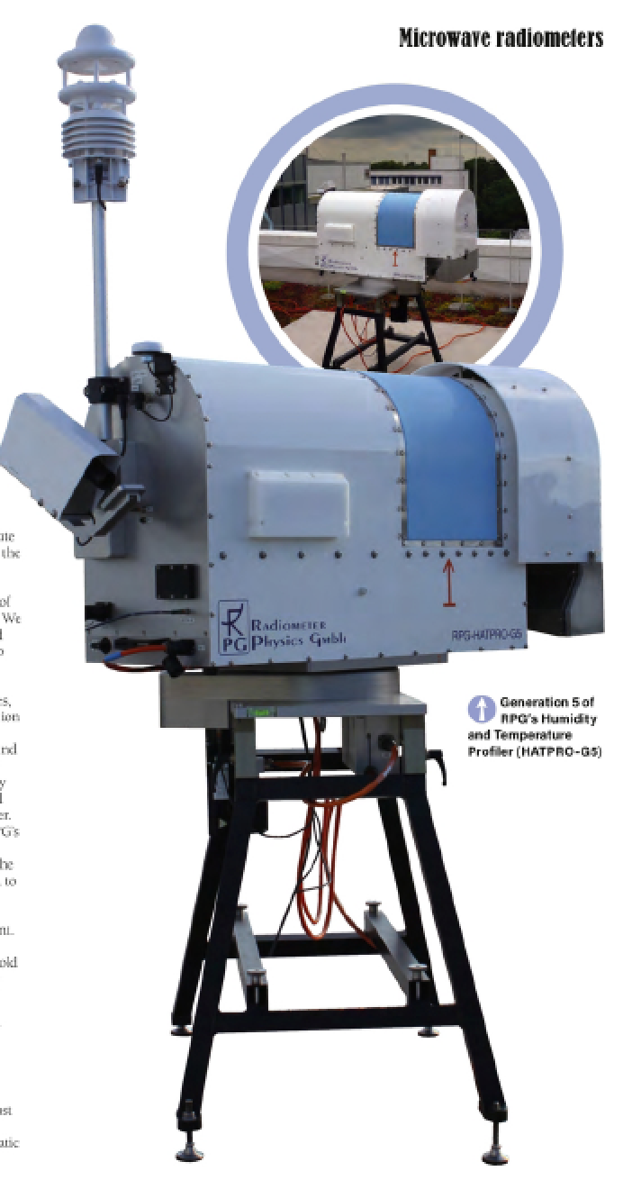
EMS Oral Session,
Sep. 8th 2023
Session UP1.5 - Atmospheric measurements: Instruments, experiments, networks and long-term programs using in-situ and remote sensing techniques
Measurement uncertainties of scanning microwave radio-meters and their influence on temperature profiling
Institute for Geophysics and Meteorology, University of Cologne | Tobias Böck, Bernhard Pospichal, Ulrich Löhnert

Slide 2
General Goals
Integration of ground-based thermodynamic profilers into the DWD forecasting system (TDYN-PRO)
EMF III: The potential of ground-based thermodynamic profilers for improving short-term weather forecasts
Q: Are the considered state-of-the-art ground-based profilers accurate and reliable enough for data assimilation?
Also very important for E-PROFILE (EUMETNET)* and other European Research Infrastructures (like COST action PROBE and ACTRIS networks)
*https://www.eumetnet.eu/activities/observations-programme/current-activities/e-profile/
2

Slide 3
Instrument: HATPRO MWR
Humidity And Temperature PROfiler from Radiometer Physics GmbH
Measures thermal emissions from the atmos-phere in 14 different frequencies (H₂O-band and O₂-band)
Converts these radiances into Brightness Temperatures TBs [K] (through Planck’s law)
allows investigation of (via inversion):
temperature profiles
rudimentary humidity profiles
integrated water vapor (IWV)
liquid water path (LWP)
commercially available for ~20 years, ready for network applications (in principle)
continuous data in all-sky conditions: resolution of seconds to minutes
3

Slide 4
Main Motivation
External error sources like physical obstacles but also radio frequency interference (RFI) and other disturbances can have an impact on observations and the quality of the obtained atmospheric profile
t → important to search for a suitable measurement location with low disturbances and properly set-up the instrument
If e.g. trees, walls, buildings and mountains are too close to the MWR, they can have significant repercussions in elevation scans which are necessary for deriving accurate T-profiles
→ crucial to pinpoint the exact location of these obstacles and to determine a minimum distance at which they do not interfere with the MWR anymore
4

Slide 5
MW-profiling: How does it work?
H₂O vapor - band
humidity
(channel 1-7)
O₂ - band
temperature
(channel 8-14)
Oxygen absorption line
constant mixing ratio with height → TB only a function of T and p → used for temperature profiling
O2-band channels are
optically thick,
especially ch 11-14:
MWR does not penetrate that far into the atmosphere
Measured TBs are Ts nearer to the ground
The more optically thinner the channels get, the farther the reach into the atmos.
Elevation scans add more layers the MWR can reach
pressure broadened WV line → total water vapor & weak profile information
WV channels are
optically thin:
MWR can “see” far into the atmosphere
Is more susceptible to external errors like RFI and far away obstacles
ch 11-14
ch 8-10
cloud contribution
5

Slide 6
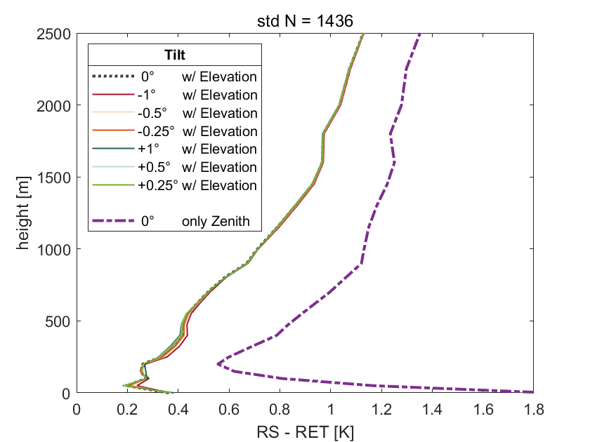
Elevation vs Zenith Measurements for T-profiling (Standard Deviation)
In general: T-profiles which were retrieved with the help of elevation scans are always more accurate!
Especially below 200m
Even when there is a pointing error/tilt of up to 1°
→ That is why we analyse elevation scanning MWRs.
6

Slide 7
Analyzed Measurement Uncertainties
Influence of physical Obstacles in range of the instrument (simulated)
Horizontal Inhomogeneities of the atmosphere (measured)
Pointing Errors or Tilts of the instrument (simulated)
Radio Frequency Interferences (RFI) and how to identify them (measured)
Focus on temperature profiling → Focus on oxygen-band channels (8 – 14)
Influences of beam width and bandwidth are negligible [Meunier et al. 2013]
This study does not analyze instrument uncertainties like:
Calibration Repeatability, Biases, Drifts, Noise
7

Slide 8
Simulating Obstacles
Assumptions for simulation:
Horizontal homogeneity
Obstacle is a solid blackbody
Obstacle fills out the entire beam width
Simulate obstacles at various distances by increasing optical thickness to very high values in a non-scattering LBL-radiative transfer model (based on Simmer (1994))
lower
optical thickness τ of atmosphere
90°
30°
10°
higher
5°
8

Slide 9
Obstacles: Impact on certain channels
9

Slide 10
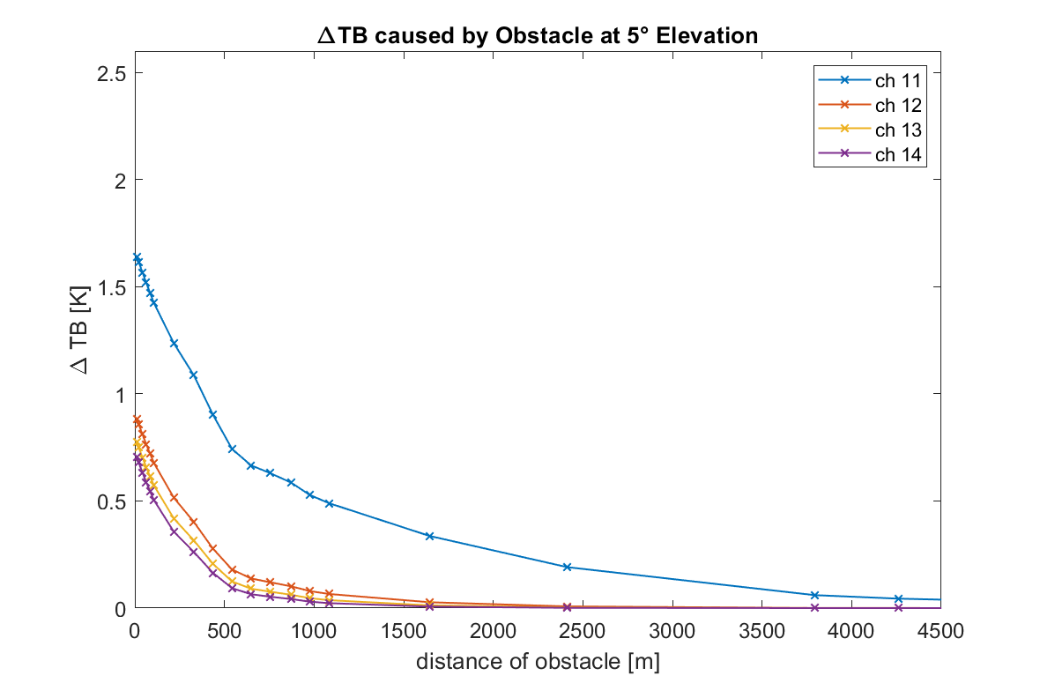
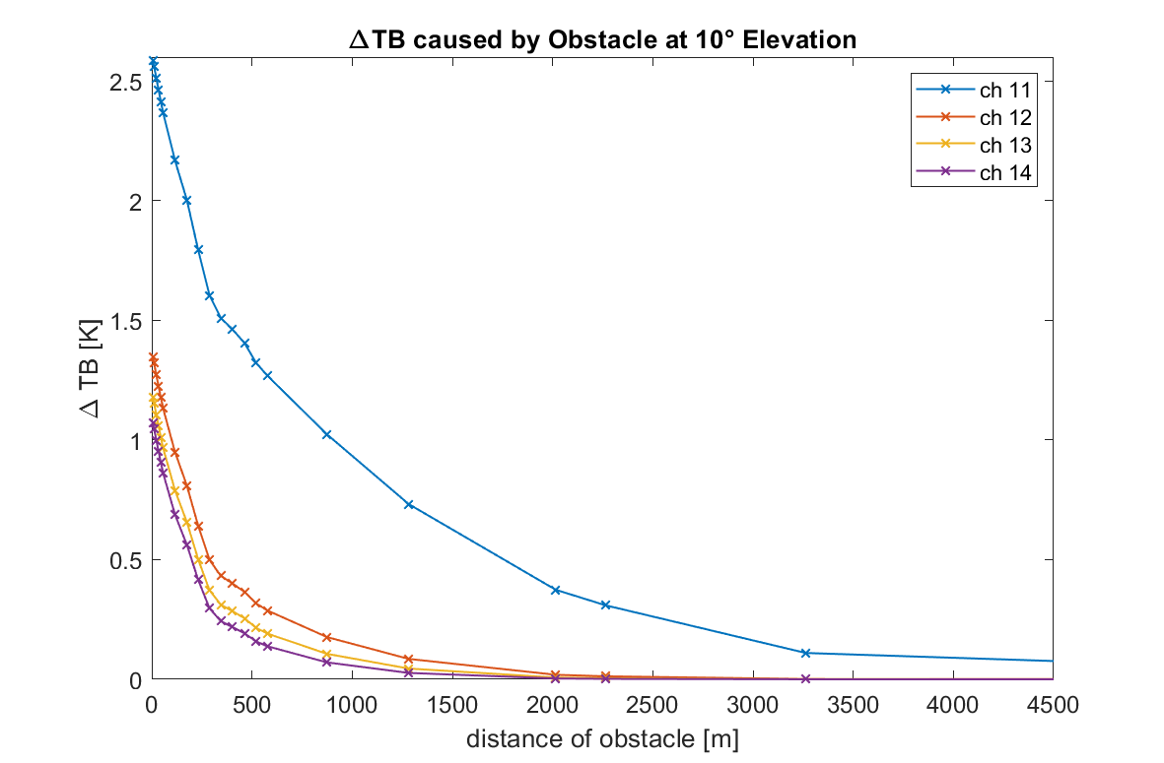
∆TB caused by obstacle (in an inversion-free atmos.)
≤0.1K
(accepted
threshold
for data assimilation and network purposes)
Obstacle has ambient temperature.
For T-profiles retrievals, only ch 11-14 are used with elevation data. These are the optically thicker channels from the oxygen-band.
10

Slide 11
Obstacles: Impact on retrieved T-profiles
11

Slide 12
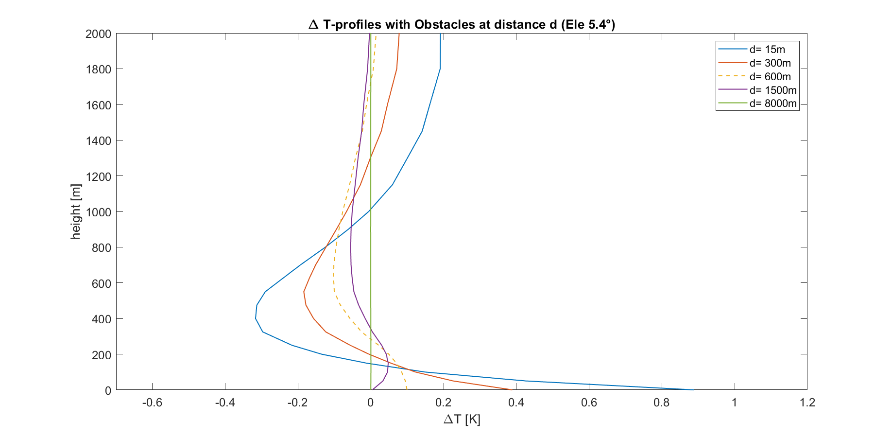
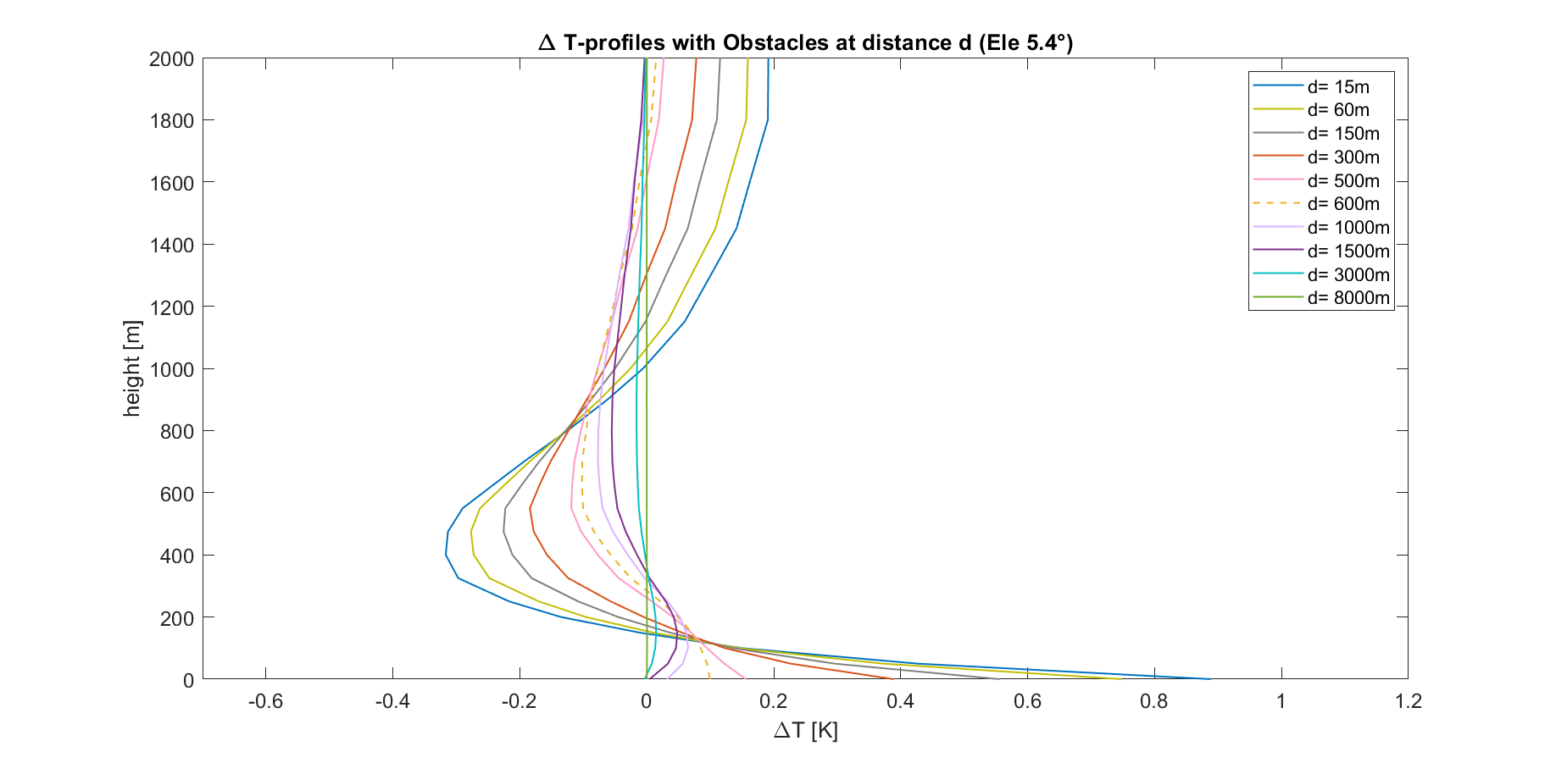
∆T-profiles caused by obstacles (inversion-free)
≤|0.1K|
12

Slide 13
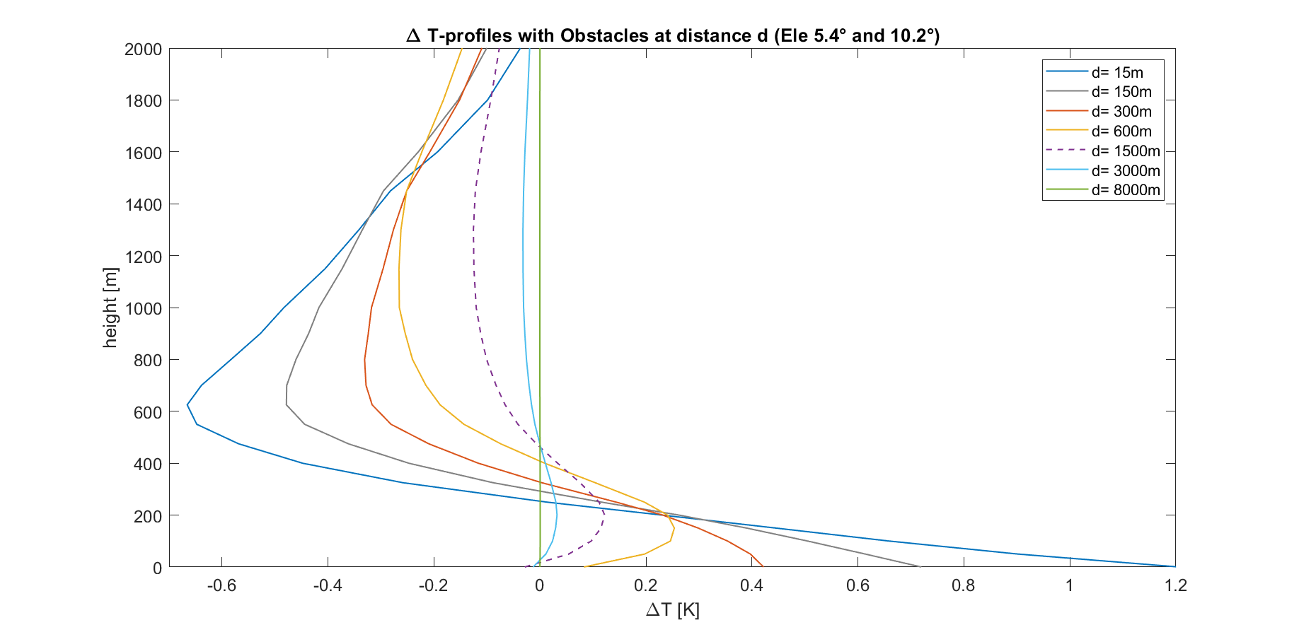
∆T-profiles caused by obstacles (inversion-free)
≤|0.1K|
13

Slide 14
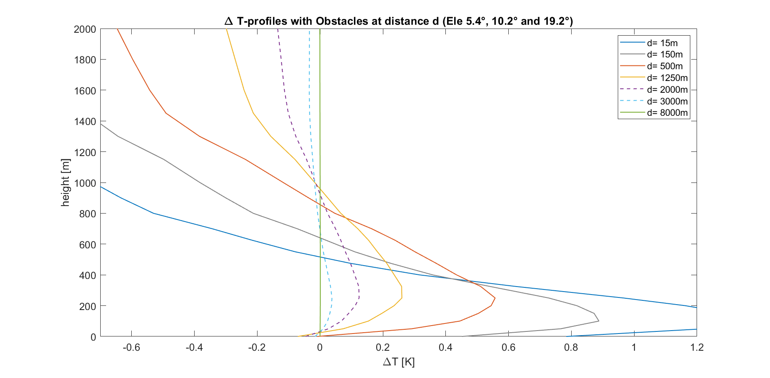
∆T-profiles caused by obstacles (inversion-free)
≤|0.1K|
14

Slide 15
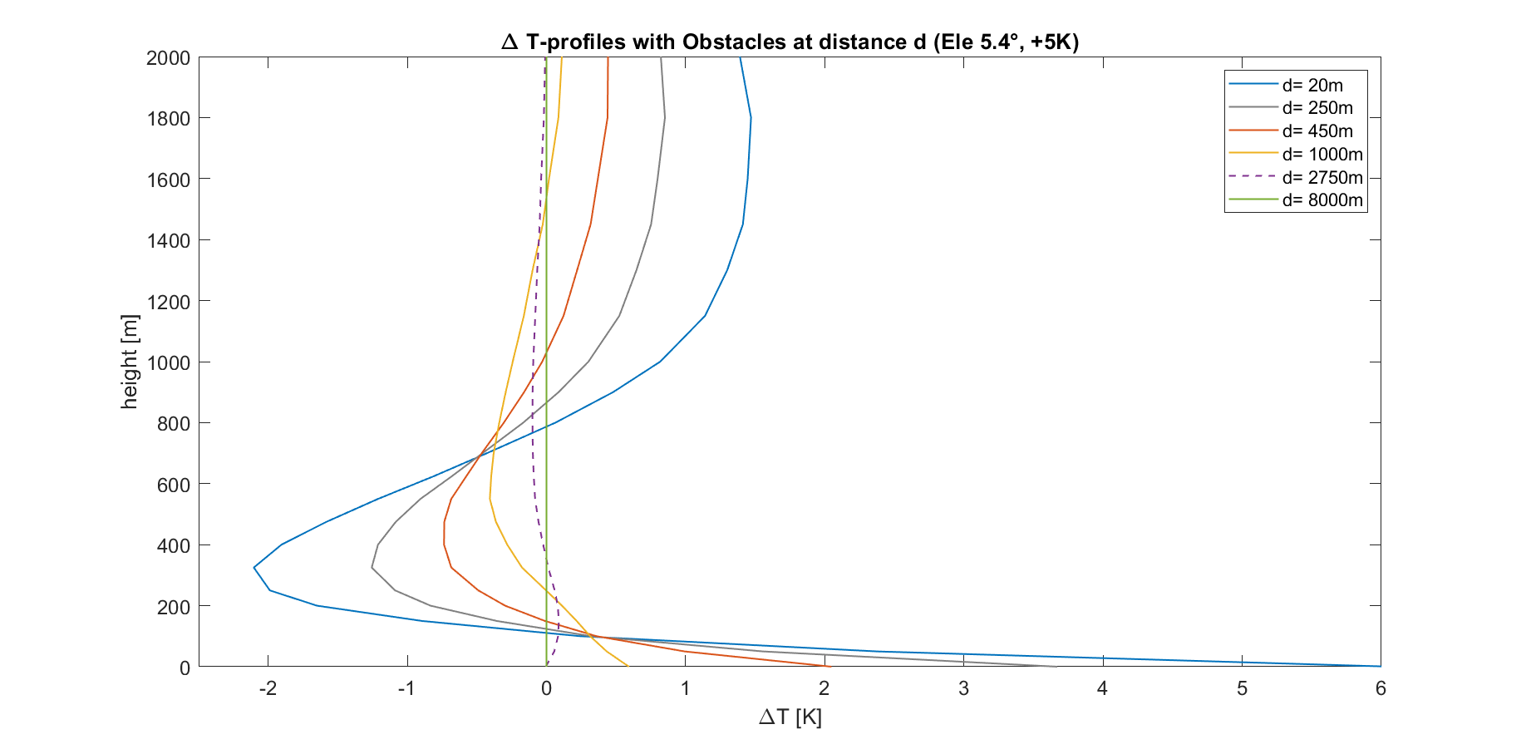
∆T-profiles caused by warmer obstacles (+5K)
≤|0.1K|
15

Slide 16
Main Conclusions for Obstacles
For T-profiling: At what distance is impact of obstacle ≤ 0.1K?
Worst case scenarios for obstacle at ambient temperature:
At 5° elevation: ≥ 600m (mostly trees or buildings)
At 5° and 10° elevation: ≥ 1500m (mostly buildings and mountains)
At 5°, 10° and 20° elevation: ≥ 2500m (mostly mountains)
If obstacle is 5K warmer than its surroundings:
At 5° elevation: ≥ 2700m (trees, buildings or mountains)
At 5° and 10° elevation: ≥ 3500m (mostly buildings and mountains)
At 5°, 10° and 20° elevation: ≥ 4000m (mostly mountains)
16

Slide 17
Remaining measurement uncertainties to discuss: - Horizontal Inhomogeneities - Instrument Tilts - RFI
17

Slide 18
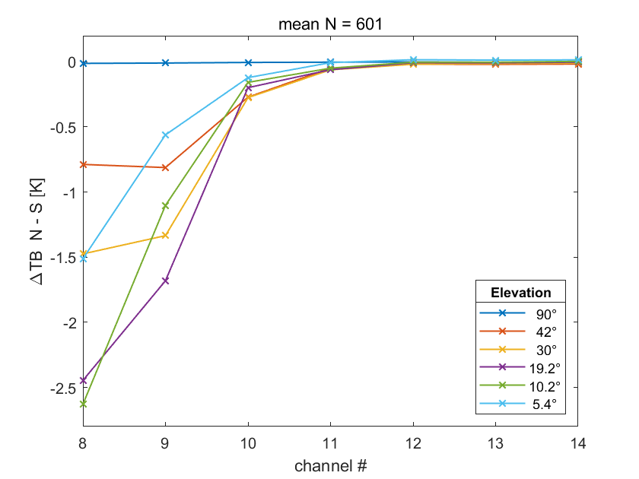
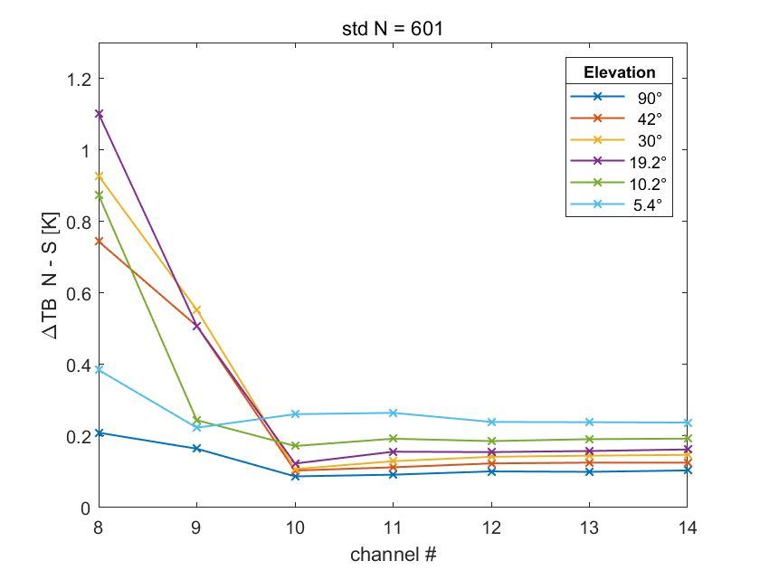
Horizontal Inhomogeneities (measured)
North Scans minus South Scans (from 3 weeks in summer 2022 in Jülich, only clear-sky)
Mean
StD
<0.1 K
Actual measured variabilites of the atmosphere
Supposedly measured mean inhomogeneities can have other causes
→Instrument TILT
<0.26 K
Optical thinner channels 8 to 10 show highest differences and deviations
The lower the elevation the wider the observed area but the lower the reach to high atmopheric layers
18

Slide 19
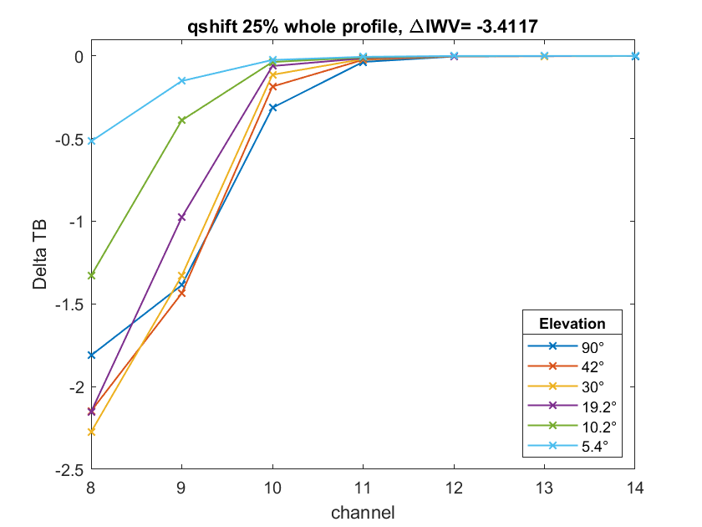
Horizontal Inhomogeneities (simulated)
25% increase in humidity over the whole profile
∆IWV of > 3.4 kg/m2 is needed to reach similar mean ∆TB than in the before shown plot of measured mean inhomogeneities.
Highly unlikely!
We assume it is due to a tilt of the instrument.
[K]
.
19

Slide 20
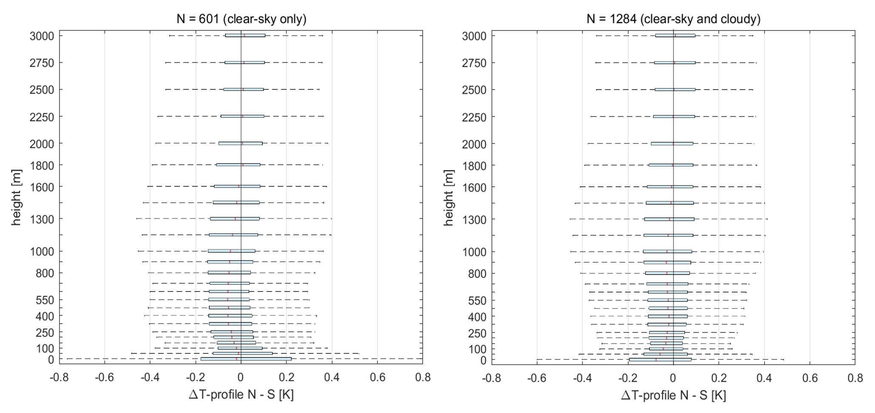
Horizontal Inhomogeneities (Impact on T-profile)
Impact very small: median < |0.1 K| (mostly due to tilt), 25th/75th percentiles < |0.22 K|.
For T-profile retrieval, only channels 11 to 14 are used with elevation scan data.
Channels 8 to 10, which show the highest deviations, are only used with zenith data.
20

Slide 21
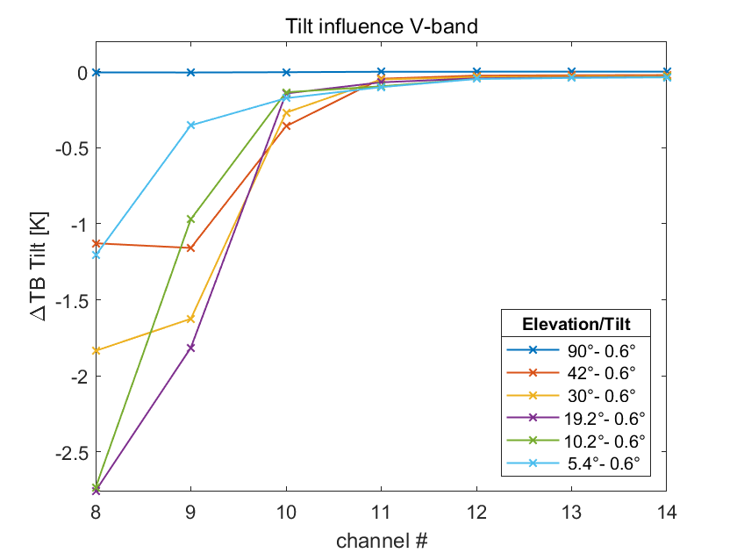
Pointing Errors/Tilts (simulated)
Simulated a deviation of 0.6° from all six elevation angles
Measured mean „inhomogeneities“
→ TBs in the oxygen-band behave very similary to the alleged measured mean horizontal inhomgeneities shown before.
→ Instrument Tilt causes these measurements
21

Slide 22
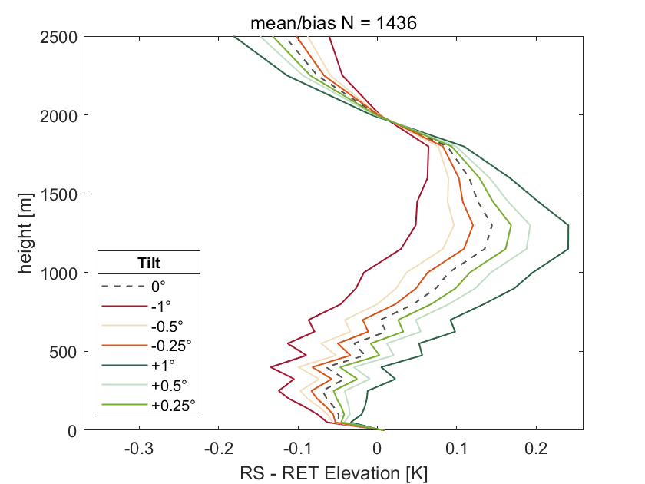
Pointing Errors/Tilts (Impact on T-profile)(simulated)
Mean over one year (2000)
T-profile retrievals with elevation scans
<0.1K
<0.1K
1° tilt causes < 0.1 K mean difference below 3000 m
Tilt of up to 1° has very small impact on T-profiling
Radiosondes minus Retrievals
22

Slide 23
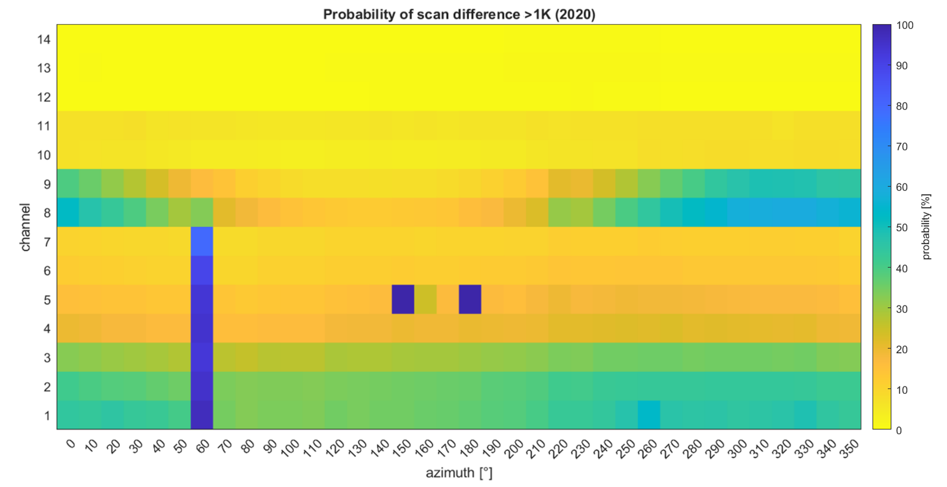
How to identify RFI (and other Disturbances)
Higher amount of water vapor mostly due to tilt
lighting rod
RFI (communication links)
Full 360° azimuth scans at 30° elevation for all 14 channels in clear-sky conditions over a longer time period:
Probability of disturbances over a certain threshold (> 1K) from 2020
23

Slide 24
Summary and Conclusions
Impact of measurement uncertainties on T-profiling:
Obstacles: have to be at least 600 m away (at ambient temperatures, filling out the whole beam) to have an impact of <0.1 K.
Horizontal Inhomogeneities: <|0.22 K| in the 25th/75th percentiles below 3000 m.
Tilt: <0.1 K below 3000 m for up to 1° of tilt.
RFI: no impact on T-profiling when it is detected within the H₂O-band, but can have ramifications for detecting horizontal humidity inhomogeneities.
RFI detecting: Scan-difference-probability plots are a capable method for detecting the usable channel/angle combinations (These plots can also show obstacles in certain frequnecies and directions, even inhomogeneities and/or tilts).
24

Slide 25
Thank you for your attention! contact: tobias.boeck@uni-koeln.de
25

Slide 26
Bonus Slides
26

Slide 27
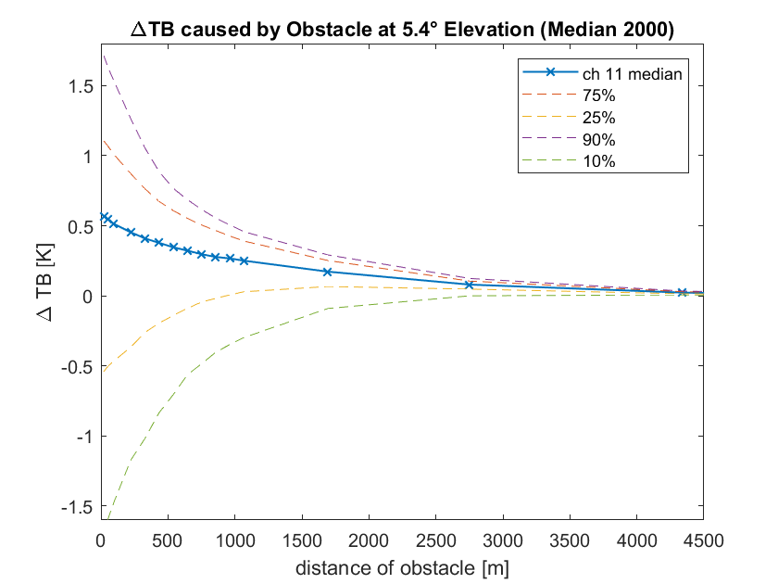
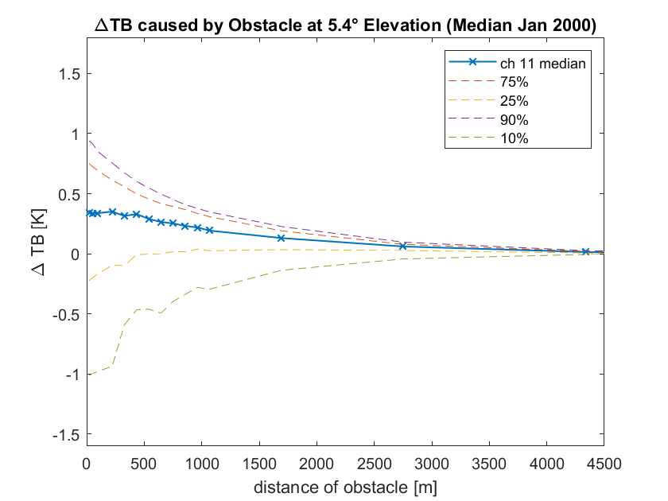
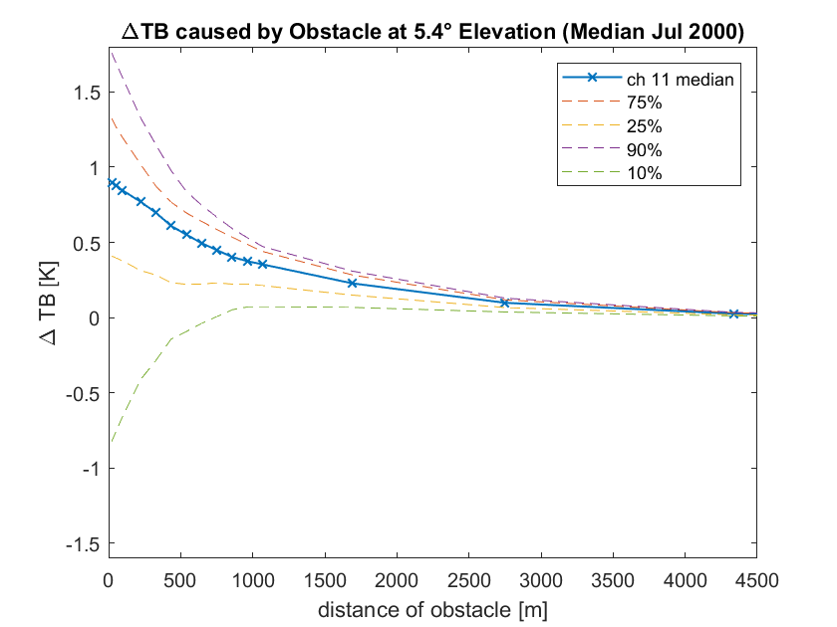
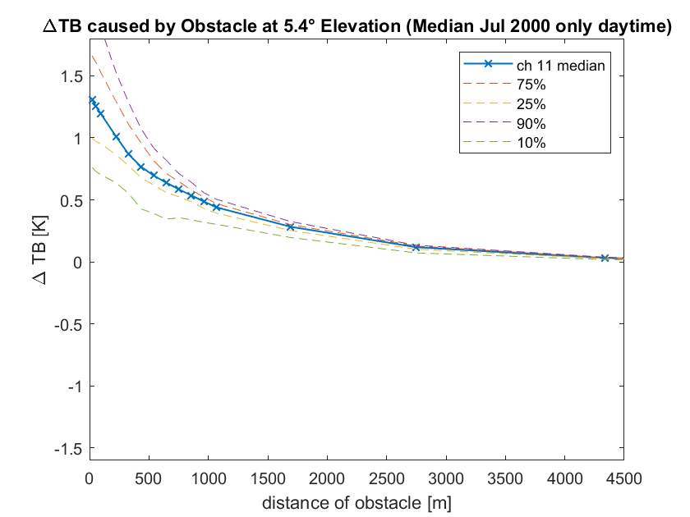
∆TB caused by obstacle (Medians)
27

Slide 28
∆TB caused by obstacle (median profile of one year)
Remember: obstacle has same temperature as its surroundings
The 90th percentile line approximately represents the inversion-free atmosphere case from before
The 10th and 25th percentile lines show cases with a temperature inversion near the ground.
Here, the atmosphere behind the ambient obstacle is warmer than the obstacle, resulting in a negative difference in TB.
28

Slide 29
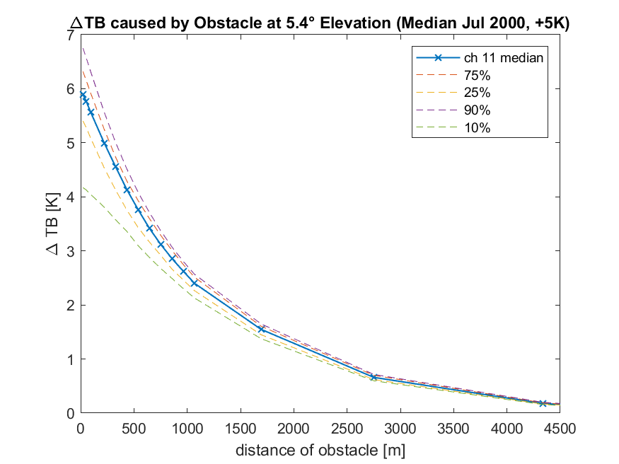
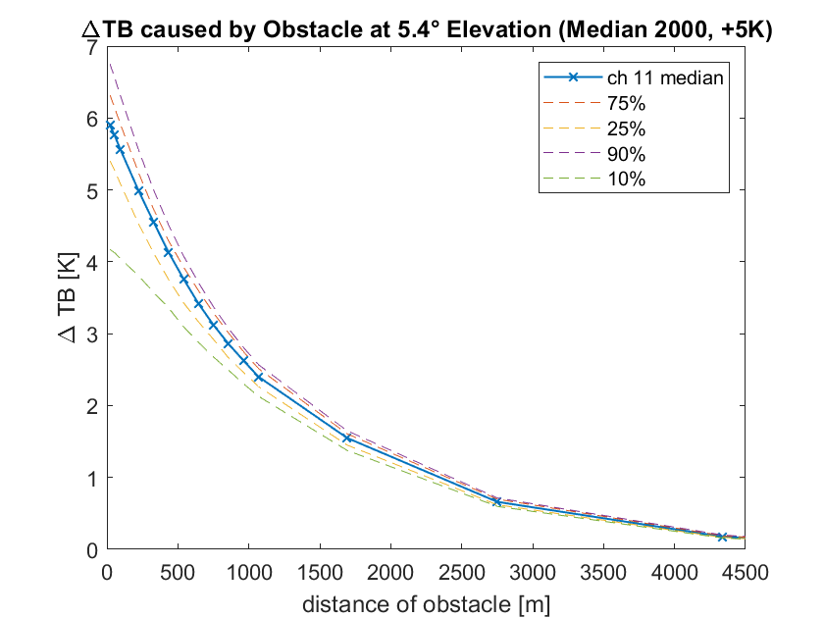
∆TB caused by a warmer obstacle (+5K)
→ Now obstacle is 5K warmer than its surroundings
≤0.1K
29

Slide 30
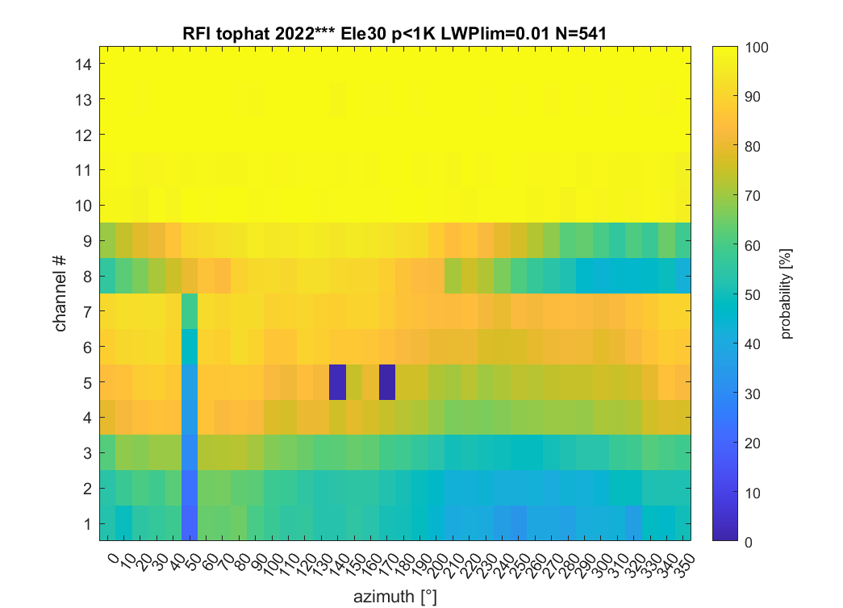
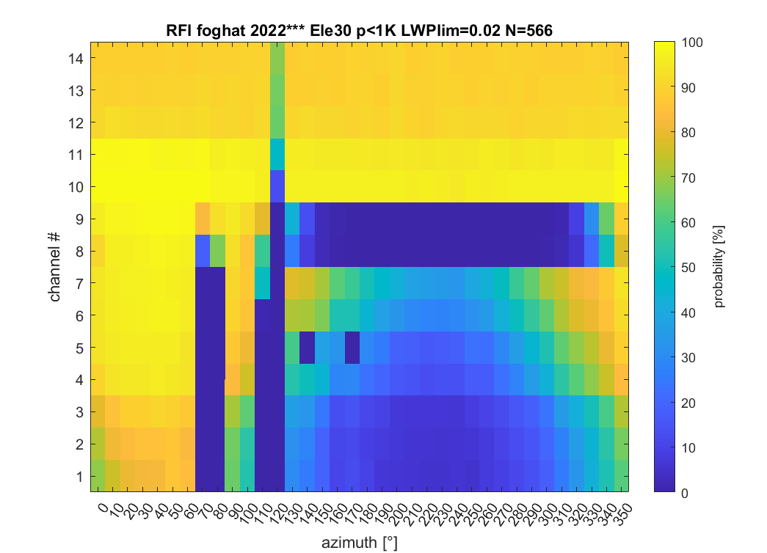
Disturbances at Jülich (for 2 different MWRs)
30° Elevation Scan Disturbances Aug-Sep 2022 TOPHAT
30° Elevation Scan Disturbances Aug-Sep 2022 FOGHAT
We see again an instrument tilt in both plots (see ch 8 & 9). The tilt on the right is stronger and towards a different direction.
30

Slide 31
Sensitivity Study: Simulate Obstacles in Line of Sight
Simulate obstacles by increasing optical thickness to very high values in a non-scattering LBL-radiative transfer model (based on Simmer (1994))
1) simulate obstacle at ambient temperature
2) simulate warmer obstacle (e.g. + 5K)
lower
distance x₂^{30°}
optical thickness τ of atmosphere
distance x₁^{90°}
distance x₁^{30°}
90°
30°
5°
higher
distance x₁^{5°}
distance x₂^{5°}
31

Slide 32
Sensitivity Study: Simulate Obstacles in Line of Sight
Simulate obstacles by increasing optical thickness to very high values in a non-scattering LBL-RT model
1) simulate obstacle at ambient temperature
2) simulate warmer obstacle (e.g. + 5K)
lower
distance x₂^{30°}
optical thickness τ of atmosphere
distance x₁^{90°}
distance x₁^{30°}
90°
30°
5°
higher
distance x₁^{5°}
distance x₂^{5°}
32

