Slide 1
MWR Data Processing and Quality Control

Slide 2
CCRES - ACTRIS Centre for Cloud Remote Sensing
Mission of CCRES:
Offer operational support to ACTRIS National Facilities operating cloud remote sensing instruments:
Doppler Cloud Radars (cloud profiling)
Microwave Radiometers (temperature profiles, cloud water, humidity)
Doppler lidars (wind profiling, ABL)
Automatic low power lidars and ceilometers (coordinated with CARS)
Disdrometers (Precipitation monitoring, radar calibration)

Slide 3
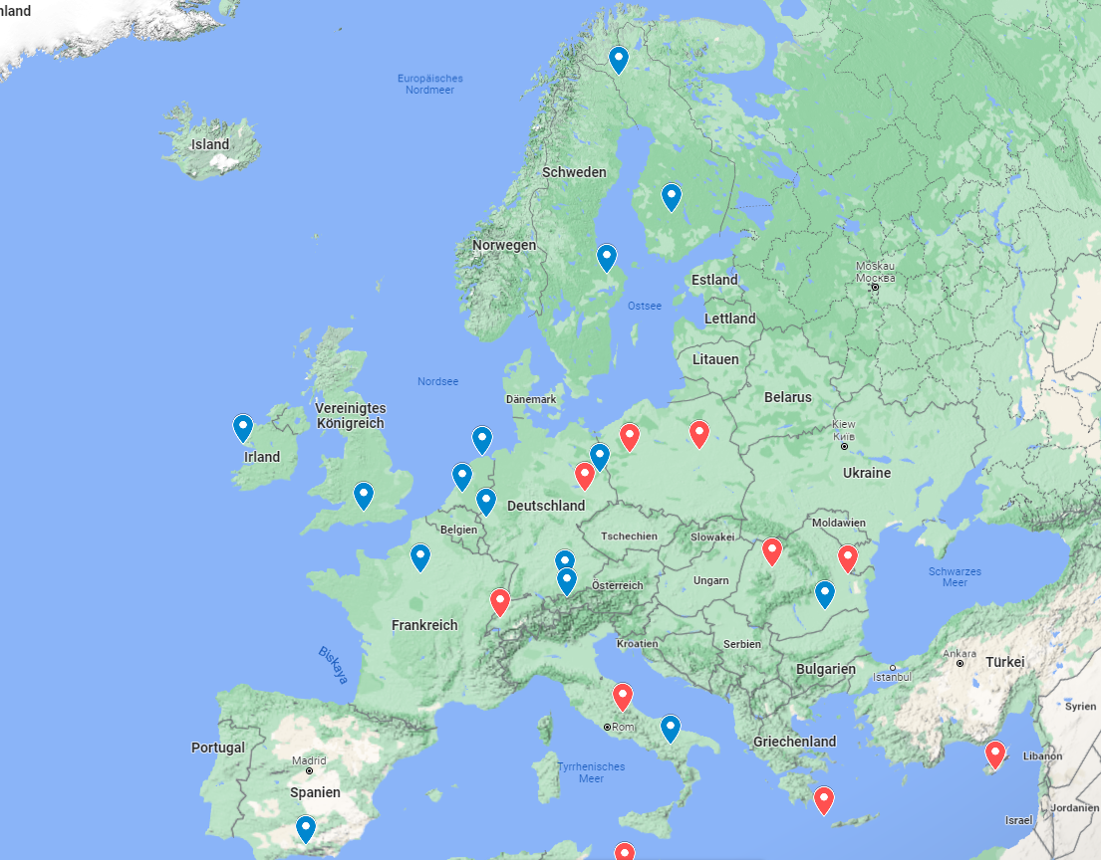
ACTRIS cloud remote sensing stations
blue: today
red: planned

Slide 4
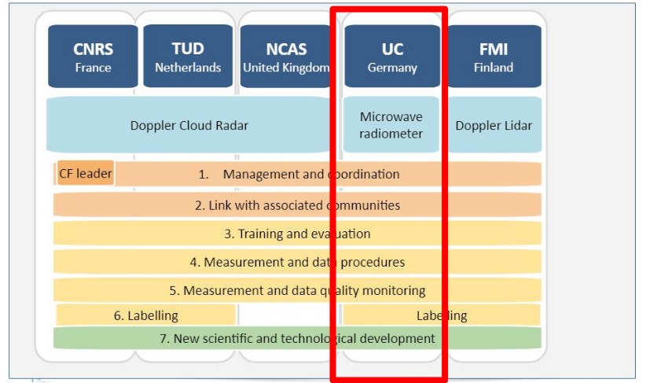
CCRES - Central Facilities
CCRES: Five units for Radar / Microwave Radiometer / Doppler Lidar

Slide 5
Goals in the ACTRIS MWR network
Homogenized data streams from all sites, including common:
data formats, file contents and metadata
quality control / flagging
retrieval development and application
data quicklooks of level1 and level2 products
Continuous near real time processing of raw data from MWRs of different manufacturers (mainly RPG)
Potential of synergistic products within CCRES
Recommendations and minimum requirements for operators concerning measurement setup, calibration, maintenance, …
Operational support, workshops and hands-on training regarding calibration and data handling

Slide 6
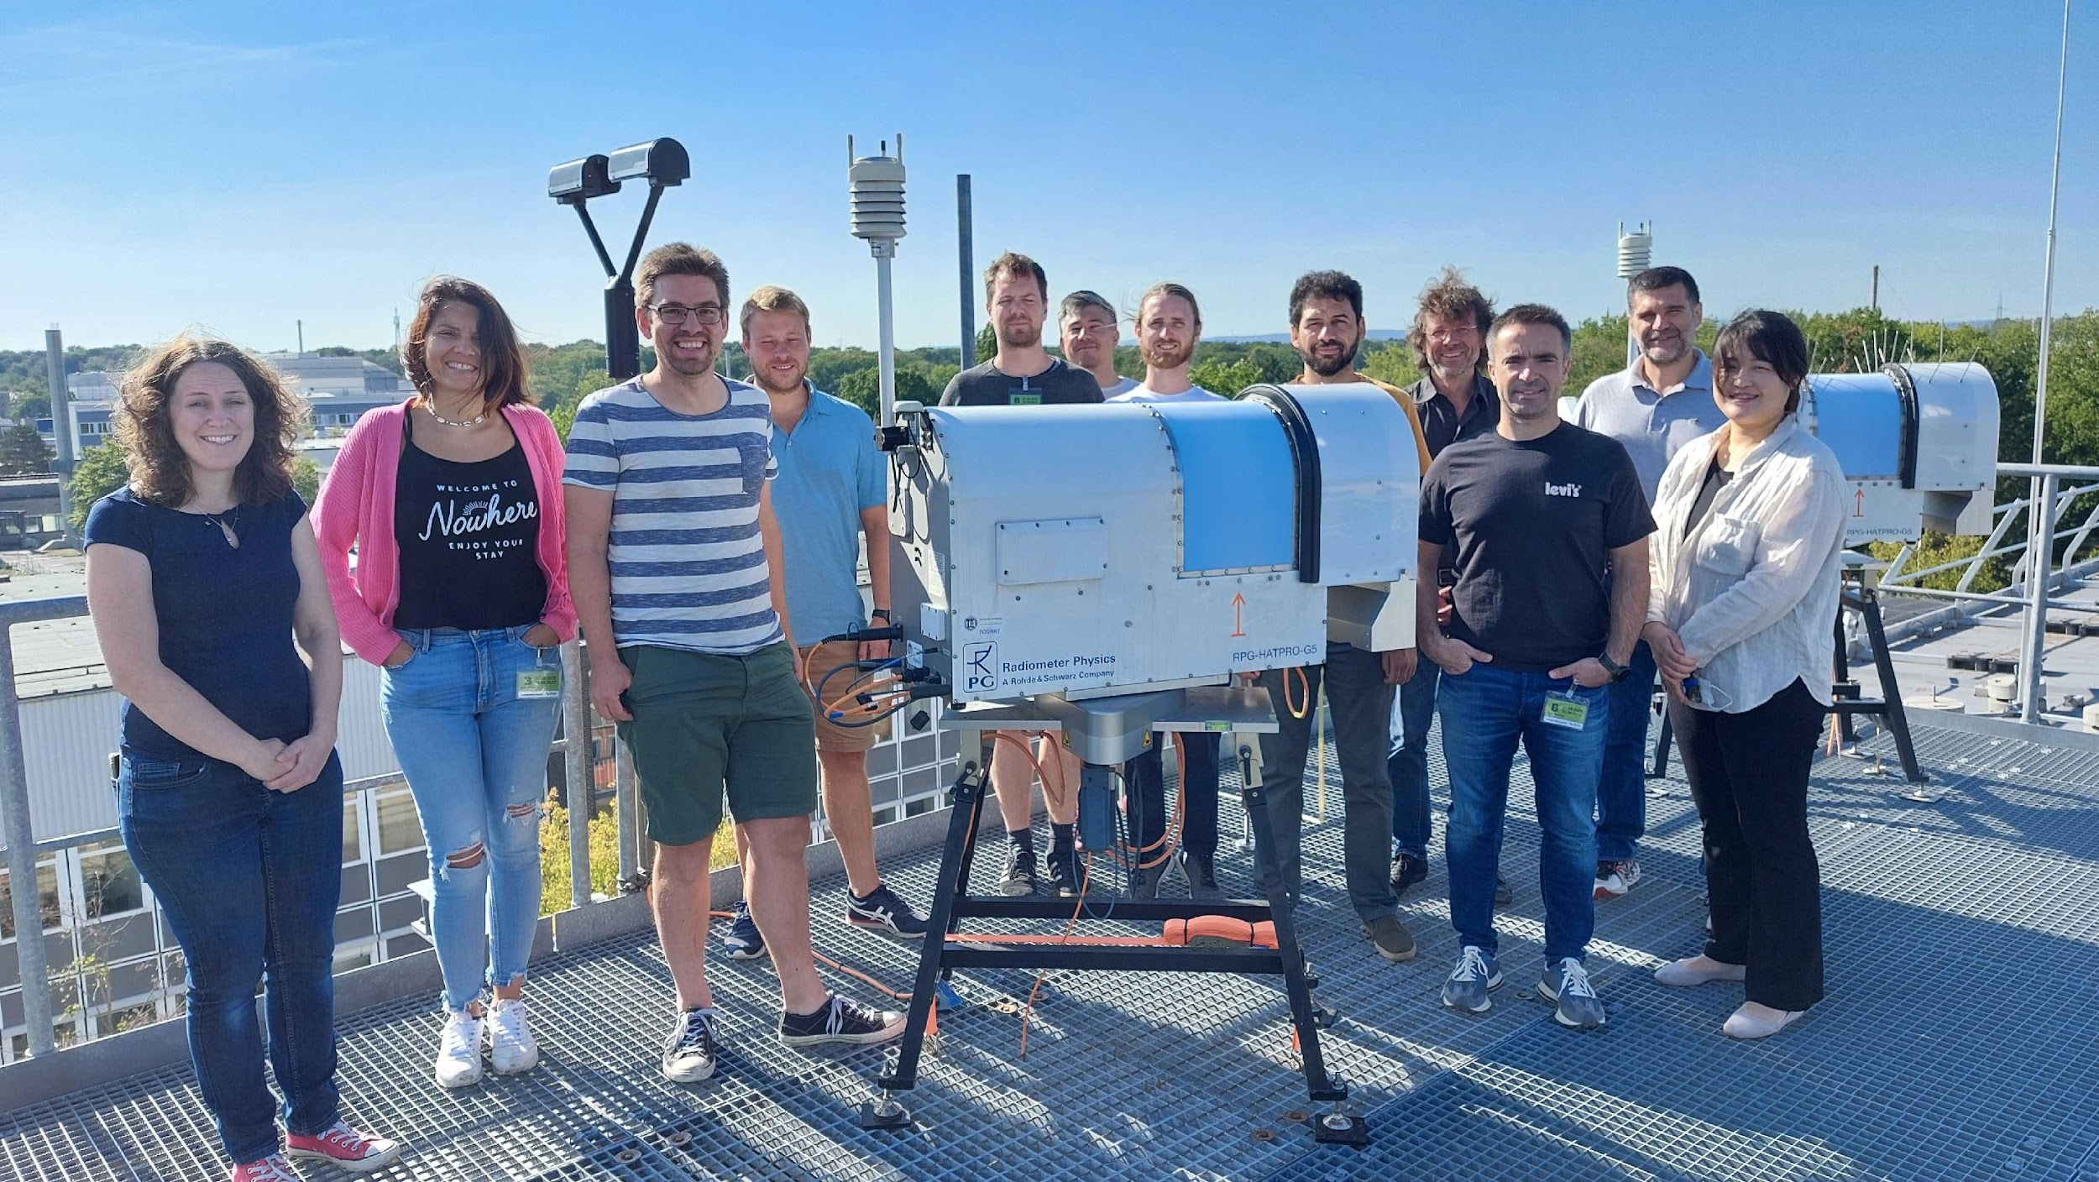
ACTRIS-CCRES / PROBE Workshop on microwave radiometer operation and calibration 31 August – 2 September 2022, Jülich, Germany
Organized by:
University of Cologne
ACTRIS-CCRES (Centre for Cloud Remote Sensing)
With support from:
PROBE COST-Action
Research Centre Jülich

Slide 7
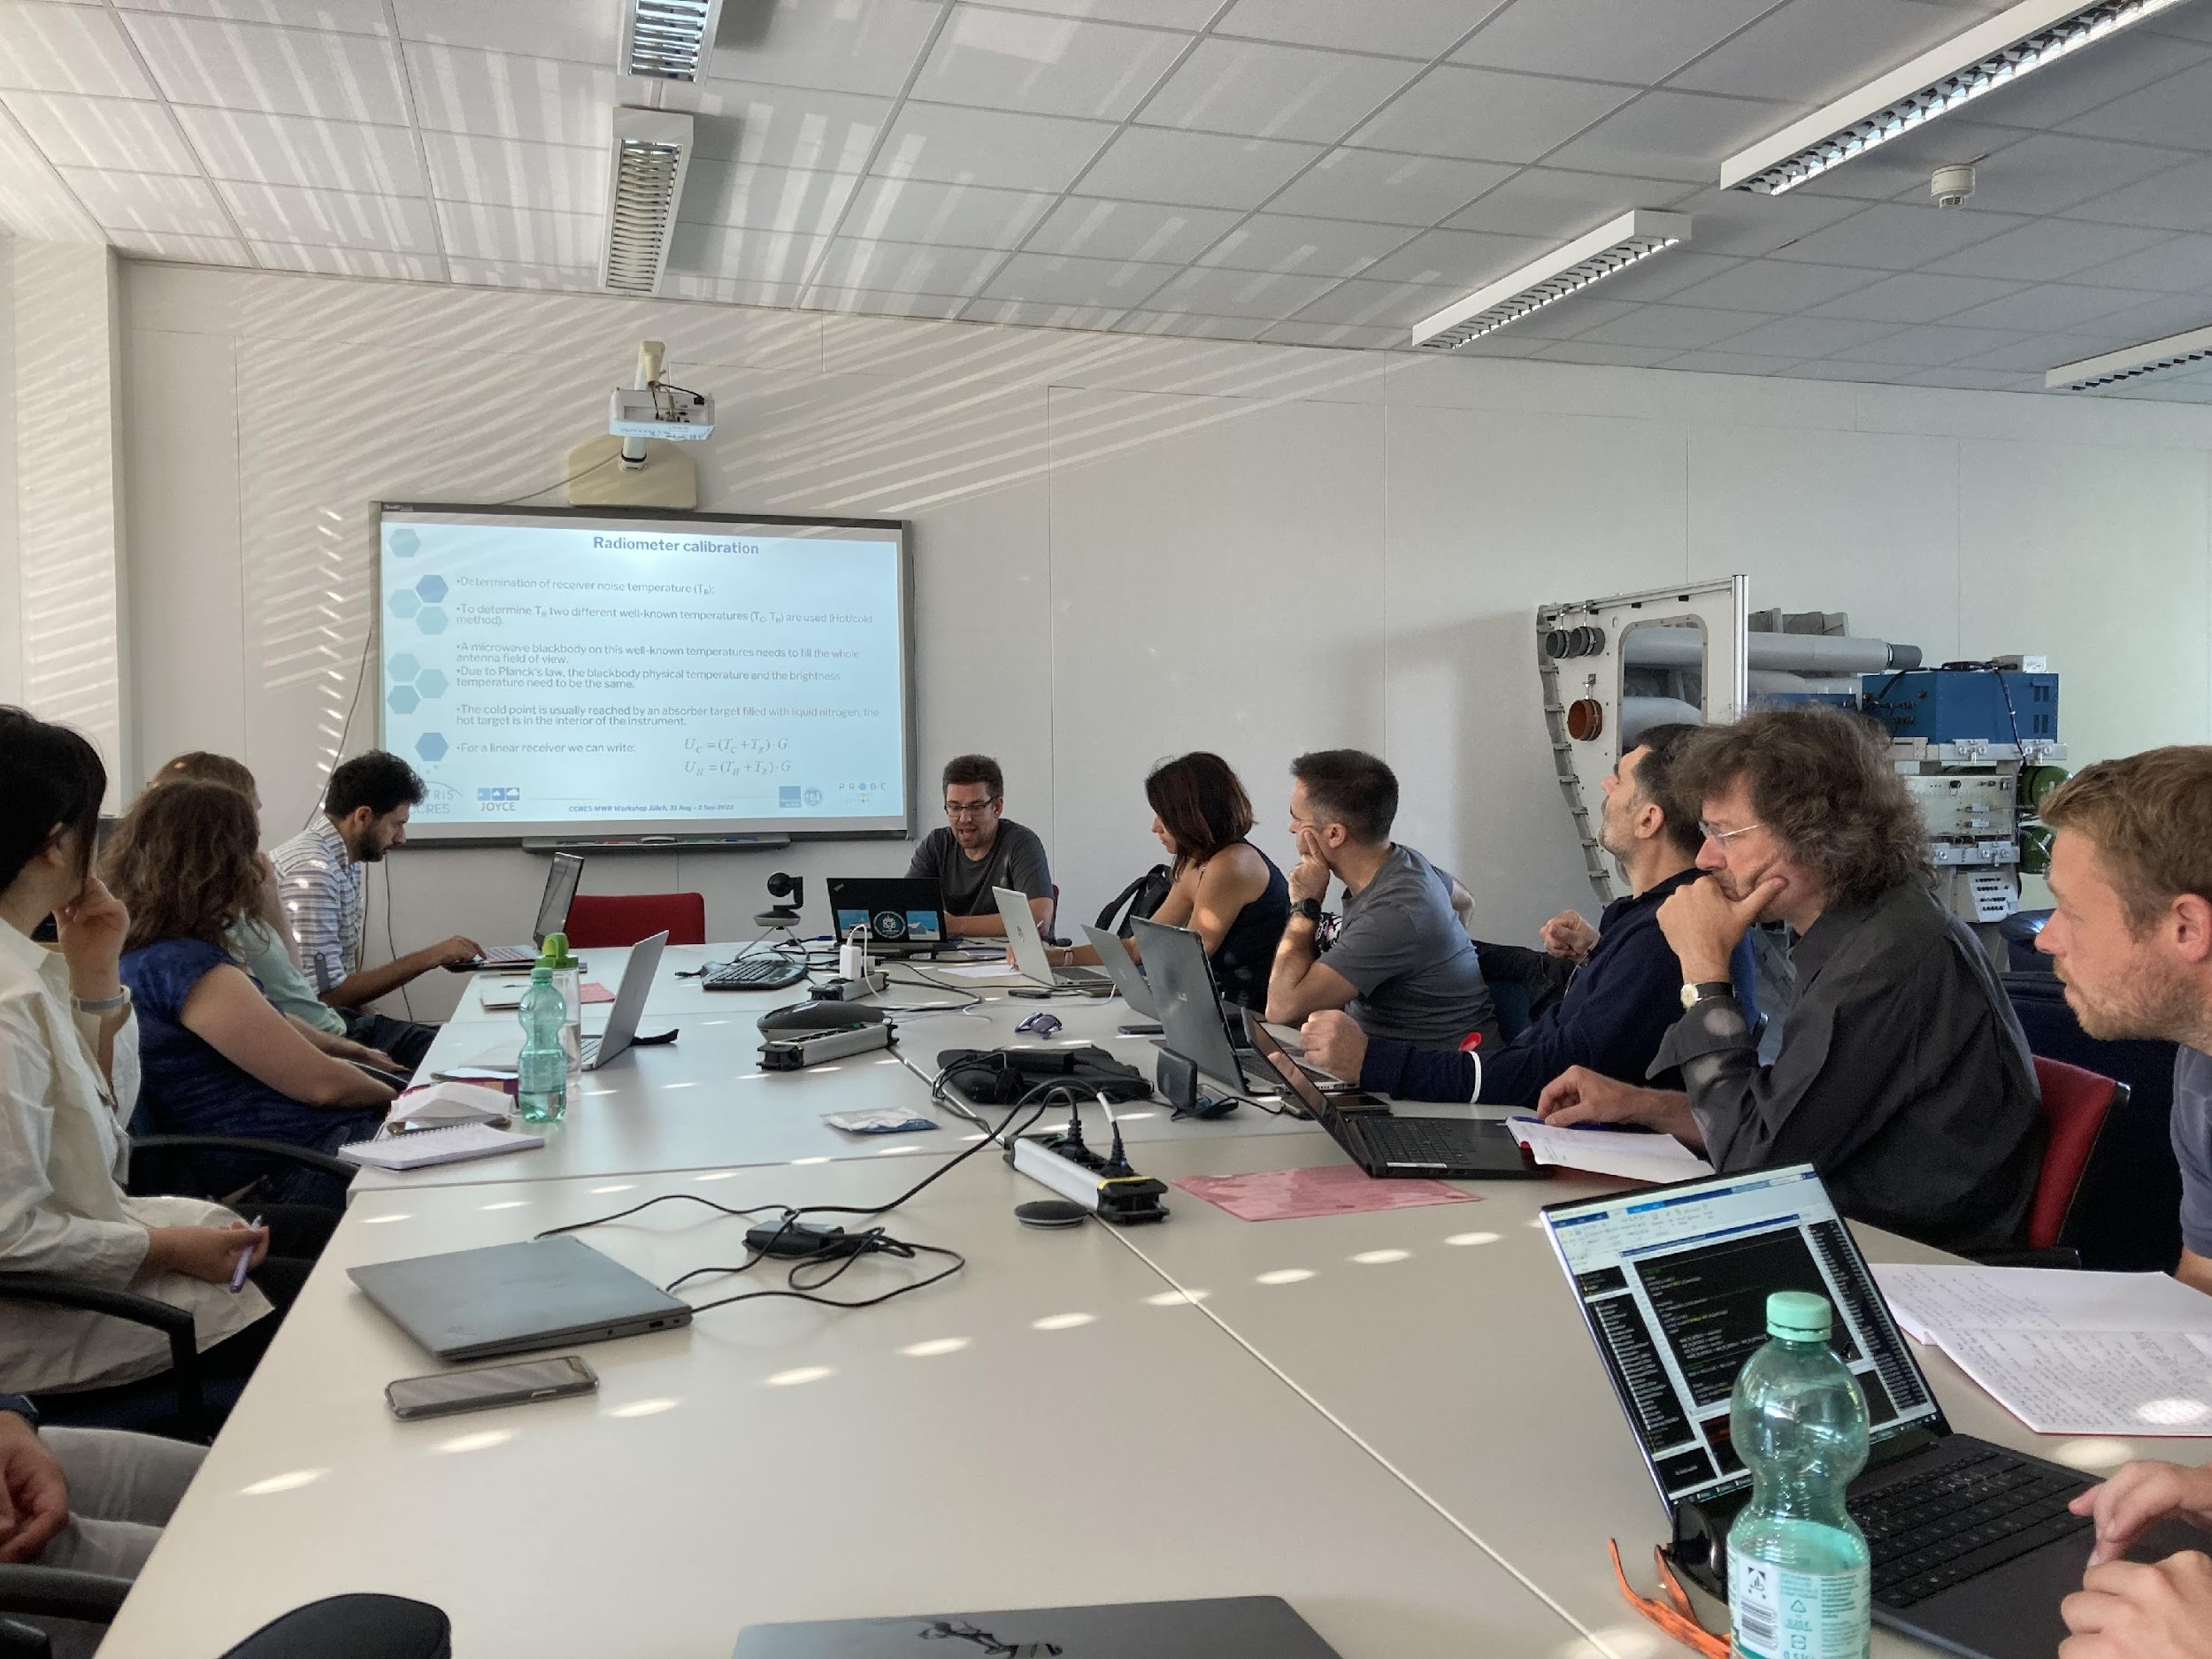
Workshop goals
Operation of microwave radiometers in networks (esp. ACTRIS and E-Profile)
Background of microwave radiometry
Data quality assurance / quality control
Calibration methods
Hands-on calibration with liquid nitrogen
Data processing
Exchange of experiences between users and with manufacturer (RPG)

Slide 8
Participants
9 participants from MWR operating institutions in
Germany
Italy
Romania
South Korea
Spain
Switzerland
Manufacturer:
Harald Czekala (RPG)
Local organizers:
Univ. Cologne (Bernhard Pospichal, Tobias Marke, Lukas Pfitzenmaier, Rainer Haseneder-Lind, Tobias Böck)

Slide 9
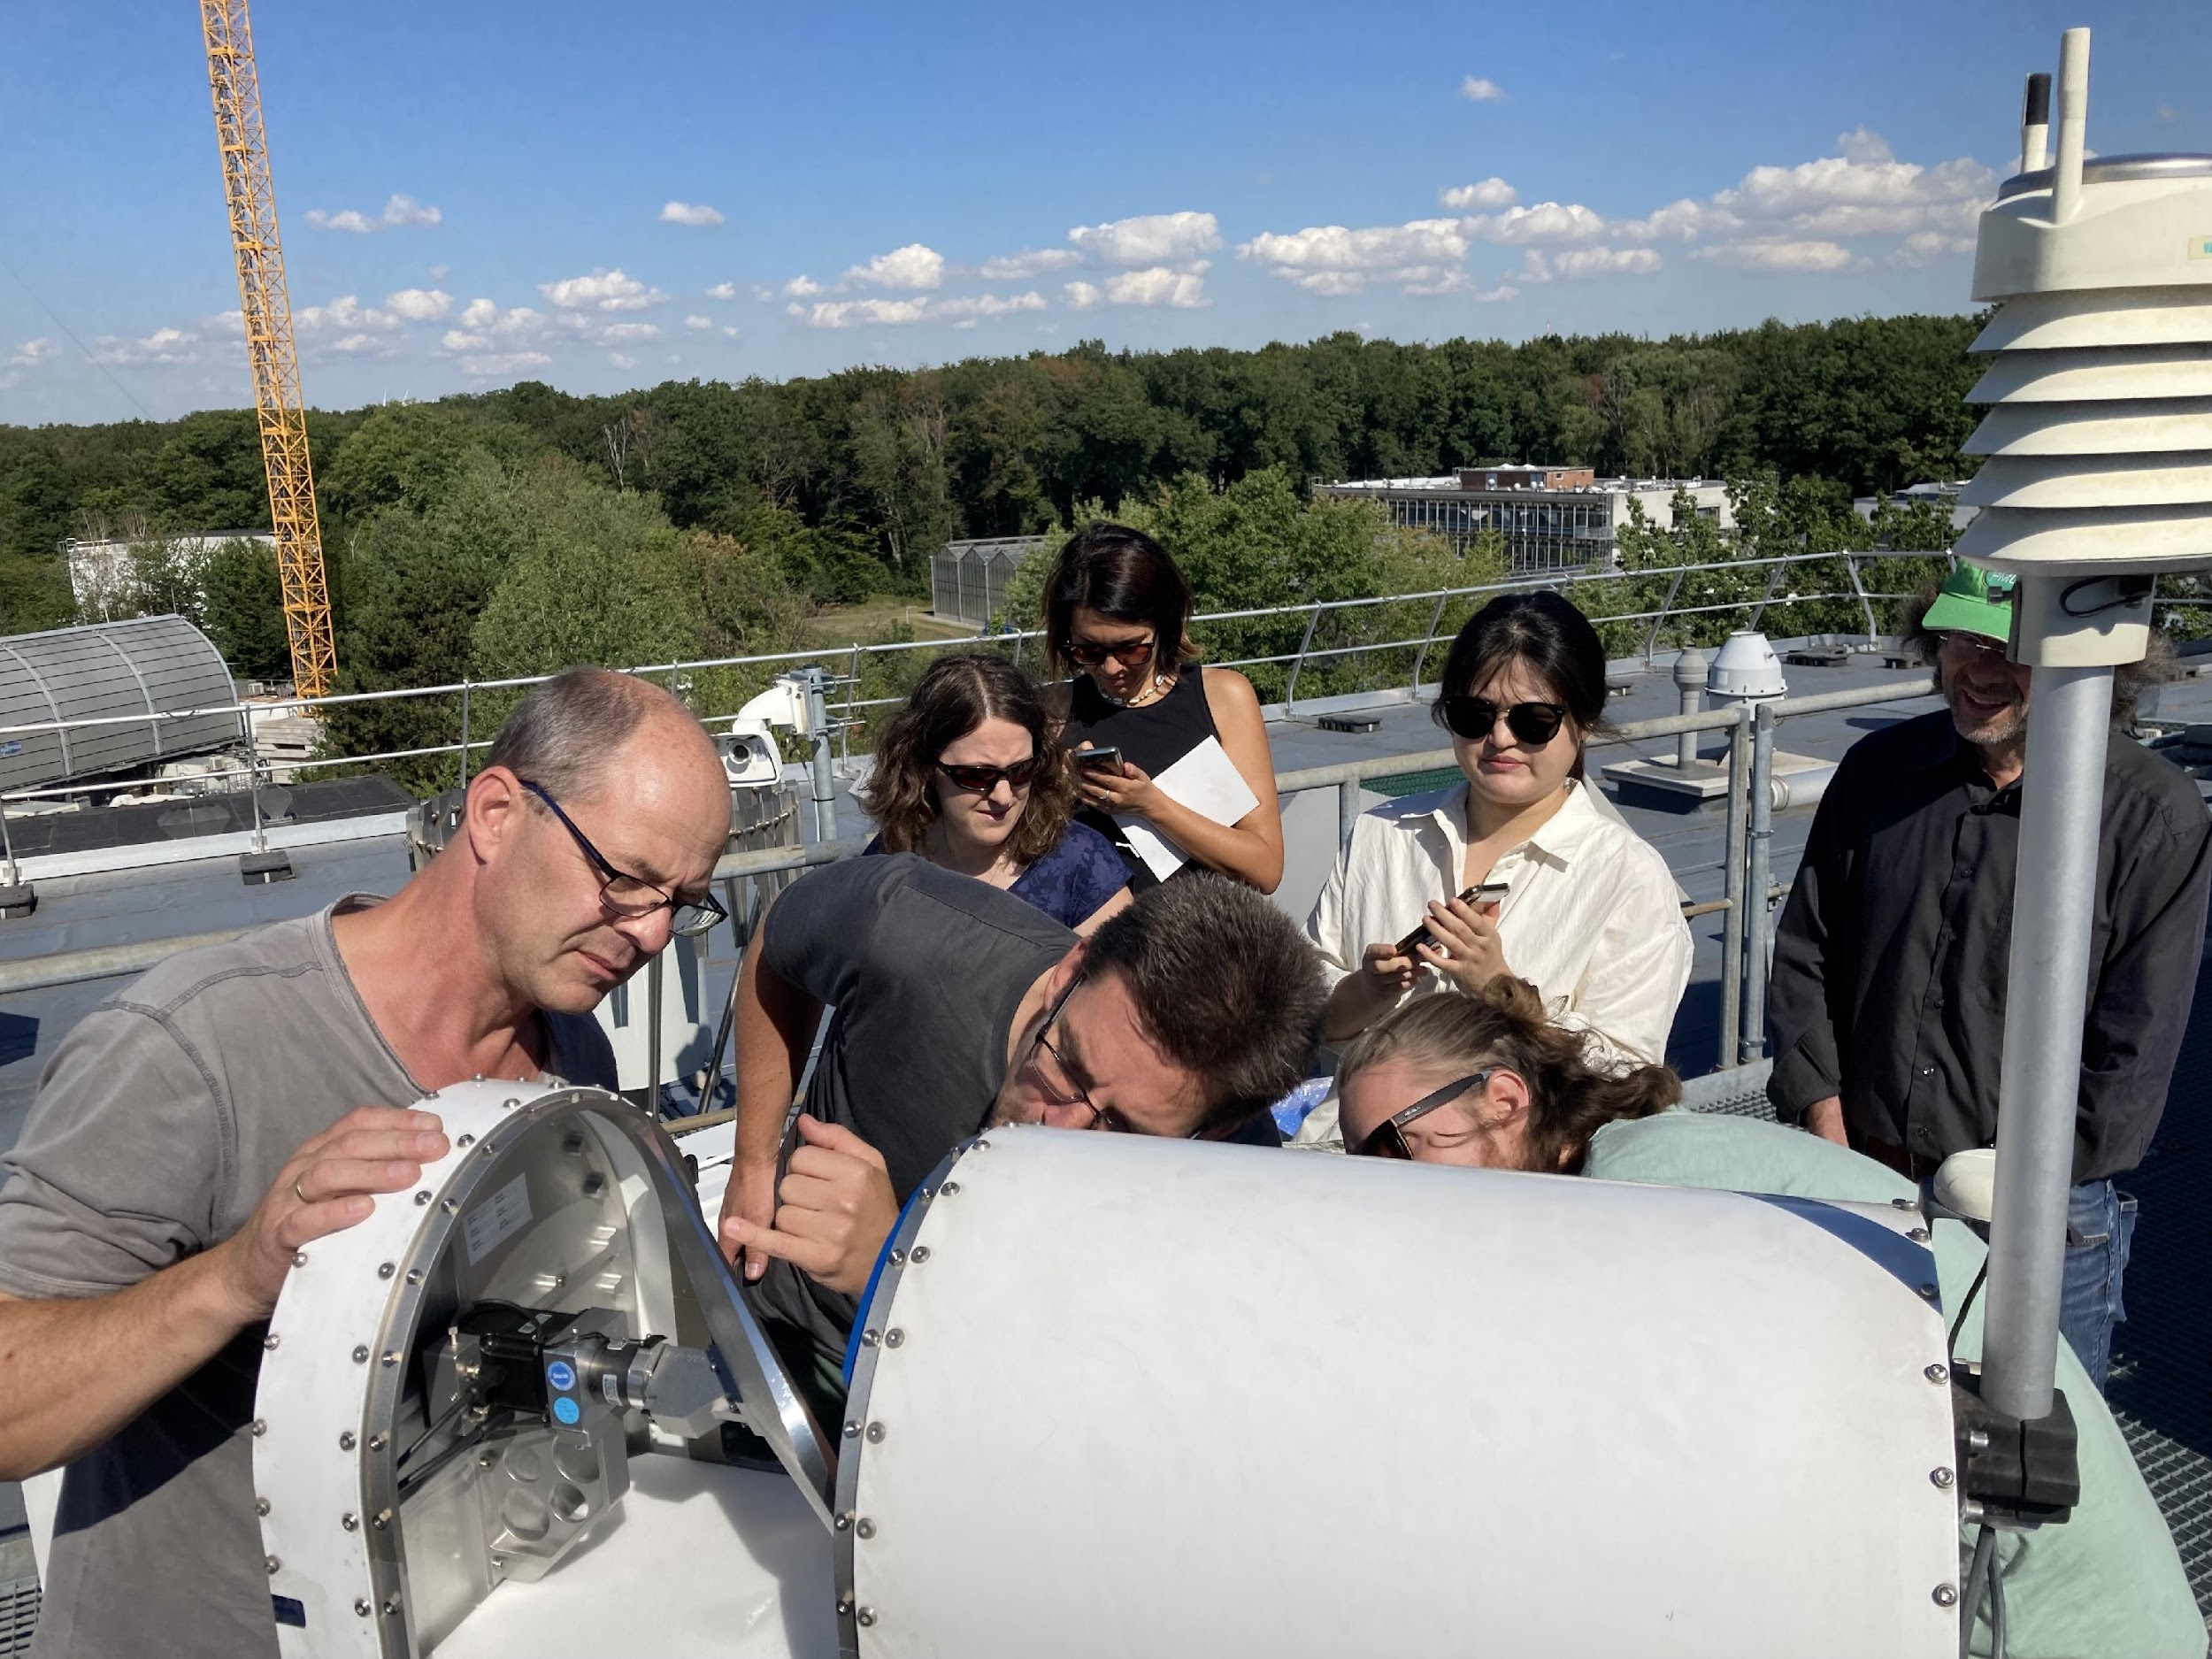
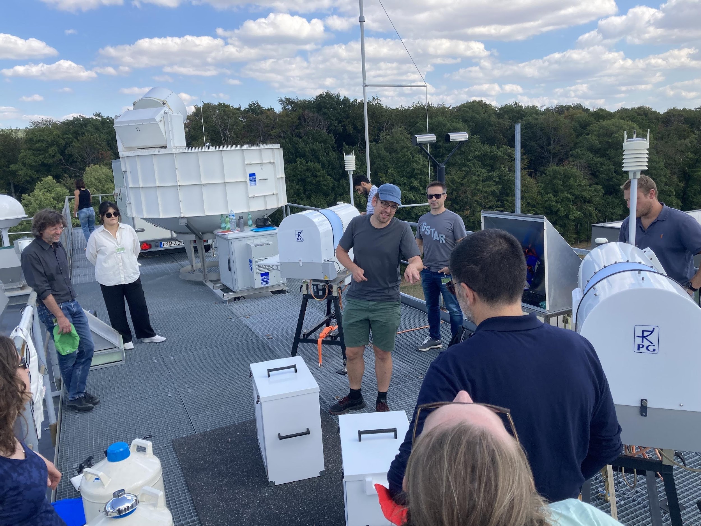
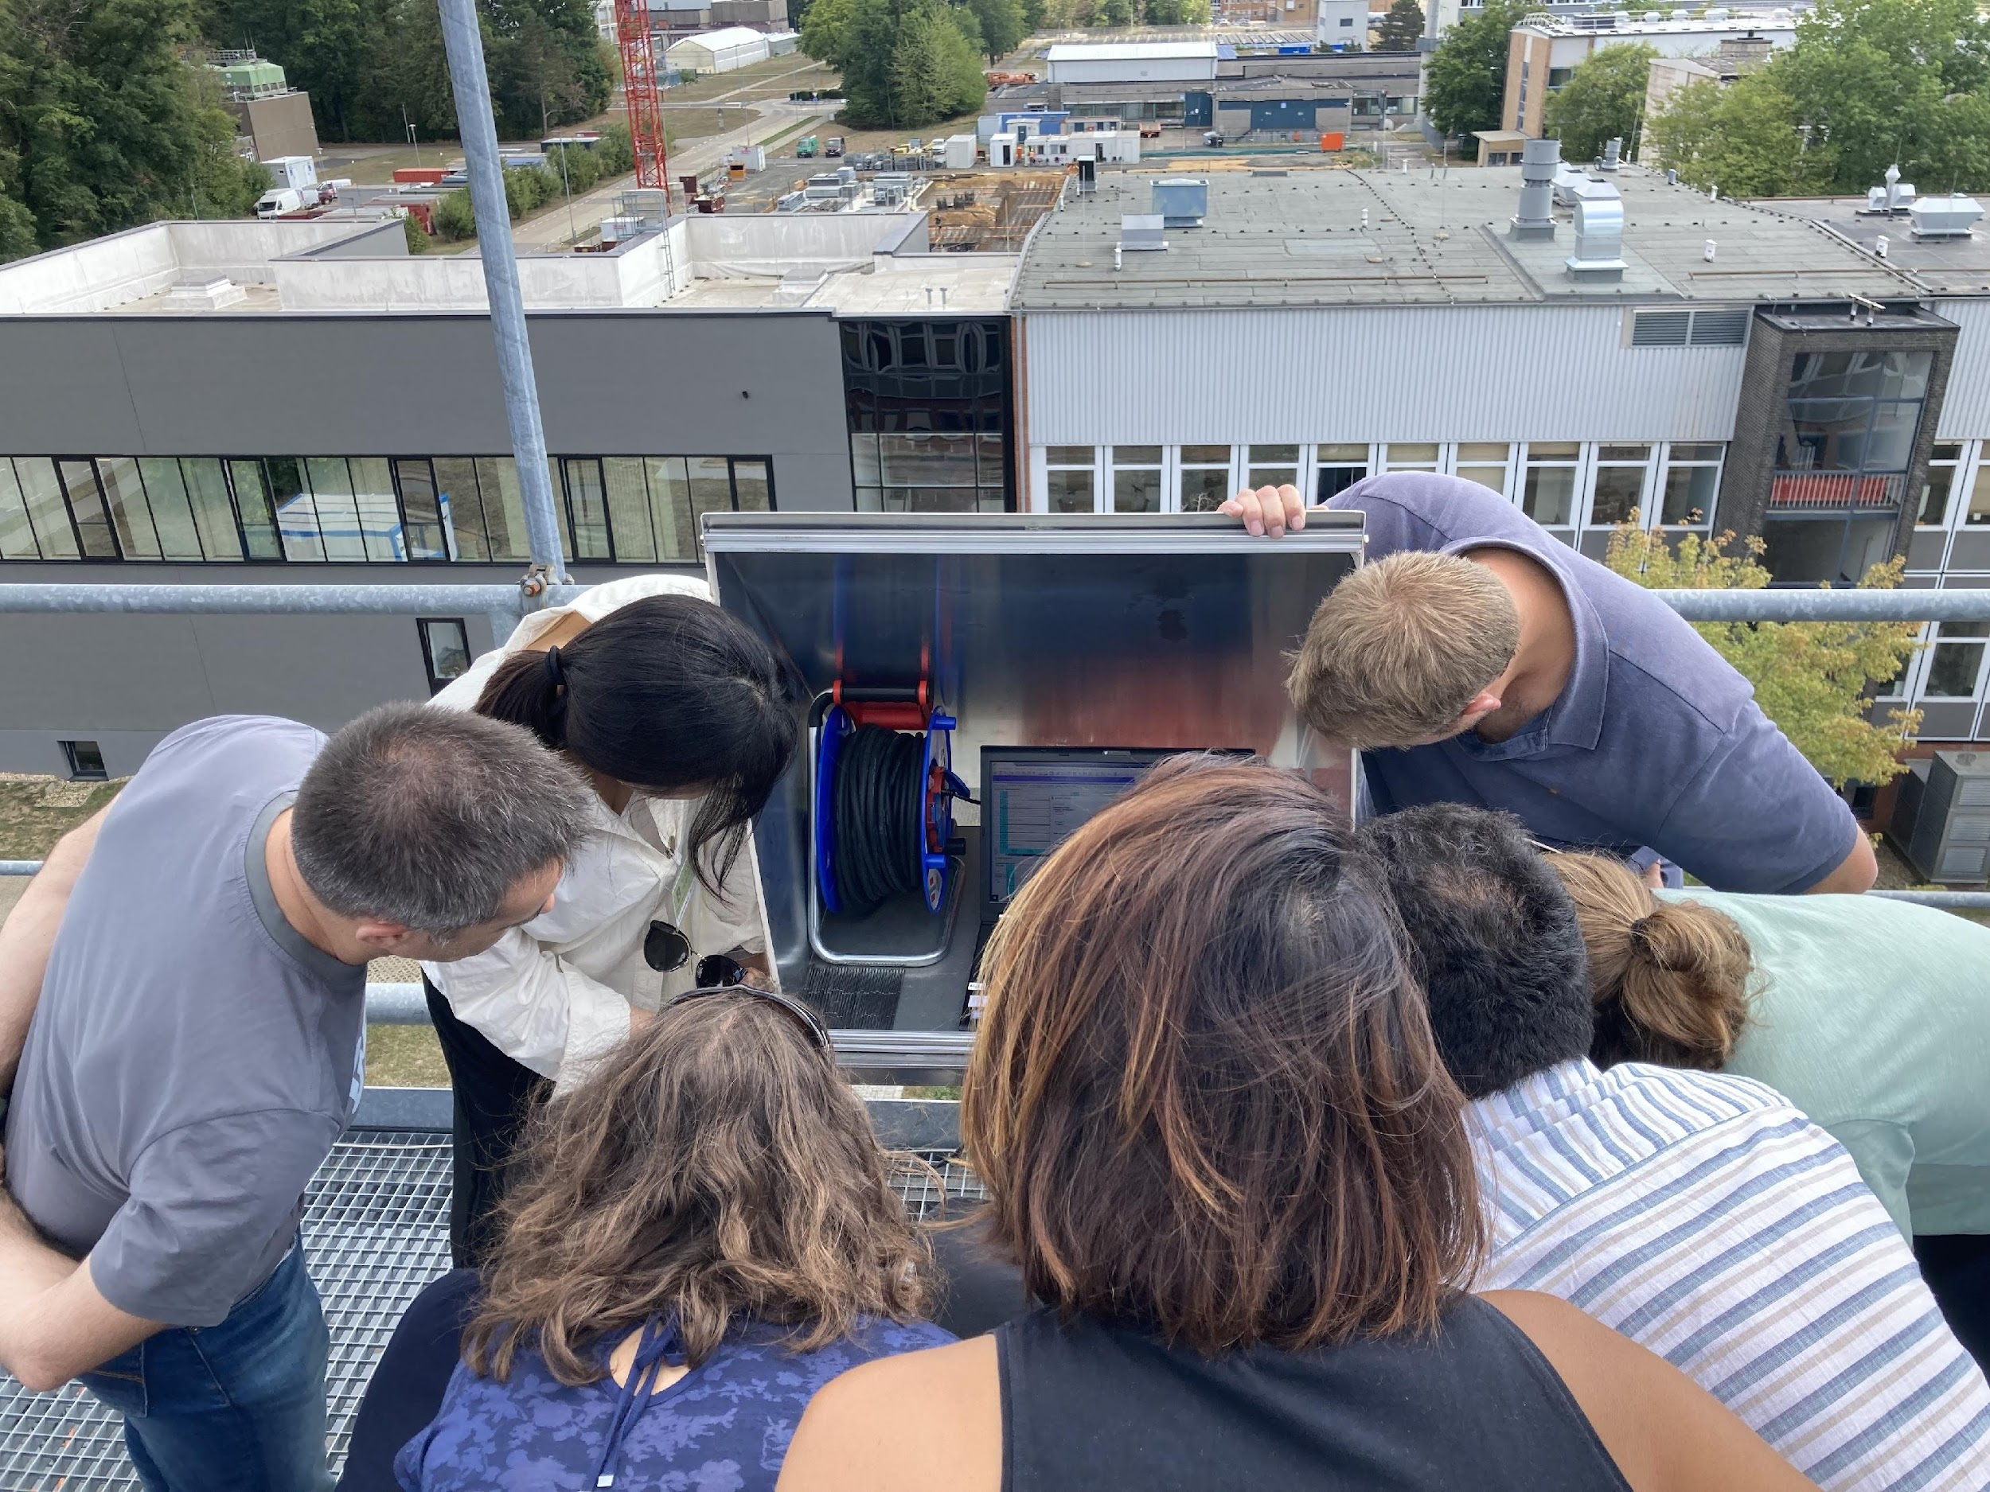
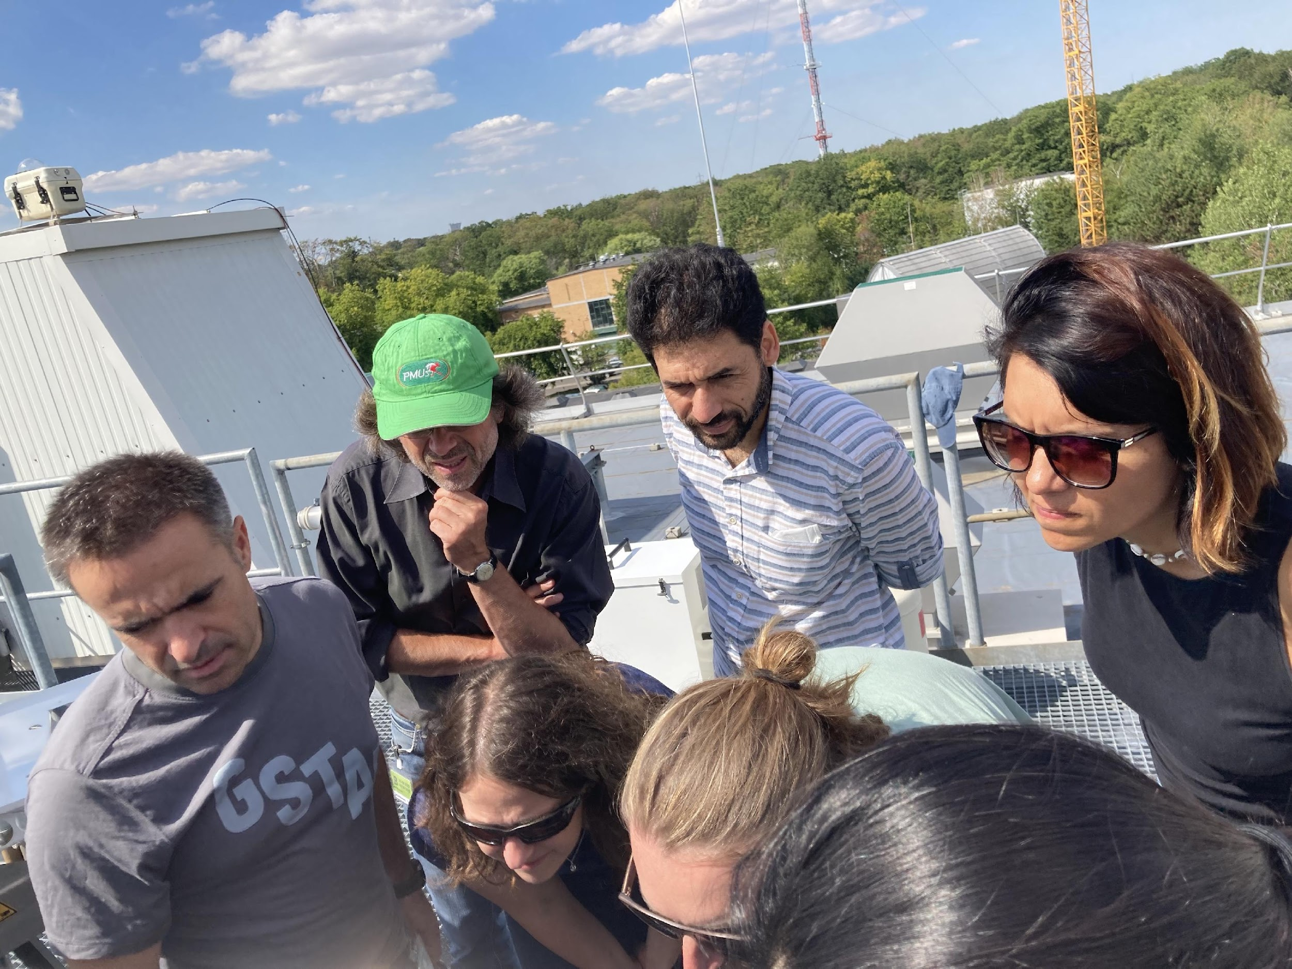
Workshop impressions

Slide 10
Feedback / Outlook
Positive feedback from participants to have this dedicated workshop, including hands-on training
Informal exchange with manufacturer was very helpful
Within ACTRIS-CCRES regular workshops for instrument operators are planned (~1 per year)
Thanks again for financial support by PROBE

Slide 11
Data Stream - Overview
Data handling will be performed by the Cloud remote sensing data centre unit (CLU)
CLU performs data versioning, data provision and archiving
Station operators are required to transfer the raw data to CLU at least once per day
Required files for RPG instruments (binary files) are:
BRT: Brightness temperatures (single angle)
BLB / BLS: Brightness temperatures from multi-angle elevation scans
HKD: Housekeeping data
IRT: Infrared radiometer brightness temperatures
MET: Meteorological sensor data
– preliminary also SPC, LWP files should be transferred.
Therefore, no data format conversion should be performed using the instrument software.
In addition, calibration LOG files are needed.

Slide 12
Data Format
Common MWR data format being developed in the EUMETNET E-Profile network
Will be used also in ACTRIS for a better cross network compatibility
RPG binary files are converted into Level 1 NetCDF files and are not needed anymore for Level 2 products
File name convention:
1B01 for MWR TB, 1B11 for IR, 1B21 for meteorological data, and 1C01 co-located
2IXX for integrated quantities (e.g. 2I01 for LWP)
2PXX for profiles (e.g. 2P01 temperature profiles)

Slide 13
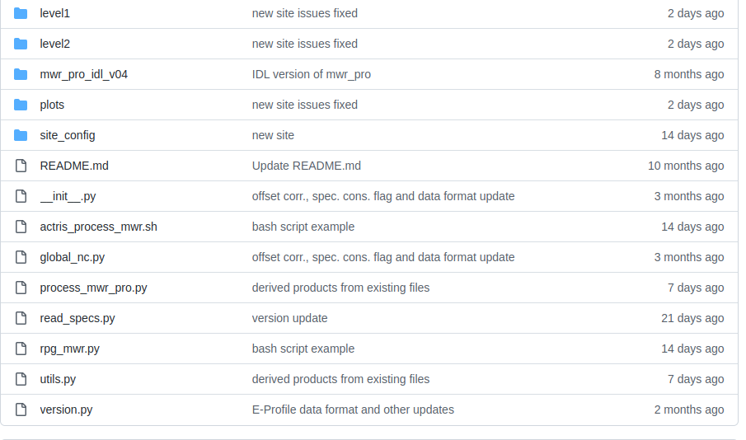
Data Processing
Python code under development and maintained on github
Based on IDL routines of “MicroWave Radiometer PROcessing” (mwr_pro)
Developed at University of Cologne and applied successfully to RPG data over years at different stations
Planned to also run outside of the ACTRIS network

Slide 14
Code Description
RPG binary files
.BRT, .BLB, .HKD, .IRT, .MET
+ config.py
lev1_to_nc
Level 2 vertically integrated
2I01: liquid water path (LWP)
2I02: integrated water vapor (IWV)
Level 1
1B01: MWR TB
1B11: IR TB
1B21: MET station data
1C01: co-located
Level 2 profiles
2P01: temperature (single-pointing)
2P02: temperature (BL scans)
2P03: humidity
(non-retrieved e.g. 2P04: rel. humidity)
lev2_to_nc
lev2_to_nc
generate_figure
Quicklooks

Slide 15
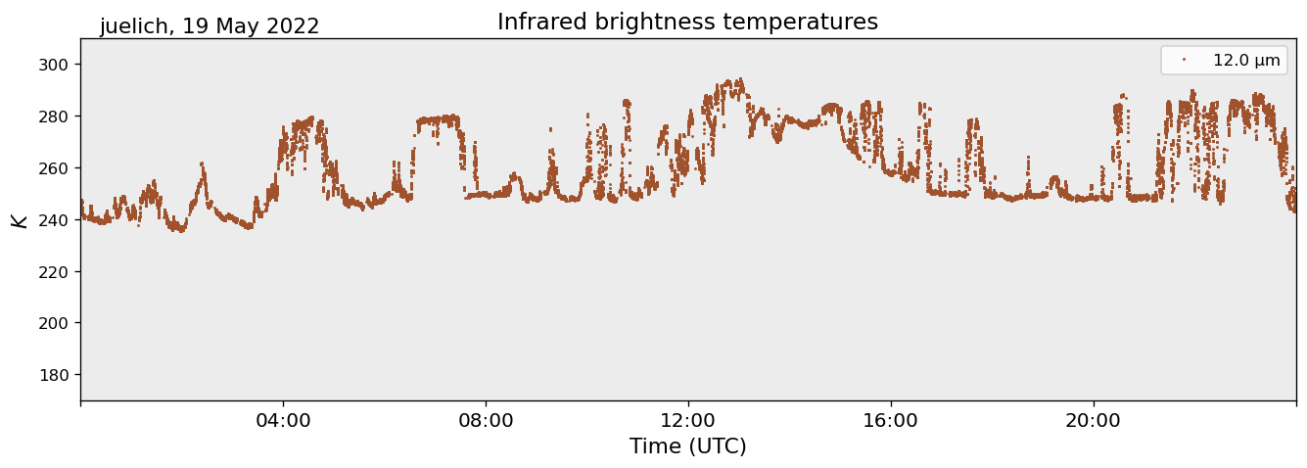
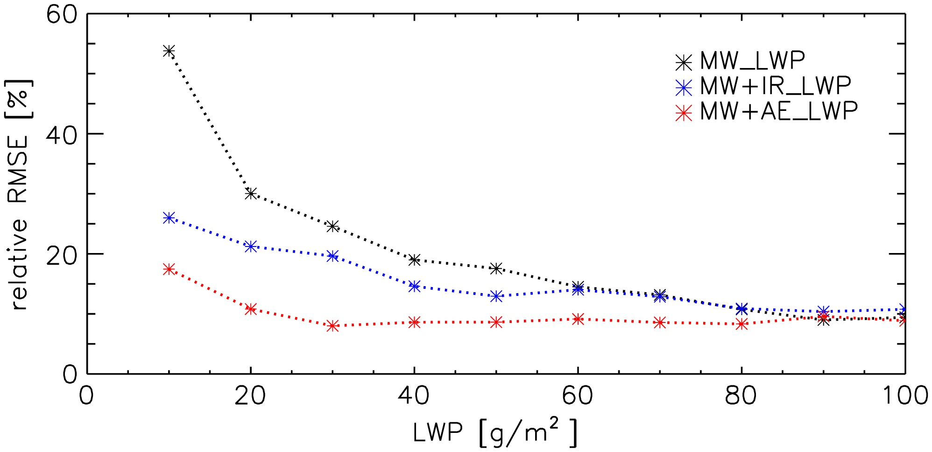
Level 1 - IRT
IRT will be used for synergy retrievals for improvements in low LWP situations
Marke et al., 2016

Slide 16
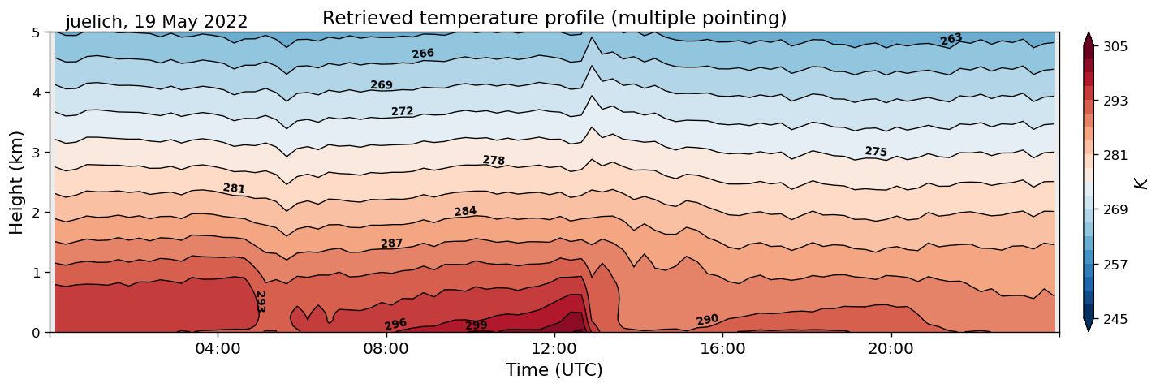
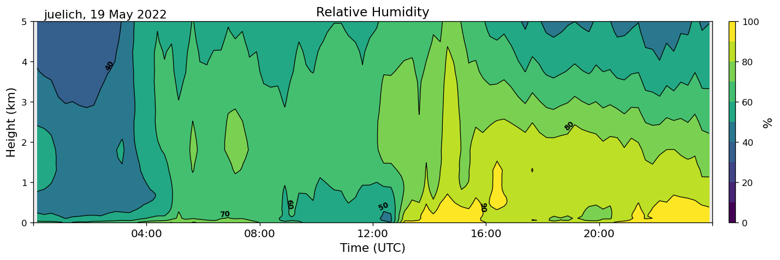
Level 2 - Multiple pointing

Slide 17
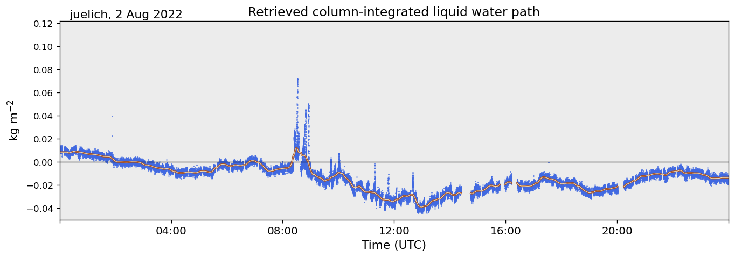
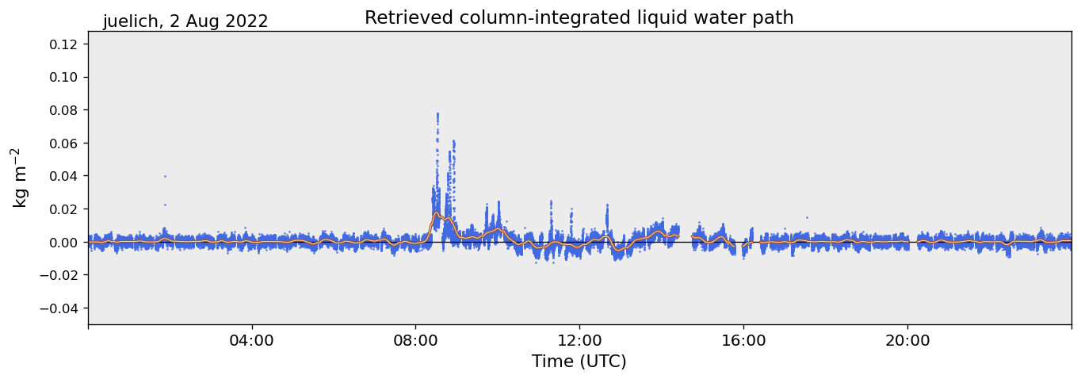
LWP Offset Correction
When using statistical retrievals, spurious LWP values can exist in clear sky scenes
Identify clear sky scenes using 2 min TB standard deviation @ 31.4 GHz and IR temperature as additional check for liquid clouds
Subtract mean LWP bias for 20 min windows if threshold criteria are fulfilled
without correction
with correction

Slide 18
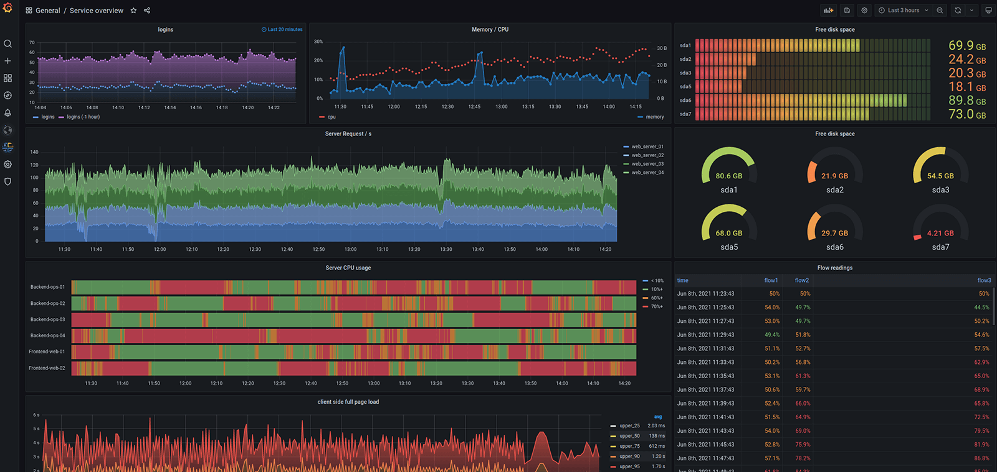
Quality Control
Data quality will be monitored continuously
Long-term statistical evaluation is performed for the labeling process, including at least 2 successful liquid nitrogen absolute calibrations
Visualization of housekeeping data is planned within CLU (using grafana)
grafana.com

Slide 19
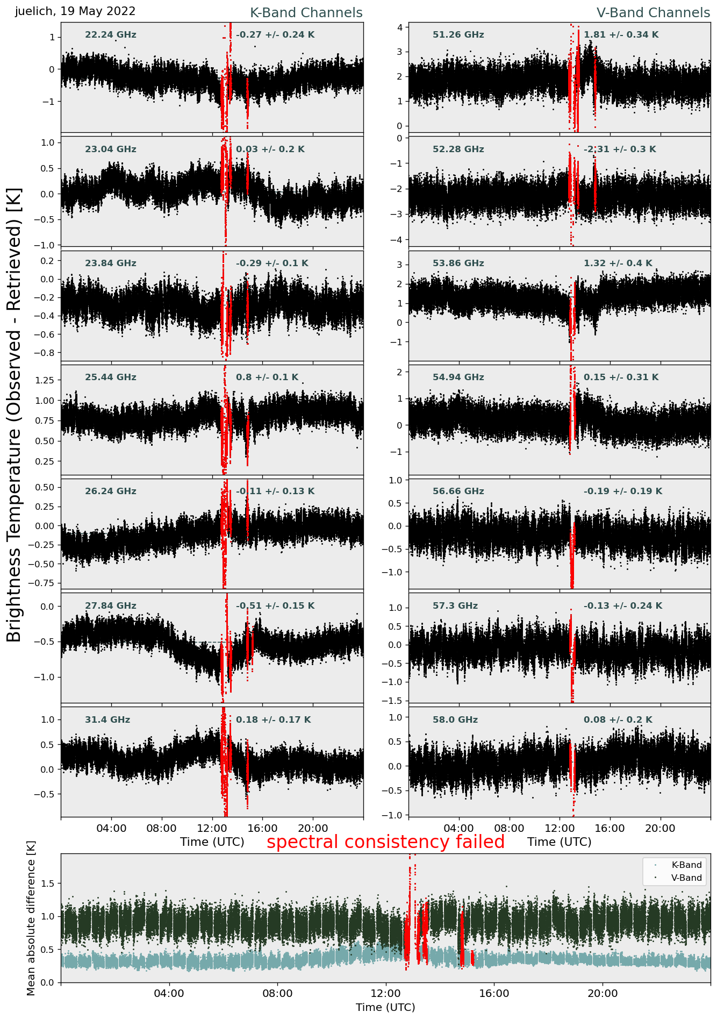
Spectral Consistency
Can the observed spectrum be explained by real atmospheric conditions?
TBs for a certain channel are derived via statistical retrieval from other channels (atmospheric information is not independent, and only certain atmospheric spectra are physically possible)
Retrieved TBs for all channels are then compared to measurements (data flagging is based on thresholds depending on channel retrieval uncertainty)
Possible to judge radome quality
(duration of inconsistency after rain w.r.t. atmospheric conditions)

Slide 20
Quality Flag
Quality flag for level 1 data
Bit 1: missing_tb
Bit 2: tb_below_threshold TB values are being checked
Bit 3: tb_above_threshold
Bit 4: spectral_consistency_above_threshold Comparison: retrieved & observed TB
Bit 5: receiver_sanity_failed Receiver & ambient target stability + noise diode status
Bit 6: rain_detected Rain sensor
Bit 7: sun_in_beam Calculate sun position for site location (relevant for scans)
Bit 8: tb_offset_above_threshold Not implemented

Slide 21
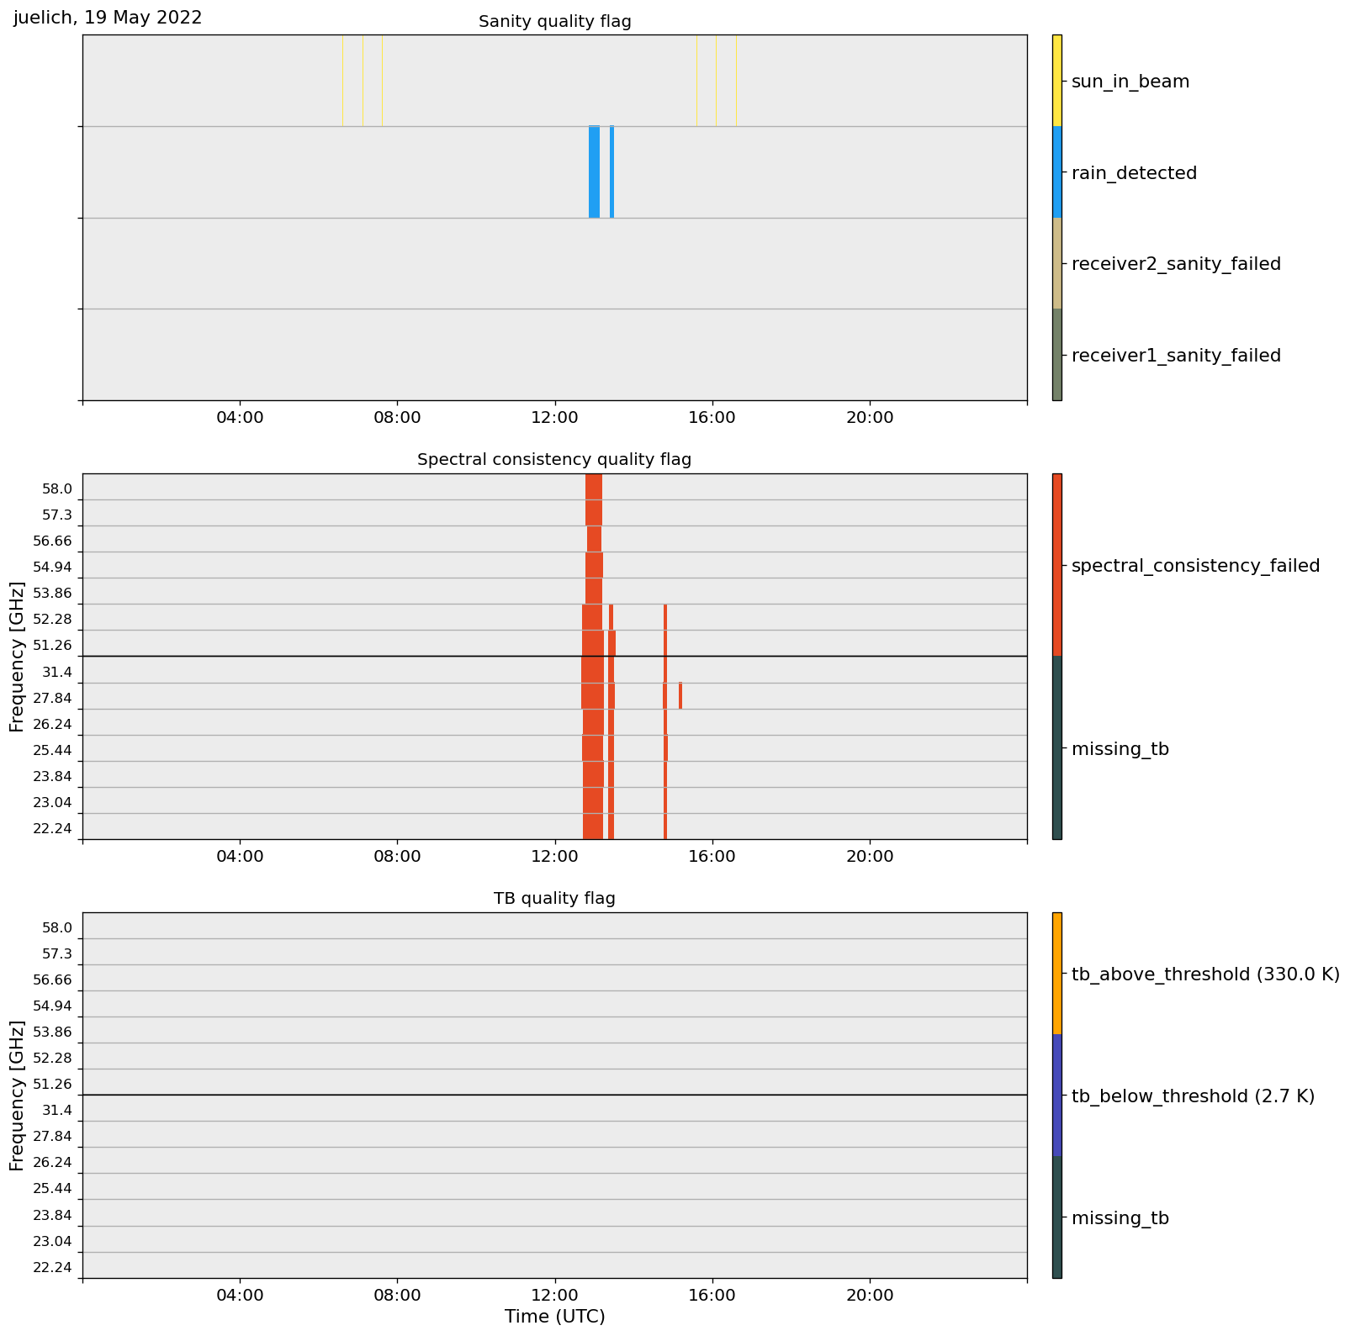
Quality Flag Quicklook
Individual channels / receivers are flagged
Helps to detect malfunctions in long-term deployments

Slide 22
Summary
Data handling performed by ACTRIS Data Centre
see docs.cloudnet.fmi.fi for Cloudnet documentation and data transfer instructions
New Python based data processing in development (will be available from github)
Processing includes common data format, quality control and retrieval application (from manufacturer)
Retrieval development starts soon

Slide 23
Thank you

