Slide 1
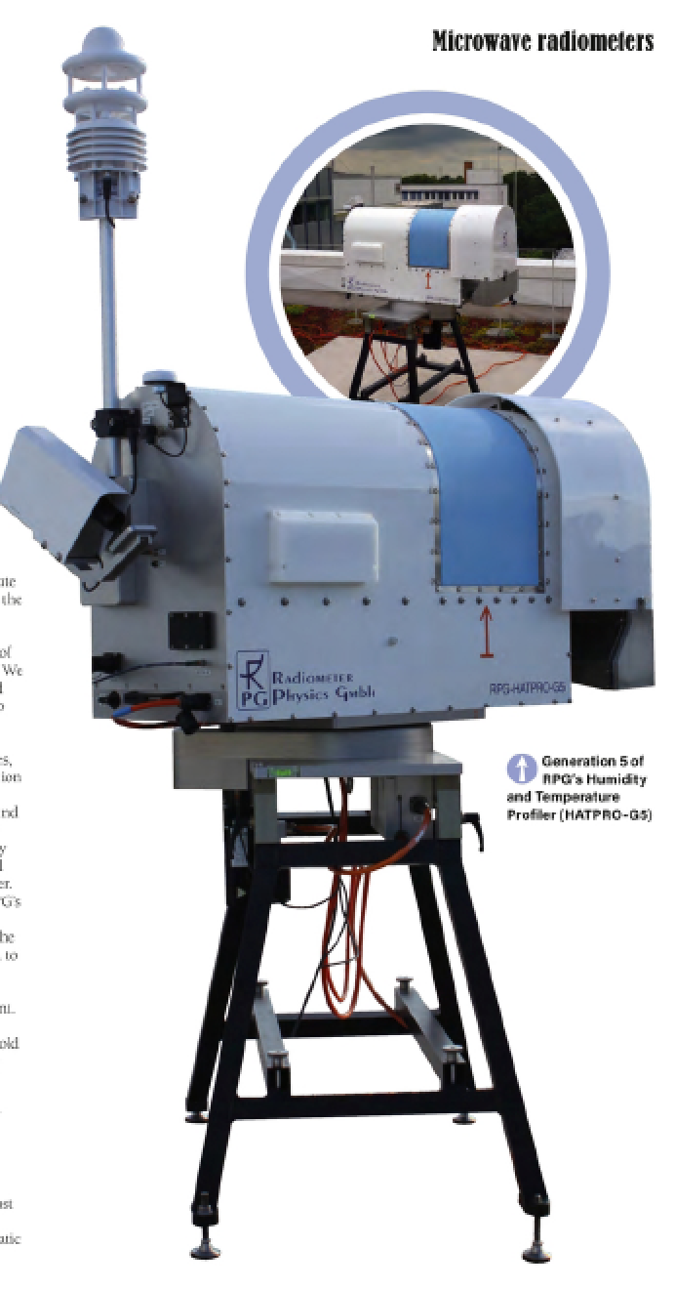
EMS Lightning Talk, Sep. 8th 2021
Session UP1.5 - Atmospheric measurements: Instruments, experiments, networks and long-term programs using in-situ and remote sensing techniques
Quality Assessment for HATPRO Microwave Radiometer Measurements and Calibrations
Institute for Geophysics and Meteorology, University of Cologne | Tobias Böck, Bernhard Pospichal, Ulrich Löhnert

Slide 2
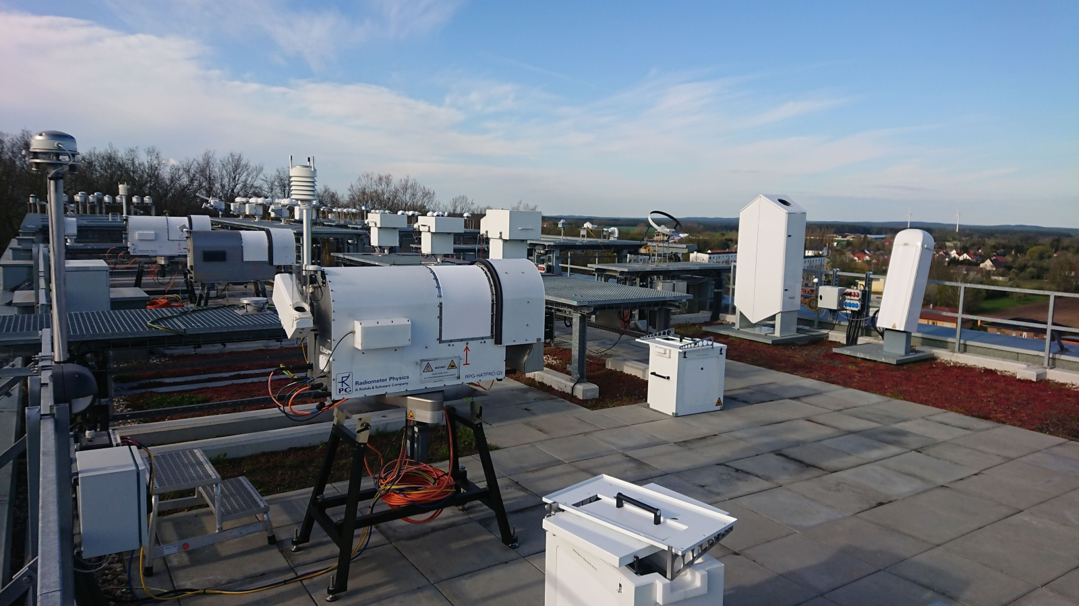
Quality Assessment for HATPRO Microwave Radiometer Measurements and Calibrations
Institute for Geophysics and Meteorology, University of Cologne, Germany | Tobias Böck, Bernhard Pospichal, Ulrich Löhnert EMS Lightning Talk, Sep. 8th 2021
Goals:
Integration of ground-based thermodynamic profilers into the DWD forecasting system (TDYN-PRO)
Q: Are the considered state-of-the-art ground-based profilers accurate and reliable enough for data assimilation at DWD?
Accuracy of HATPROs (Instrument Error):
Characterize
systematic errors:
absolute LN2 calibration errors (bias)
drifts (instrument stability, TB leaps between calibrations)
random errors:
radiometric noise (e.g. via covariance matrices)
repeatability of calibrations
through coordinated experiments at the JOYCE site and during a LN2 calibration campaign at FESSTVaL 2021 with 4 HATPROs.
HATPRO MWRs
Fig. 1: Humidity And Temperature PROfiler (HATPRO).
jjjjjjjjj
It measures thermal emissions from the atmosphere in 14 different frequencies within the K- and V-band and allows investigation of:
jjjjjjjjjjjjj temperature profiles, rudimentary humidity profiles, integrated water vapor (IWV), liquid water path (LWP)
2

Slide 3
Quality Assessment for HATPRO Microwave Radiometer Measurements and Calibrations
Institute for Geophysics and Meteorology, University of Cologne, Germany | Tobias Böck, Bernhard Pospichal, Ulrich Löhnert EMS Lightning Talk, Sep. 8th 2021
Preliminary Results (for Gen5 HATPROs):
Type of Error | Typical Error Values K-band | Typical Error Values V-band | Determined via | Error influenced by handling? | How to reduce Error?
Biases/Offsets | usually ≤ 0.3 K (up to 0.48 K) | usually ≤ 0.5 K (up to 1.1 K) | Zenith measurement differences between two MWRs | yes | Quality of calibration
Drifts (over 6 months) | usually ≤ 0.3 K (up to 0.6 K) | usually ≤ 0.8 K (up to 1.3 K) | Leaps at coldload after calibration (should V-band be determinded via coldload at all?) | no | Frequency of calibration
Calibration Repeatability | ≤ 0.12 K | ≤ 0.24 K | Leaps to zenith reference measurements after two immediate consecutive calibrations | yes | Qualtity of calibration
Noise Levels (coldload – hotload) (1s) | ≤ 0.11 K – 0.18 K | ≤ 0.27 K – 0.35 K | Standard deviation | no | Not possible, instrument specific
3

Slide 4
In more detail:
4

Slide 5
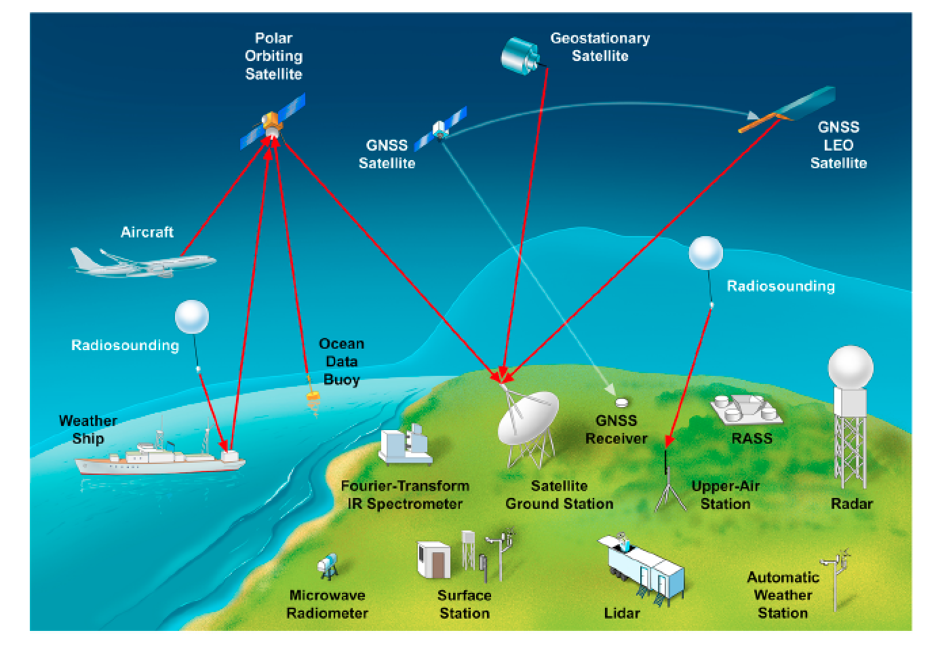
Introduction: Status of Atmospheric Profiling
Upper-air observations (radiosondes)
→ Problem horizontal and temporal coverage: diurnal cycle and meso-scale circulation not resolvable
Aircraft (AMDAR, E-AMDAR, MODE-S,…)
→ Regionally limited to areas around large airports & no humidity yet
Polar-orbiting satellites (AMSU-A/B, AIRS, IASI,..): ~2x daily overpasses deliver world-wide coverage of T and WV profiles, as well as clouds
WMO
→Atmospheric Boundary Layer (ABL) not resolved (variable surface emissivity and low vertical resolution)
5

Slide 6
Motivation
The atmospheric boundary layer (ABL) is the most important under-sampled part of the atmosphere*
For NWP applications, the top-priority atmospheric variables not currently adequately measured**
wind profiles
temperature (T) and humidity (H) profiles (specifically in cloudy areas)
T and H profiles can be obtained by ground-based microwave radiometer (MWR) observations
Yet MWR observations are not assimilated by any operational NWP system
*US National Research Council Reports **WMO guidance on observations for NWP: https://www.wmo.int/pages/prog/www/OSY/GOS-RRR.html
6

Slide 7
Goals
WMO:
“…remote sensing techniques (surface-based) are especially useful for making observations at times between balloon-borne soundings and for filling gaps at locations without regular radiosonde ascents. They thus have great potential to be a valuable part of integrated networks.”
http://www.wmo.int/pages/prog/www/OSY/Gos-components.html
Integration of ground-based thermodynamic profilers into the DWD forecasting system (TDYN-PRO)
EMF III: The potential of ground-based thermodynamic profilers for improving short-term weather forecasts
Q: Are the considered state-of-the-art ground-based profilers accurate and reliable enough for data assimilation at DWD?
7

Slide 8
Instrument: HATPRO MWR
HATPRO MWR
Humidity And Temperature PROfiler from Radiometer Physics GmbH
Measures thermal emissions from the atmos-phere in 14 different frequencies (primarily from oxygen, water vapor and liquid water)
Converts these radiances into Brightness Temperatures TBs [K] (through Planck’s law)
allows investigation of (via inversion):
rudimentary humidity profiles
temperature profiles
integrated water vapor (IWV)
liquid water path (LWP)
commercially available for ~10 years, ready for network applications (in principle)
continuous data in all-sky conditions: resolution of seconds to minutes
8

Slide 9
MW-profiling: How does it work theoretically?
K-Band
(7 channels)
V-Band
(7 channels)
Oxygen absorption → constant VMR, so only temperature dependent
cloud contribution
pressure broadened WV line → total water vapor & weak profile information
9

Slide 10
Accuracy of HATPROs (Instrument Errors)
Characterize
systematic errors:
absolute calibration errors (bias)
drifts (instrument stability, TB leaps between calibrations)
random errors:
radiometric noise (e.g. via covariance matrices)
external errors:
radio frequency interference
through coordinated experiments at JOYCE and RAO (FESSTVaL)
Assess quality flags during operation and repeatability of calibrations
Objective: Define & apply procedure for MWR measurement uncertainty characterization for TBs (level1) per channel
→ necessary for data assimilation applications
10

Slide 11
HATPRO Calibration
Absolute calibration with liquid nitrogen (LN2), Coldload
~77.2 K boiling point
Target (PT-V1) with two sides, one for the K-Band and one for the V-Band
Standard procedure:
Measure TBs from coldload before calibration (min. 3min)
Do calibration (integration time 100s)
Measure TBs from coldload after calibration (min. 3min)
Measure TBs from hotload (min. 10min)
Relative calibration on Hotload every 10 min ? (automatic; target inside radiometer; a bit above ambient temp.)
11

Slide 12
First Look at some Preliminary Results
12

Slide 13
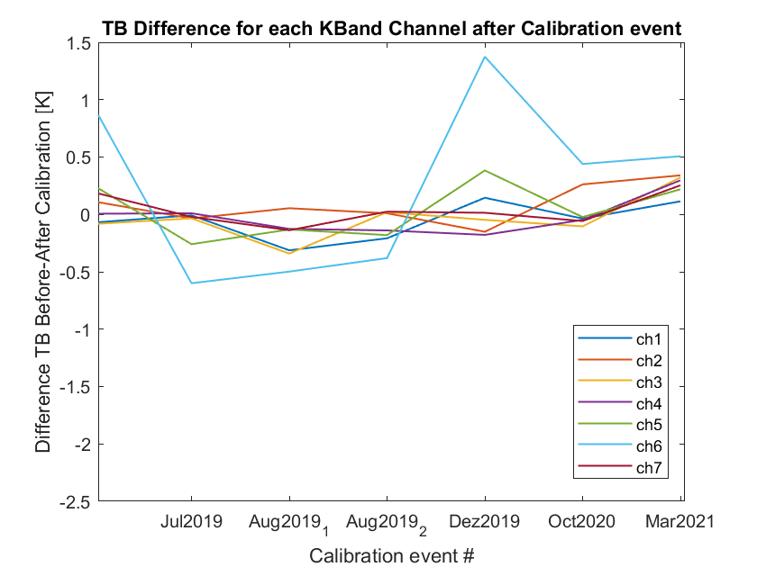
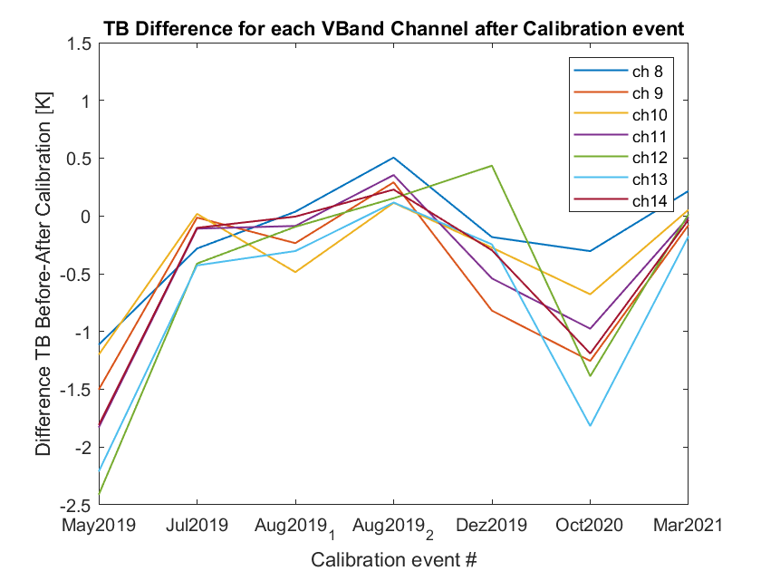
TOPHAT at JOYCE: Drifts (via Coldload Leaps)
Cannot be directly influenced by operator
High frequency of calibrations reduces this error
Is also influenced by biases!
(x-achse als monate zwischen Kalibrationen)
(oder y-achse auf 1 monat normieren)
13

Slide 14
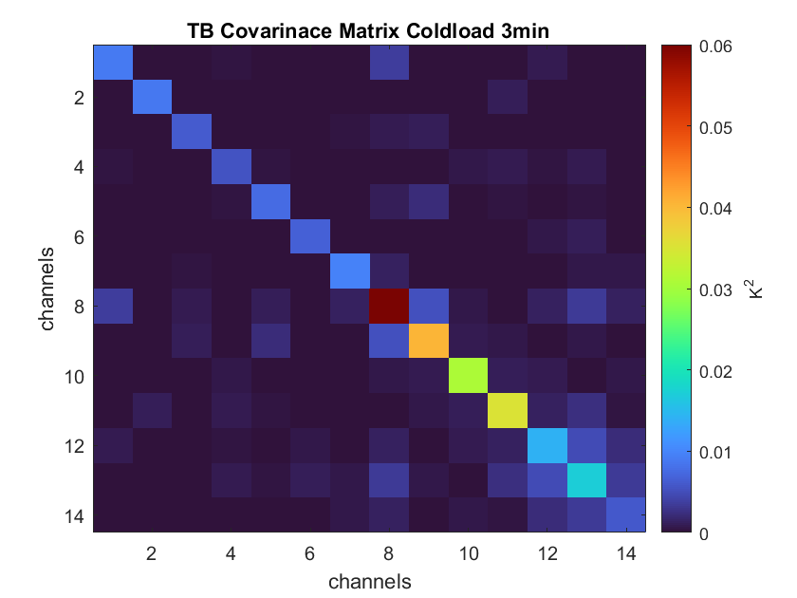
Short Reminder: Covariance Matrix
Correlated radiometric noise for all 14 channels (shows dependency of these channels)
The radiometric noise for a single channel can be determined by calculating the variance when looking on a stable blackbody target
Highly correlated channels are of no use for retrievals and data assimilations as they don‘t contain additional information
14

Slide 15
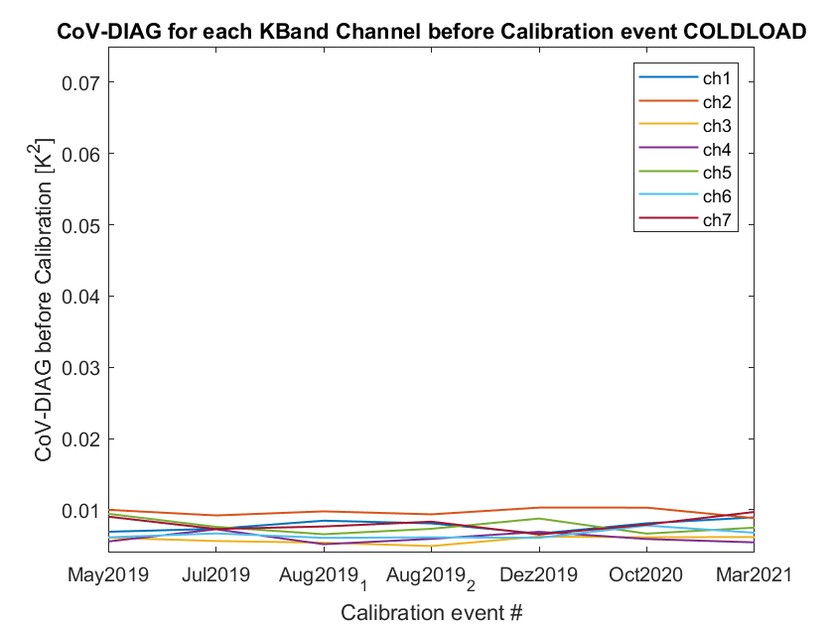
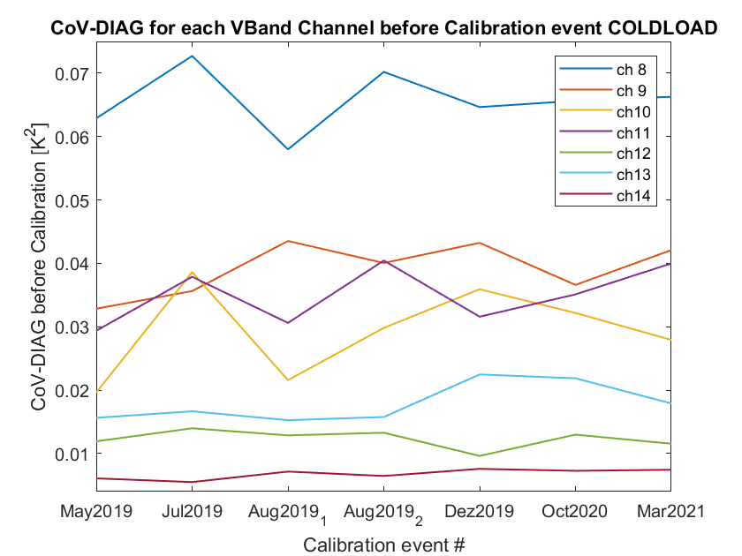
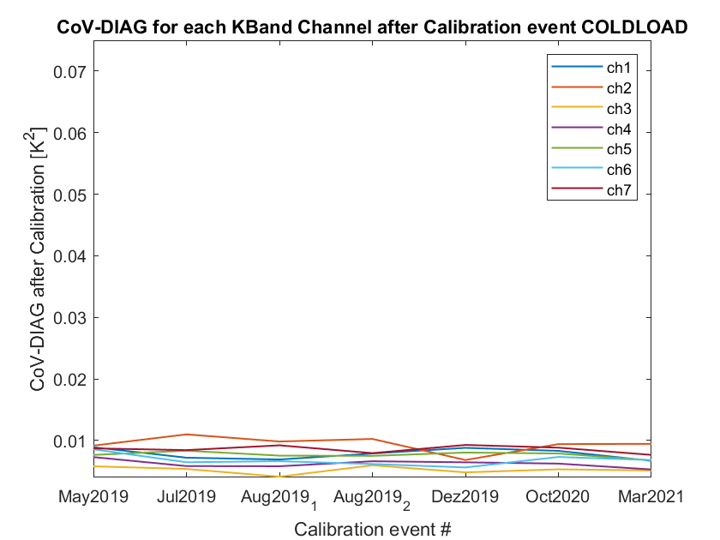
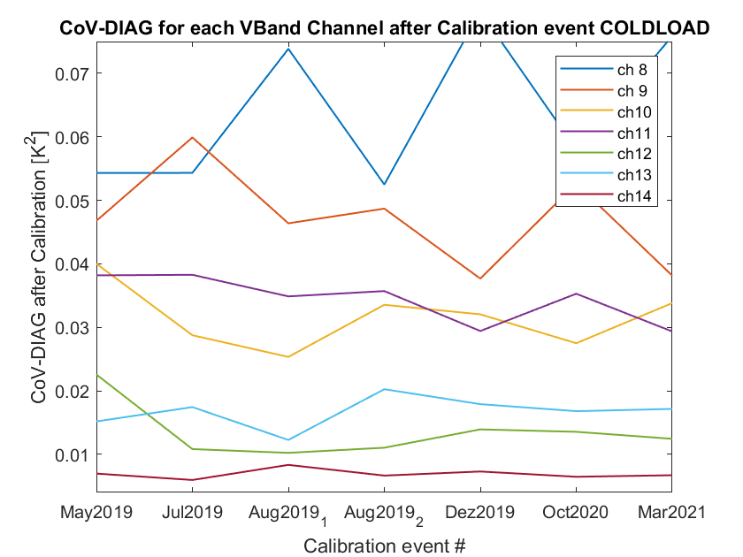
TOPHAT at JOYCE: Covariance Diagonals Coldload
15

Slide 16
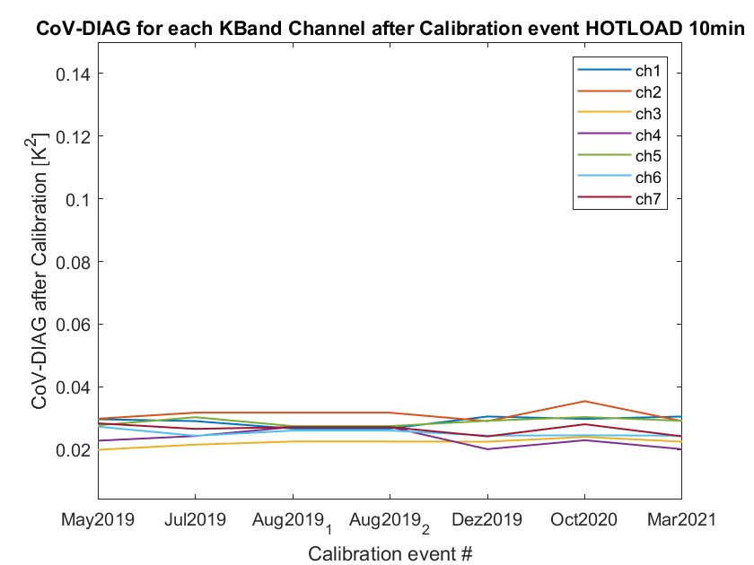
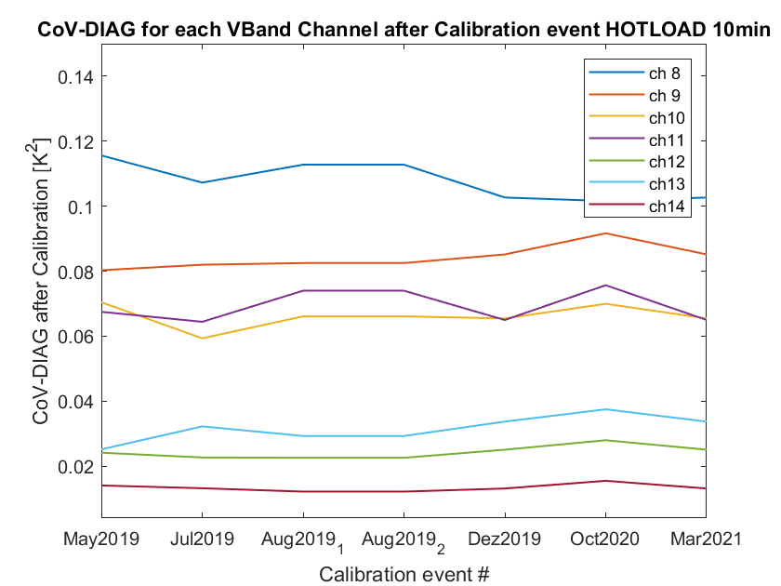
TOPHAT at JOYCE: Covariance Diagonals Hotload
Coldload and Hotload Covariances similar for all Gen5 HATPROs, significantly higher values for Gen2
Operator independent, instrument specific
Square root of diagonals is the same as standard deviation
16

Slide 17
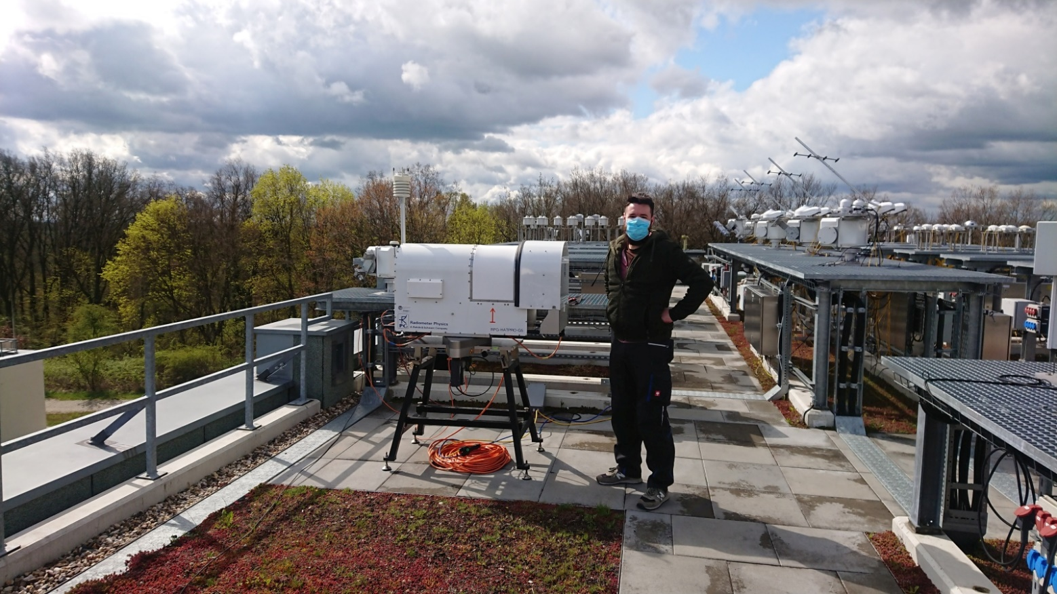
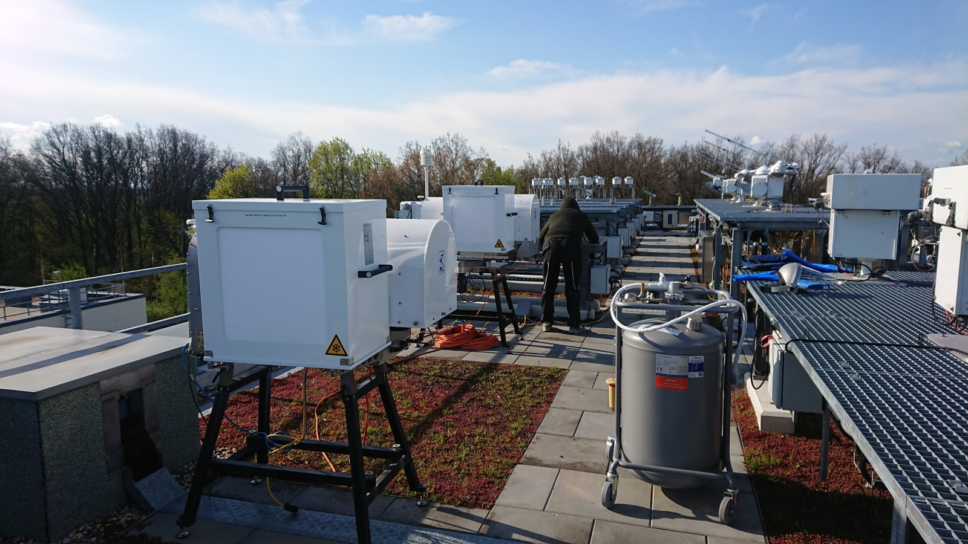
Calibration Campaign during FESSTVaL
17

Slide 18
Calibration Campaign at RAO in Lindenberg
4 HATPROs (FOGHAT G5, DWDHAT G5, SUNHAT G2, HAMHAT G2)
Calibration campaign:
Calibrate all 3 HATPROs on the roof in a row for three times each with the standard procedure
Zenith measurements in between
4th HATPRO nearby gets calibrated only once and then always measures zenith; is used as a reference later
First calibration round: May 5, 2021
Second and third calibration round: May 6, 2021
Comparisons of zenith and blackbody measurements (to find out biases, drifts/leaps, noise levels, repeatability)
18

Slide 19
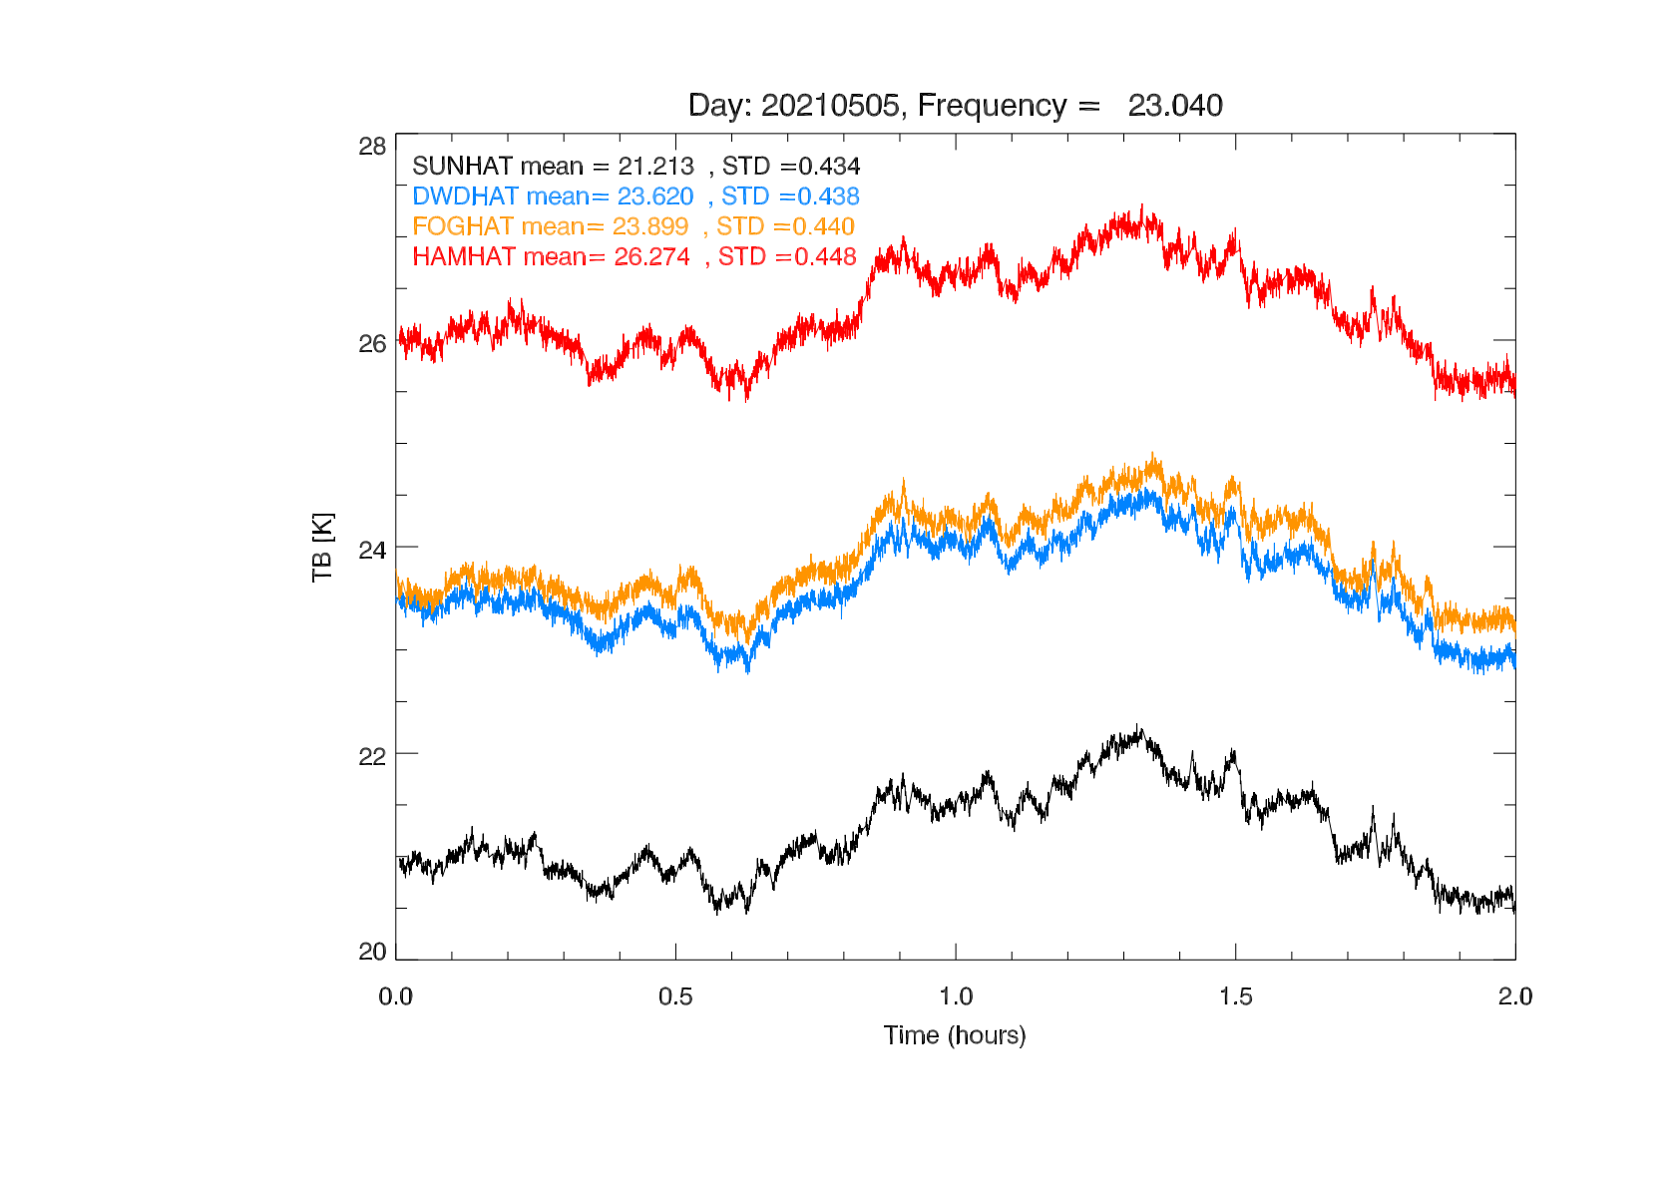
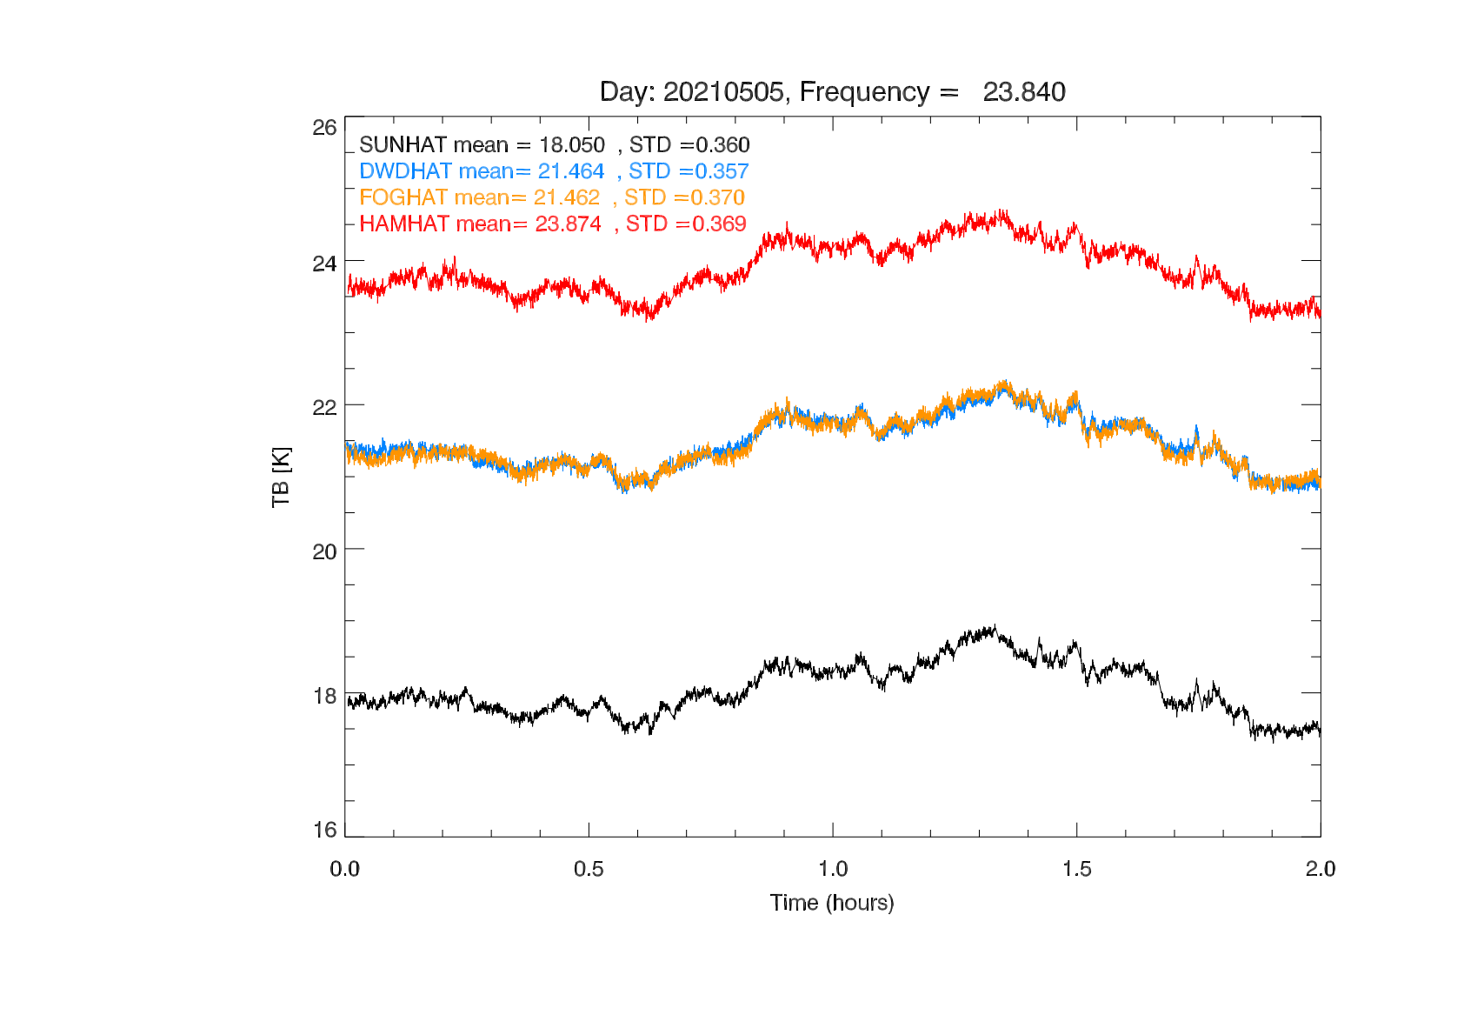
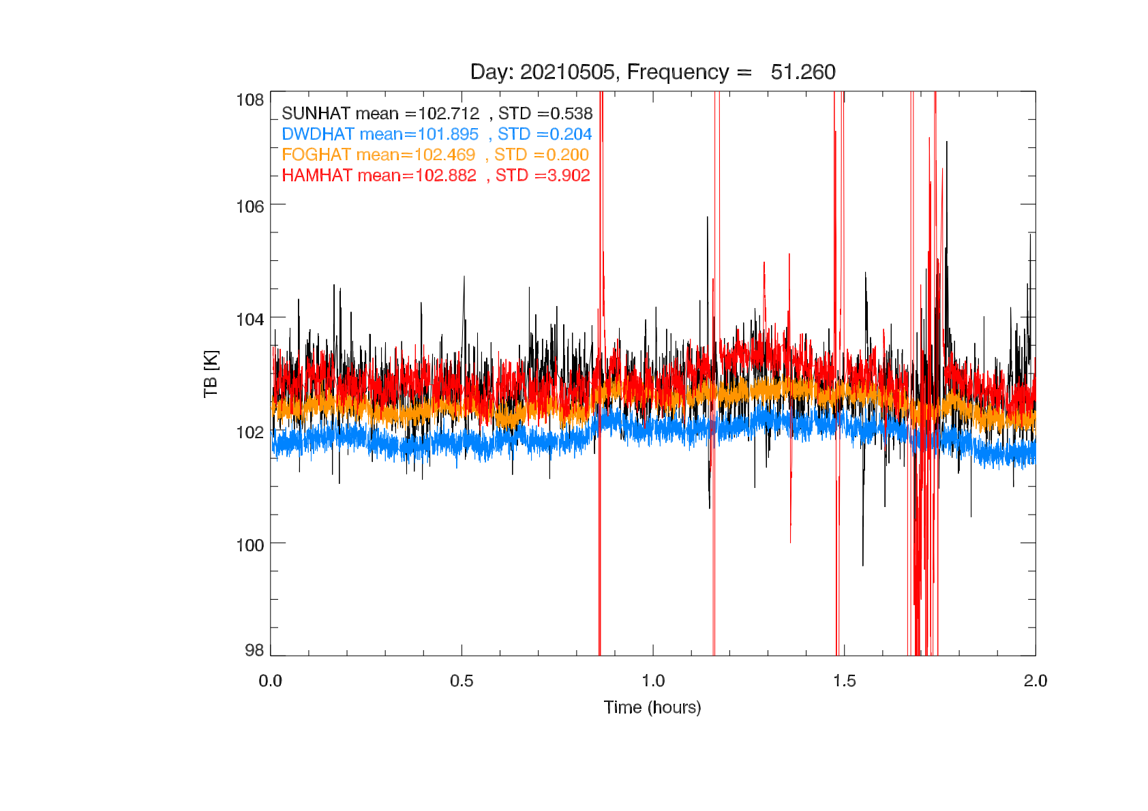
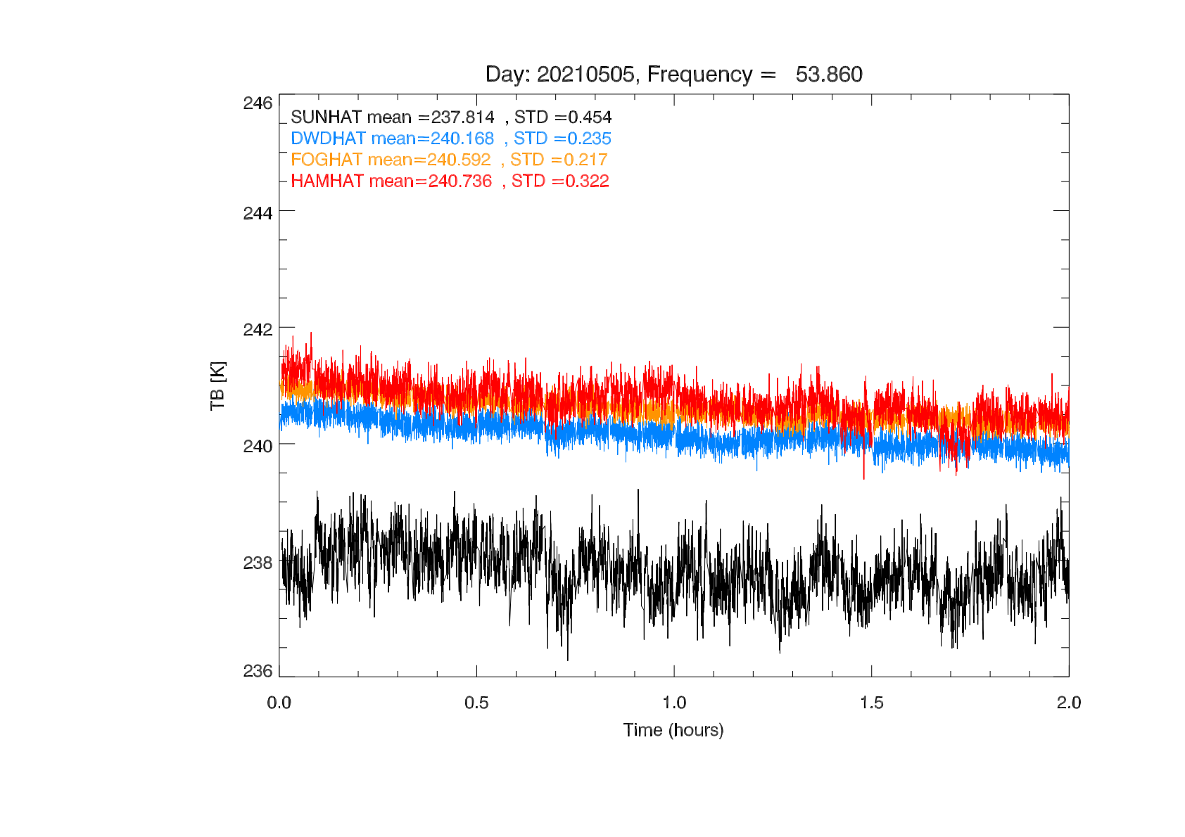
Calibration Campaign First Results: Zenith Comparisons
Before calibration campaign
(zenith clear sky)
Plots from Dr. Bernhard Pospichal, University of Cologne
19

Slide 20
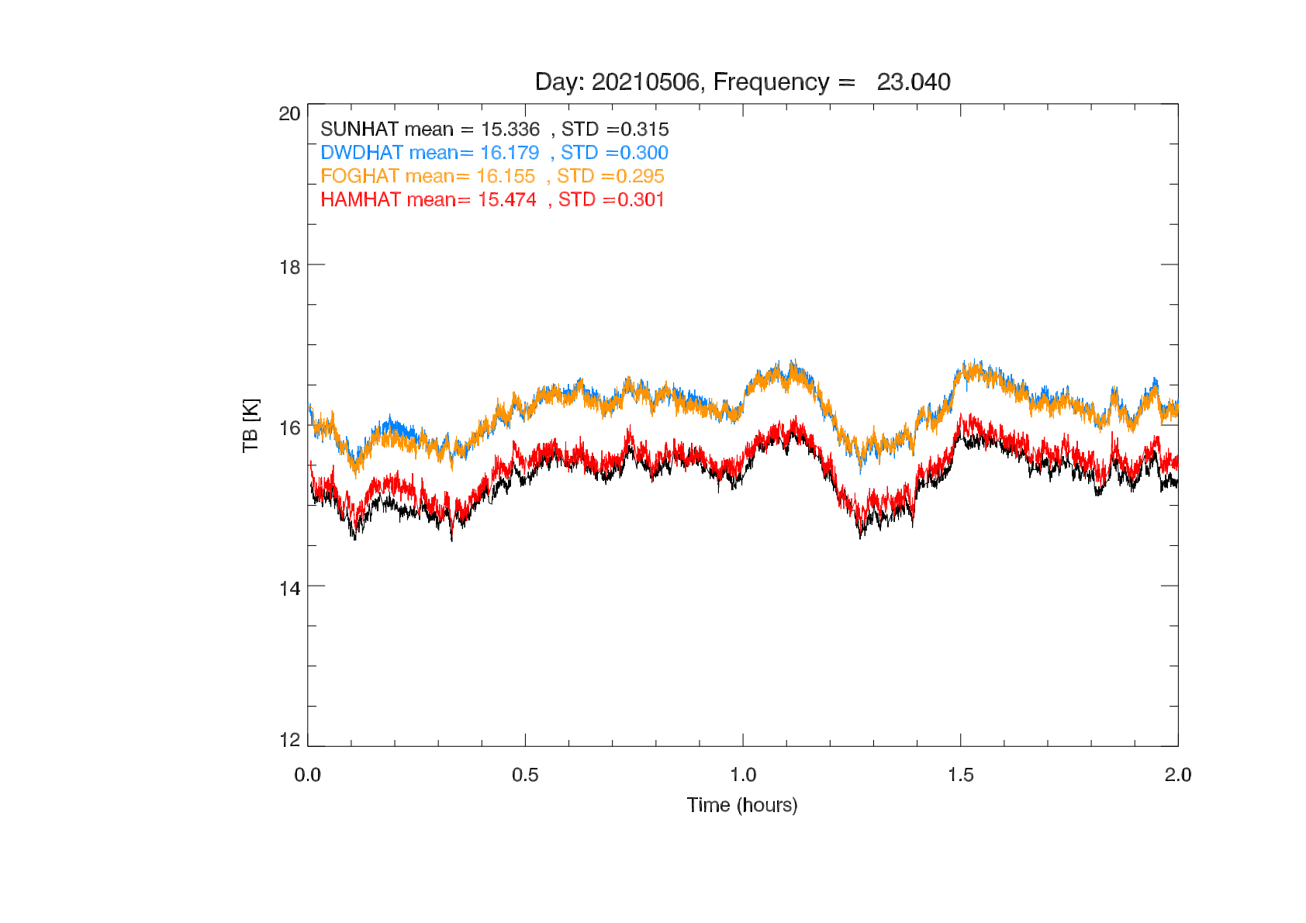
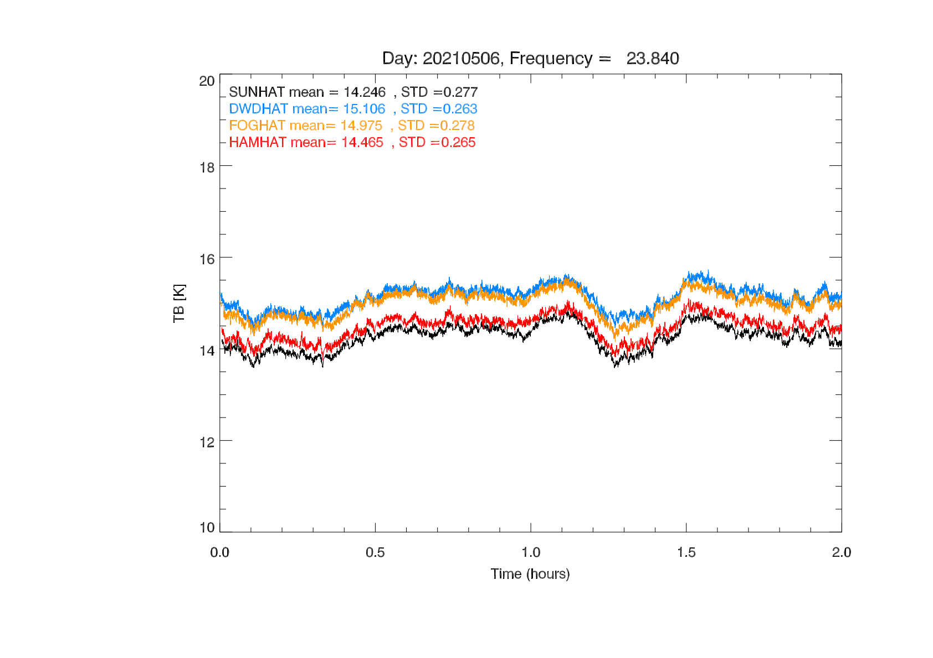
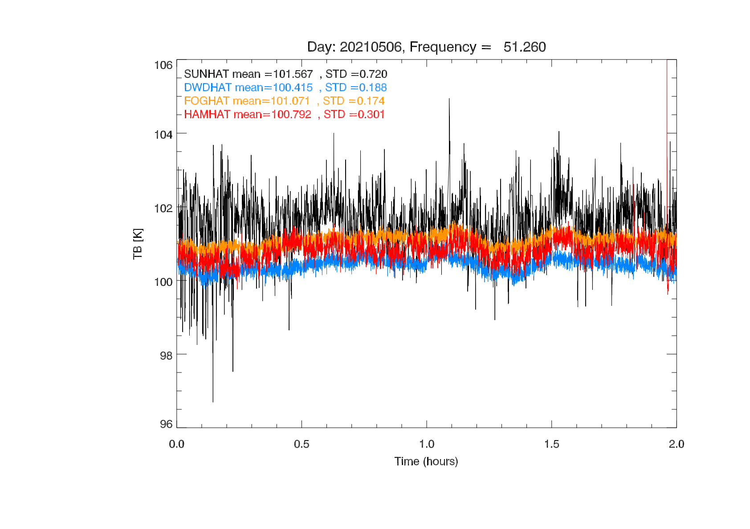
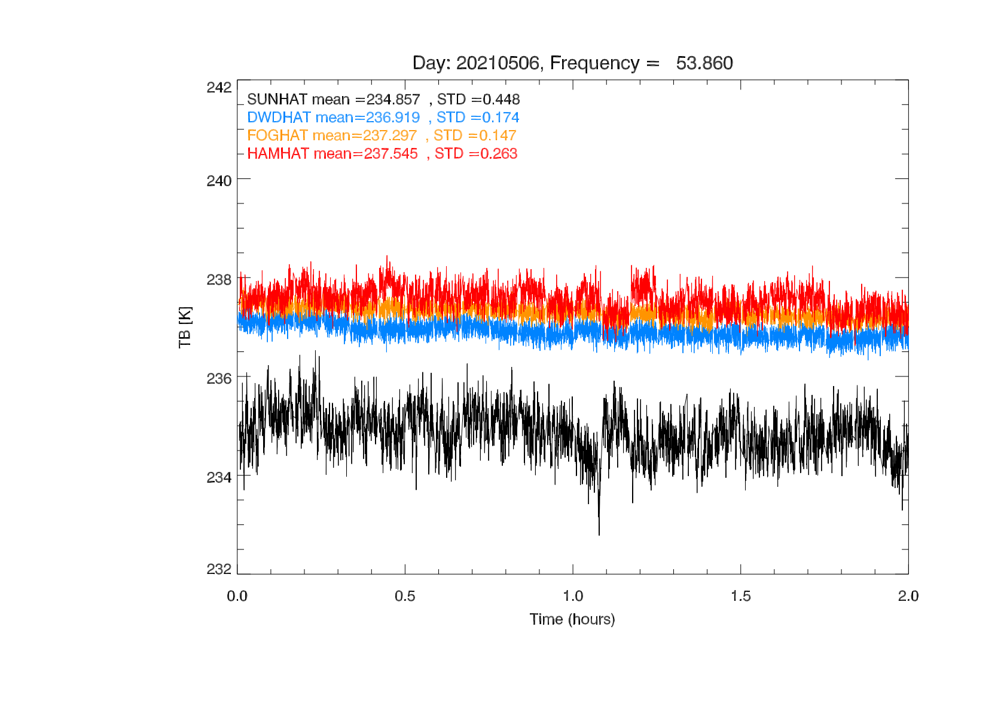
Calibration Campaign First Results: Zenith Comparisons
After first calibration round
(zenith clear sky)
Plots from Dr. Bernhard Pospichal, University of Cologne
20

Slide 21
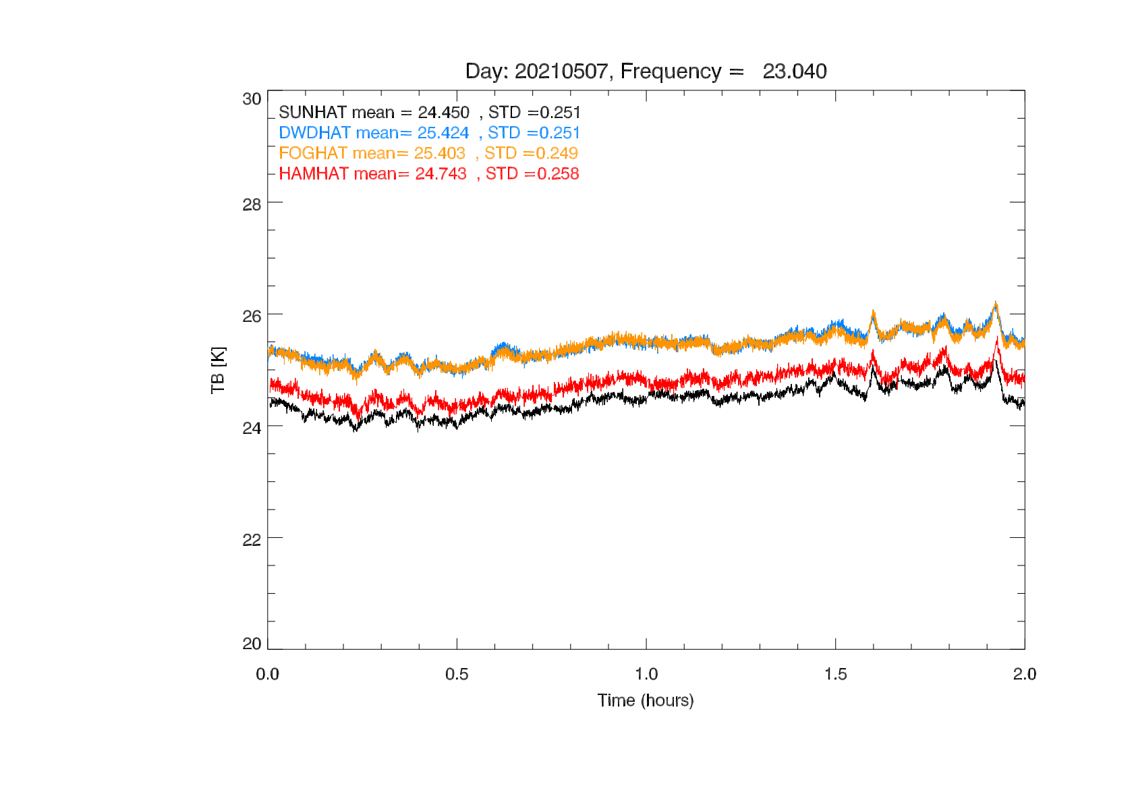
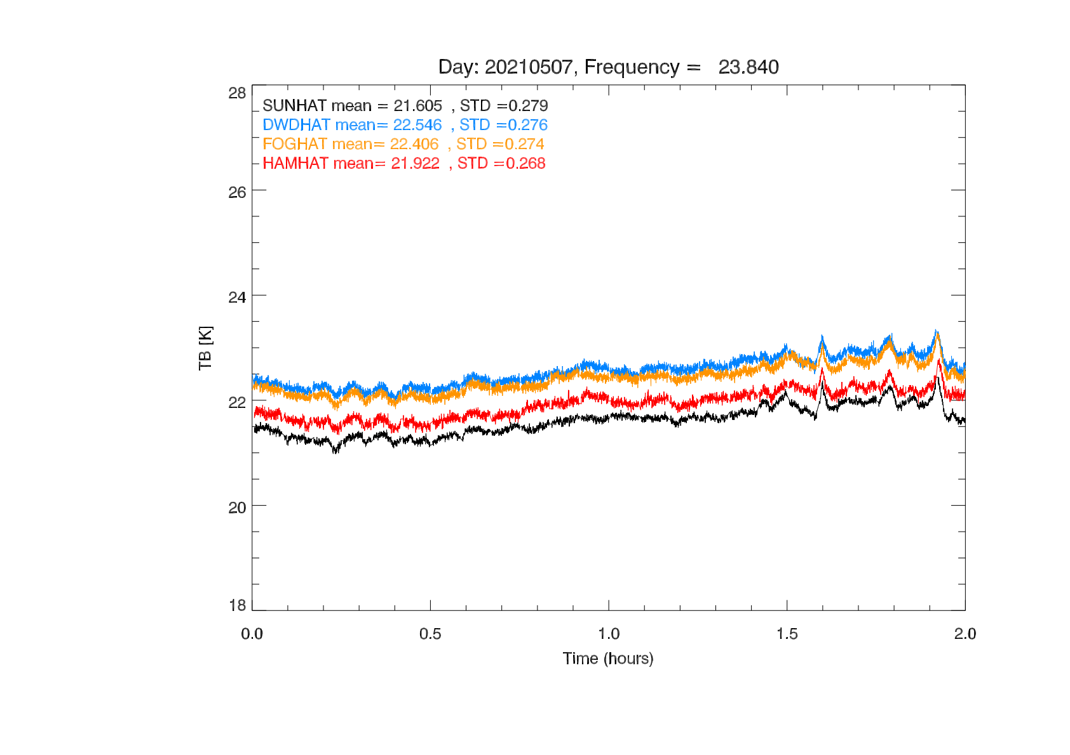
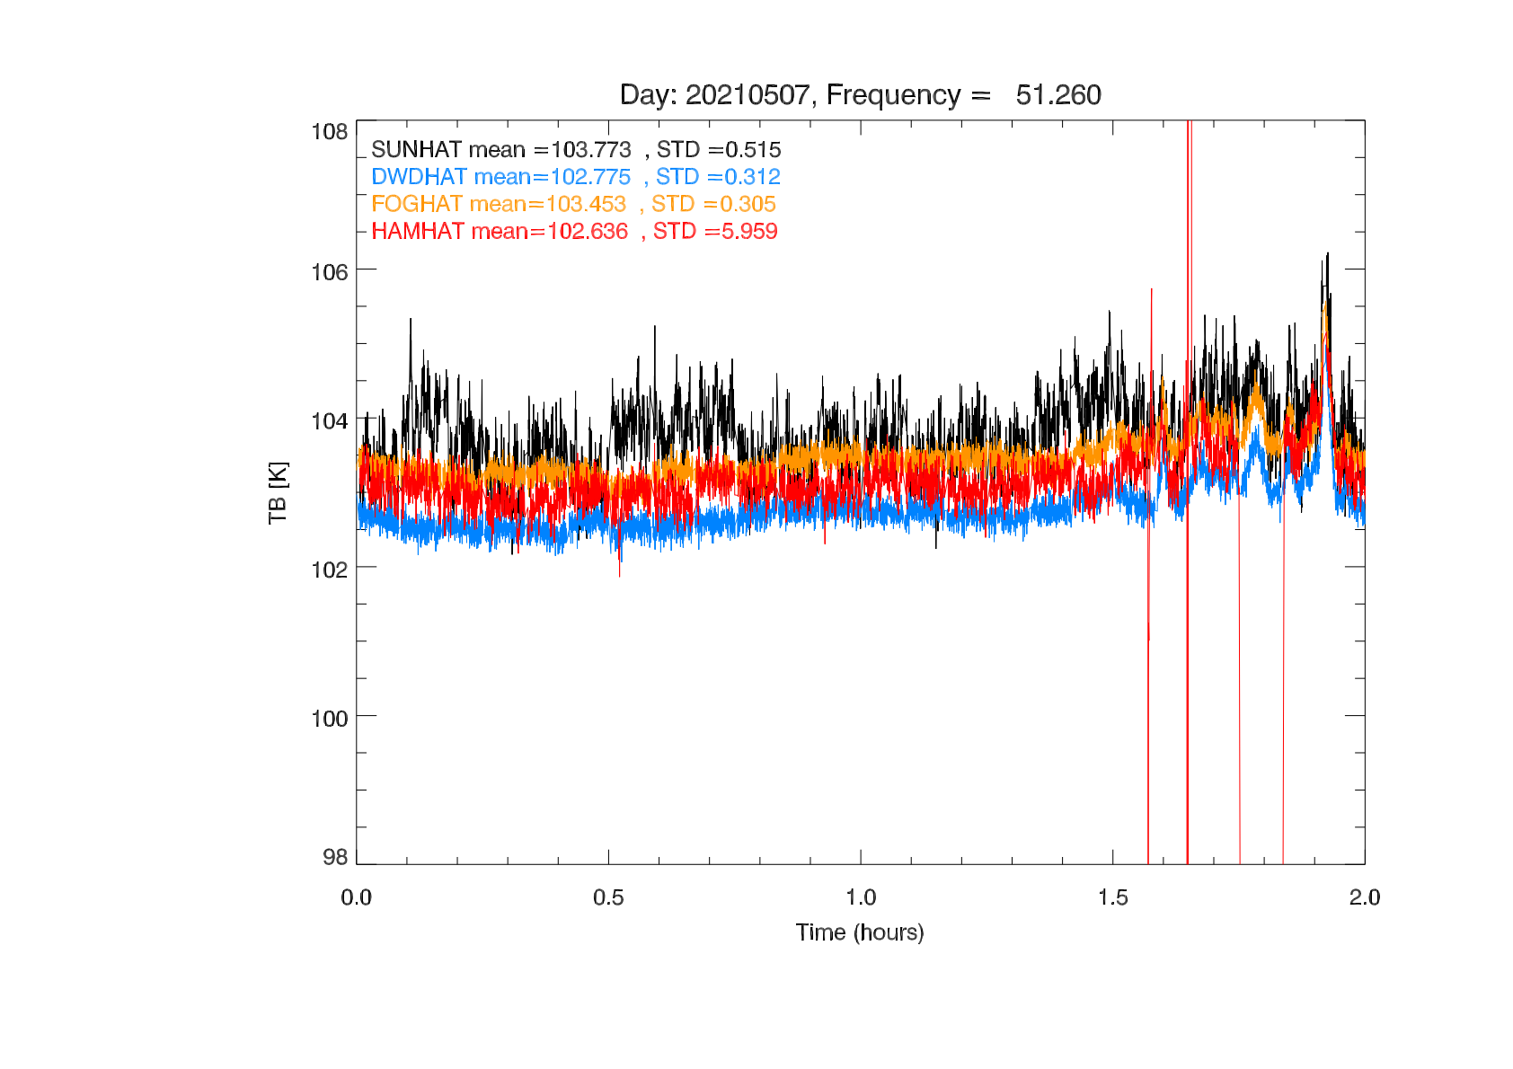
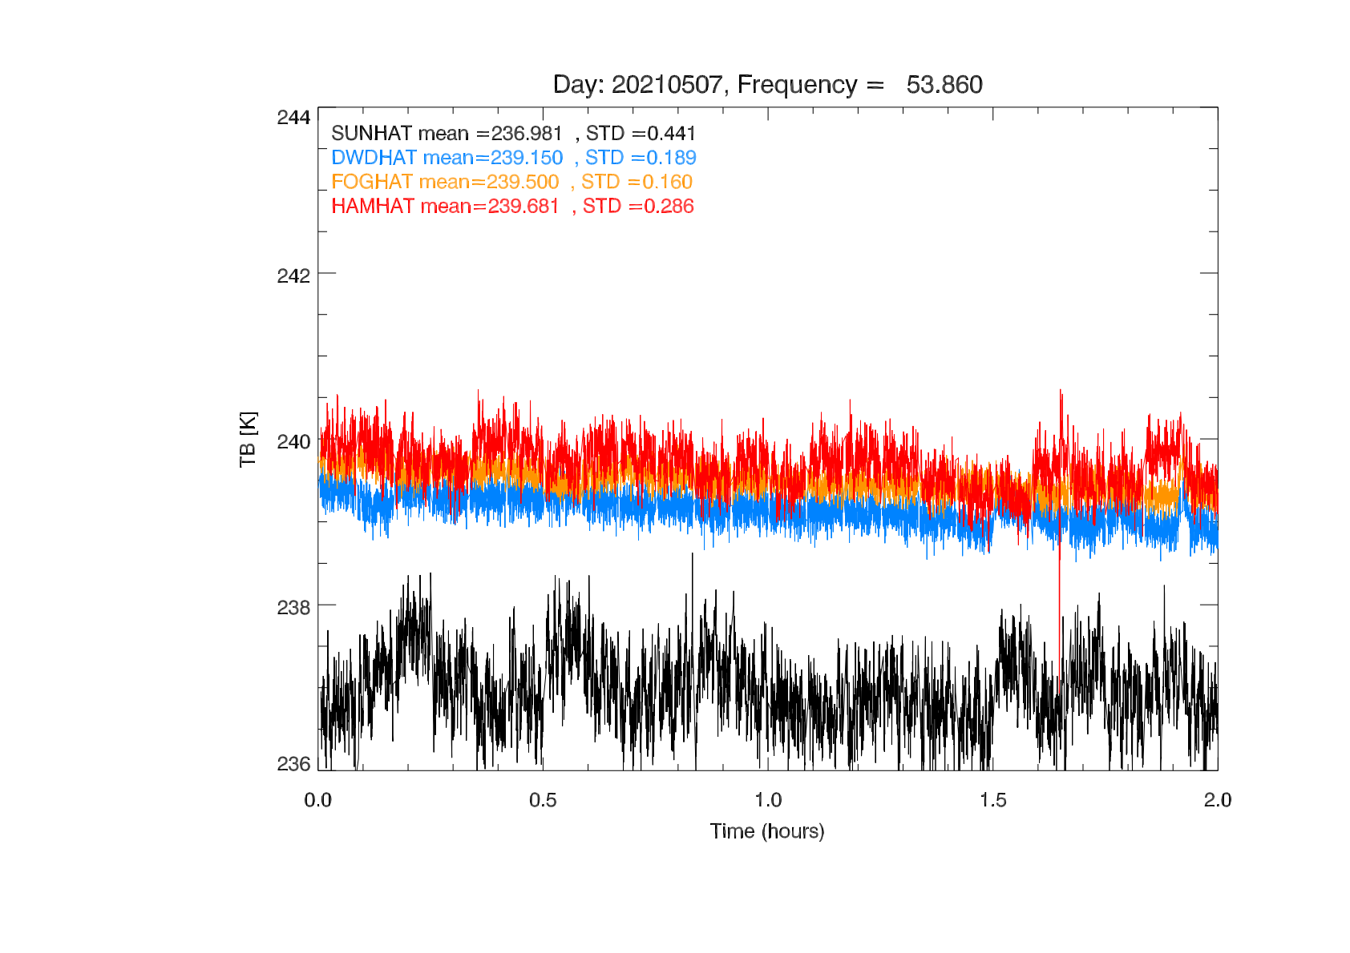
Calibration Campaign First Results: Zenith Comparisons
After calibration campaign (zenith clear sky)
Plots from Dr. Bernhard Pospichal, University of Cologne
21

Slide 22
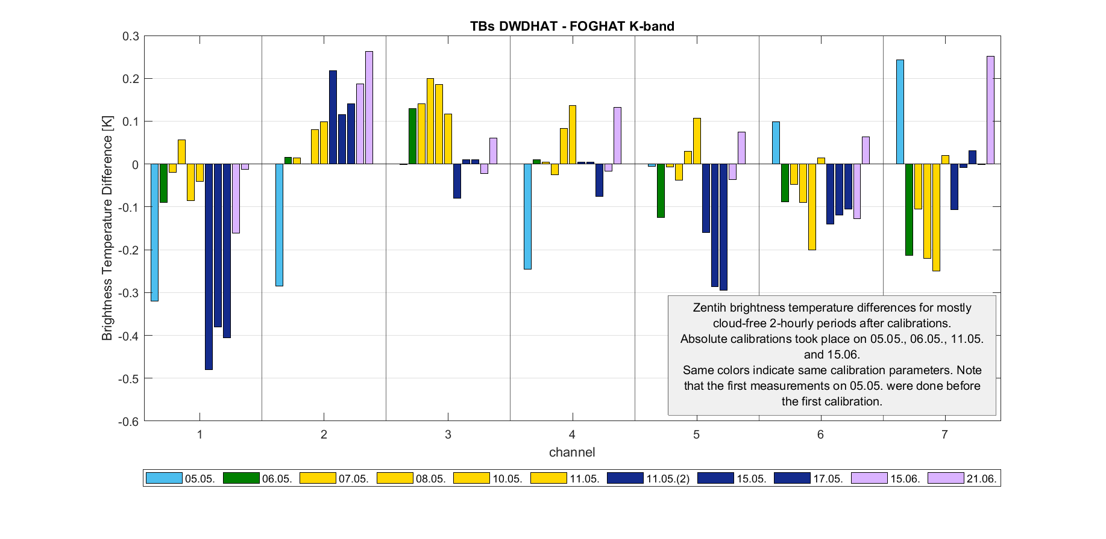
Biases/Offsets via Zenith Comparisons
22

Slide 23
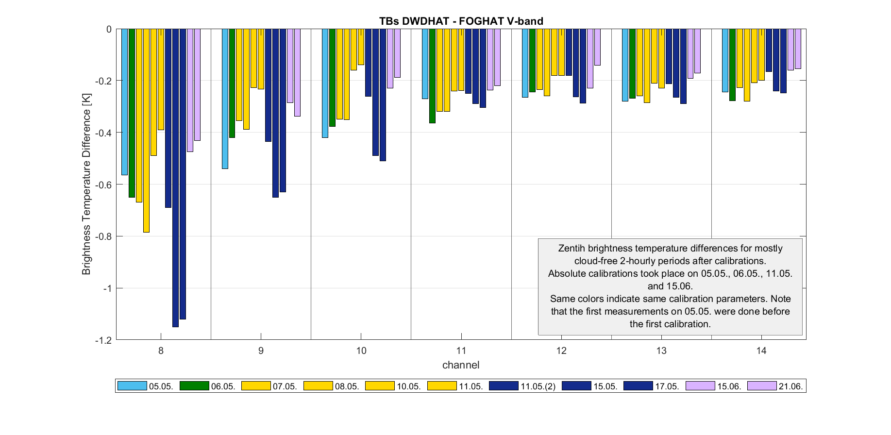
Biases/Offsets via Zenith Comparisons
Biases/Offsets can be reduced by better LN2 calibrations
All errors are relative, there is no perfect absolute reference
(add calibration from August)
23

Slide 24
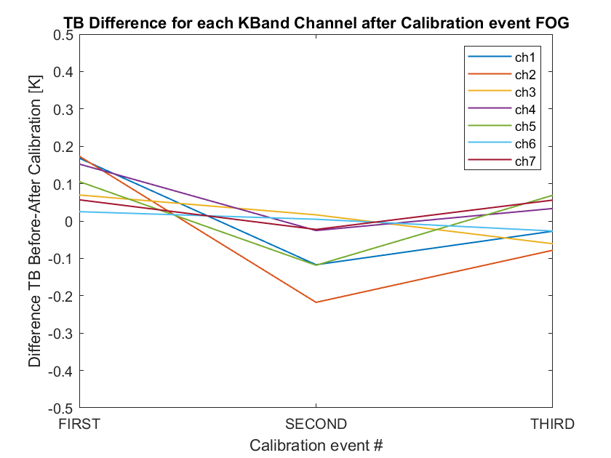
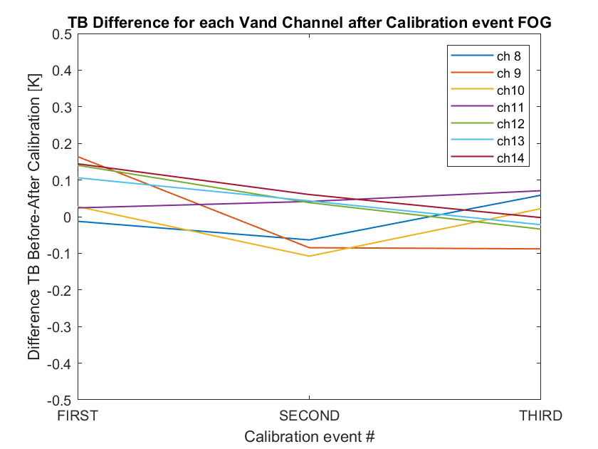
Leaps on Coldload between calibrations FOGHAT
24

Slide 25
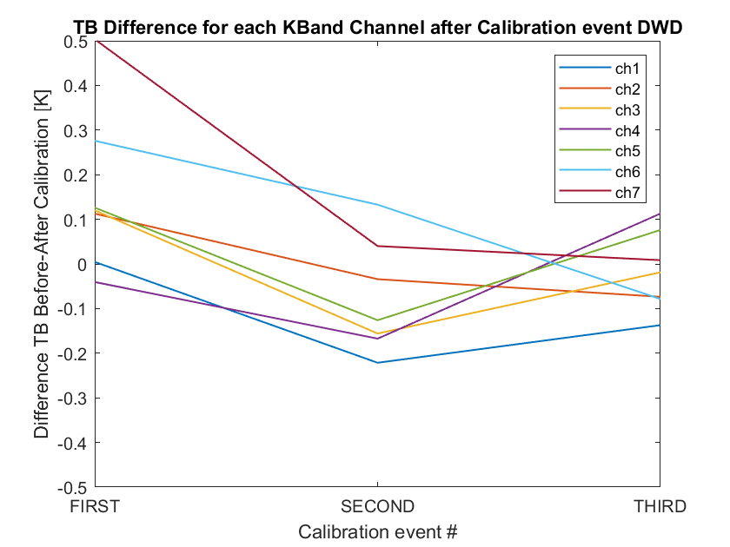
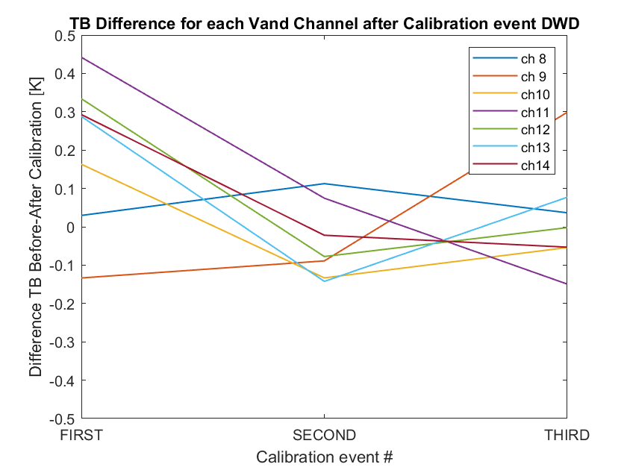
Leaps on Coldload between calibrations DWDHAT
Can also be used for repeatability check (consecutive calibrations on the same day)
Mean over 3min
25

Slide 26
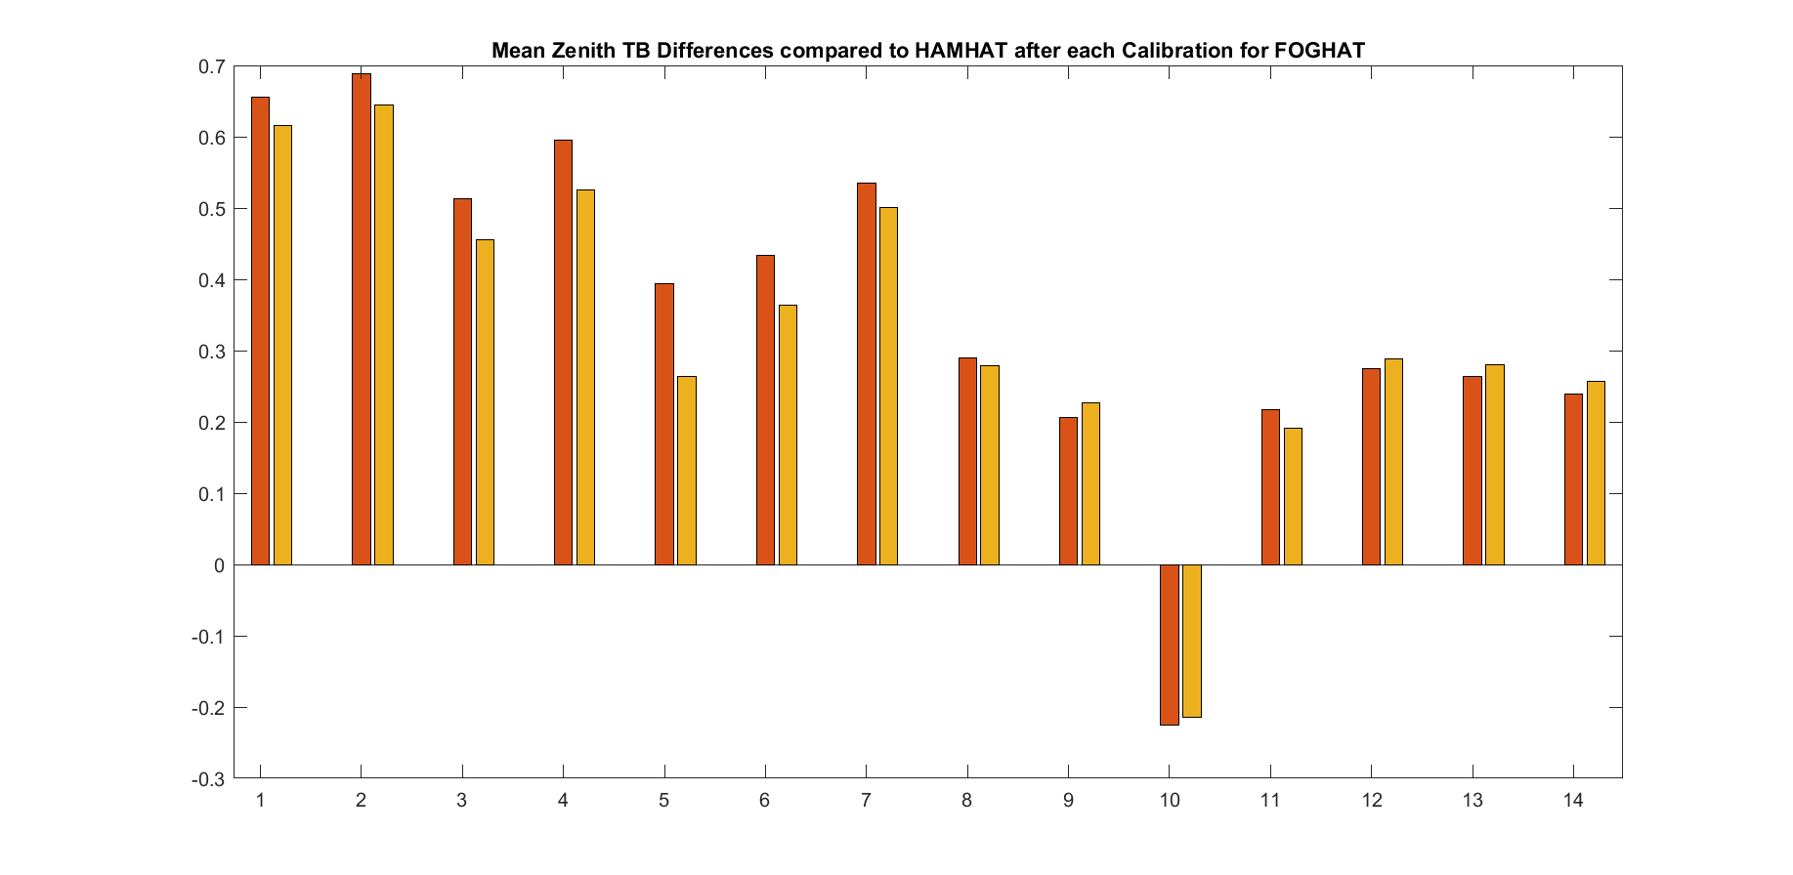
Leaps at Zenith between calibrations FOGHAT (Repeatability)
26

Slide 27
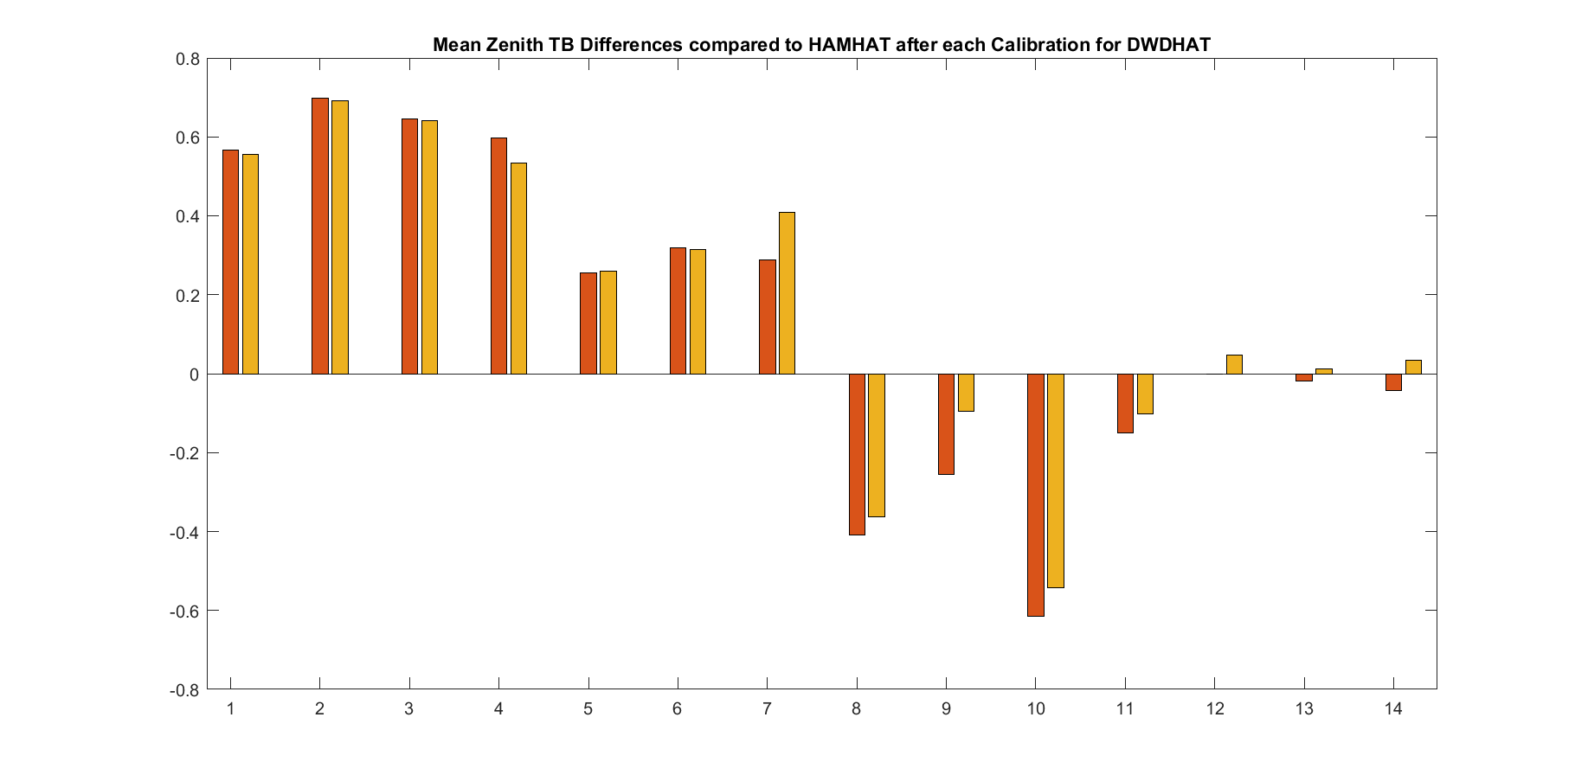
Leaps at Zenith between calibrations DWDHAT (Repeatability)
Is influenced by the quality of the calibration
Can only be done this way when there are at least two MWRs on the same site simultaneously
Should be very similar to the noise level
Meaningful values can only be achieved with the same conditions for each calibration (same day, same weather, same target,…)
≤ 0.24 K
V-band
≤ 0.12 K
K-band
27

Slide 28
Summary
Preliminary Results (for Gen5 HATPROs):
Type of Error | Typical Error Values K-band | Typical Error Values V-band | Determined via | Error influenced by handling? | How to reduce Error?
Biases/Offsets | usually ≤ 0.3 K (up to 0.48 K) | usually ≤ 0.5 K (up to 1.1 K) | Zenith measurement differences between two MWRs | yes | Quality of calibration
Drifts (over 6 months) | usually ≤ 0.3 K (up to 0.6 K) | usually ≤ 0.8 K (up to 1.3 K) | Leaps at coldload after calibration | no | Frequency of calibration
Calibration Repeatability | ≤ 0.12 K | ≤ 0.24 K | Leaps to zenith reference measurements after two immediate consecutive calibrations | yes | Qualtity of calibration
Noise Levels (coldload – hotload) (1s) | ≤ 0.11 K – 0.18 K | ≤ 0.27 K – 0.35 K | Standard deviation | no | Not possible, instrument specific
28

Slide 29
Next Steps
More in-depth analysis of all the data from the calibration campaign in order to characterize all instrument errors and uncertainties in detail:
Assess differences between different HATPRO generations
→ all uncertainty values per channel need to be implemented into level 1 files (necessary for DA)
values like: typical biases/offsets
typical drifts over a certain time
typical noise levels (covariance matrix)
typical calibration repeatability
(everything above 0.5K may be a problem)
Determine some kind of total error!
29

Slide 30
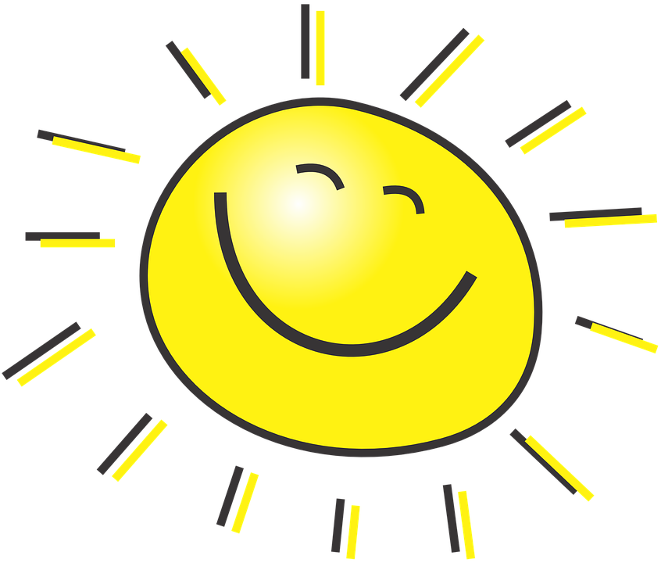
Thank you for your attention!
30

Slide 31
Bonus Slides: External Errors
31

Slide 32
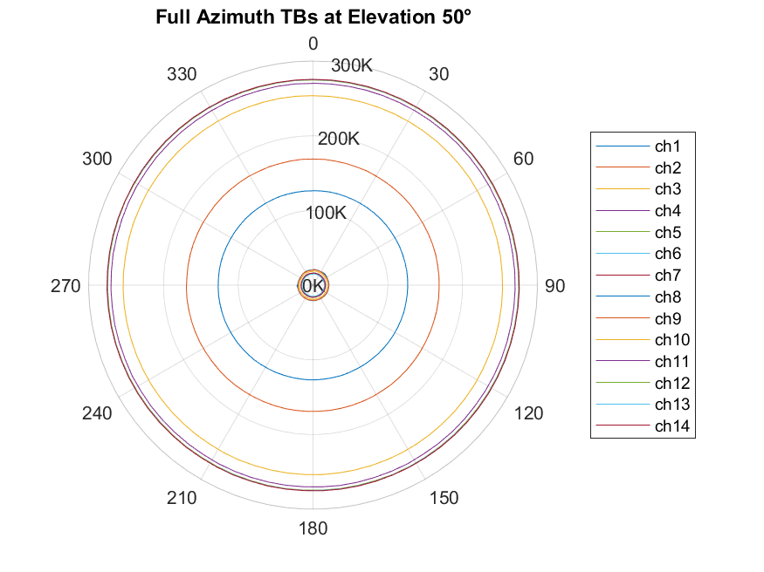
FOGHAT at Köln: Azimuth Scans (Obstacles and external Interference)
32

Slide 33
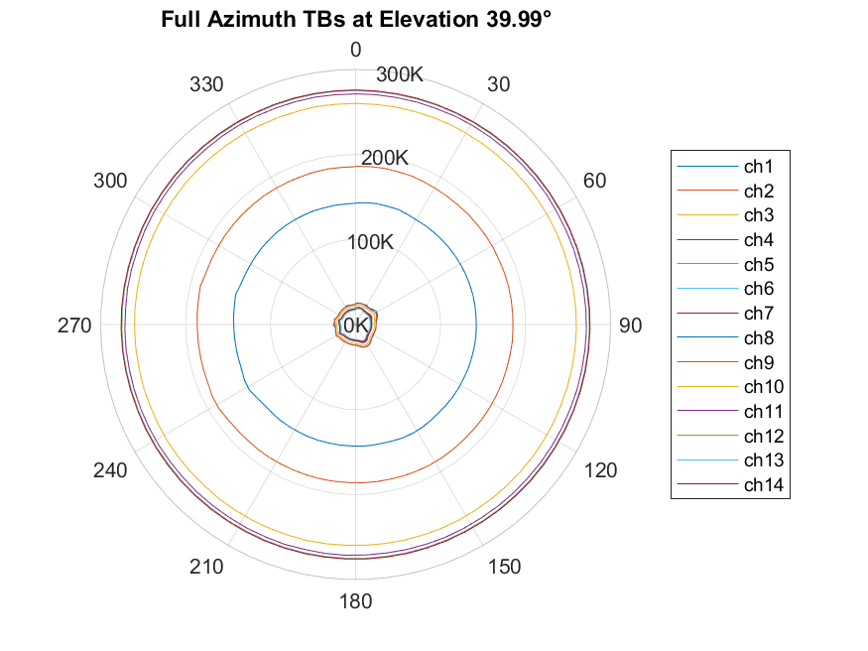
FOGHAT at Köln: Azimuth Scans (Obstacles and external Interference)
33

Slide 34
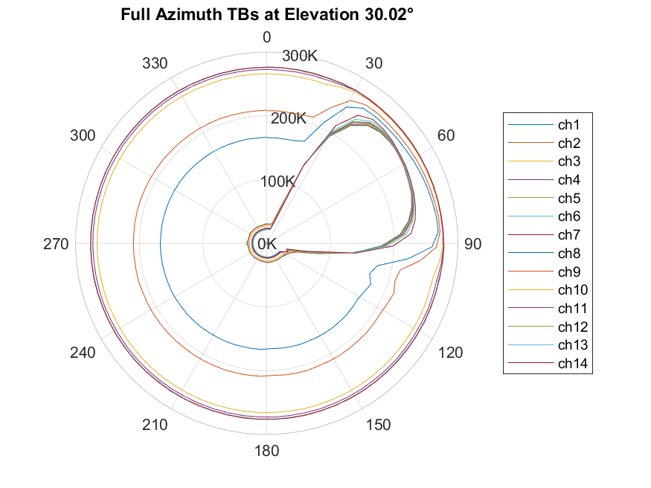
FOGHAT at Köln: Azimuth Scans (Obstacles and external Interference)
34

Slide 35
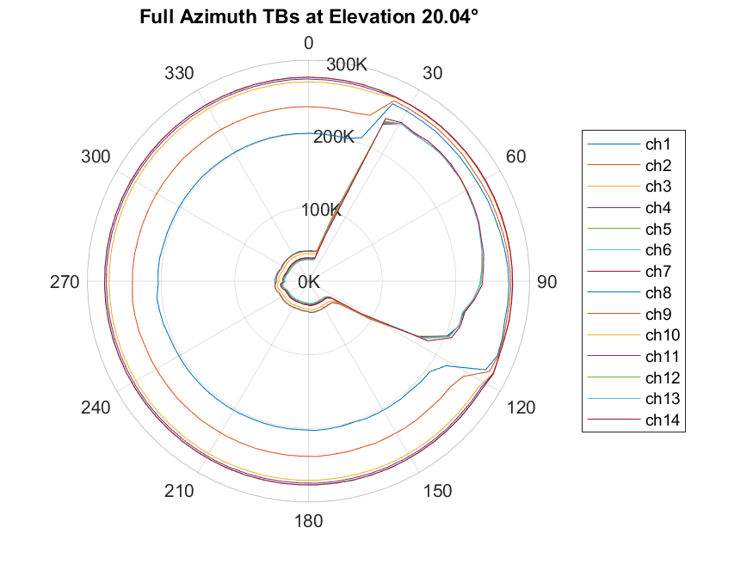
FOGHAT at Köln: Azimuth Scans (Obstacles and external Interference)
wall from building
between
NE and SE
35

Slide 36
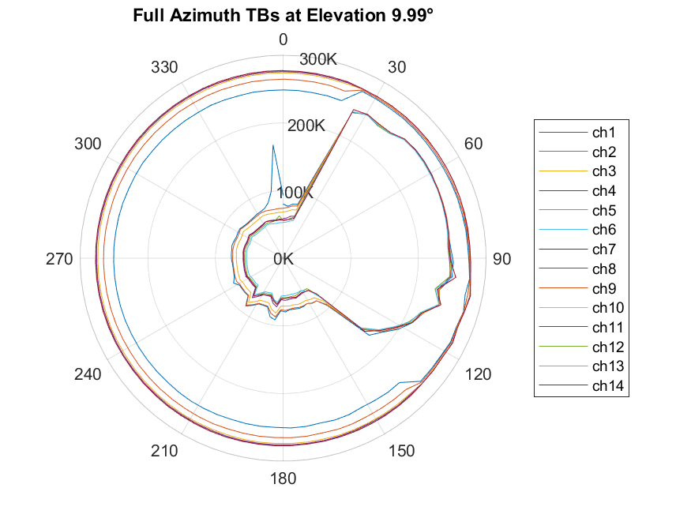
FOGHAT at Köln: Azimuth Scans (Obstacles and external Interference)
wall from building
between
NE and SE
36

Slide 37
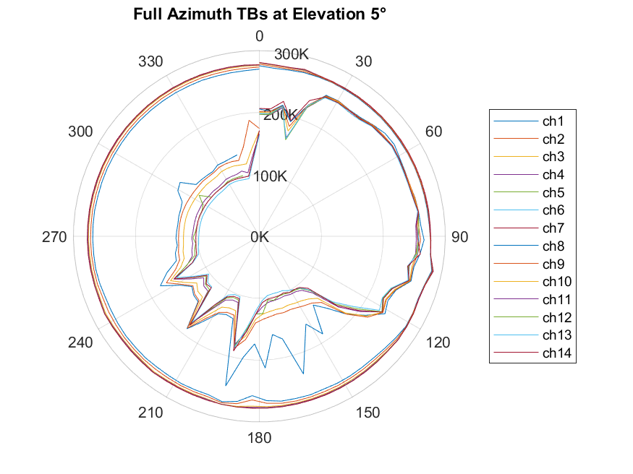
FOGHAT at Köln: Azimuth Scans (Obstacles and external Interference)
wall from building
between
NE and SE
EM interference?
37

