Slide 1
MIA: RTTOV-gb – adapting the fast radiative transfer model RTTOV for the assimilation of ground-based microwave radiometer observations (Francesco De Angelis et al.)
1

Slide 2
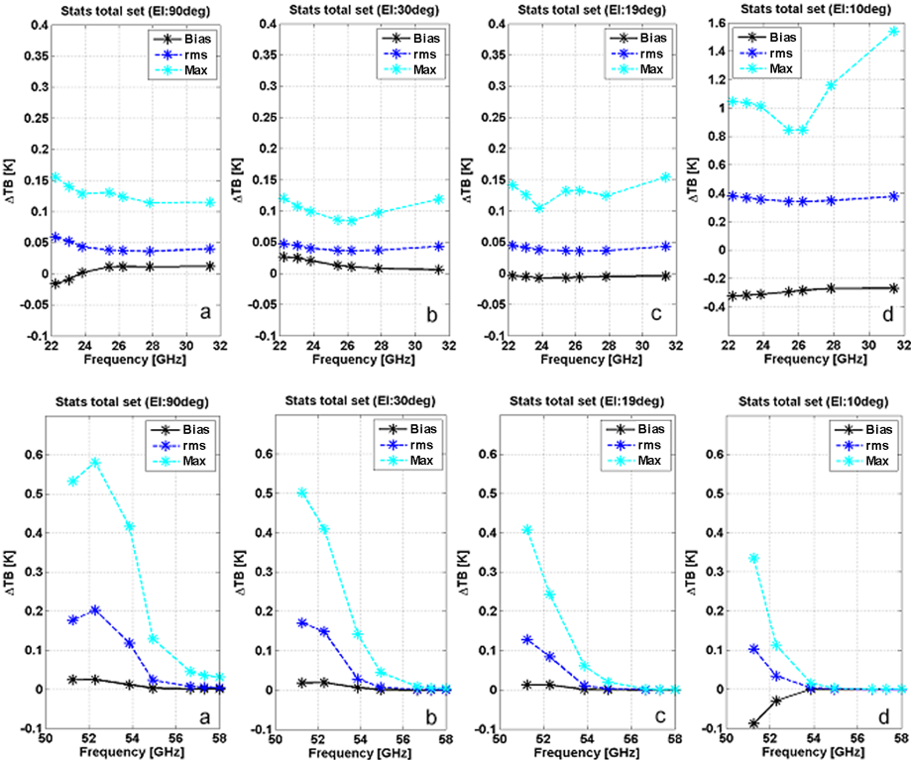
Comparison 1
Figure 3: Bias (black solid line), rms (blue dashed line), and maximum (cyan dashed line) of TB difference between RTTOV-gb and LBL
R98 (Rosenkranz, 1998) for the dependent 83-proﬁle set and the best training conﬁguration (R98 minus RTTOV-gb). Top panels: K-band
channels; bottom panels: V-band channels. Panels (a),(b),(c), and (d) report results at 90, 30, 19, and 10◦ elevation angle, respectively. Note
that the top panel (d) has a different y axis scale with respect to the other top panels.
2

Slide 3
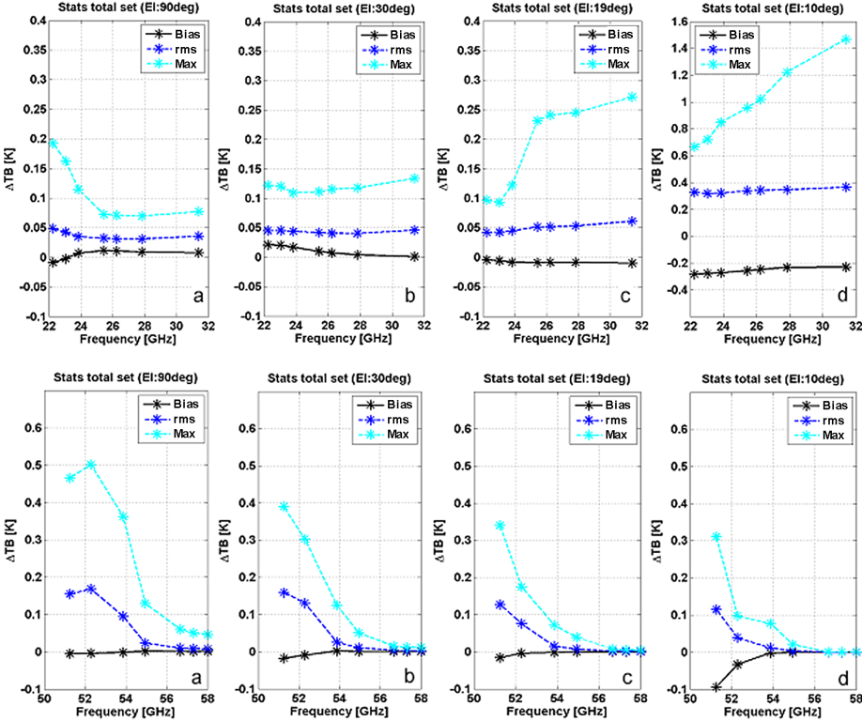
Comparison 2
Figure 4: Same as Fig. 3 but for the independent 52-proﬁle set (R98 minus RTTOV-gb). Top panels: K-band channels; bottom panels: V-band
channels. Panels (a),(b),(c), and (d) report results at 90, 30, 19, and 10◦ elevation angle, respectively. Note that top panel (d) has a different
y axis scale to the other top panels.
3

Slide 4
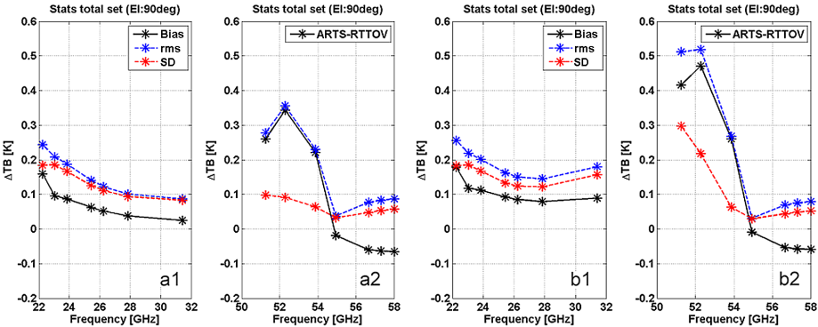
Comparison 3
Figure 5. Bias (black solid line), standard deviation (red dashed line), and rms (blue dashed line) of TB differences between RTTOV-gb and
the reference radiative transfer model ARTS (Eriksson and Buehler, 2015), for both clear (a1–2) and cloudy (b1–2) sky conditions (ARTS
minus RTTOV-gb). Panels (a1, b1–a2, b2) are for K- and V-band channels, respectively. All panels report results at 90◦ elevation angle.
Comparing Figs. 4 and 5, we no-
tice slightly larger differences (by 0.1–0.2 K) in the RTTOV-
gb vs. ARTS than in the RTTOV-gb vs. R98 tests. We at-
tribute this to the fact that RTTOV-gb is totally independent
of ARTS and moreover to the speciﬁc proﬁle dataset, which
likely introduces biases with respect to the RTTOV-gb train-
ing climatology.
4

